Slide 1
Observability in .NET

Slide 2
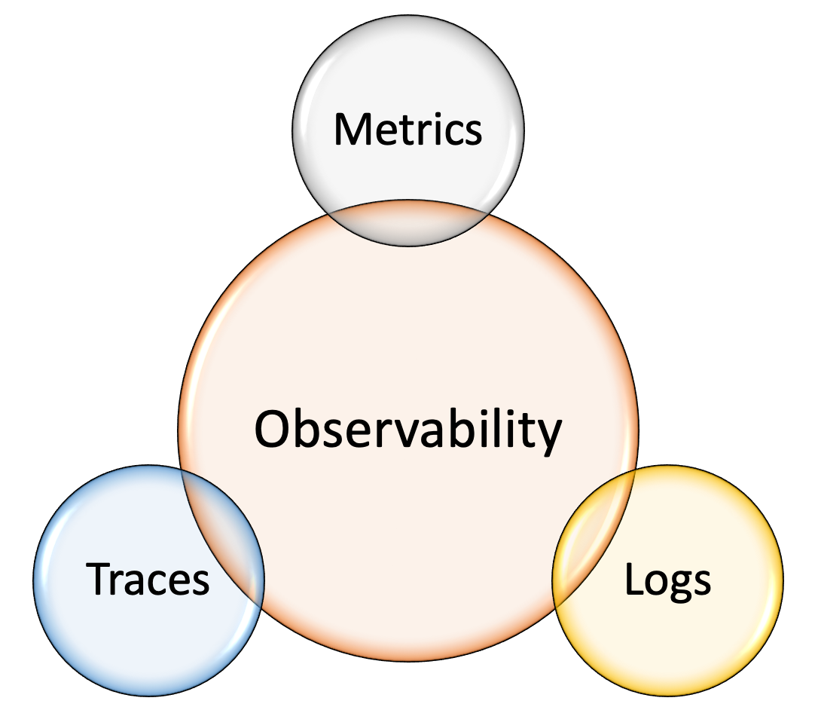
What is observability?
Alerts/Exception tracking

Slide 3
OpenTelemetry
OpenTracing provided a vendor-neutral API for sending telemetry data over to an Observability back-end; however, it relied on developers to implement their own libraries to meet the specification.
OpenCensus provided a set of language-specific libraries that developers could use to instrument their code and send to any one of their supported back-ends.

Slide 4
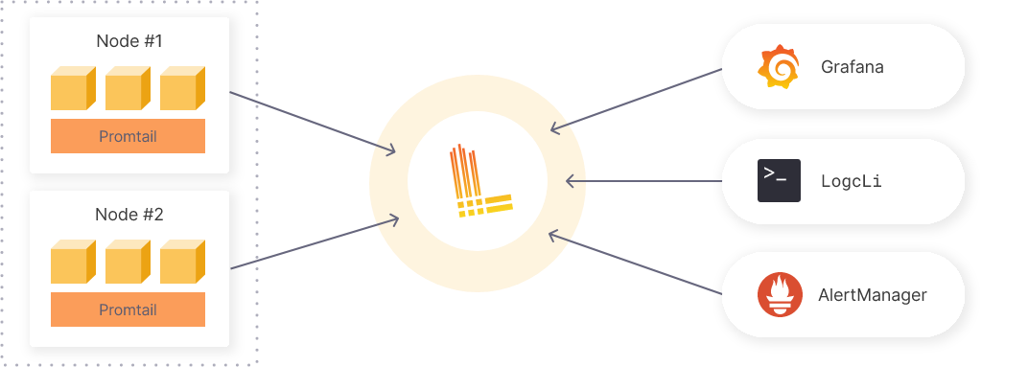
Logging
File logging vs log aggregation systems
Grafana Loki
Notes:
Working with log files is inconvenient:
log files can only be accessed locally
difficult to query and filter log records (e.g. mess in multithread apps)
Promtail – parse logs on the host and send them to the Loki
LogCli – command line tool to operate with logs
Grafana – is the central UI for everything (logs, metrics, traces, alerts)

Slide 5
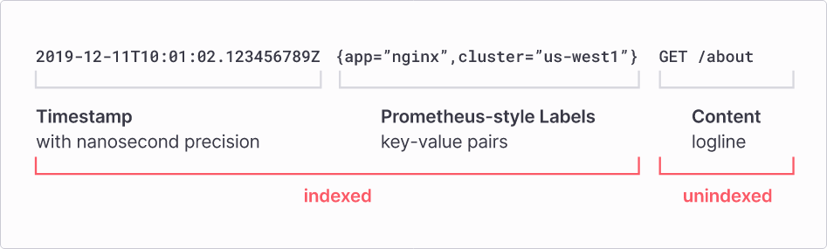
Logging (Grafana Loki)
Notes:
- Content could be JSON
- High cardinality problem

Slide 6
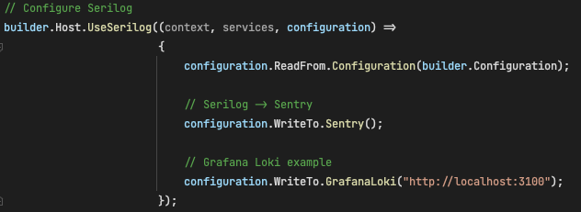
Log to Loki with Serilog
Serilog.Sinks.Grafana.Loki nuget package (https://github.com/serilog-contrib/serilog-sinks-grafana-loki)

Slide 7
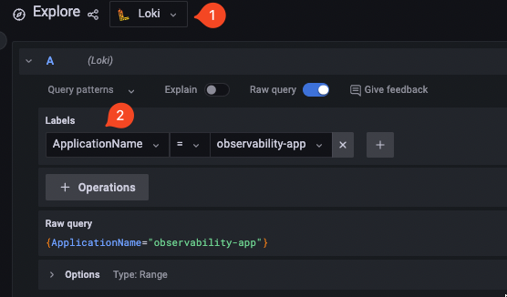
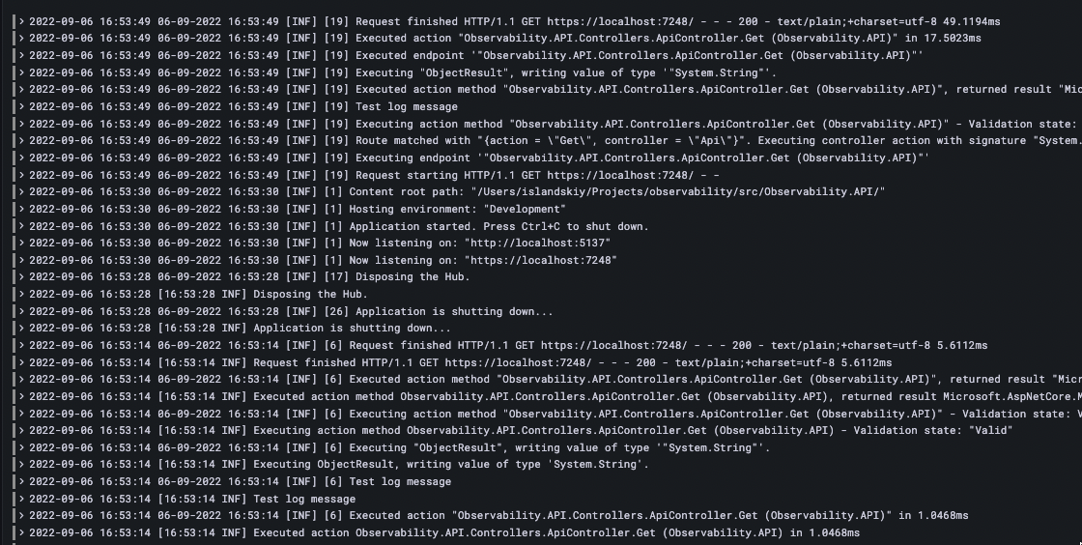
Log to Loki with Serilog
Notes:
https://localhost:7248
Filter logs by ApplicationName
Filter scope could be narrowed by ActionName
LogQL (https://grafana.com/docs/loki/latest/logql/)

Slide 8
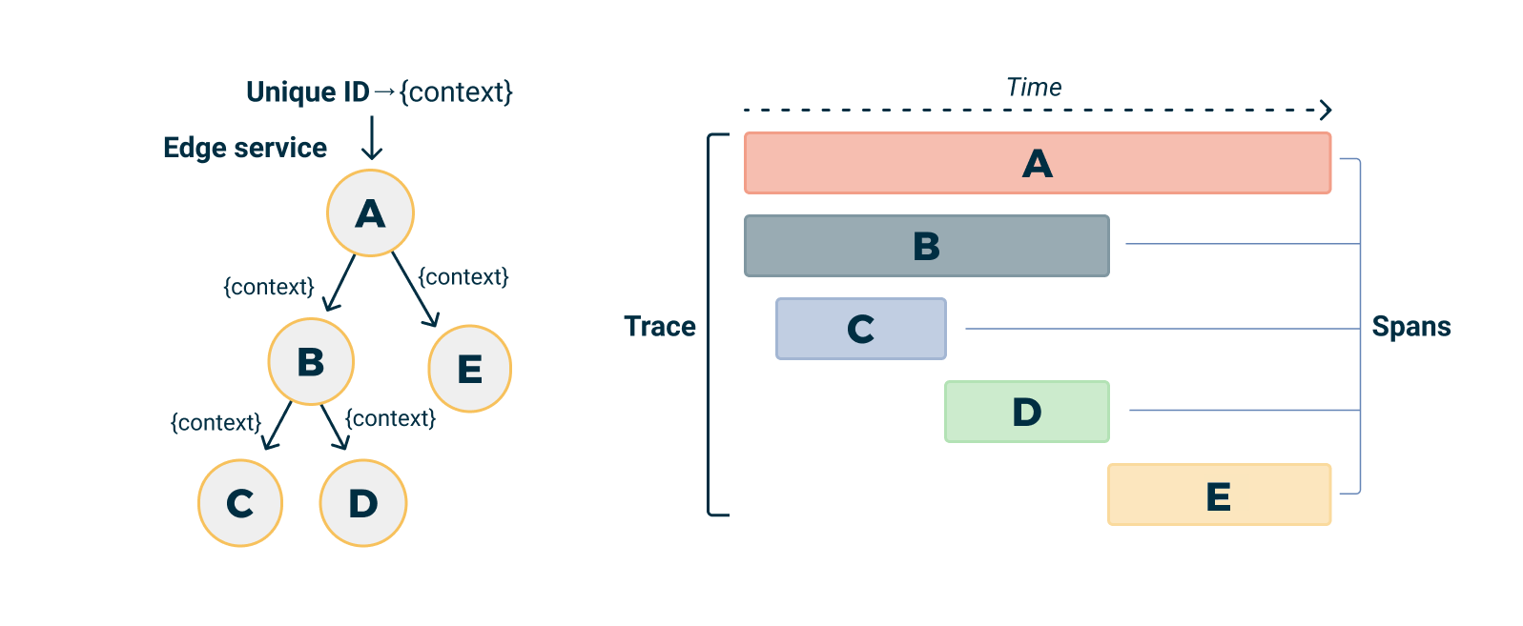
Distributed tracing
*A is a root span
Notes:
- How to configure traces using by OpenTelemtry SDK

Slide 9
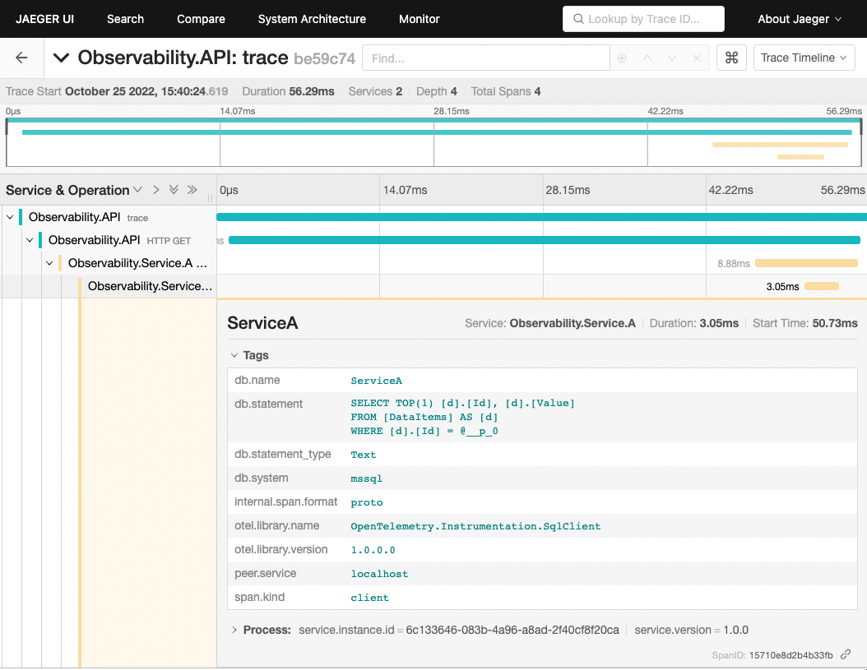
Distributed tracing - Jaeger
Notes:
Trigger API https://localhost:7248/trace
Trace context – additional tags through instrumentation tools

Slide 10
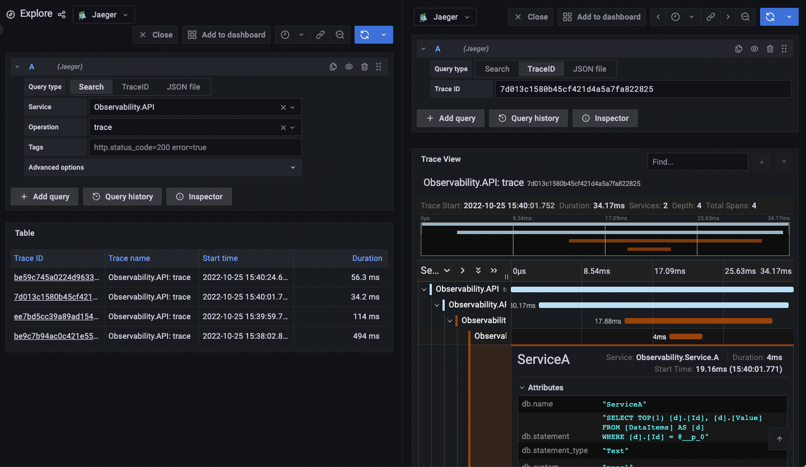
Distributed tracing - Grafana
Notes:
Jaeger data source must be added

Slide 11
Metrics
Metrics are a numerical representation of data that can be used to determine a service or component’s overall behaviour over time.
Metric types
Counter
Gauge
Histogram
Summary
Notes:
Could be obtained from logs, but very expensive, fragile

Slide 12
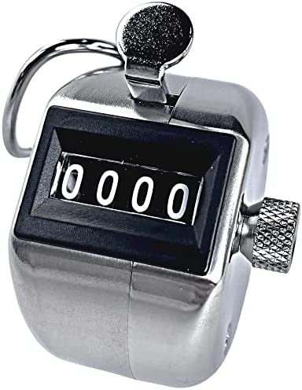
Metrics - Counter
Counter is a metric value which can only increase or reset i.e the value cannot reduce than the previous value.
Examples:
Requests number
Errors number
The number of accounts created
The number of HTTP 5xx errors

Slide 13
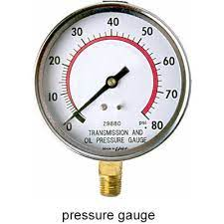
Metrics - Gauge
Gauge is a number which can either go up or down. It can be used for metrics like number of pods in a cluster, number of events in an queue etc.
Examples:
Amount of memory
CPU load

Slide 14
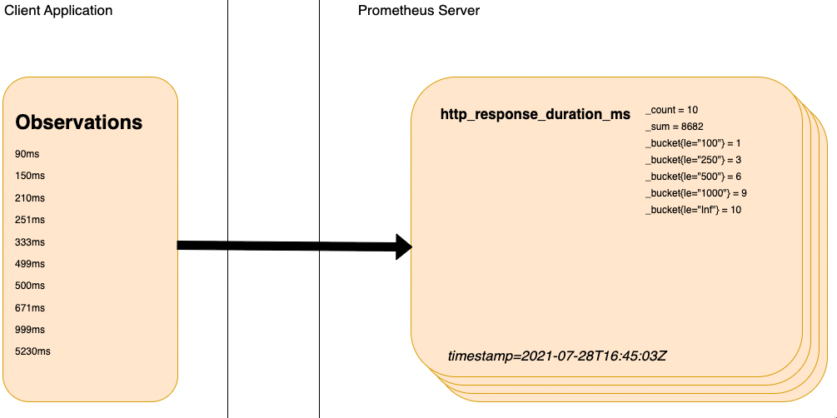
Metrics - Histogram
Histograms measure the statistical distribution of a set of values including the min, max, mean, median, standard deviation and quantiles.
Examples:
Request duration, size

Slide 15
Metrics – Summary (Prometheus specific)
Summaries also measure events and are an alternative to histograms. They are cheaper, but lose more data. They are calculated on the application level hence aggregation of metrics from multiple instances of the same process is not possible. They are used when the buckets of a metric is not known beforehand, but it is highly recommended to use histograms over summaries whenever possible.

Slide 16
Metrics – OpenTelemetry & custom metrics
For .NET the OpenTelemetry metrics implementation based on default System.Diagnostics.Metrics
Meter object defines a set of metrics of specific subsystem (app, library1, library2, etc)
Register OpenTelemetry services, add common Instrumentations
Expose metrics endpoint
Create custom metrics
Demo

Slide 17
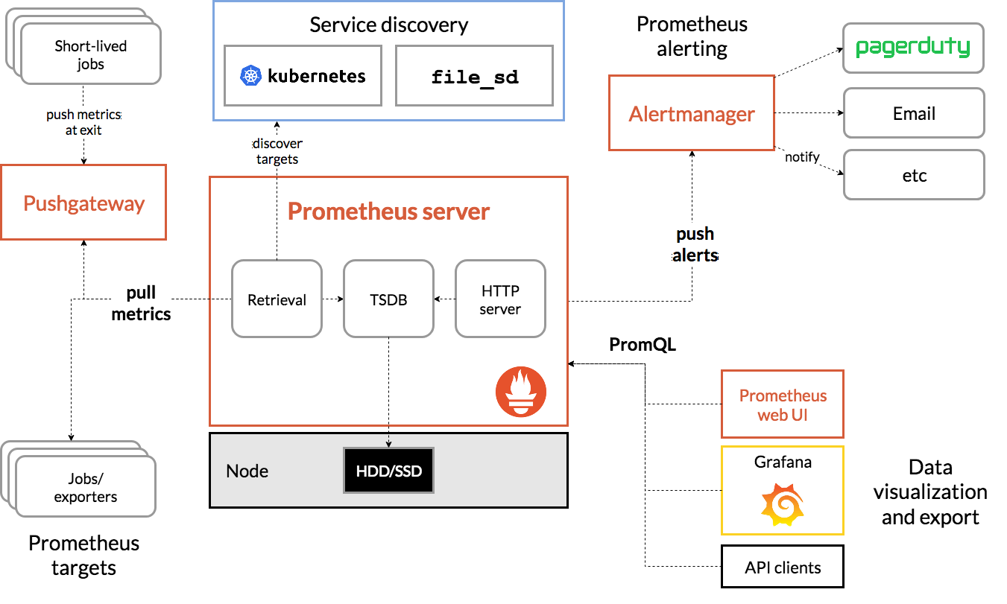
Metrics – Prometheus
Notes:
Push vs Pull
TSDB store
Scrape interval
http://localhost:9090/targets?search=
Node exporter demo
High-precise alternative is VictoriaMetrics

Slide 18
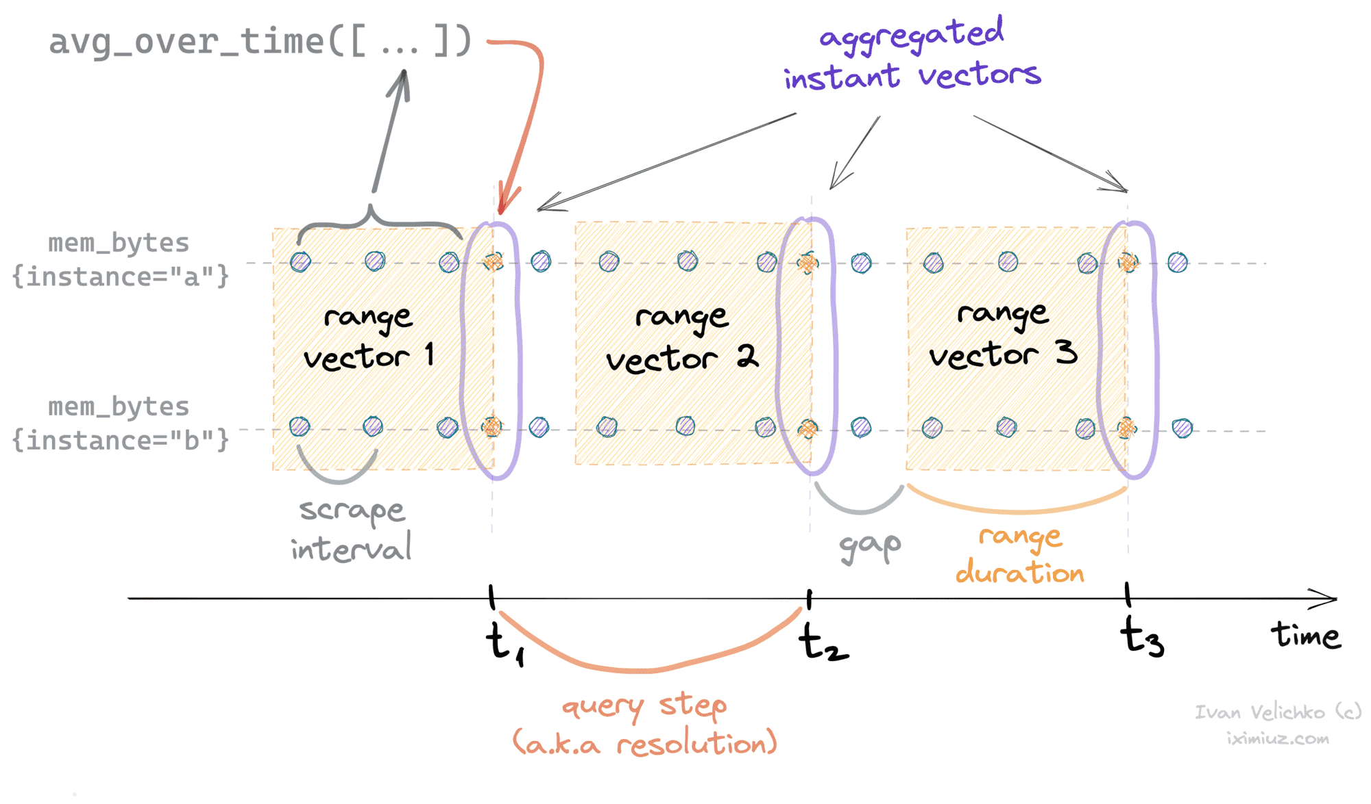
Metrics – Percentiles & PromQL
Instant vectors
Range vectors
Scalar
String
Notes:
Often used aggreagated values, not the source ones
https://twitter.com/nalgeon/status/1358783814022156291?ref_src=twsrc%5Etfw%7Ctwcamp%5Etweetembed%7Ctwterm%5E1358783814022156291%7Ctwgr%5E4740c304a5bc201a4218a81be3e85b1faa94b71c%7Ctwcon%5Es1_&ref_url=https%3A%2F%2Fembedd.srv.habr.com%2Fiframe%2F6335b8fe0c924e8d415b157b
100 - (avg by (cpu) (rate(node_cpu_seconds_total{mode="idle"}[1m])) * 100)

Slide 19
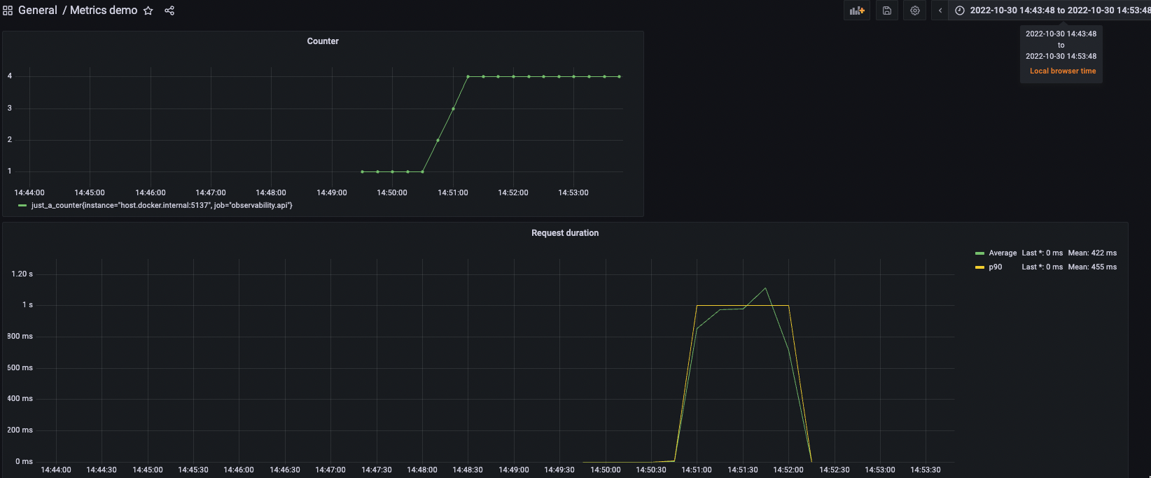
Metrics – Grafana
Notes:
http://localhost:3000/
Add Prometheus data source

Slide 20
Metrics – Golden Signals
“The Four Golden Signals” from Google https://sre.google/sre-book/monitoring-distributed-systems/
Latency The time it takes to service a request
Traffic RPS
Errors e.g., HTTP 500s
Saturation How "full" your service is. A measure of your system fraction, emphasizing the resources that are most constrained (e.g., in a memory-constrained system, show memory; in an I/O-constrained system, show I/O). Note that many systems degrade in performance before they achieve 100% utilization, so having a utilization target is essential.

Slide 21
Metrics – Apdex (Application Performance Index)
$$Apdex= \frac{SatisfiedCount+ToleratingCount∗w_{tc}+FrustratedCount∗w_{fc}}{TotalSamples}∈[0;1]$$
1 – Fully satisfied
0 – Fully unsatisfied

Slide 22
Alerts actions based on changes in metric values
Each monitoring toolkit provides it’s own alerting mechanism
Most often Prometheus Alertmanager is used
Grafana supports external Prometheus Alertmanager
Loki supports alerts on logs
Most of the time alerts based on metrics
Grafana alert demo

Slide 23
Exception tracking using Sentry
Installation demo
Setup the project (ASP.NET Core & Angular)
Catch errors (with automerge)
Alerts
Performance monitoring and traces

Slide 24
References
https://docs.microsoft.com/en-us/dotnet/core/diagnostics/distributed-tracing-concepts
Человеческим языком про метрики
https://habr.com/ru/company/tochka/blog/683608/
https://habr.com/ru/company/tochka/blog/685636/
https://habr.com/ru/company/tochka/blog/690814/
https://habr.com/ru/company/tochka/blog/693834/

