Slide 1
Observability in .NET

Slide 2
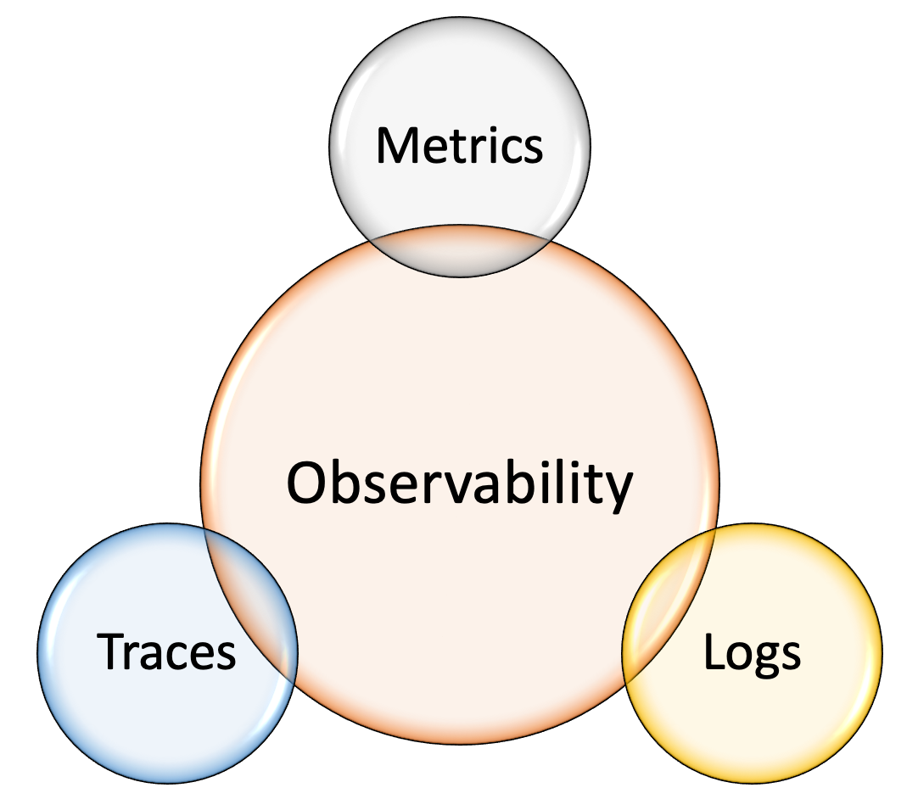
What is observability?
Alerts/Exception tracking

Slide 3
OpenTelemetry
OpenTracing provided a vendor-neutral API for sending telemetry data over to an Observability back-end; however, it relied on developers to implement their own libraries to meet the specification.
OpenCensus provided a set of language-specific libraries that developers could use to instrument their code and send to any one of their supported back-ends.

Slide 4
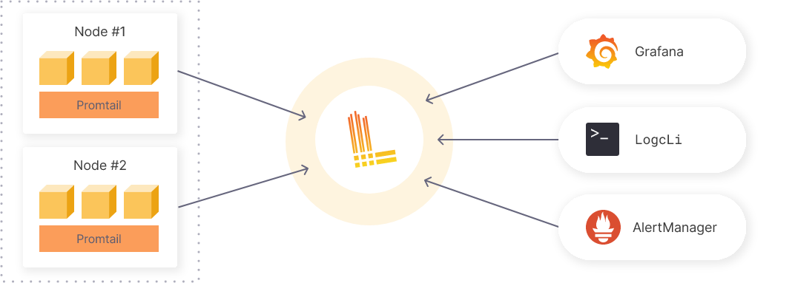
Logging
File logging vs log aggregation systems
Grafana Loki
Notes:
Working with log files is inconvenient:
log files can only be accessed locally
difficult to query and filter log records (e.g. mess in multithread apps)
Promtail – parse logs on the host and send them to the Loki
LogCli – command line tool to operate with logs
Grafana – is the central UI for everything (logs, metrics, traces, alerts)

Slide 5
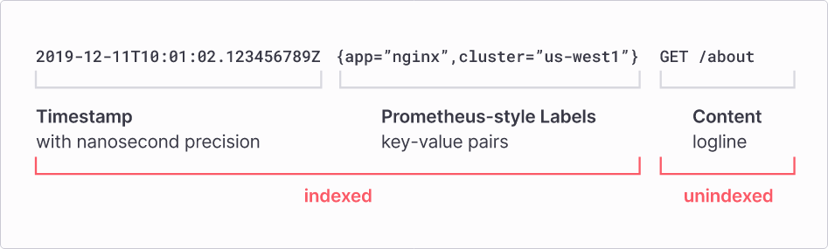
Logging (Grafana Loki)

Slide 6
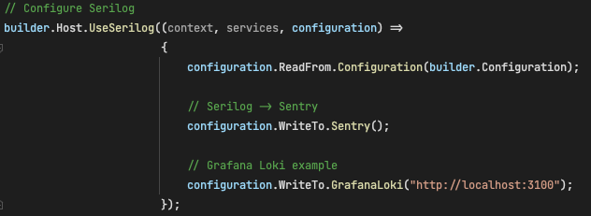
Log to Loki with Serilog
Serilog.Sinks.Grafana.Loki nuget package (https://github.com/serilog-contrib/serilog-sinks-grafana-loki)

Slide 7
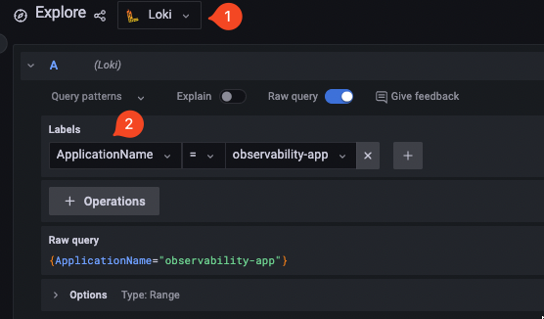
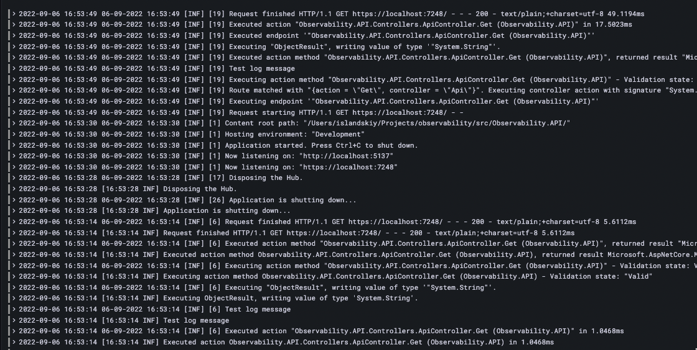
Log to Loki with Serilog

Slide 8
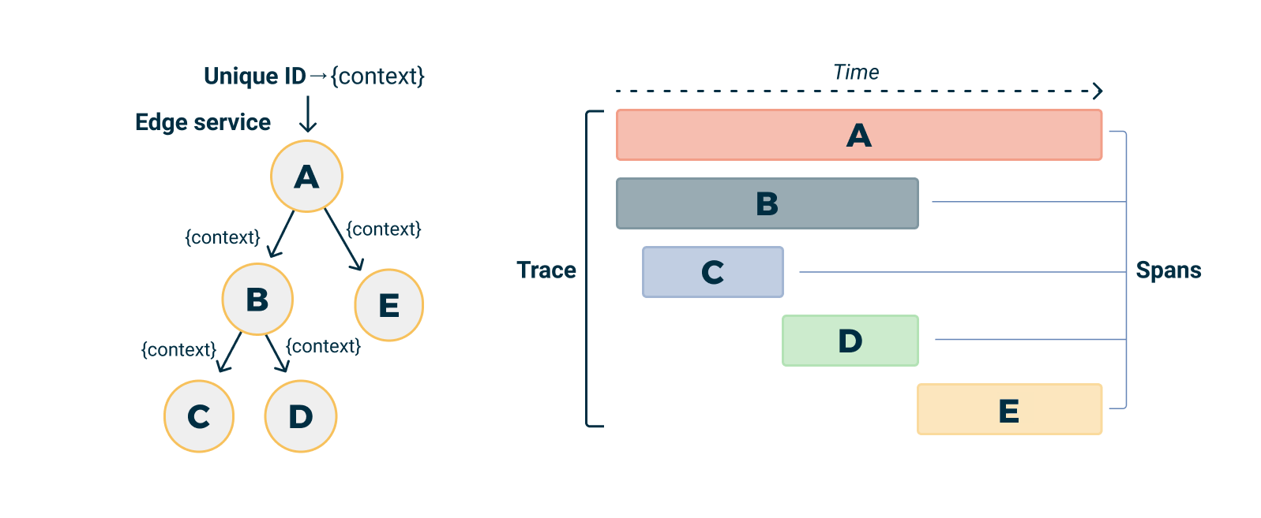
Distributed tracing
*A is a root span

Slide 9
Distributed tracing

Slide 10
Metrics
Metrics are a numerical representation of data that can be used to determine a service or component’s overall behaviour over time.
Metric types
Counter
Gauge
Histogram
Summary

Slide 11
Metrics - Counter
Counter is a metric value which can only increase or reset i.e the value cannot reduce than the previous value.
Examples:
Requests number
Errors number
The number of accounts created
The number of HTTP 5xx errors

Slide 12
Metrics - Gauge
Gauge is a number which can either go up or down. It can be used for metrics like number of pods in a cluster, number of events in an queue etc.
Examples:
Amount of memory
CPU load

Slide 13
Metrics - Histogram
Histograms measure the statistical distribution of a set of values including the min, max, mean, median, standard deviation and quantiles.
Examples:
Request duration, size

Slide 14
Metrics - Summary
Summaries also measure events and are an alternative to histograms. They are cheaper, but lose more data. They are calculated on the application level hence aggregation of metrics from multiple instances of the same process is not possible. They are used when the buckets of a metric is not known beforehand, but it is highly recommended to use histograms over summaries whenever possible.

Slide 15
Metrics – custom metrics
Register OpenTelemetry services
Expose metrics endpoint
Create custom metrics
Demo

Slide 16
Metrics

Slide 17
Metrics

Slide 18
Exception tracking using Sentry
Installation demo
Setup the project (ASP.NET Core & Angular)
Catch errors (with automerge)
Alerts
Performance monitoring and traces

Slide 19
Alerts
Each monitoring toolkit provides it’s own alerting mechanism.

Slide 20
References
https://docs.microsoft.com/en-us/dotnet/core/diagnostics/distributed-tracing-concepts

