Slide 1
High Rise Structure Assignment
ISLAVATH MOHAN NAIK
21CE31006

Slide 2
General details
Dimension: 56m x 36m
Number of floors: 51 (G+50)
City: Gandhinagar
Seismic zone: Zone III
Wind base speed: 45 m/s
Grade of concrete: M30
Grade of steel: Fe500

Slide 3
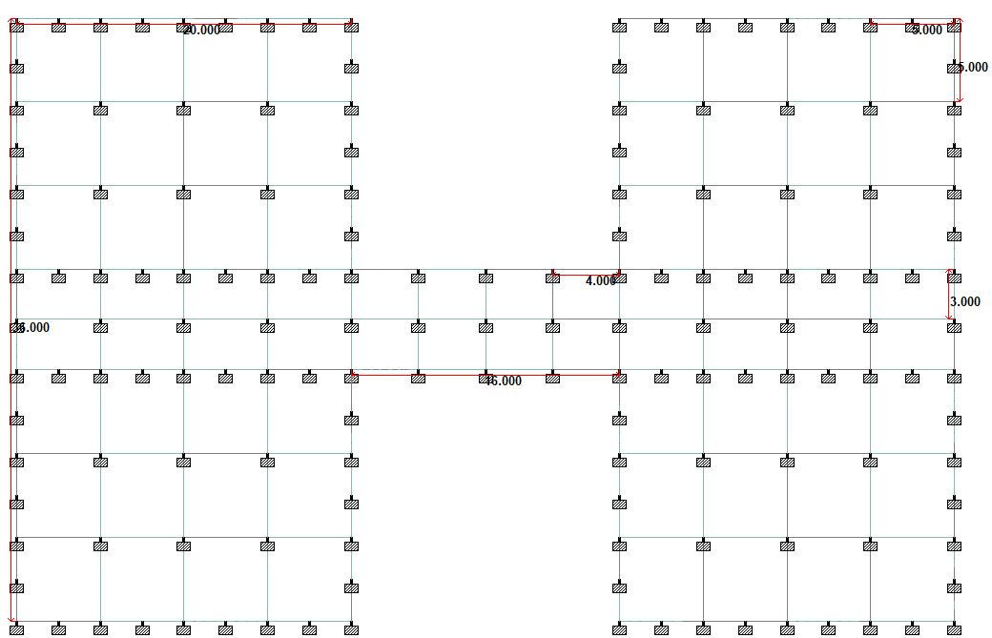
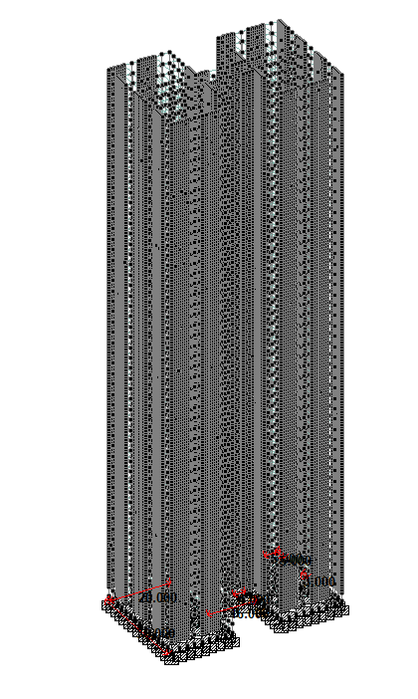
Plan of the building
All dimensions are in meters

Slide 4
Preliminary Submissions in January

Slide 5
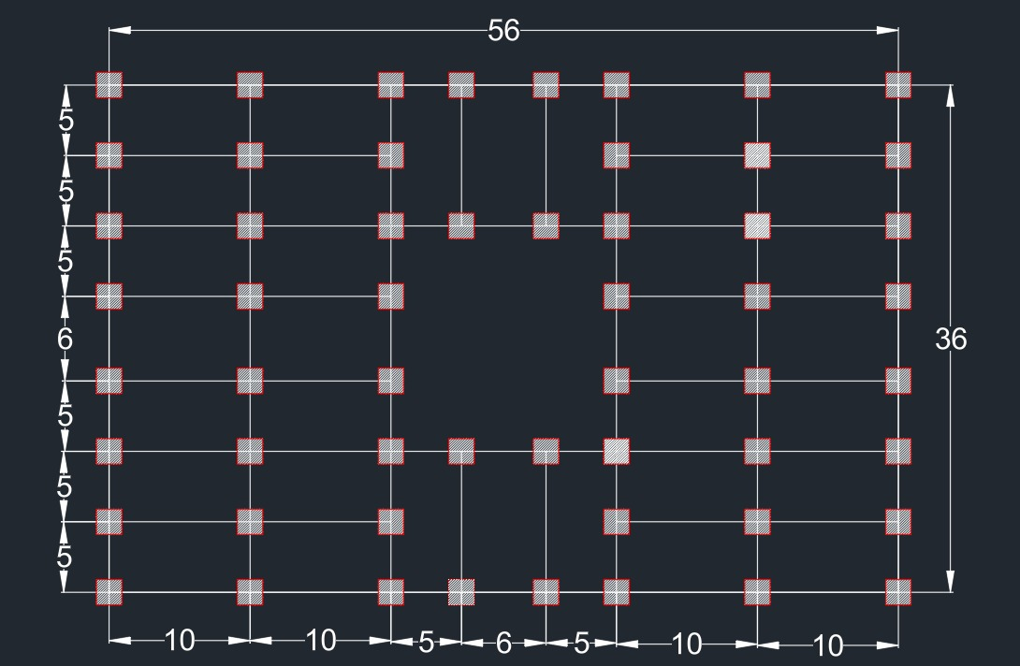
Beam-Column Layout

Slide 6
Column details
Floor | Size | Reinforcements
Ground floor - 10 | 1.8m x 1.8m | 36-32phi 10phi @ 300mm
11 - 40 | 1.5m x 1.5m | 20-32phi 10phi @ 300mm
41 - 50 | 1.2m x 1.2m | 16-32phi 10phi @ 300mm

Slide 7
Beam details
Floor | Size | Reinforcements
All beams | 0.6m x 0.3m | Top: 3-32 phi Bottom: 3-32 phi Stirrups: 10 phi @ 200mm c/c

Slide 8
Slab details
Floor | Depth | Reinforcements
All slabs | 0.15m | Longitudinal reinforcements: 276 sq. mm/m Transverse reinforcements : 276 sq. mm/m

Slide 9
Final Submissions in April

Slide 10
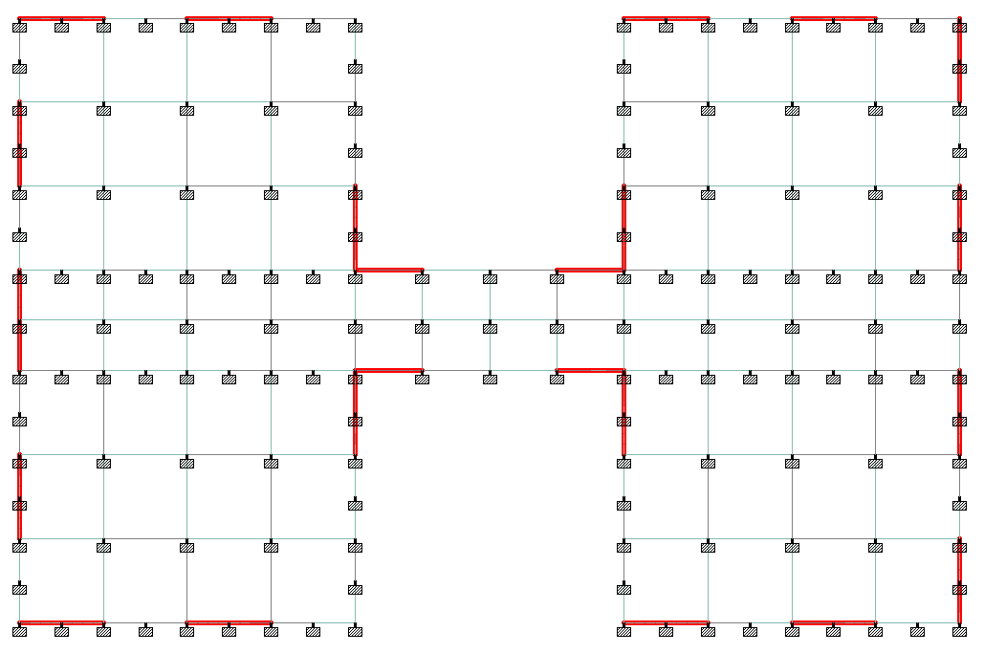
Beam-Column Layout

Slide 11
Column details
Column | Floor | Size | Reinforcements
A1-A24, E1-E24, L1-L24, P1-P24, B1,B9,B16,B24, C1,C9,C16,C24, D1,D9,D16,D24, F1,F9,F16,F24, G1,G9,G16,G24, H1,H9,H16,H24, I1,I9,I16,I24, J1,J9,J16,J24, K1,K9,K16,K24, M1,M9,M16,M24, N1,N9,N16,N24, O1,O9,O16,O24 | Ground floor - 10 | 0.8m x 0.8m | 24-32phi 10phi @ 300mm c/c
 | 11 - 40 | 0.7m x 0.7m | 8-32phi 10phi @ 300mm c/c
 | 41 - 50 | 0.6m x 0.6m | 8-32phi 10phi @ 300mm c/c
C5,C20, G5,G11,G14,G20, J5,J11,J14,J20, N5,N20 | Ground floor - 10 | 1.5m x 1.5m | 84-32phi 10phi @ 300mm c/c
 | 11 - 40 | 1.2m x 1.2m | 28-32phi 10phi @ 300mm c/c
 | 41 - 50 | 1.0m x 1.0m | 16-32phi 10phi @ 300mm c/c

Slide 12
Beam details
Floor | Size | Reinforcements
All beams | 0.6m x 0.3m | Top: 3-32 phi Bottom: 3-32 phi Stirrups: 10 phi @ 185mm c/c

Slide 13
Slab details
Floor | Depth | Reinforcements
All slabs | 0.15m | Longitudinal reinforcements: 276 sq. mm/m Transverse reinforcements : 276 sq. mm/m

Slide 14
Shear wall details
Floor | Depth | Reinforcements
All slabs | 0.3m | Longitudinal reinforcements: 396 sq. mm/m Transverse reinforcements : 396 sq. mm/m

Slide 15
Output comparison
Drift
Initial | Final
0.0024 | 0.00182

Slide 16
Loads
Dead Load
Self weight
Wall load = 7kN/m (200mm thickness)
Floor finish = 1kN/m^2
Live Load
Floor load = 4kN/m^2

Slide 17
Loads (continued)
Wind Load
Pd (kN/m^2) | Height (m)
0.973 | 0
1.167 | 25
1.332 | 50
1.413 | 75
1.496 | 100
1.545 | 125
1.595 | 150
1.617 | 172.8

Slide 18
Load combinations
1.5DL + 1.5 LL
1.2DL + 1.2LL ± 1.2EL (X and Z)
1.2DL + 1.2LL ± 1.2WL (X and Z)
1.5DL ± 1.5EL (X and Z)
1.5DL ± 1.5WL (X and Z)
0.9DL ± 1.5EL (X and Z)
0.9DL ± 1.5WL (X and Z)

Slide 19
Mistakes done in preliminary submission
Very large column sizes
No shear wall provided
Drift exceeded the standard limit
Floor finish not considered in Dead Load
Designed it as a mid-rise building which resulted in such high drift

Slide 20
Lessons learnt and adopted in final submission
To reduce the column size, bundled-tube structural form has been used
Shear walls have been provided
Introduced floor finish
Drift reduced from 0.0024 to 0.00184 (within standard limits)

Slide 21
Special features for lateral force resistance
Bundled tube structural form has been used
Shear walls have been incorporated

Slide 22
Conclusion
The structural form and shear wall together reduced the drift of the structure
Designing the building in a certain structural form rather than like a regular mid-rise building has benefits

