Slide 1
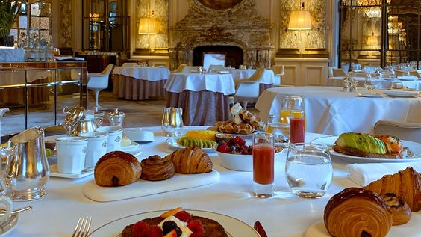
Bistro’s
Get the true experience of the French cuisine

Slide 2
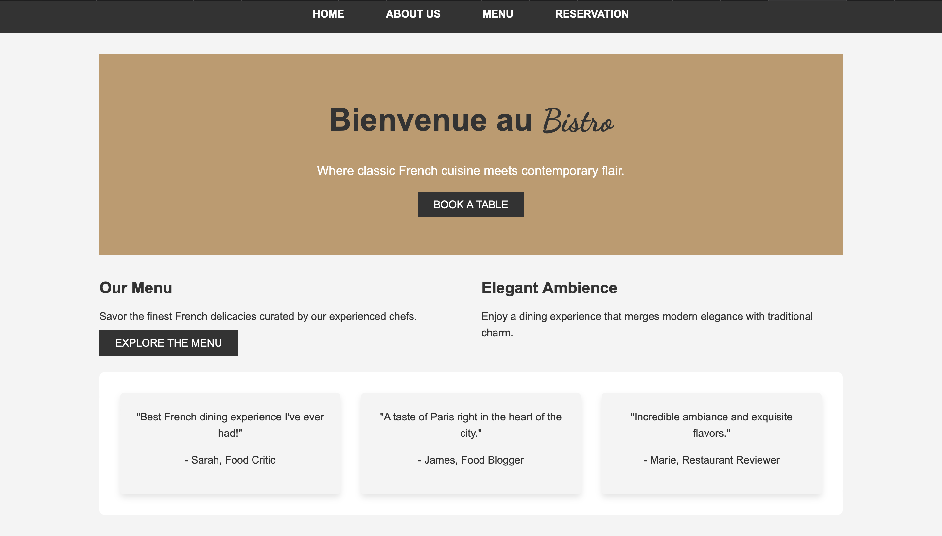
Home Page

Slide 3
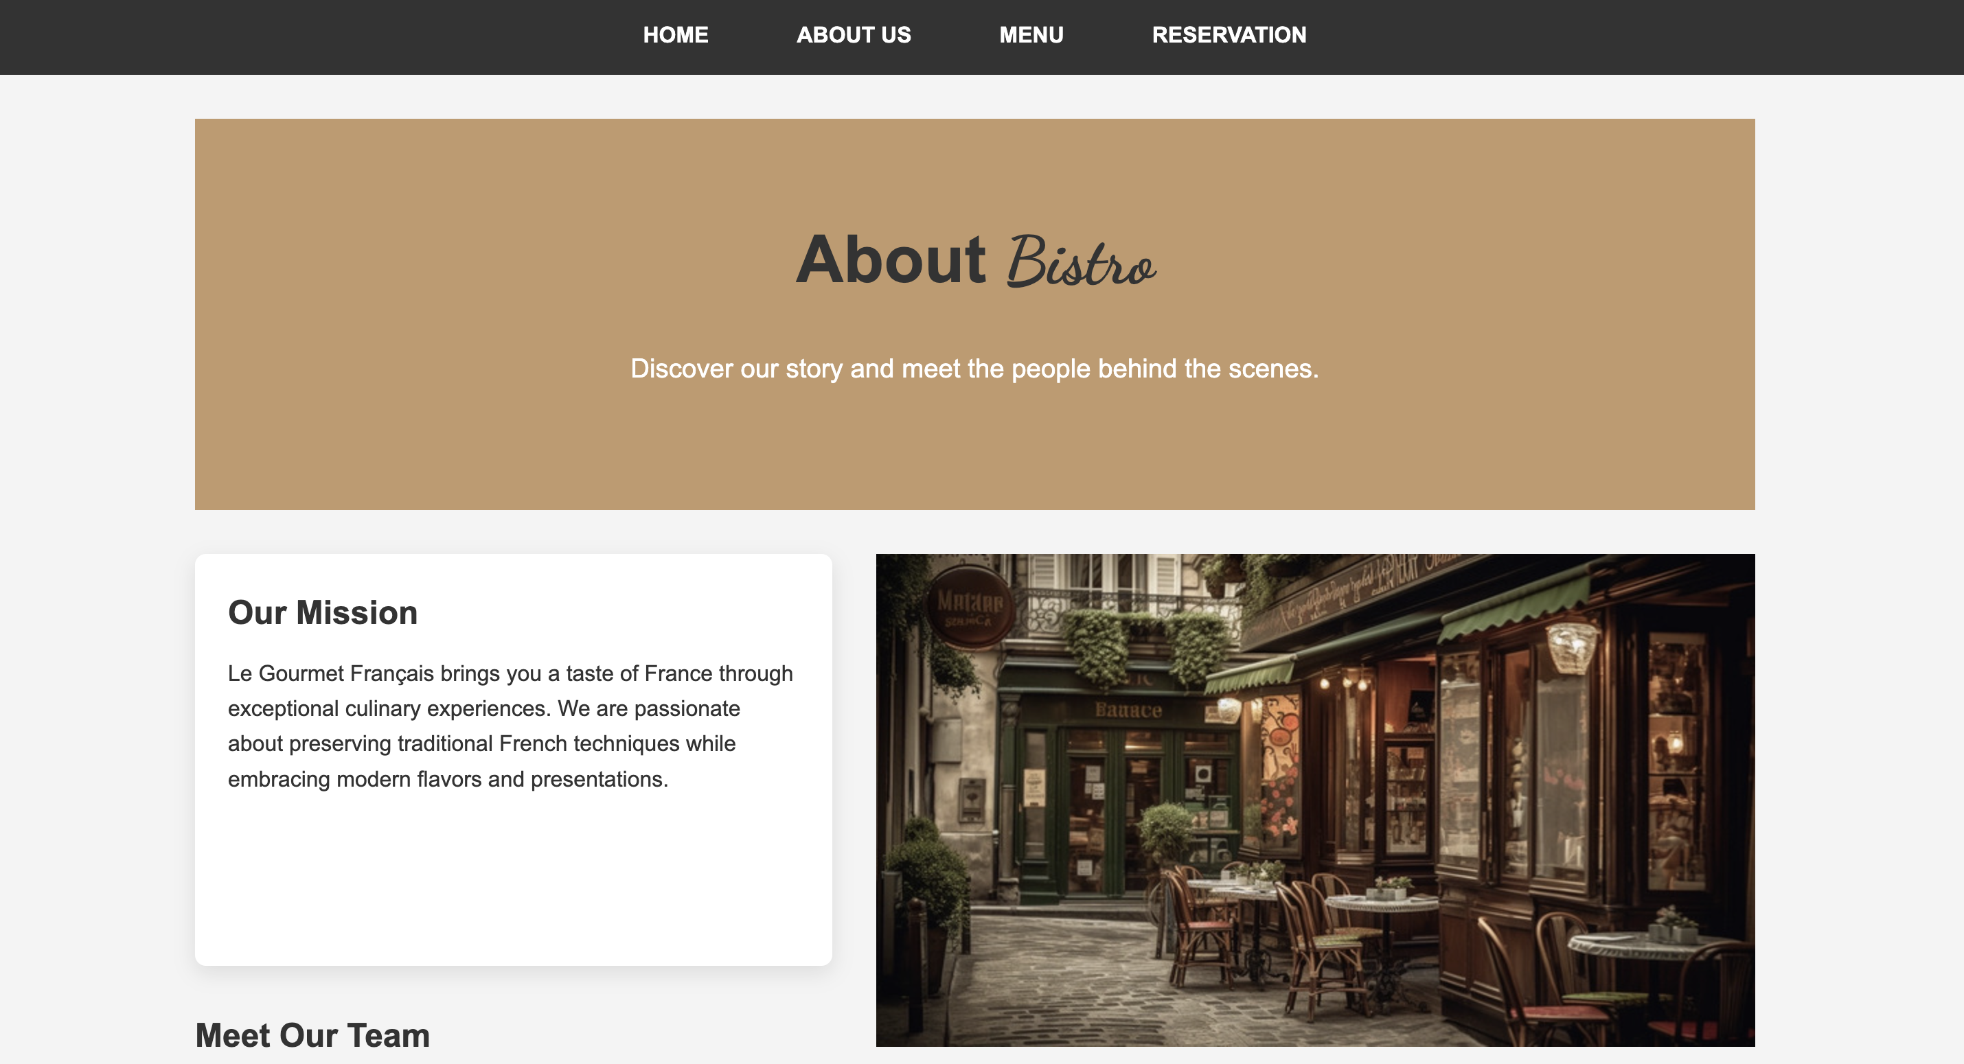
About page

Slide 4
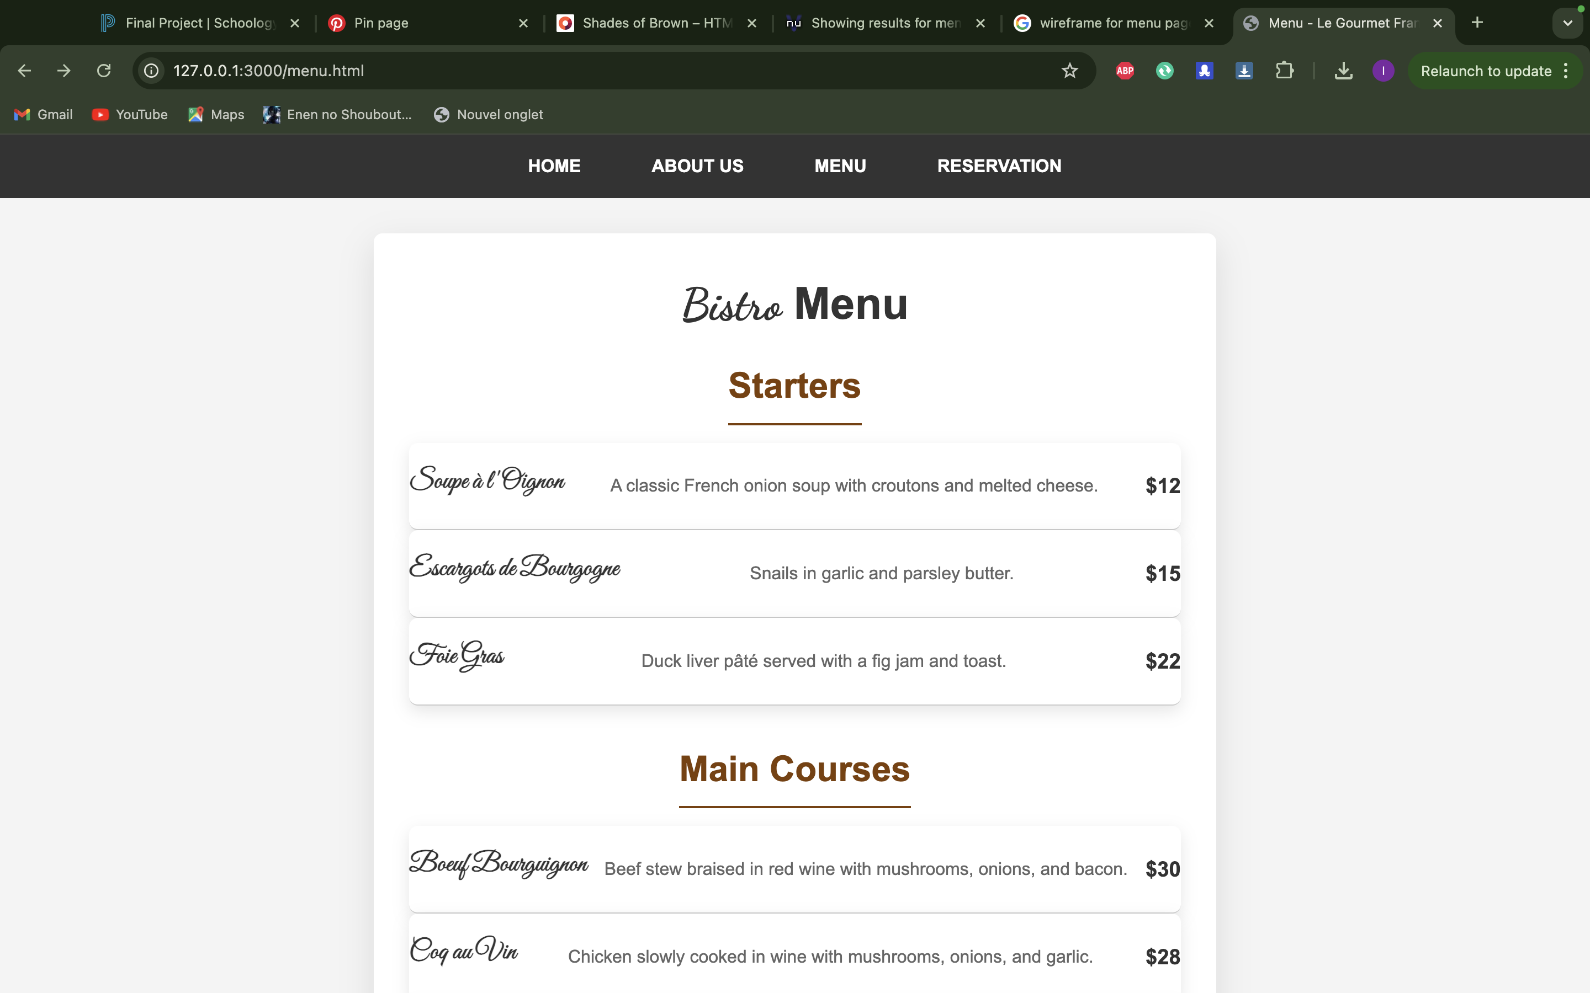
Menu Page

Slide 5
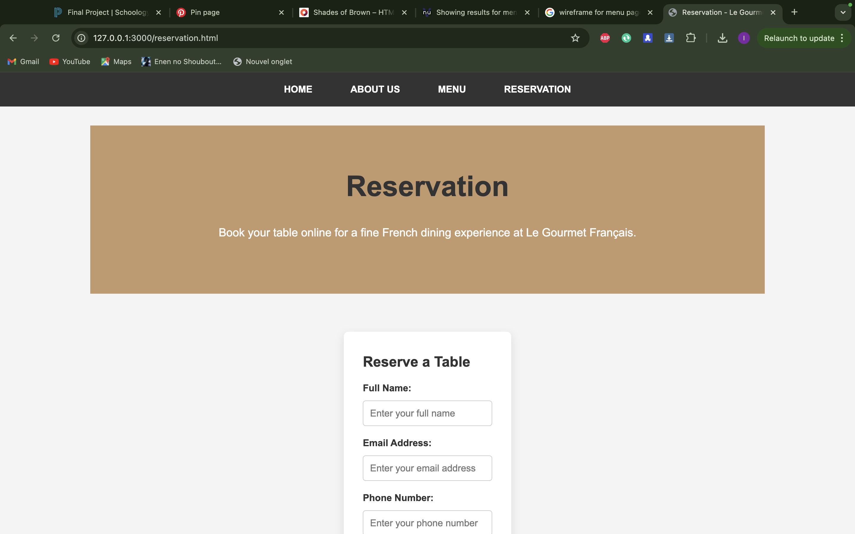
Reservation Page

Slide 6
Thank You For watching!
Link for website:
https://isma-dot0.github.io/Bistro-s/

