Slide 1










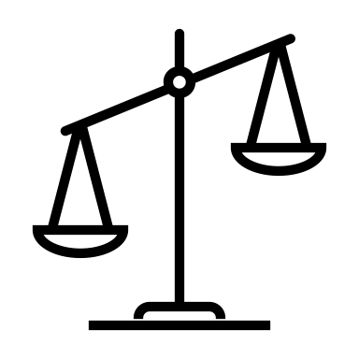





Reinforces existing biases
Automates decision making
Privacy
Danger of misuse
High environmental cost
Informed
consent
Capable of direct harm
Classifies or ranks people
Ignores or opposes community need
Difficult to understand

Slide 2

Danger of misuse

