Slide 1
















Reinforces existing biases
Automates decision making
Privacy
Danger of misuse
High environmental cost
Informed
consent
Capable of direct harm
Classifies or ranks people
Ignores or opposes needs
Difficult to understand

Slide 2
Contains Data Science
Automates decision-making
May invade privacy
Reinforces existing biases
Danger of misuse
High environmental cost
Lacks informed
consent
May cause physical harm
Classifies or ranks people
Lacks community involvement
Difficult to understand

Slide 3
Data Hazards
Data Hazards
Data Hazards
Data Hazards
Data Hazards
Data Hazards
Data Hazards
Data Hazards
Data Hazards
Data Hazards
Data Hazards
Data Hazards
Data Hazards
Data Hazards
Data Hazards
Data Hazards
Data Hazards

Slide 4
Data Hazards
Data Hazards
Data Hazards
Data Hazards
Data Hazards
Data Hazards
Data Hazards
Data Hazards
Data Hazards
Data Hazards
Data Hazards
Data Hazards
Data Hazards
Data Hazards
Data Hazards
Data Hazards
Data Hazards

Slide 5
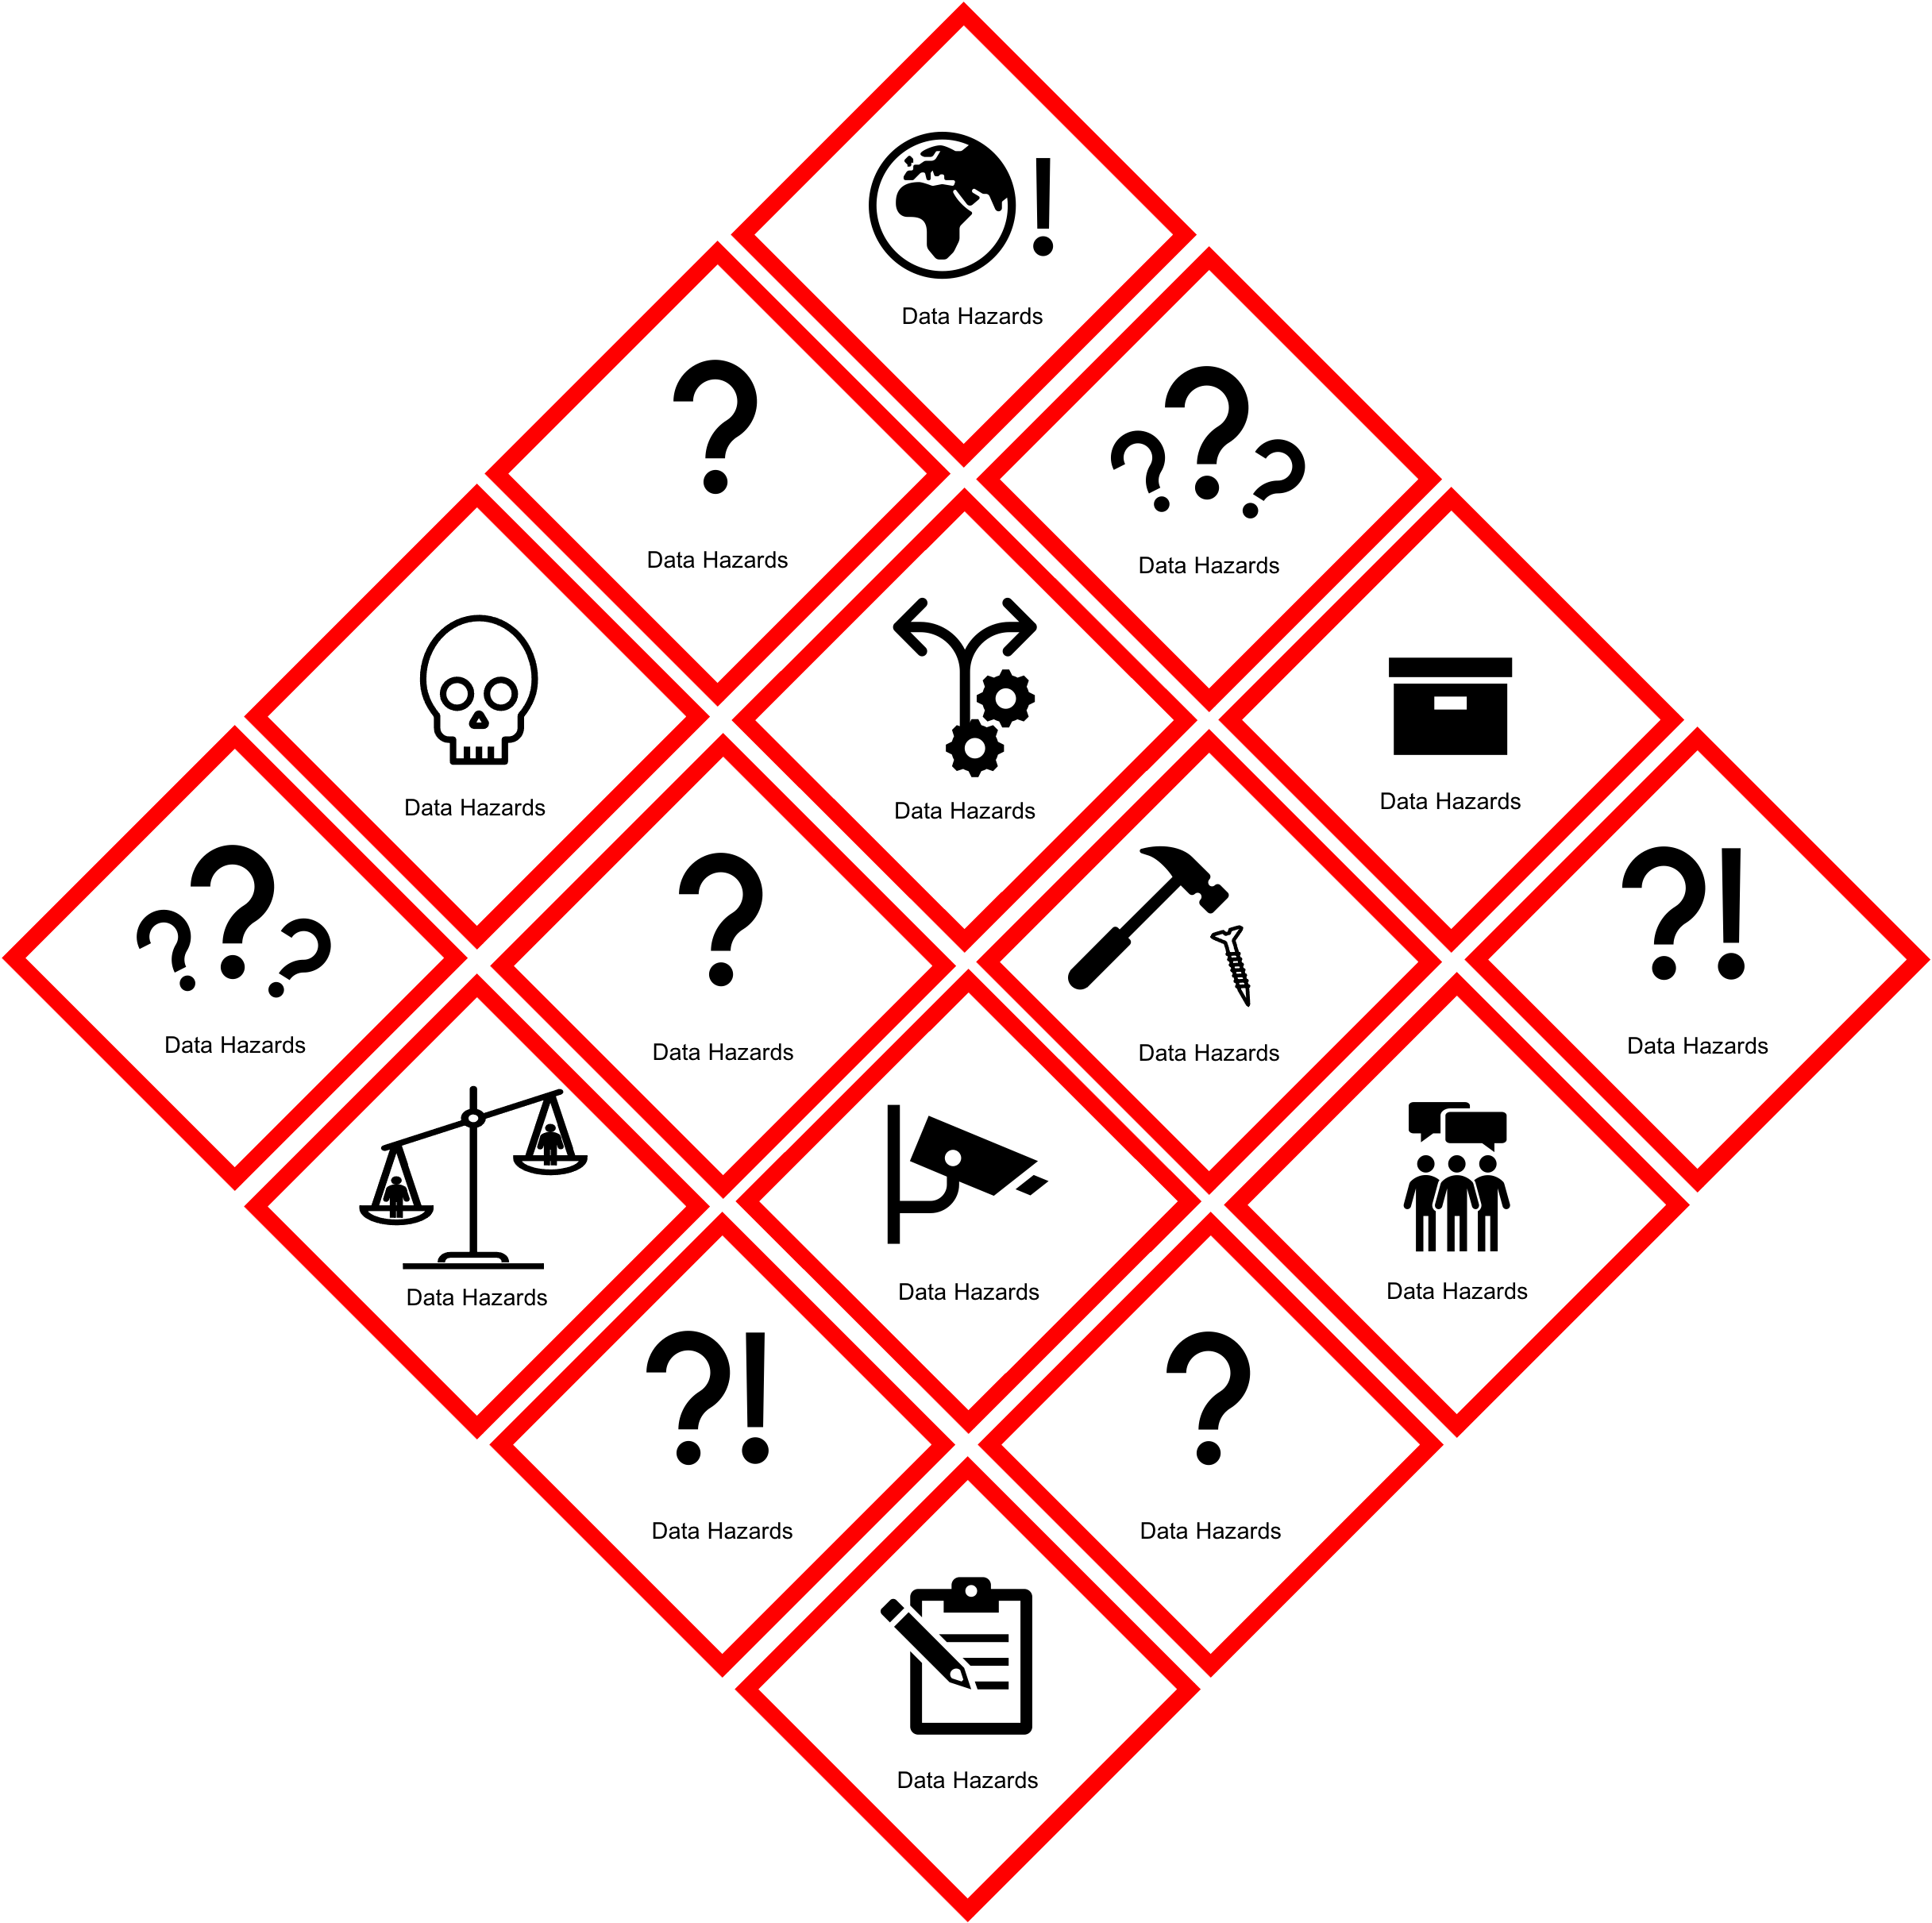

Slide 6
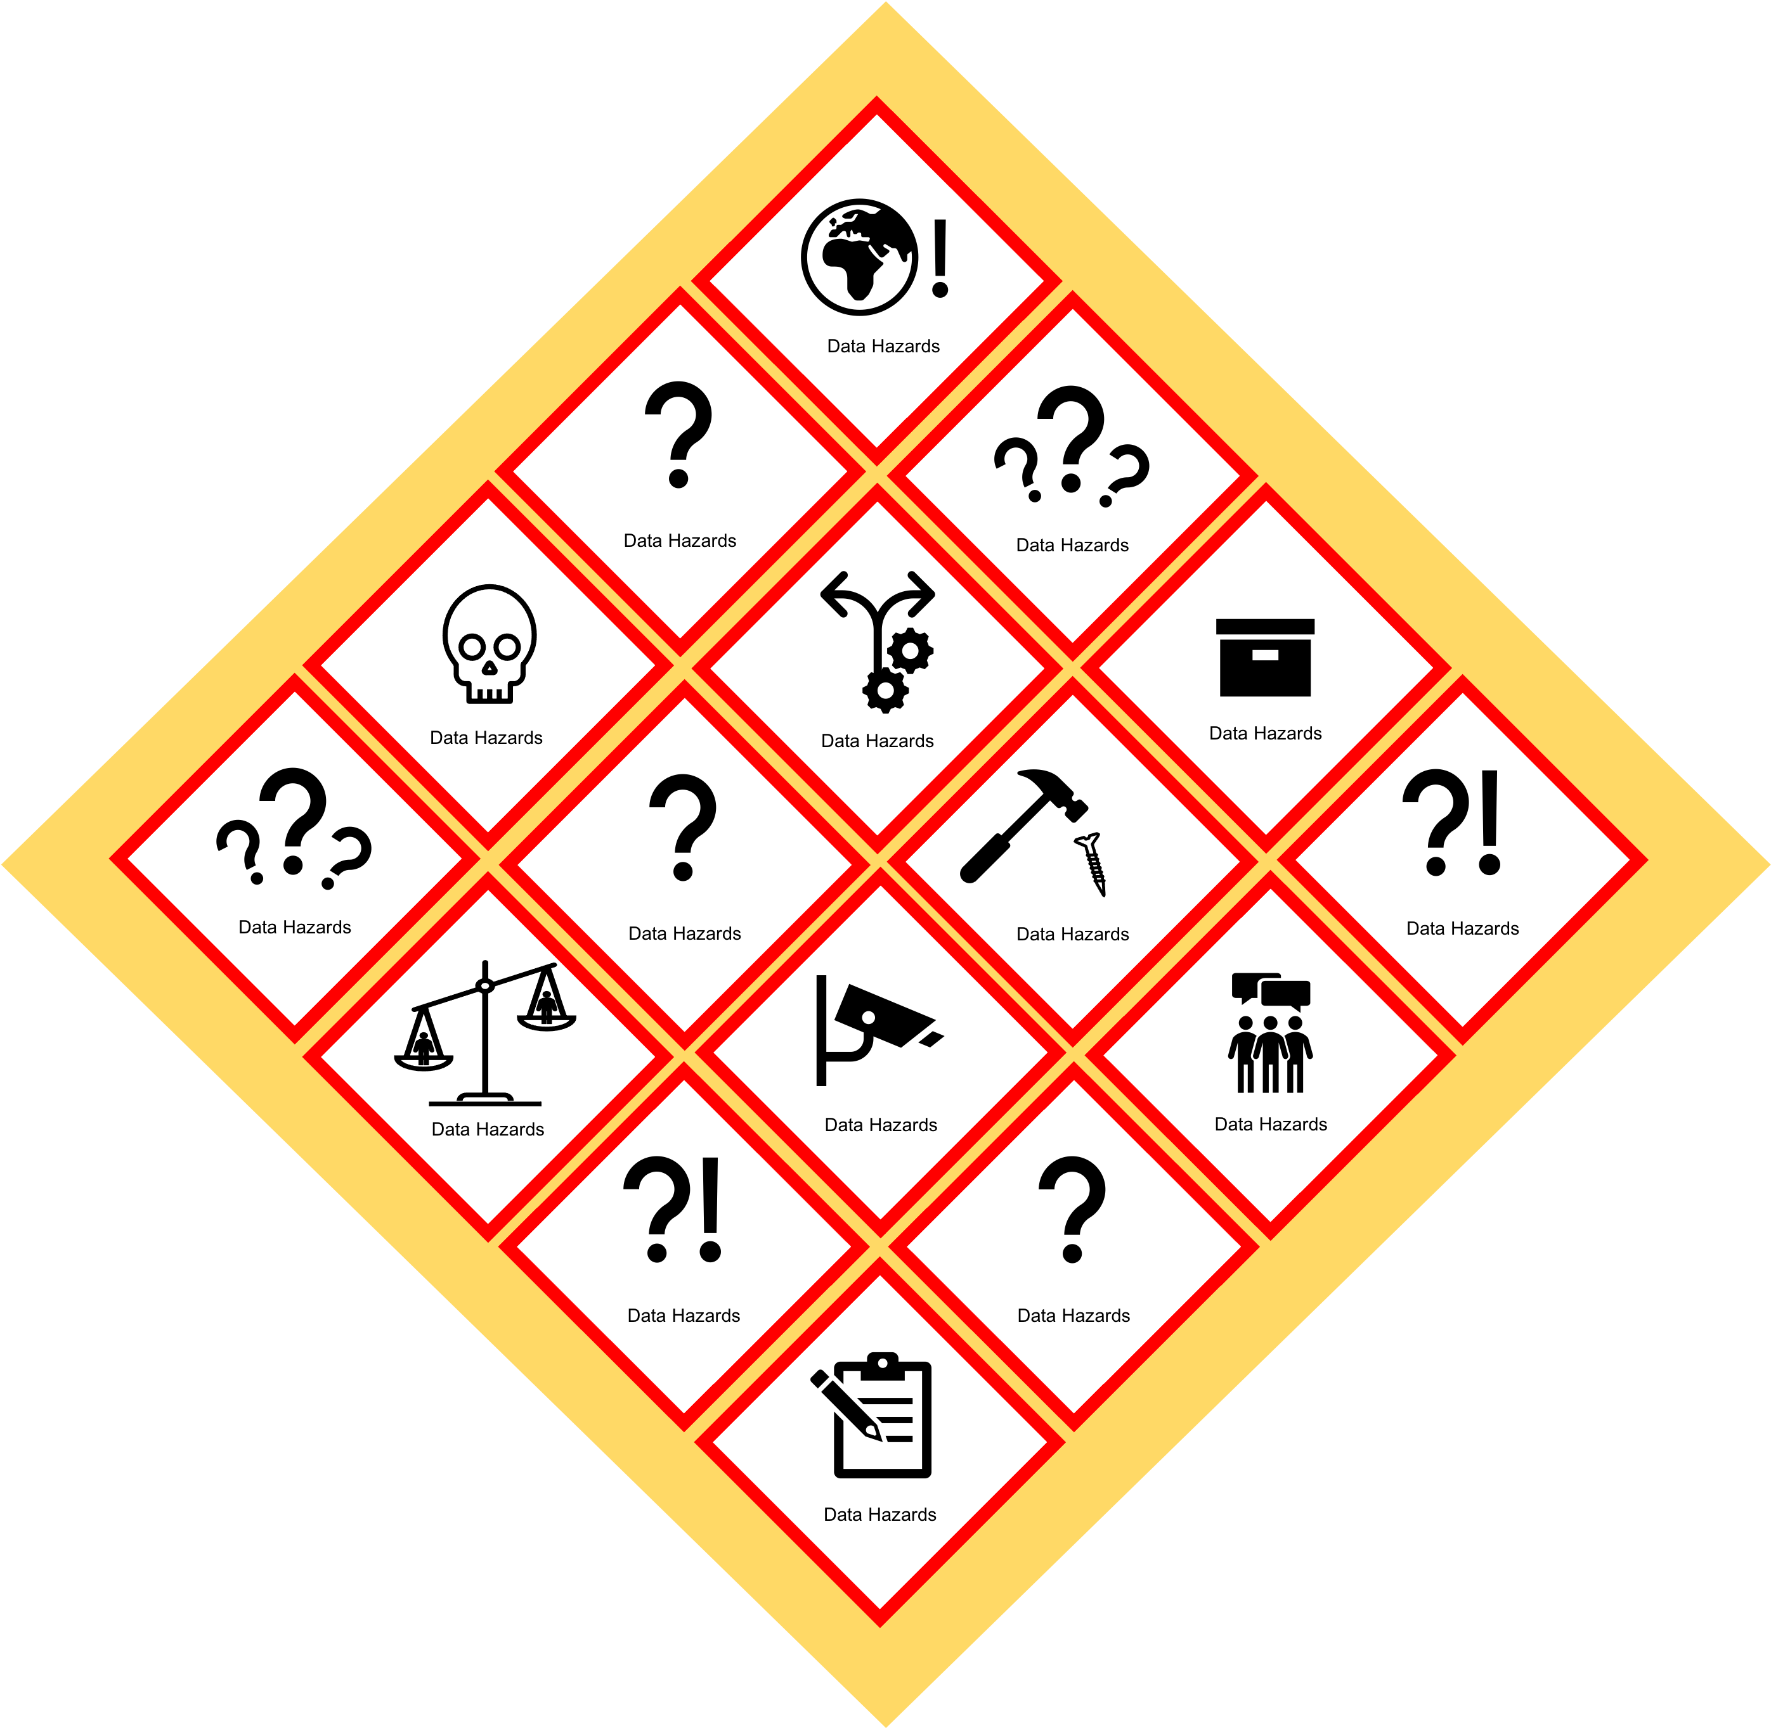
Data Hazards

Slide 7

May cause direct harm
Difficult to understand
Danger of misuse
Contains Data Science
Ignores or opposes community need
Data Hazards

