Slide 1










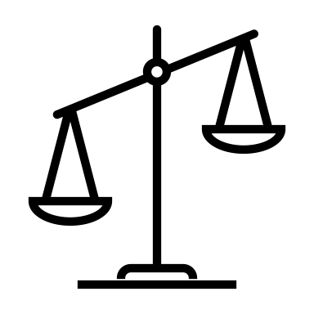





Reinforces existing biases
Automates decision making
Privacy
Danger of misuse
High environmental cost
Informed
consent
Capable of direct harm
Classifies or ranks people
Ignores or opposes needs
Difficult to understand

Slide 2

Reinforces existing biases
Automates decision-making
Threatens Privacy
Danger of misuse
High environmental cost
Undermines informed
consent
May cause direct harm
Classifies or ranks people
Ignores or opposes community need
Difficult to understand

Slide 3
Data Hazards
Data Hazards
Data Hazards
Data Hazards
Data Hazards
Data Hazards
Data Hazards
Data Hazards
Data Hazards
Data Hazards
Data Hazards
Data Hazards
Data Hazards
Data Hazards
Data Hazards
Data Hazards
Data Hazards

Slide 4
Data Hazards
Data Hazards
Data Hazards
Data Hazards
Data Hazards
Data Hazards
Data Hazards
Data Hazards
Data Hazards
Data Hazards
Data Hazards
Data Hazards
Data Hazards
Data Hazards
Data Hazards
Data Hazards
Data Hazards

Slide 5
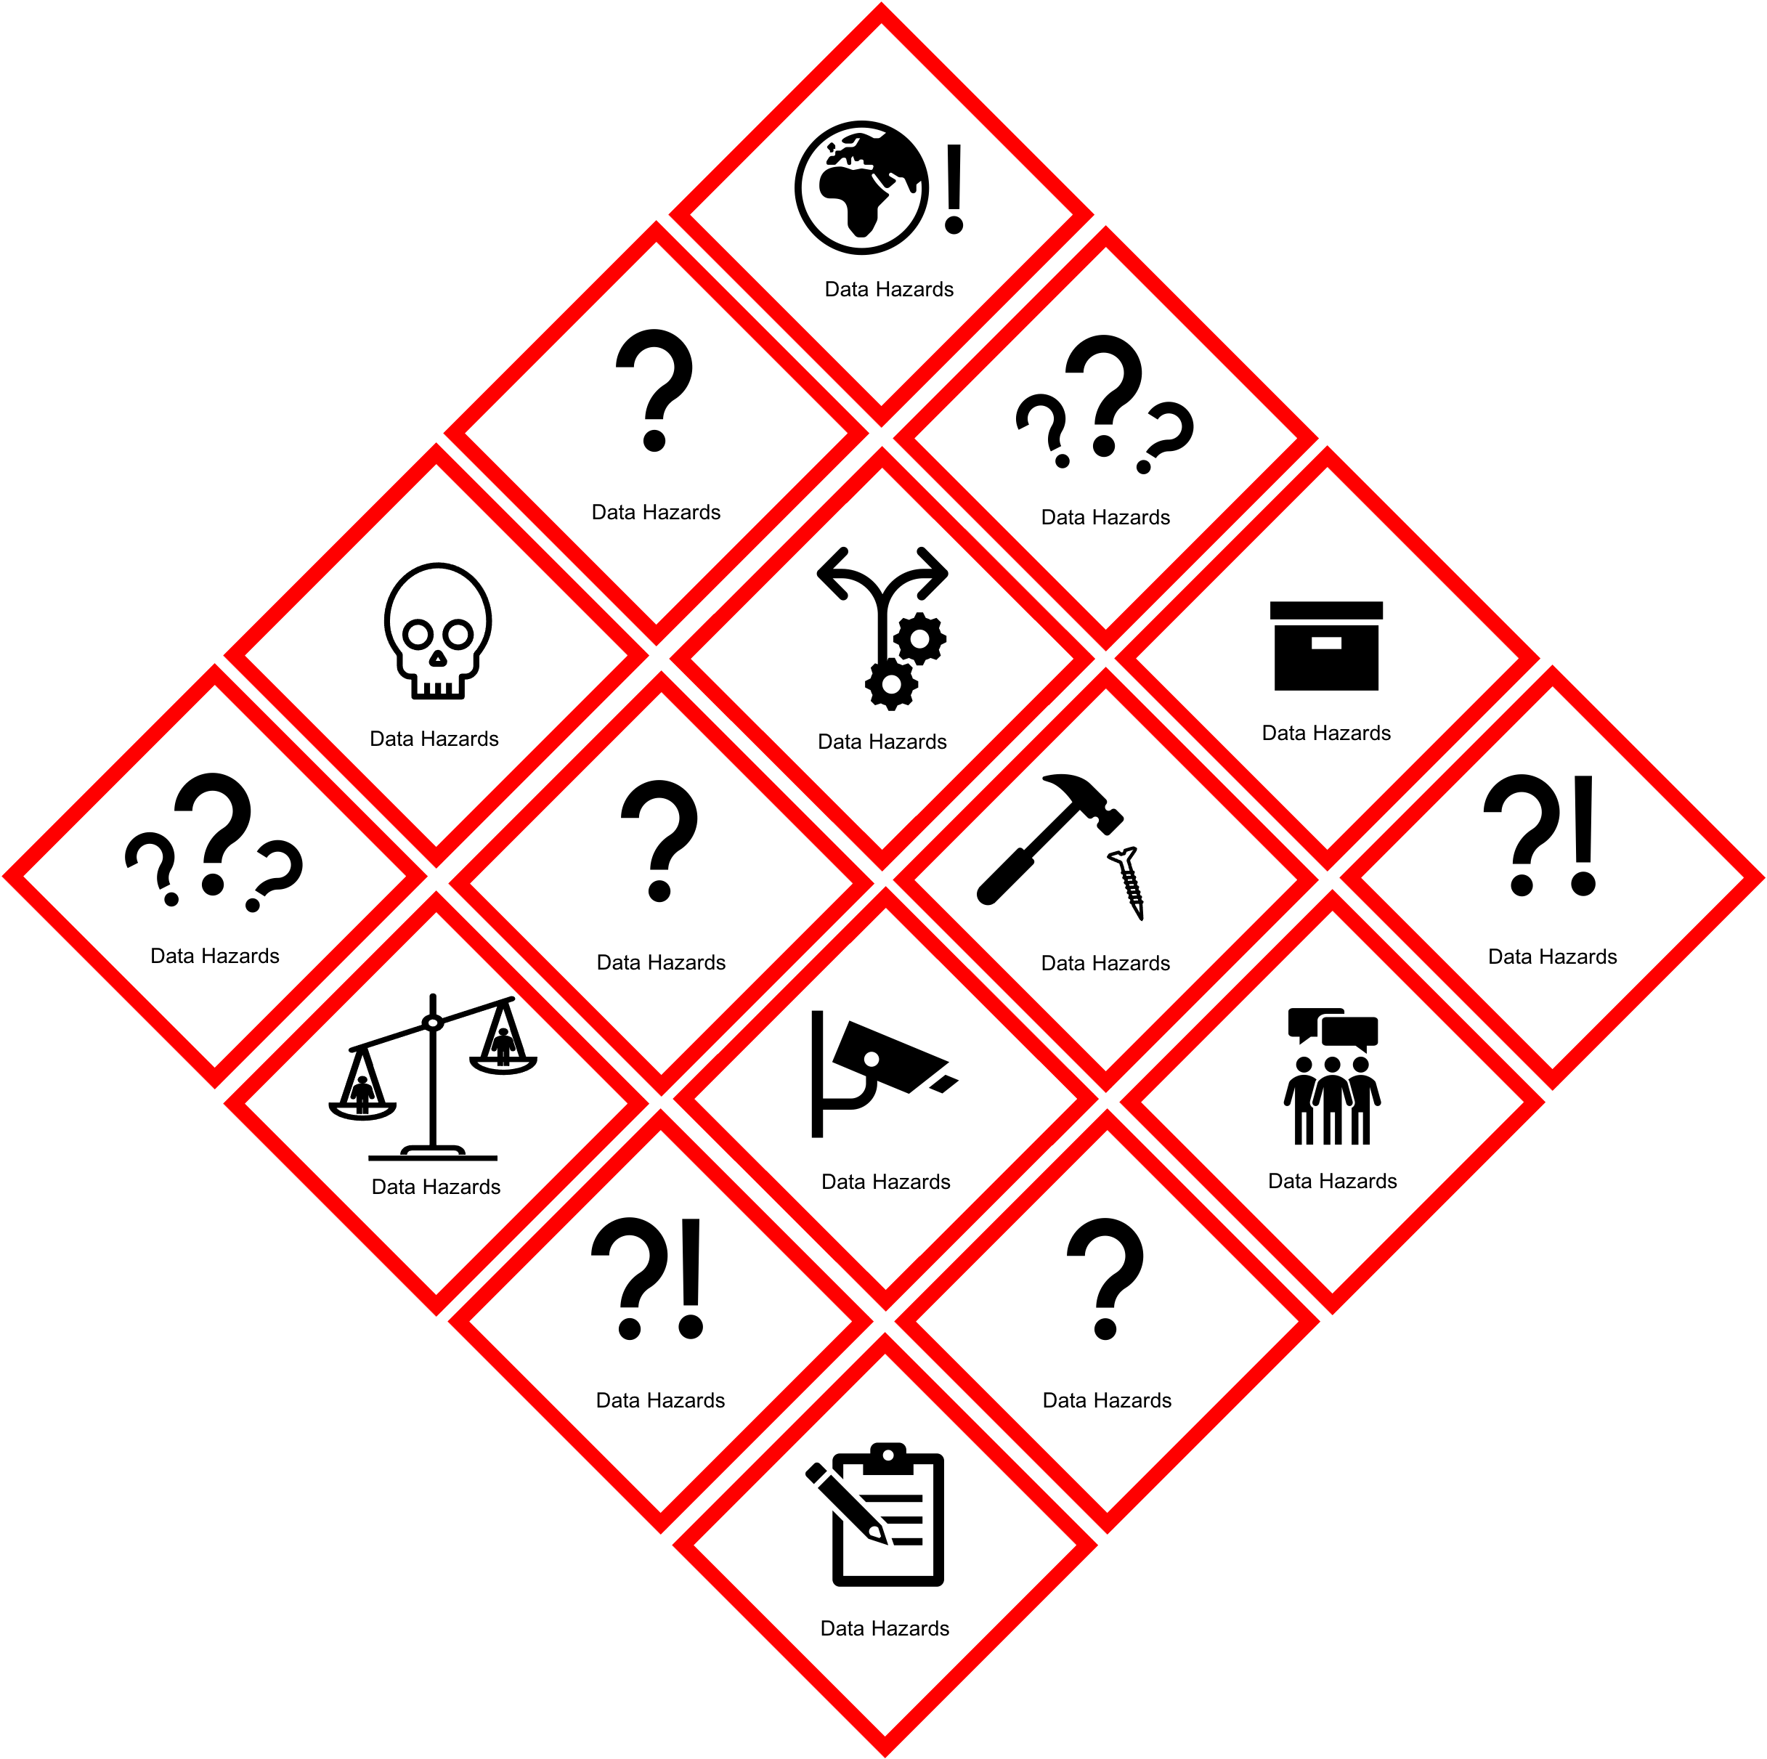

Slide 6
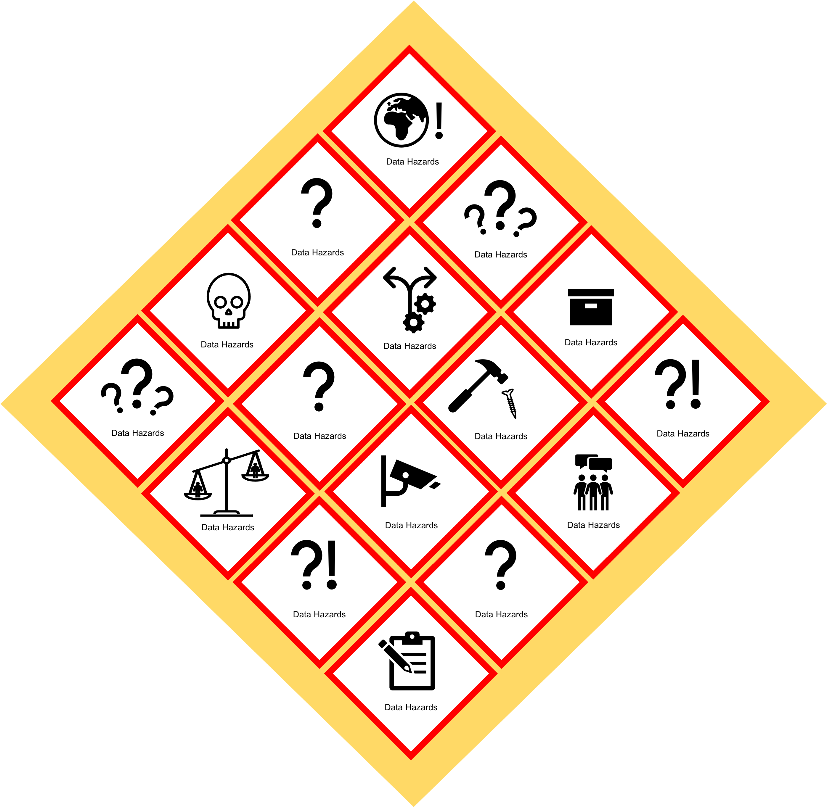
Data Hazards

Slide 7

Danger of misuse

