Slide 1

Facilitating responsible participation in data science
Welcome Meeting
January 29th 2021

Slide 2
(Informal) Agenda
Introductions
About the SIG
Possible Topics & Projects
Ways of Working
Future Meetings
AoB

Slide 3
Introductions

Slide 4
About the Special Interest Group

Slide 5
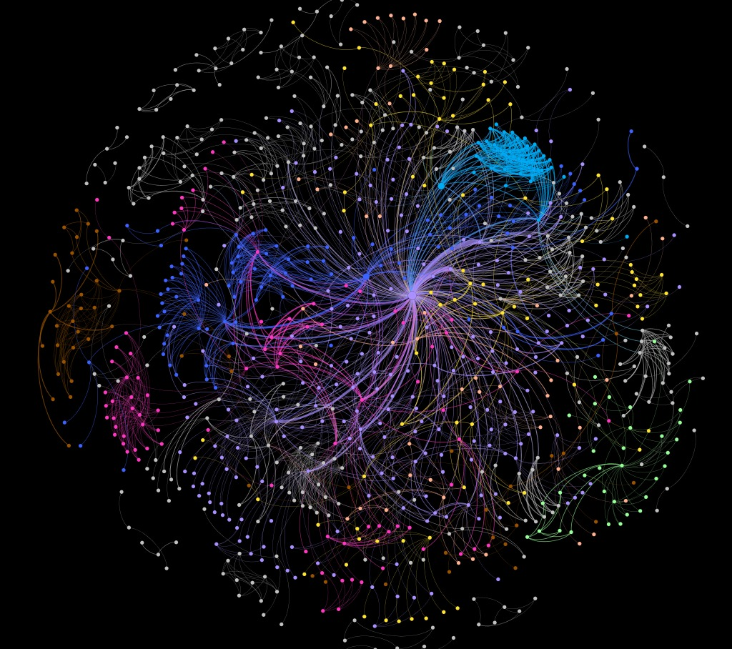
About the SIG
The primary aim of this special interest group is to understand better the needs and demands of different groups of users and stakeholders to ensure fair treatment from and access to the development of data-driven technologies, in particular for safety critical services and technologies (e.g. healthcare) or in public sector organisations that are responsible for socially significant decision-making (e.g. geolocation services).

Slide 6
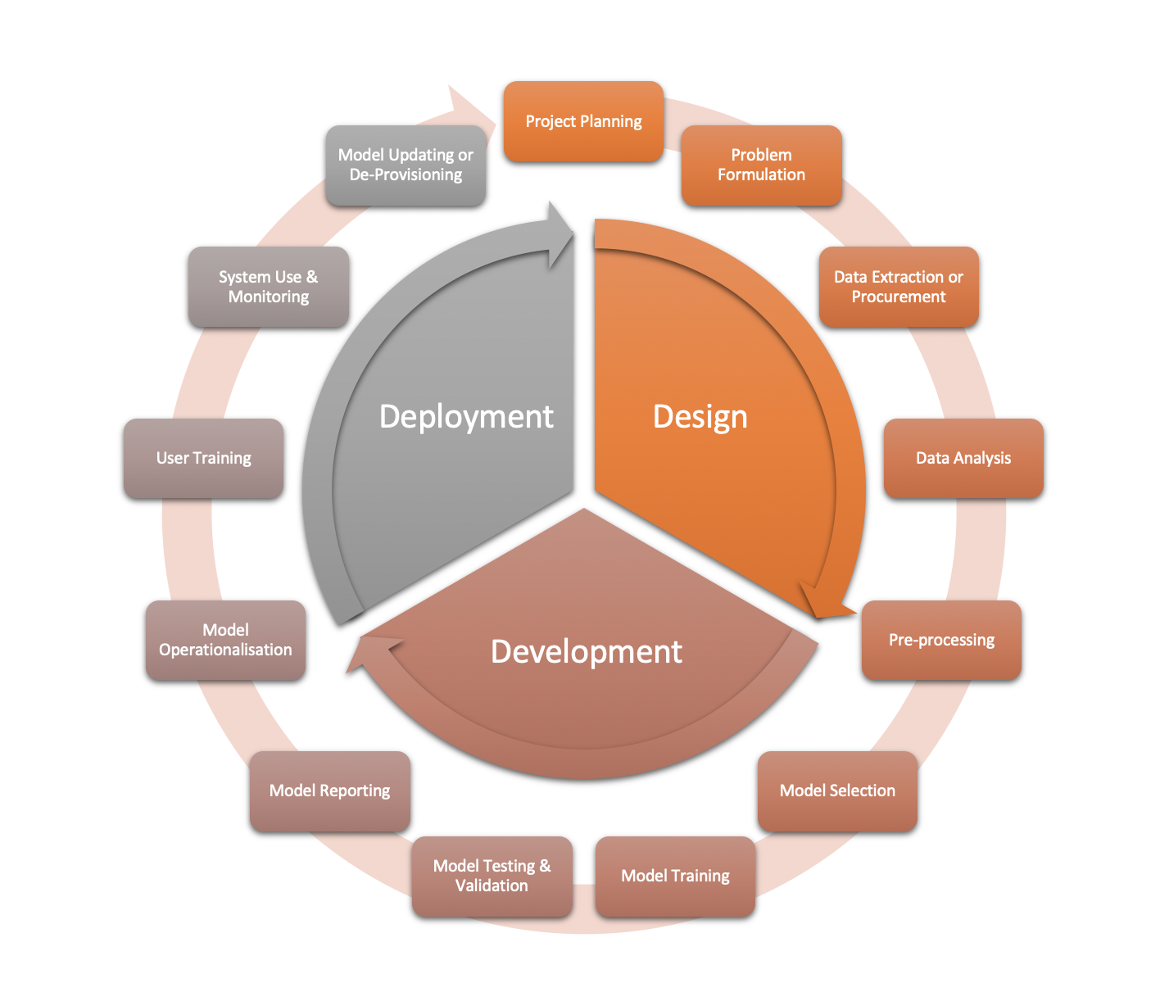

Slide 7
Possible Topics & Projects

Slide 8
Questions
What guidance do we need to have in place to ensure that stakeholder participation is meaningful, effective, and inclusive?
How does biased participation, as reflected in data-driven technologies and services, affect and alter our understanding of society and the environment?
Can we identify and understand the underlying barriers to participation from missing or biased data?
What are the ethical implications of addressing these scientific and sociotechnical concerns?
https://www.turing.ac.uk/research/interest-groups/facilitating-responsible-participation-data-science

