Slide 1
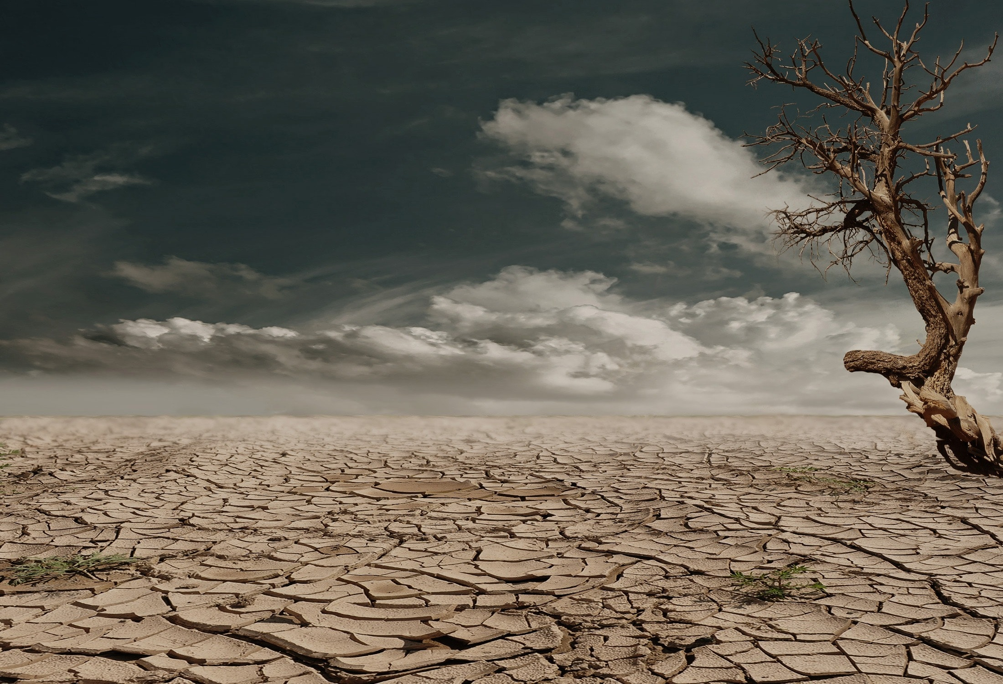
Talan Global Hackathon 2023 Project
Team 16 - Climate Wavers

Slide 2
Team Members:
1.Wesonga Hassan - Backend Engineer
2.Salawu Joseph - Backend Engineer
3.Ismael Kiprop - Backend Engineer
4.Abdulqoyyum Aileru - Fullstack Engineer / Penetration Tester
5.Alan - AI Engineer

Slide 3
Executive Summary:
In the face of escalating climate change impacts and the increasing frequency of natural disasters, our project harnesses the power of AI and data analytics to revolutionize disaster response strategies. By integrating real-time data from diverse sources such as satellites, climate stations, and social media feeds, our solution provides a cutting-edge platform for proactive disaster management and climate change mitigation. Climate Wavers aims to address this urgent need by developing an AI-driven social media platform for climate change monitoring, community engagement and disaster response.

Slide 4
How Climate Wavers Effectively Address Disaster Response
Prevention:
Climate Wavers can contribute to prevention efforts by:
Predictive Analysis: Utilizing machine learning algorithms to predict climate patterns and potential disasters and signs from users and climate experts in the area can help authorities and communities prepare for impending events
Early Warning Systems: Implementing real-time monitoring and alert systems to notify users and communities in the areas at risk, allowing timely evacuation and preventive measures
Mitigation:
To mitigate the impact of disasters, your project can:
Risk Assessment: Analyzing historical and real-time data from climate wavers to identify high-risk areas, enabling targeted mitigation strategies and infrastructure improvements.
Climate Change Adaptation: Offering insights into long-term climate trends, assisting policymakers in crafting strategies to adapt to changing environmental conditions.
Preparedness:
Climate wavers can enhance preparedness by:
Community Engagement: Our AI chatbot involving local communities through crowdsourced data, raising awareness, and educating them about disaster risks and preparedness measures.
Training Simulations: Our AI chatbot and climate expert on our web application can create virtual training scenarios for emergency responders and communities, enhancing their preparedness for various disaster scenarios.
Response:
During the response phase, climate waverst can assist:
Real-time Monitoring: Providing real-time data feeds to emergency responders, enabling them to monitor disaster situations and respond swiftly to changing conditions.
Resource Allocation: Utilizing predictive analytics to forecast resource needs, ensuring efficient allocation of emergency services and supplies to affected areas.
Recovery:
In the recovery phase, climate wavers can support:
Damage Assessment: Using AI to assess infrastructure damage from data like images and videos from users and communty groups in the affected areas, helping authorities prioritize recovery efforts and allocate resources effectively.
Community Support: Creating platforms for affected communities to communicate their needs, fostering collaboration in recovery efforts and ensuring a more targeted response.
By addressing these aspects of emergency and disaster management, your project acts as a comprehensive, intelligent system that empowers both authorities and communities, making the entire disaster management process more proactive, efficient, and community-oriented.

Slide 5
