Slide 1


Slide 2


Introduction about my yourself
Past
present
future covering the University career
Personal Job aspirations
How I discovered the Data Analysts course with ZTQ

Slide 3



Brief explanation of the experience on the course
What I have learned.
What I have enjoyed.
Overall experience of the course

Slide 4

Experience on each of the modules in the course
Presentation Skills
Project Management
SQL
Statistics
Python
Power BI
Quality Assurance
RPA

Slide 5
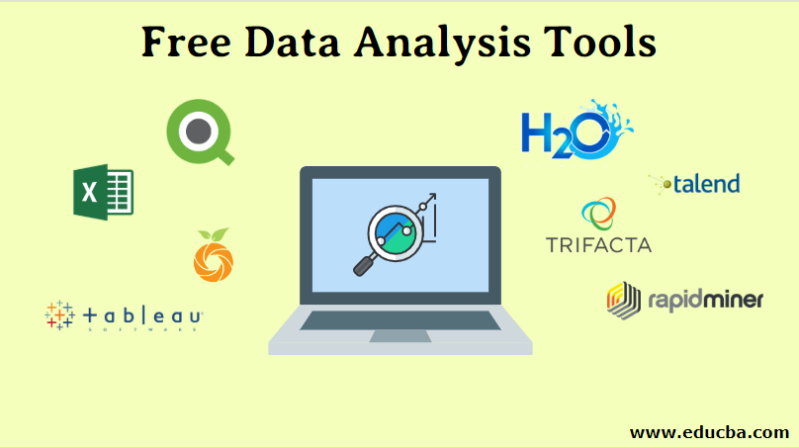
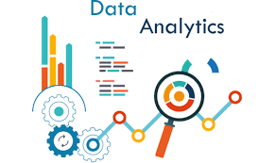
Benefits of course and how is it going to help as a Data Analyst.
Enhanced Skill Set
Data Handling Proficiency
Problem-Solving Skills
Data Visualization Mastery
Informed Decision-Making
Industry-Relevant Tools

Slide 6


Displaying the project plan
The Gantt chart for the Summative assessment
Explaining the approach of doing all the assessments.
Time

Slide 7

Introducing the show case web site and demonstrate how to access it and use it.
How access to the website.

Slide 8

Demonstrating every Output of the summative assessment using the show case web site.
Project Plan (On click up)
Presentation skills
SQL
Statistics
Python
Power BI
Quality Assurance
RPA

Slide 9
Conclusion
THANK YOU

