Slide 1
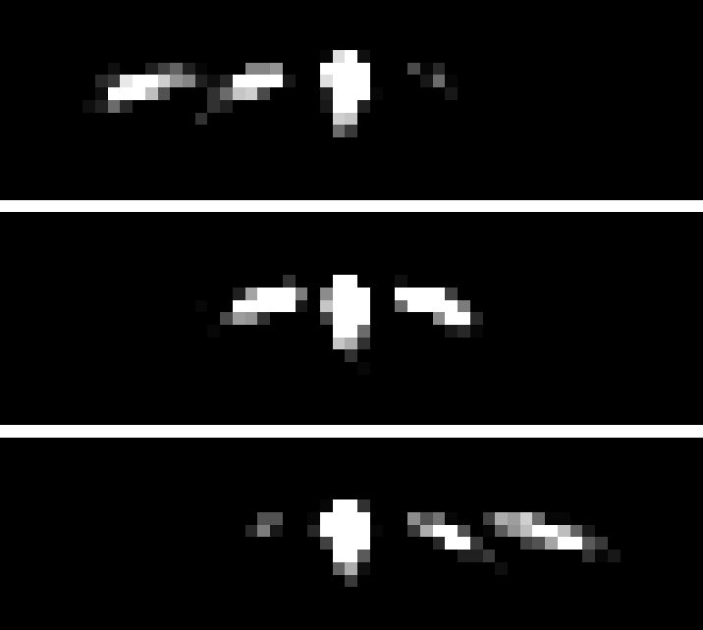

ANALYSIS OF NEUTRON DIFFRACTION BY OPTICALLY THIN GRATING
Student:
Ismaele Vincent Masiello
Supervisors:
Simon E. Wall¹
Jürgen Klepp²
¹Department of Physics and Astronomy, University of Aarhus, Ny Munkegade, Building 1520, DK-8000 Aarhus C, Denmark
²University of Vienna, Faculty of physics, Boltzmanngasse 5, 1090 Vienna, Austria

Slide 2
INTRODUCTION

Slide 3
NEUTRONS

Slide 4
HOLOGRAPHIC GRATING

Slide 5
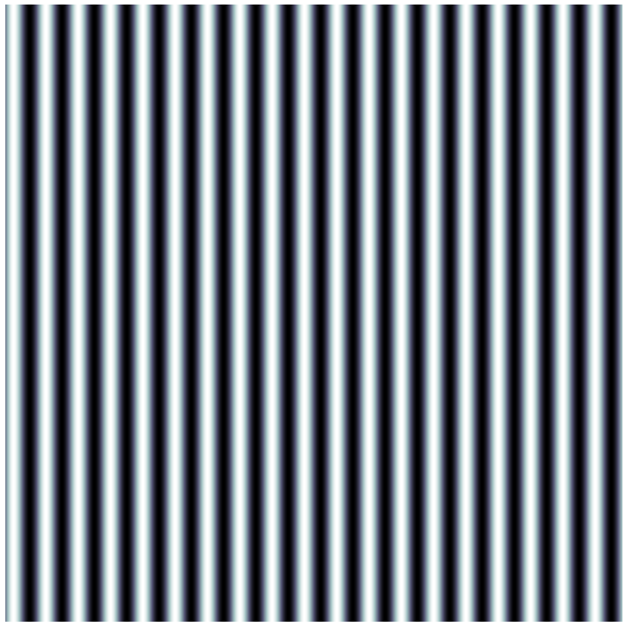
DIFFRACTION EXPERIMENT
-2
-1
Incoming
beam
0
1
θ

Slide 6
OPTICALLY THICK/THIN GRATINGS
. . .
-2
-2
-1
-1
Incoming
Incoming
beam
0
beam
0
1
. . .

Slide 7
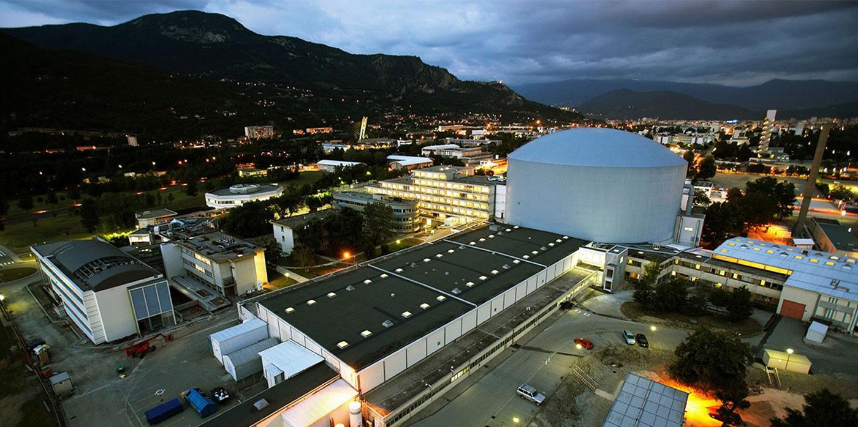
THE DATA

Slide 8
THEORY

Slide 9
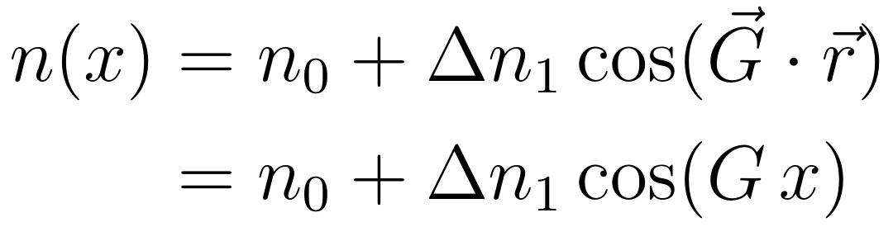
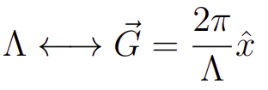
HOLOGRAPHIC GRATING
d
REFRACTIVE INDEX PROFILE
Incoming
beam
z
x

Slide 10
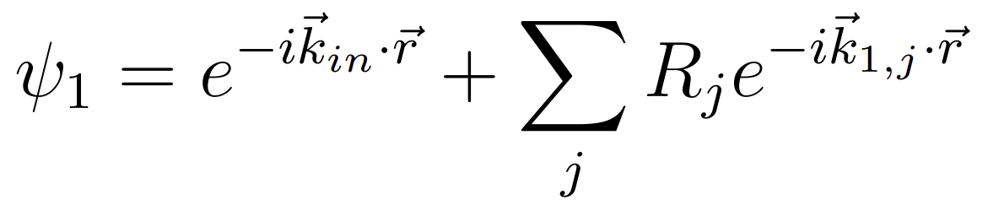
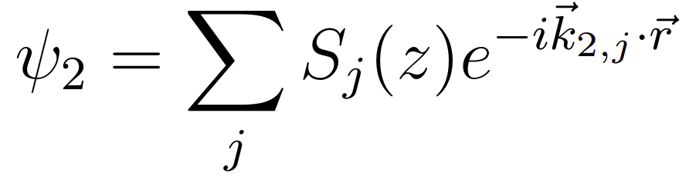
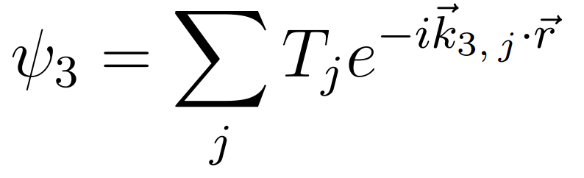
REFRACTIVE INDEX PROFILE
Region
1
Region
2
Region
3
Forward
diffracted
waves
REFRACTIVE INDEX PROFILE
REGION 1
. . .
. . .
-2
-2
-1
-1
REGION 2
0
0
z
+1
+1
. . .
. . .
Backward
diffracted
waves
REGION 3
x

Slide 11
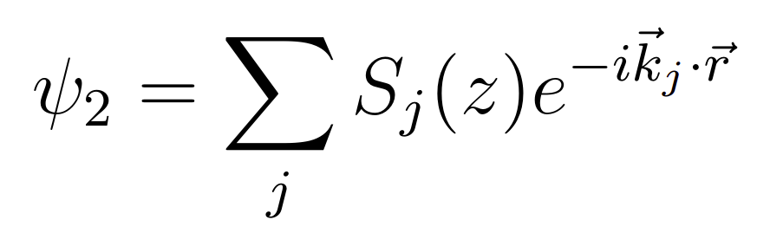
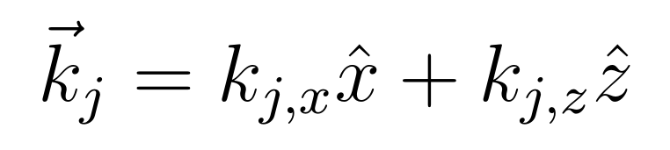
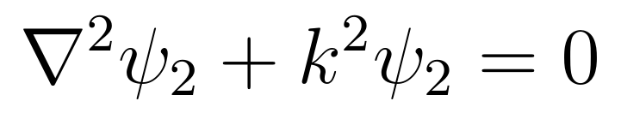
REGION 2
TIME INDEPENDENT WAVE EQUATION

Slide 12
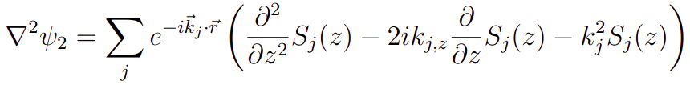
REGION 2
TIME INDEPENDENT WAVE EQUATION

Slide 13
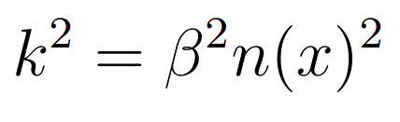
REGION 2
TIME INDEPENDENT WAVE EQUATION
REFRACTIVE INDEX PROFILE

Slide 14

REGION 2
TIME INDEPENDENT WAVE EQUATION

Slide 15

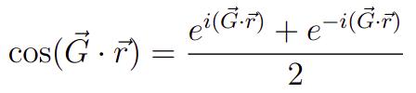
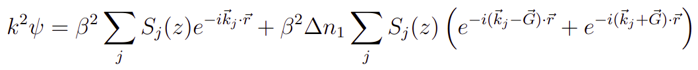
REGION 2
TIME INDEPENDENT WAVE EQUATION

Slide 16
REGION 2
TIME INDEPENDENT WAVE EQUATION

Slide 17
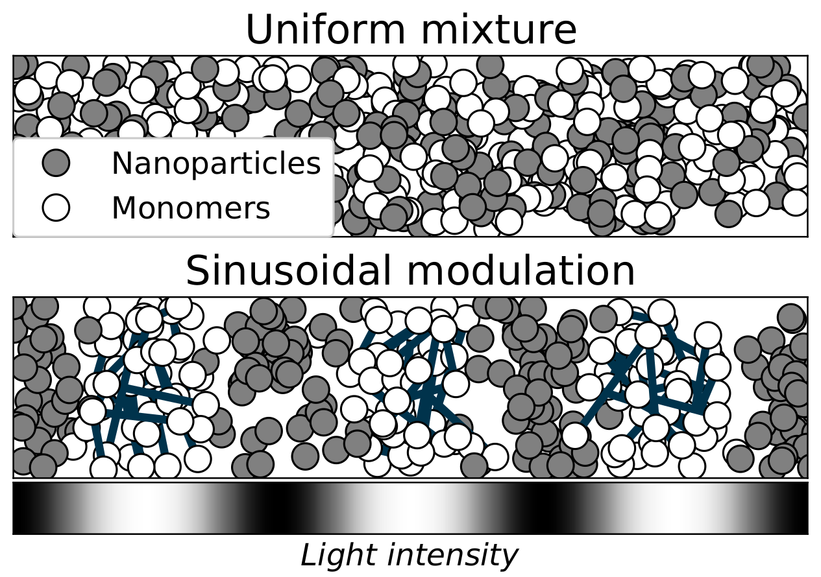
HOLOGRAPHIC GRATING

Slide 18
HOLOGRAPHIC GRATING
Grating period (Λ) | Thickness (d)
0.5 μm | 78 μm

