Slide 1
FETAL HEALTH
CLASS MODELING

Slide 2
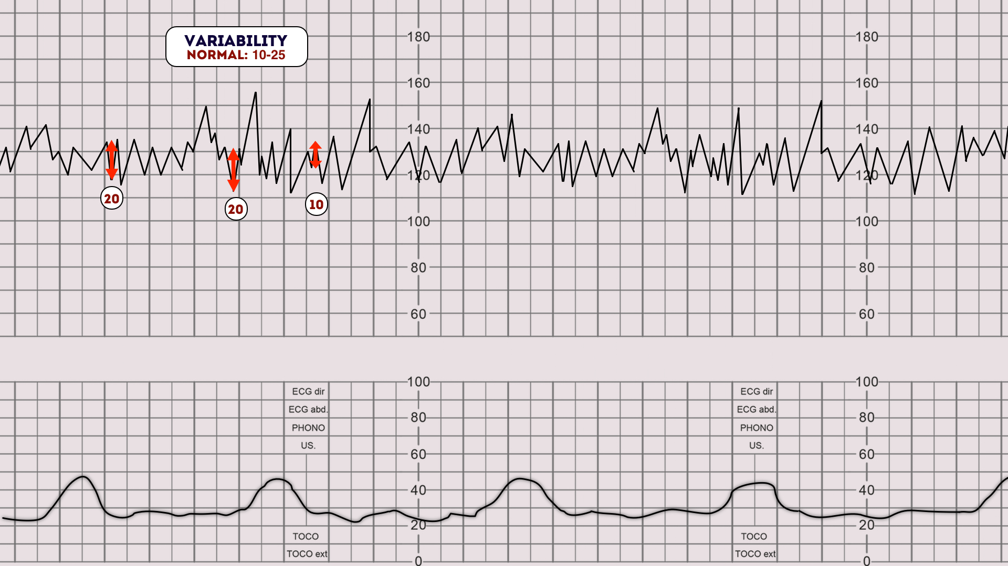
Prevent child mortality
Not everyone has access to technology
CTGs scans are cost effective and widely spread
Eliminate erroneous surgical intervention
Overview

Slide 3
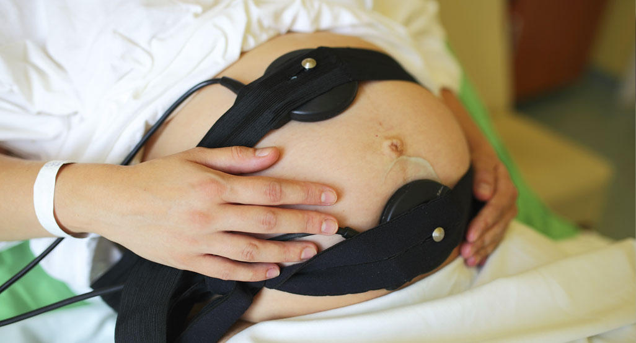
CTG scans are currently interpreted via visual analysis by the physician, and erroneous errors may increase fetal health risk
Business
Problem

Slide 4
What, if any, new features affect the model?
What feature coefficients have the greatest influence on the model?
Business
Questions
Which model makes the best predictions of fetal health class?

Slide 5
From Kaggle
Program for Automated Analysis of Cardiotocograms
It has 2,126 rows and 22 columns
Target variables were healthy and distressed
CTG Metrics
Data
Citation: Ayres de Campos et al. (2000) SisPorto 2.0 A Program for Automated Analysis of Cardiotocograms. J Matern Fetal Med 5:311-318

Slide 6
01
Exploratory Data Analysis
01
Vanilla Modeling Process
Methods
03
Experimental Modeling Process
03
Logistic Regression, KNN, Decision Tree, Random Forest, Grid Search, and XGBoost
03
Changed target class label into binary fetal health class

Slide 7
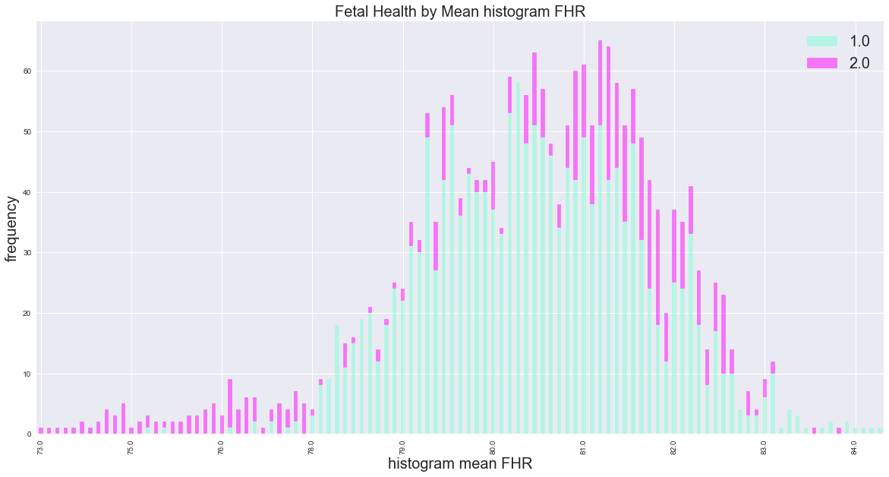
EDA
01
Depth analysis of features and relations with other features and the target class
03
Our baseline models performed well even without feature engineering
03
Feature engineering for experimental model

Slide 8
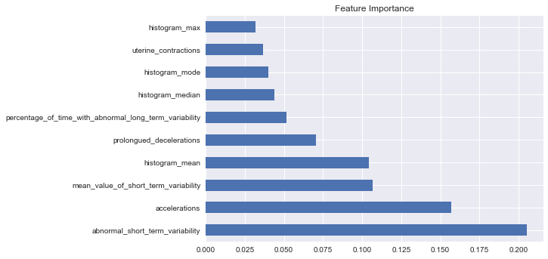
Vanilla Modeling Process
Takeaways
Unmodified dataset
Our baseline models had a good performance
Grid Search Random Forest had the best performance
Evaluation Metrics:
Accuracy: 0.9605
Recall: 0.9755
F1 Score: 0.9743
Precision: 0.9731

Slide 9
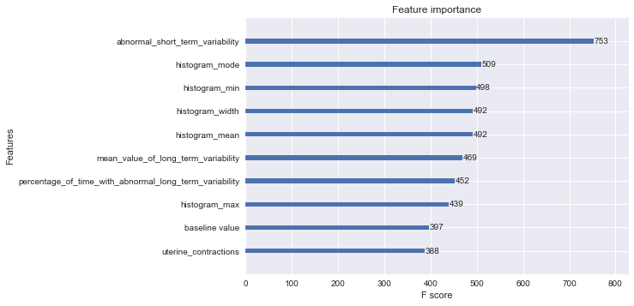
Experimental Modeling Process
Takeaways
Feature engineering in the dataset
We were able to improve our models even more
XGBoost Random Forest had the best performance
Evaluation Metrics:
Accuracy: 0.9661
Recall: 0.9902
F1 Score: 0.9782
Precision: 0.9665

Slide 10
Vanilla and Experimental Model Evaluation
XGBoost Grid Search was the overall best model
Lowest recall and the a very high precision score
Random Forest Grid Search performed well, but XGBoost Random Forest had a better Recall
Final Model Evaluation
Random Forest
Grid Search Metrics:
Accuracy: 0.9605
Recall: 0.9755
F1 Score: 0.9743
Precision: 0.9731
XGBoost Random
Forest Metrics:
Accuracy: 0.9661
Recall: 0.9902
F1 Score: 0.9782
Precision: 0.9665

Slide 11
Most Important CTG Metrics
Abnormal short term variability
Histogram mode
Histogram mean
Histogram width
Histogram min
Our identified key features are the same features that doctors look for during a visual analysis. Because our model is so precise, we can be confident that our model will predict the class at a better rate than the visual analysis, eliminating human error.
Conclusion
Final Conclusion

Slide 12
Make a multiclass prediction for fetal health
Find a larger dataset
Consider maternal health and other diagnostic metrics into the model (heart rate, oxygen level, what anesthetics are used, etc.)
Next Steps

