Slide 1


Approach Notes
PCD
Forex Dashboard

Slide 2
Contents
1
Overview of the use-case
2
PCD Demo
3
Architecture
4
Timelines
5

Slide 3
Overview of the use-case
Forex dashboard
Problem statement
PCD
FX Operations teams receive margin change requests (e.g., create new margin tiers or update existing ones, validate outputs), they currently rely on manual entry in PCD/Excel.
This process is slow (4+ hours per request), repetitive, and prone to human error.
Multiple layers of validation are required, which increases turnaround time.
Solution : PCD tool
PCD
A self-service Streamlit app where Ops teams can:
Upload a mapping file with currencies, tiers, and segments.
Automatically create new currency margins in bulk (instead of row-by-row).
Update existing margins with multiple options (flat replacement, % increase/decrease, bid-point adjustment).
Generate validation reports (soft checks + optional NLP hard validation).

Slide 4






Architecture
Local Installation
Cloud Deployment
Advantages
Faster setup & execution – Runs directly on the user’s machine without dependency on cloud infra.
No internet dependency – Can function in secure/internal environments without exposing data outside.
Lower upfront cost – No cloud hosting, storage, or compute charges.
Challenges
No central logging/monitoring – Each user’s logs stay local, making governance & audit trails harder.
Technical limits – User has to install and run the tool using scripting
Advantages
Centralized logs & monitoring – Every margin creation/update action is logged, ensuring governance and audit compliance.
Scalability & availability – Cloud resources auto-scale for multiple users or large data loads.
Collaboration & access – Multiple Ops & Governance team members can use the same tool from anywhere.
Challenges
Higher cost – Ongoing charges for compute, storage, and logging infrastructure.
Singapore
UAE
Expat
Singapore
UAE
Expat
MYH

Slide 5
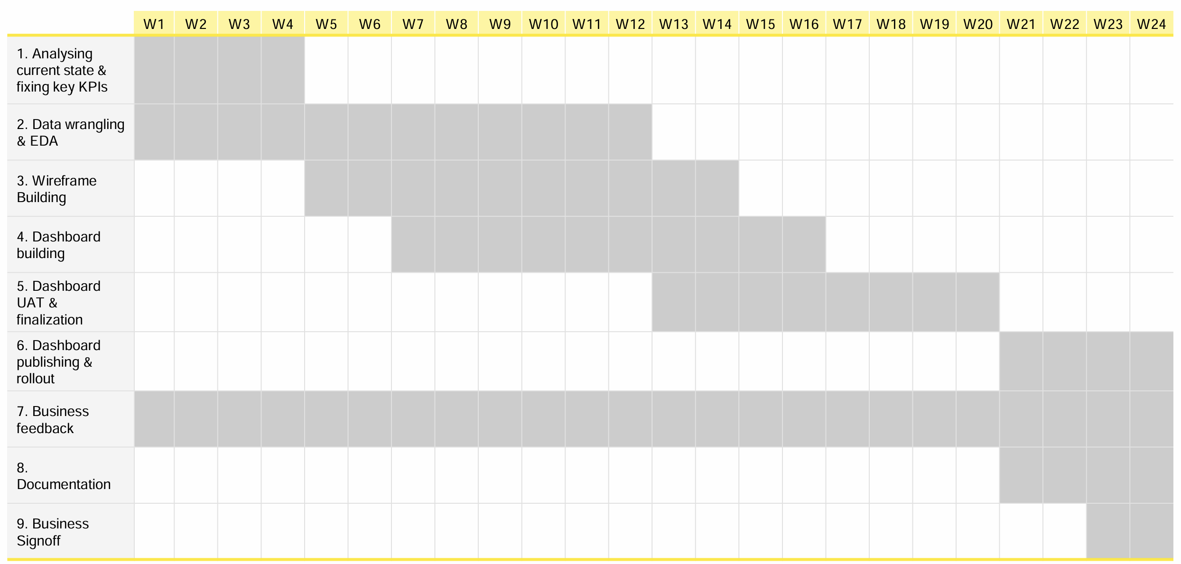
Timelines
Forex dashboard

Slide 6
Contents
1
Overview of the use-case
2
Business usage
3
Data collection & dependencies
4
Approach & Methodology
5
Timelines

Slide 7
Overview of the use-case
Forex dashboard
Use-case objective
Forex dashboard
Analysis of factors driving forex revenue growth
Identification of type and proposition of customers for interventions to identify and track growth based on customer behavior
Target KPIs & Key benefits to business
Forex dashboard
Connect the big picture of revenue to the nitty-gritty details of customer behavior, transaction patterns, and margins. And eventually, it will also helps determine our next steps using advanced forecasting through a Machine learning model.

Slide 8
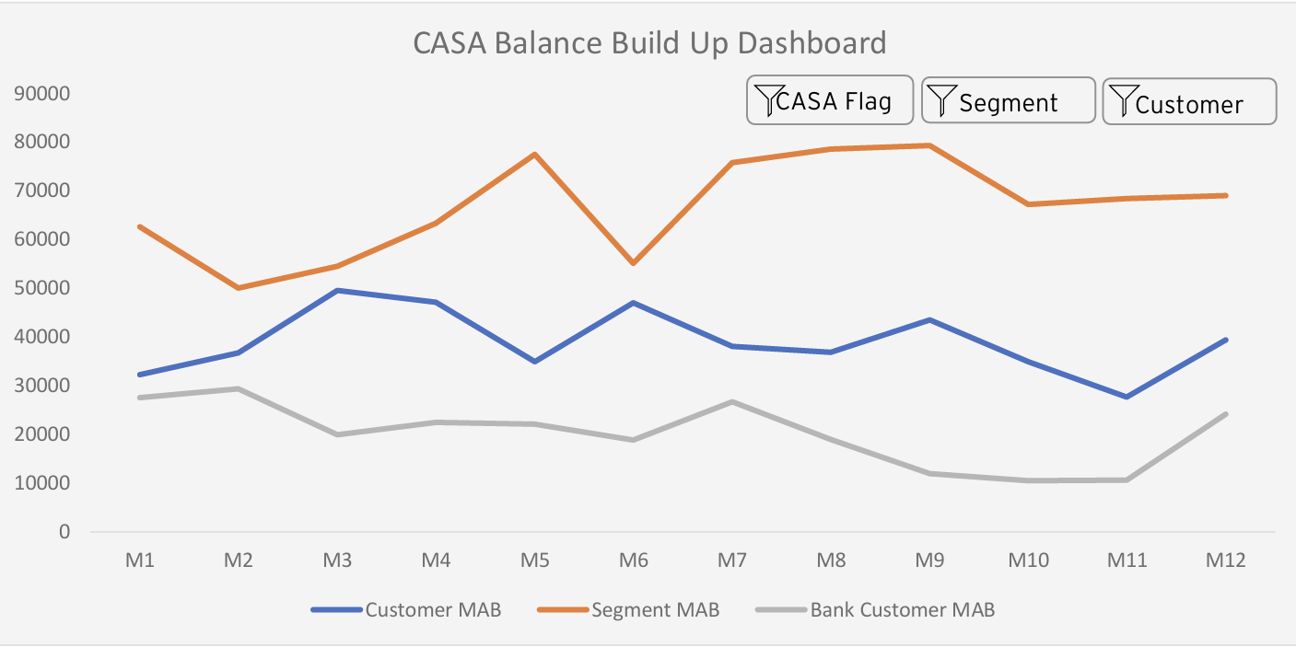
Business usage
Forex dashboard
Fx Dashboard :View Description
Product manager has the option to select on Market (say CIIOM Expat in this case)
Given customer segmentation will flow as an input, this Premier and Non-Premier will be distributed into different segments of Existing to bank and New to bank Customers

Slide 9
Data collection & dependencies
Forex dashboard
Transaction details
Customer details
Currency Margins details
Value and Volume of transactions
Branch and Digital transaction
Type of customers Premier, Non-premier or Top-Tier
Transaction falling different buckets of transactions amount
Customer demographics
Account vintage
Customer holdings
Spends analysis
Price change details
Margins for different types of customer
Margins on channels
Margins on products
Campaigns based price details
NOTE: This is illustrative and non-exhaustive and final list of variables to be used will be arrived after deriving insights from data, data availability and inputs gathered through business workshops

Slide 10
Approach & Methodology : EDA
Forex dashboard
Basic EDA
Customer details
Channel details
Basic EDA of Existing Data
Variable distributions for key metrics:
Revenue, Number of Transactions, Transaction Value, Average Ticket Size, Take Rate, Margin Rate.
Missing value rates across customer segment, proposition, channel, and currency pair.
Detect outlier/anomalous values: unusually large transactions, negative spreads, zero revenue cases.
Time consistency checks: ensure no gaps or duplicates in dates.
2. Customer Segmentation & Proposition Analysis
Distribution of customers across Premier vs Non-Premier segments.
Distribution across ETB-ETP, ETB-NTP, NTB-NTP categories.
Identify active vs dormant customers based on recent transaction activity.
ATS (Average Ticket Size) patterns across propositions and customer segments.
Growth comparison: MoM and YoY revenue contribution by each customer type.
3. Channel Usage Analysis
Volume and value of transactions split by Digital vs Branch channels.
% of all FX transactions performed digitally.
Trend analysis of digital adoption vs branch reliance over time.
Compare average transaction size & margin rate across channels.
Identify channel-product alignment (e.g., higher-value deals done via branch vs self-service digital).

Slide 11
Approach & Methodology : EDA
Forex dashboard
Currency analysis
Tiers analysis
Trend Analysis
4. Currency Pair Analysis
Distribution of transactions across currency pairs (USD/INR, EUR/INR, etc.).
Revenue contribution by each currency pair.
Margin Rate differences across pairs.
Detect anomalies: sudden spikes/drops in specific currency pairs.
Seasonal pattern analysis: peak months for specific currency pairs.
5. Transaction Bracket & Margin Analysis
Distribution of transactions by brackets (0–14K, 14–28K, 28–70K, 70–280K, >280K).
Margin rate comparison across transaction brackets.
% revenue contribution from high-value brackets (>280K).
Outlier check: extreme spreads in small-value transactions.
Identify skewness: are a few large-value deals driving majority of revenue?
3. Channel Usage Analysis
MoM & YoY trends in:
Revenue
Number of Transactions
Transaction Value
Average Ticket Size
Margin Rate
Growth comparison: Premier vs Non-Premier,
ETB vs NTB.
Detect periods of unusual spikes/drops and link to business events (campaigns, macroeconomic changes, product launches).

Slide 12
Timelines
Forex dashboard

