Slide 1


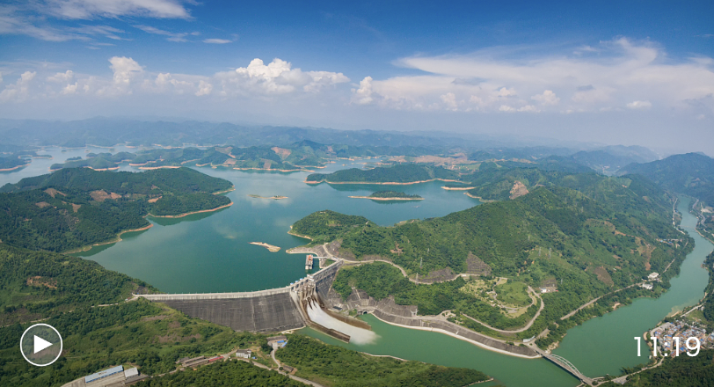

Study on the Optimal Operation of a Hydropower Plant Group Based on the Stochastic Dynamic Programming with Consideration for Runoff Uncertainty
Authors:
Hongxue Zhang, Lianpeng Zhang, Jianxia Chang, Yunyun Li,
Ruihao Long
and
Zhenxiang Xing
You are saying I can manage dams with SDP?!
Lancang River, Yunan, China

Slide 2

Introduction :
Objective: The study aims to find a way to maximize the energy output of the 3 dams along the Lancang river by optimizing the outflow of the big upstream dam: Nuozhadu. (NDZ)
Challenges & Solutions:
Challenge 1: Limited historical data : Researches had access to the natural day runoff and monthly runoff only for 60 years, between 1953 and 2013.
Solution 1: They used a statistical method combining copulas and Gibbs sampling to simulate 5000 years of runoff data. They then compared this simulated data with actual historical records and found that about 72% of the transitions matched the real data. The remaining differences were also close, showing that the simulated inflows were realistic and reliable.
Challenge 2: Inflow is uncertain: Due to variable rainfall, snowmelt, mist, etc.
Solution 2: Researchers used Stochastic dynamic programing to model the uncertainty.
Challenge 3: Solution must respect multiple constraints: ecological flow, navigation (shipping), storage limits.
Solution 3: These constraints were directly incorporated into the SDP model.

Slide 3


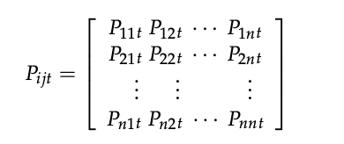

SDP formulation :
States: Reservoir water level at the start of each month
Stages: Months (t=current month).
Decision variable: Reservoir water level at the end of the month (controls outflow)
Random variable: Monthly runoff (= monthly inflow)
Transition function: Based on simulated runoff → transition probability matrix
Bellman equation:

Slide 4
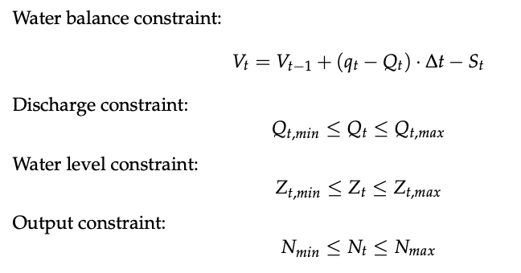
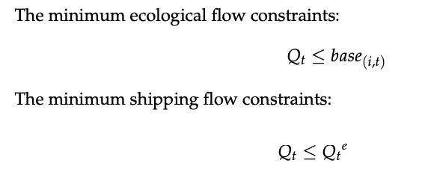

Constraints :

Slide 5
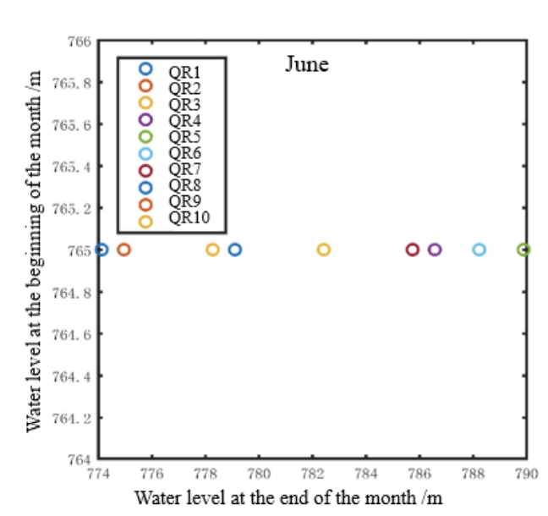
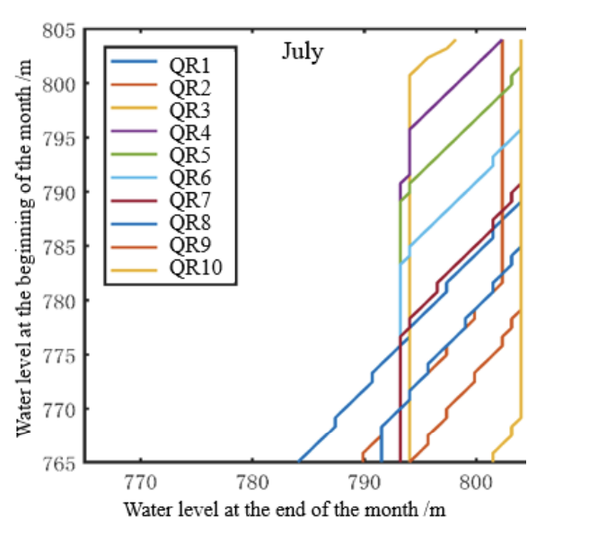
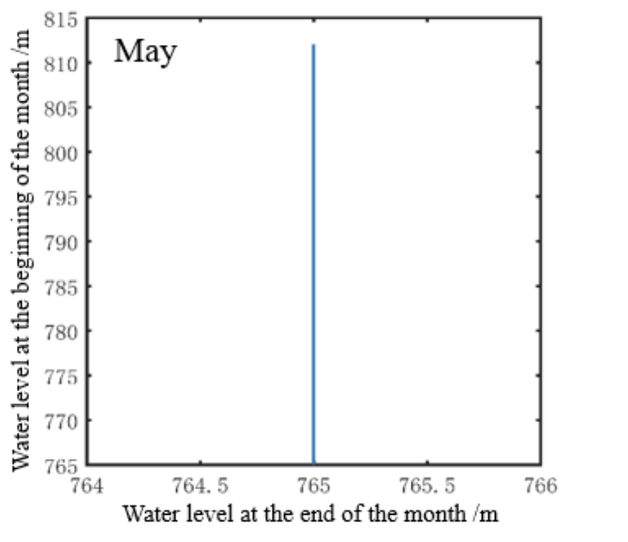
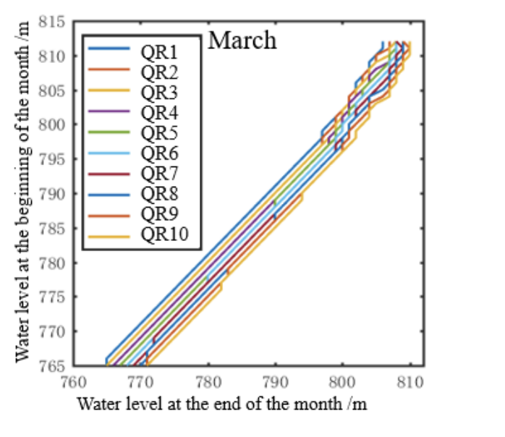
Results :
The optimal policy:
1. The model produces an optimal policy that tells the operator what “end-of-month water level” to aim for.
2. This decision depends on both the starting water level and the runoff category (QR1–QR10).
In wet months (July–September), the policy is more scattered due to high inflow variability, which allow for higher discharge.
In dry months, the policy is more stable and predictable — decisions change smoothly with water level, less discharge, more filling up the reservoir.
Notes:
May is the dead water level+ The incoming runoff in flood season (July to September) was large and unstable, so the curves of the July, August, and September operation diagrams were scattered and irregular

Slide 6
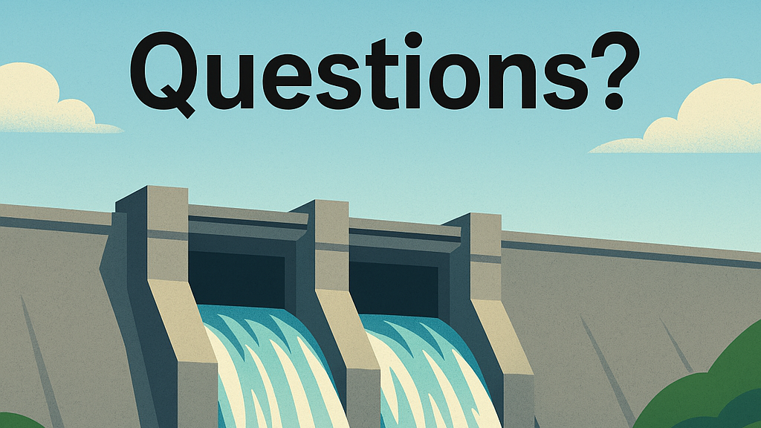


Slide 7
What is a copula?
It is a mathematical function that lets you Model how two (or more) random variables are connected, even if each has a different individual distribution.
Each month’s runoff has its own distribution (log-normal for 8 months). But the amount of runoff in one month depends on the previous month’s runoff.
So, this copula function lets us model the dependency between the months, without changing their individual distributions.
* It converts each month runoff to its cumulative distribution function ->then use a copula function (like Gumbel, Clayton, Frank) to link these two CDF values together.
What is a Gibbs sampling?
Start with some random inflow value for one month.
Use the conditional distribution from the copula to generate the next month.
Repeat this until you have 12 months (one year).
Then start over and do this for 5000 years.

Slide 8
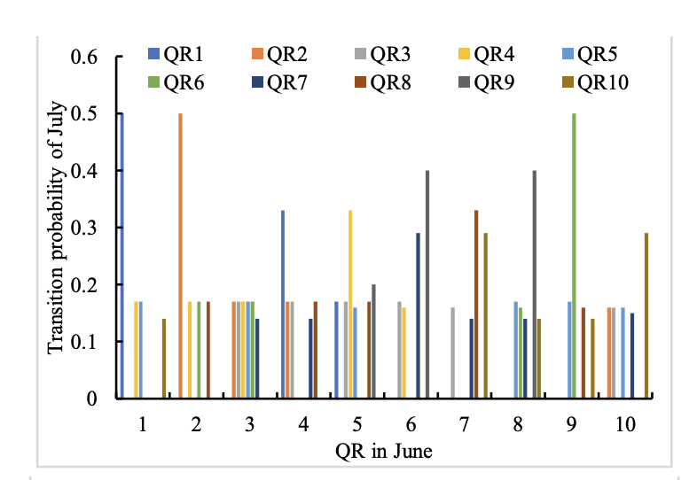
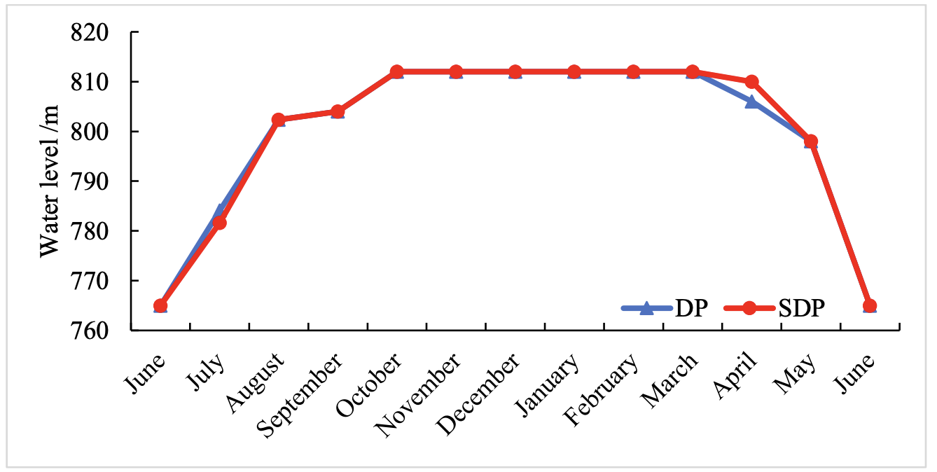
In a normal year, DP is not too far off from SDP. The paper implies though not stated directly, that in NON normal conditions, like an exceptional drought or heavy rain year, SDP will outperform DP.

