Slide 1
TimeCook
Présenté par Ismail HAMAI

Slide 2
Remerciements

Slide 3
Table Des Matières
01
05
02
06
03
07
Contexte
Planification du travail
Problematique
Technologie
Fonctionnalités
Conclusion
04
08
Conception
Demo

Slide 4
Contexte Géneral!
Une application de kit de repas est une plateforme qui fournit aux utilisateurs des ingrédients préportionnés et préparés pour cuisiner des repas à la maison.

Slide 5
Problematique!

Slide 6
“Quels sont les avantages de la cuisine faite maison en termes de santé, de budget et de développement de compétences culinaires, et comment les mettre en avant auprès des jeunes’’

Slide 7
Solution

Slide 8
TimeCook
You can enter a subtitle here if you need it

Slide 9
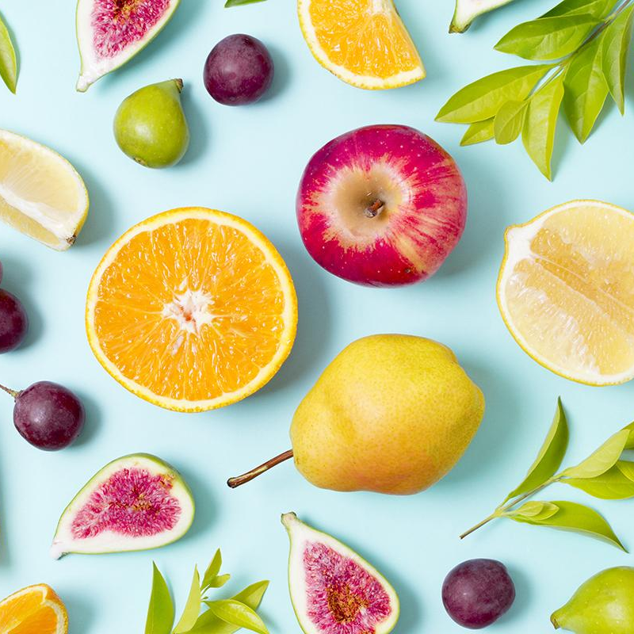
Fonctionnalités
Admin
Client

Slide 10
04
Conception

Slide 11
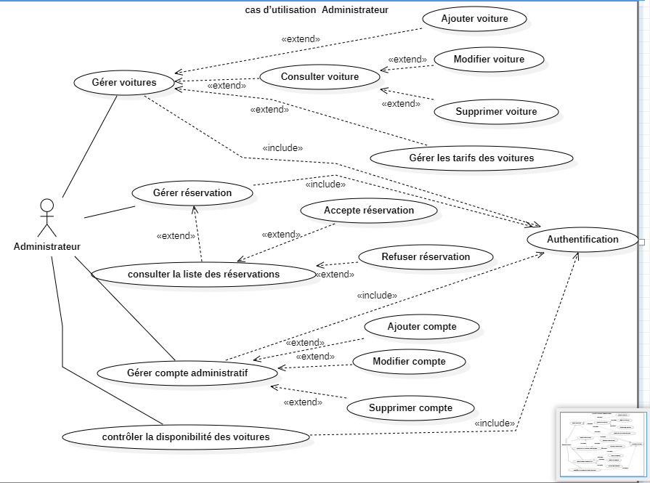
Diagramme de classe

Slide 12
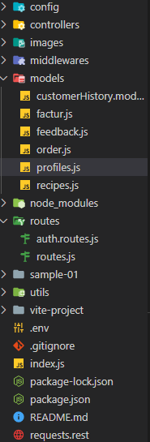
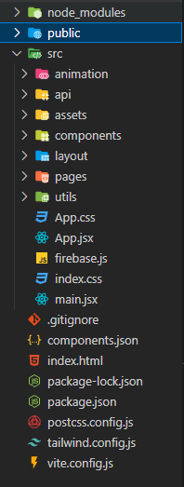
Structure

Slide 13
02
Seasonal fruit
You can enter a subtitle here if you need it

Slide 14
03
Exotic fruit
You can enter a subtitle here if you need it

Slide 15
05
Planificatino
You can enter a subtitle here if you need it

Slide 16
The Slide Title Goes Here!
Do you know what helps you make your point clear? Lists like this one:
They’re simple
You can organize your ideas clearly
You’ll never forget to buy milk!
And the most important thing: the audience won’t miss the point of your presentation

Slide 17
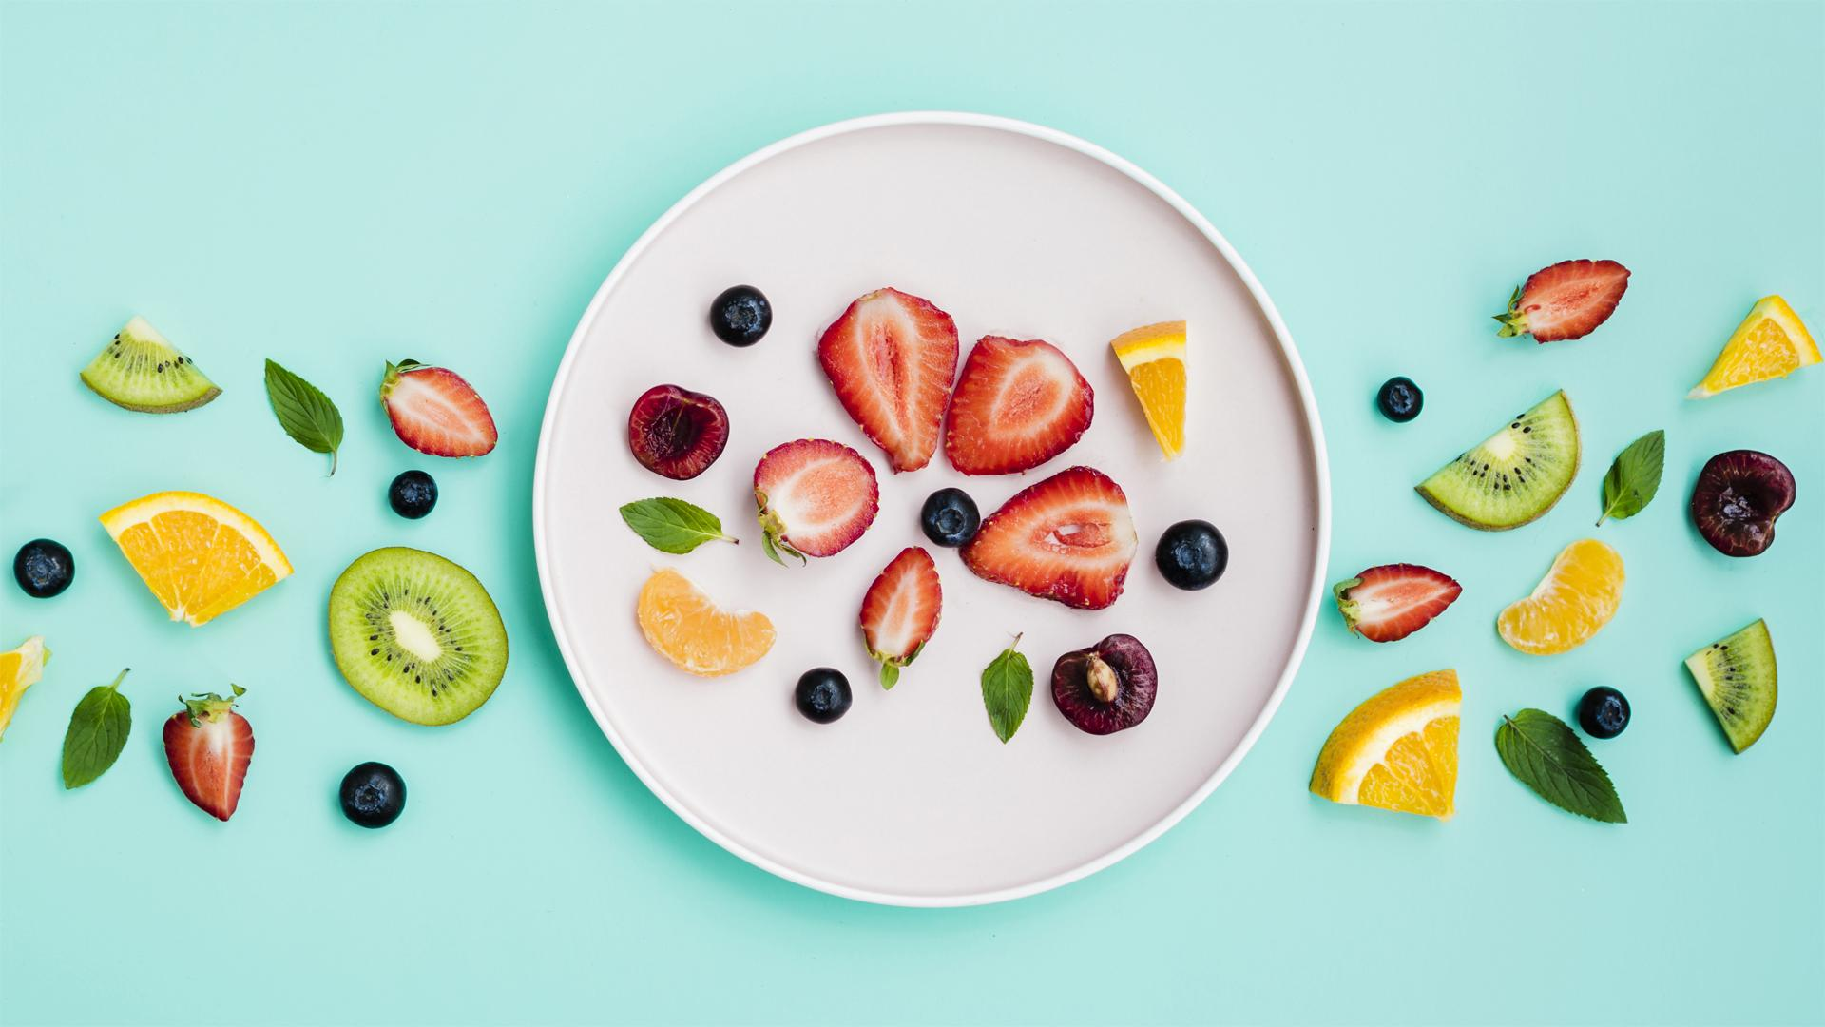
A Picture Is Worth a Thousand Words

Slide 18
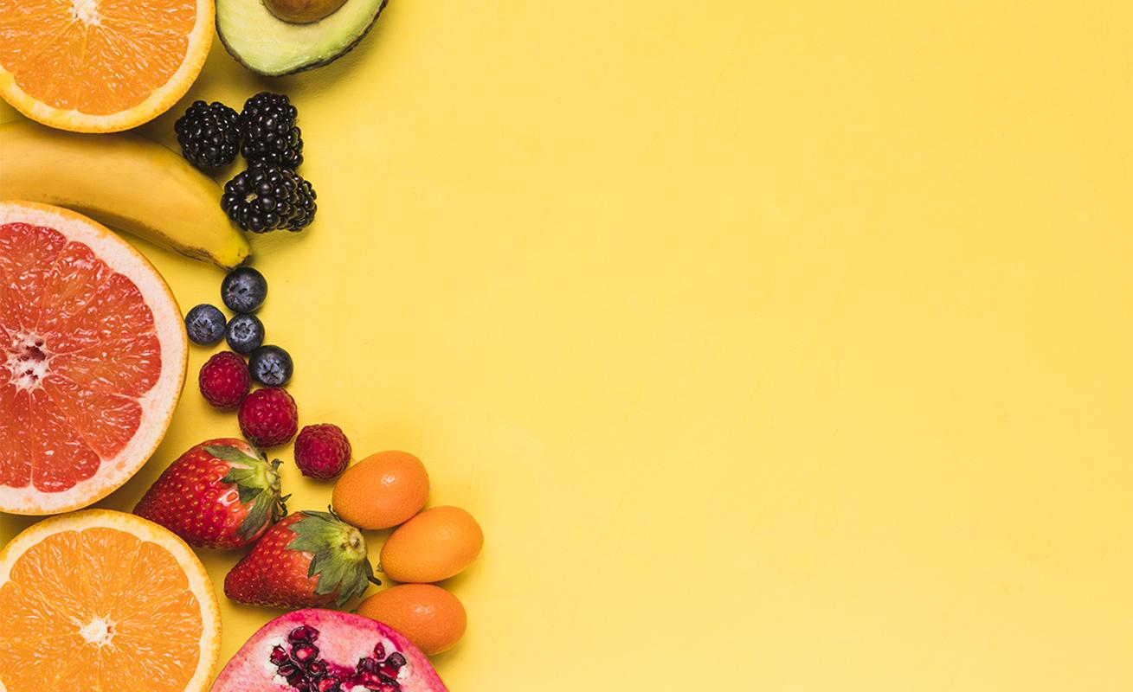
A Picture Is Worth a Thousand Words

Slide 19
This Is a Table
 | ORANGE | APPLE | CHERRY | GRAPE
Breakfast
Lunch
Dinner

Slide 20
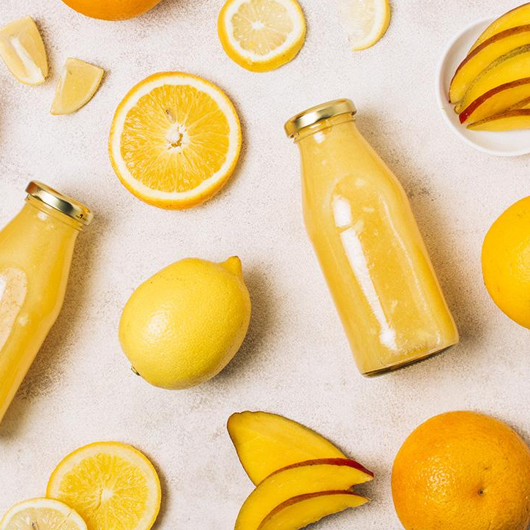
A Picture Reinforces the Concept
Images reveal large amounts
of data, so remember: use an image instead of a long text

Slide 21
How About Three Columns?
01
02
03
MERCURY
VENUS
MARS
Mercury is the closest planet to the Sun
Venus has a beautiful name, but it’s hot
Despite being red, Mars is a cold place

Slide 22
Or Three Vertical Columns?
01
02
03
PAPAYA
Despite being red, Mars is actually a cold place
KIWI
Neptune is the farthest planet from the Sun
COCONUT
Saturn is composed mostly of hydrogen and helium

Slide 23
Awesome Words
Because key words are great for catching your audience’s attention

Slide 24
Awesome Words

Slide 25
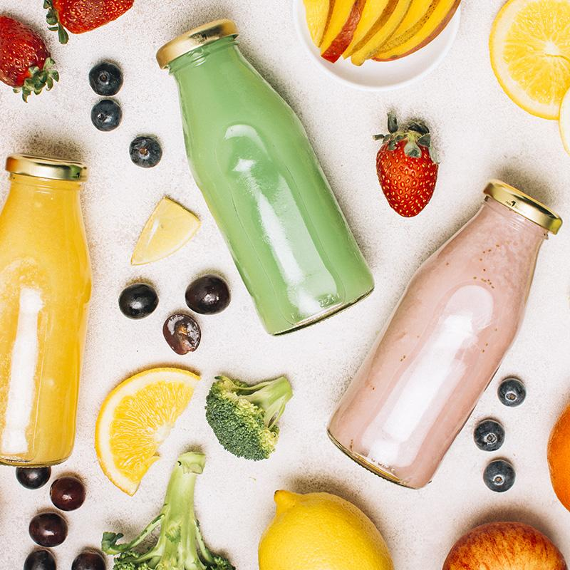
Here Is Another Picture
Images reveal large amounts of data, so remember: use an image instead of a long text

Slide 26
Sometimes, Reviewing Concepts Is a Good Idea
VENUS
MERCURY
MARS
It has a beautiful name, but it’s very hot
Mercury is the closest planet to the Sun
Despite being red, Mars is a cold place
JUPITER
SATURN
NEPTUNE
It’s the biggest planet in the Solar System
Saturn is the ringed one and a gas giant
It’ the farthest planet from the Sun

Slide 27
This Is a Map
Venus has a beautiful name, but it’s hot
Mercury is the closest planet to the Sun
Despite being red, Mars is a cold place

Slide 28
This Is a Map
Venus has a beautiful name, but it’s hot
Mercury is the closest planet to the Sun
Despite being red, Mars is a cold place
Jupiter is the biggest planet of them all

Slide 29
A Timeline Always Works
DAY 1
DAY 3
DAY 2
DAY 4
Jupiter is the biggest planet in the Solar System
Venus has a beautiful name, but it’s hot
Saturn is the ringed one and a gas giant
Despite being
red, Mars is a
cold place

Slide 30
Thanks!
DO YOU HAVE ANY QUESTIONS?
youremail@freepik.com
+91 620 421 838
yourcompany.com
Please keep this slide for attribution

