Slide 1

GRADUATION PROJECT • EXPLORATORY DATA ANALYSIS
Car Sales Data Analysis
Uncovering demand, pricing, and regional patterns across 23,906 dealership transactions
Dataset: Car Sales (2022–2023), 23,906 records, 16 attributes
Tools: Python • Pandas • NumPy • Matplotlib
🚗
Prepared for the business owner — data-driven decisions on inventory, pricing, and regional investment
Page 1 / 18

Slide 2
AGENDA
What We'll Cover
1
2
3
4
5
🎯
🗄
🔽
📊
🏅
Project Objective
Dataset Overview
Data Cleaning
10 Key Questions
Conclusions
Why we analyzed this dataset and what questions we set out to answer
Structure, scope, and quality of the raw car sales data
Handling missing values, types, and outliers before analysis
Sales, pricing, regional, and demographic insights
Summary of findings and recommendations
Car Sales Data Analysis | Graduation Project
Page 2 / 18

Slide 3
Turning raw dealership records into decisions
🎯
This project performs an end-to-end exploratory data analysis (EDA) on a two-year car sales dataset to understand what drives sales volume and pricing across companies, models, body styles, regions, and dealers.
📊
Identify best-selling companies, models, and body styles
PROJECT OBJECTIVE
💲
Compare average pricing across segments and regions
📈
Track how monthly sales evolve over the two-year period
👥
Explore whether income and demographics relate to pricing choices
Car Sales Data Analysis | Graduation Project
Page 3 / 18

Slide 4
THE DATA
Dataset Overview
23,906
16
16 Columns, 4 Groups
Transaction
Transactions
Attributes
Car_id, Date
Customer
2022–2023
0
Customer Name, Gender, Annual Income
Vehicle
Date Range
Duplicate Rows
Company, Model, Engine, Transmission, Color, Body Style, Price ($)
Dealer
Dealer_Name, Dealer_No, Dealer_Region, Phone
Car Sales Data Analysis | Graduation Project
Page 4 / 18

Slide 5
PREPARATION
Data Cleaning & Quality Checks
✓
Missing values
≡
Type conversion
One row missing "Customer Name" was dropped (23,906 → 23,905 rows); all other columns were fully complete.
"Date" parsed to datetime; Gender, Company, Model, Engine, Transmission, Color, Body Style, and Dealer_Region cast to categorical.
🔽
Duplicate check
📊
Outlier scan (IQR)
Zero exact duplicate rows found across all 16 columns — no de-duplication needed.
Annual Income and Price both show right-skewed distributions with IQR-based outliers on the high end, consistent with luxury purchases.
Car Sales Data Analysis | Graduation Project
Page 5 / 18

Slide 6
PREPARATION
Summary Statistics
Metric | Annual Income ($) | Price ($)
Mean | 830,840 | 28,090
Median | 735,000 | 23,000
Std. Deviation | 720,006 | 14,789
Minimum | 10,080 | 1,200
Maximum | 11,200,000 | 85,800
Skewness | 1.74 (right-skewed) | 1.47 (right-skewed)
📈
Both variables are right-skewed: most customers earn and pay near the median, with a smaller group of high-income buyers pulling the average price and income upward.
Correlation between Annual Income and Price ($): r ≈ 0.012 — essentially no linear relationship.
Car Sales Data Analysis | Graduation Project
Page 6 / 18

Slide 7
EXECUTIVE SNAPSHOT
The Numbers That Matter First
$671.5M
$28,090
$23,000
23,905
Total Sales Value
Average Price
Median Price
Transactions
Top brand (units): Chevrolet (1,819) | Top brand (sales value): Chevrolet ($47.7M) | Top body style: SUV (6,374 units) | Auto/Manual split: 52.6% / 47.4%
The ten questions on the following pages break these headline numbers down into decisions the business can act on this quarter.
Car Sales Data Analysis | Graduation Project
Page 7 / 18

Slide 8
QUESTION 1
Which car companies (brands) sell the most units?
Identifies which brands to prioritize in inventory and marketing spend.
BUSINESS TAKEAWAY
Chevrolet leads with 1,819 units, followed closely by Dodge and Ford. These three brands alone account for a large share of total volume — never let them run out of stock, and protect their promotional budget first if spend is ever cut.
Car Sales Data Analysis | Graduation Project
Page 8 / 18

Slide 9
QUESTION 2
Which car models are most popular?
Pinpoints exactly which SKUs to reorder, beyond the brand level.
BUSINESS TAKEAWAY
No single model dominates — the top five are tightly clustered between 380 and 420 units. This means reordering decisions should be spread across a diversified model list rather than betting heavily on one SKU.
Car Sales Data Analysis | Graduation Project
Page 9 / 18

Slide 10
QUESTION 3
Which body style dominates sales?
Guides showroom space, floor planning, and supplier negotiation by category.
BUSINESS TAKEAWAY
SUVs and Hatchbacks together make up more than half of all sales. Showroom and lot space should be weighted toward these two categories, with slower-moving body styles reviewed for reduced inventory commitments.
Car Sales Data Analysis | Graduation Project
Page 10 / 18

Slide 11
QUESTION 4
Automatic vs Manual — what's the real split?
Informs procurement mix and supplier negotiations on transmission type.
BUSINESS TAKEAWAY
The split is close to even (52.6% Automatic vs 47.4% Manual) — closer than many assume. Manual is not a niche in this market; procurement should keep both types well stocked rather than defaulting to automatic-only inventory.
Car Sales Data Analysis | Graduation Project
Page 11 / 18

Slide 12
QUESTION 5
Which dealer regions generate the most sales?
Directs regional investment, staffing, and expansion priorities.
BUSINESS TAKEAWAY
Austin and Janesville are the clear leaders. These regions are the strongest candidates for opening additional outlets or expanding floor space, while lagging regions may need a targeted marketing push or a dealer performance review.
Car Sales Data Analysis | Graduation Project
Page 12 / 18

Slide 13
QUESTION 6
Which body style commands the highest average price?
Shows which vehicle category has the highest average selling price and may support premium positioning.
BUSINESS TAKEAWAY
Sedans have the highest average selling price, while SUVs lead in volume. This suggests an opportunity to explore premium positioning and upsell strategies for sedan buyers.
Car Sales Data Analysis | Graduation Project
Page 13 / 18

Slide 14
QUESTION 7
Which company has the highest average price?
Identifies which brands are positioned as premium versus volume in this network.
BUSINESS TAKEAWAY
Cadillac is the clear premium leader at nearly $41,000 average — well above the network average of $28,090. These brands deserve higher-touch sales service and premium financing partnerships rather than volume-style promotions.
Car Sales Data Analysis | Graduation Project
Page 14 / 18

Slide 15
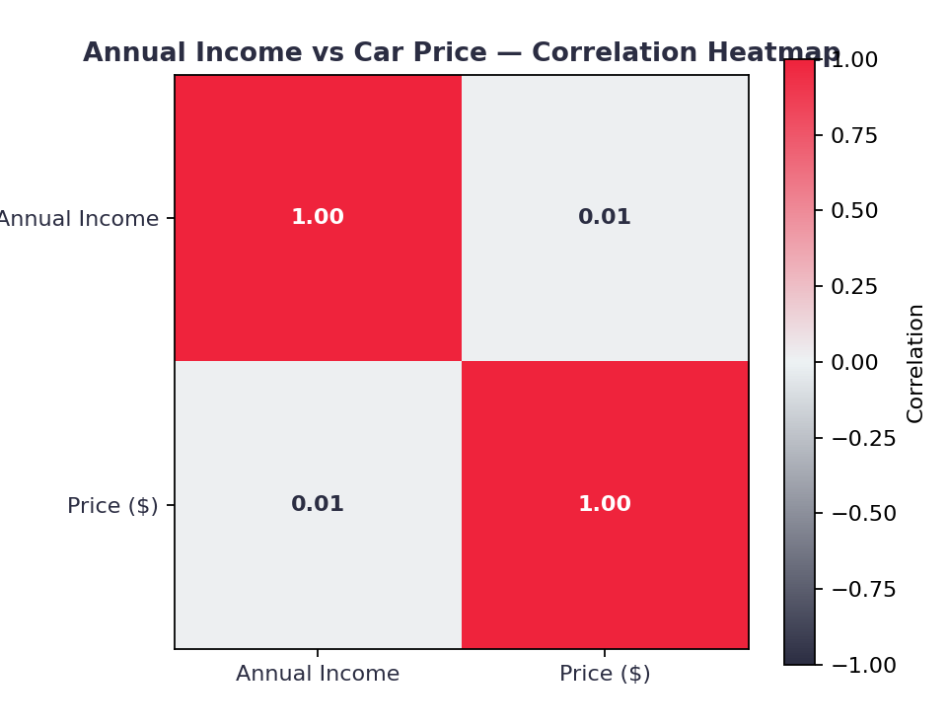
QUESTION 8
Is there a relationship between customer income and car price?
Tests whether income-based customer segmentation is a useful sales strategy at all.
BUSINESS TAKEAWAY
The correlation is essentially zero (0.01). Customer income does not show a meaningful linear relationship with car price (r ≈ 0.012). Avoid using income alone to predict the price band a customer will choose; test additional behavioral and market factors.
Car Sales Data Analysis | Graduation Project
Page 15 / 18

Slide 16
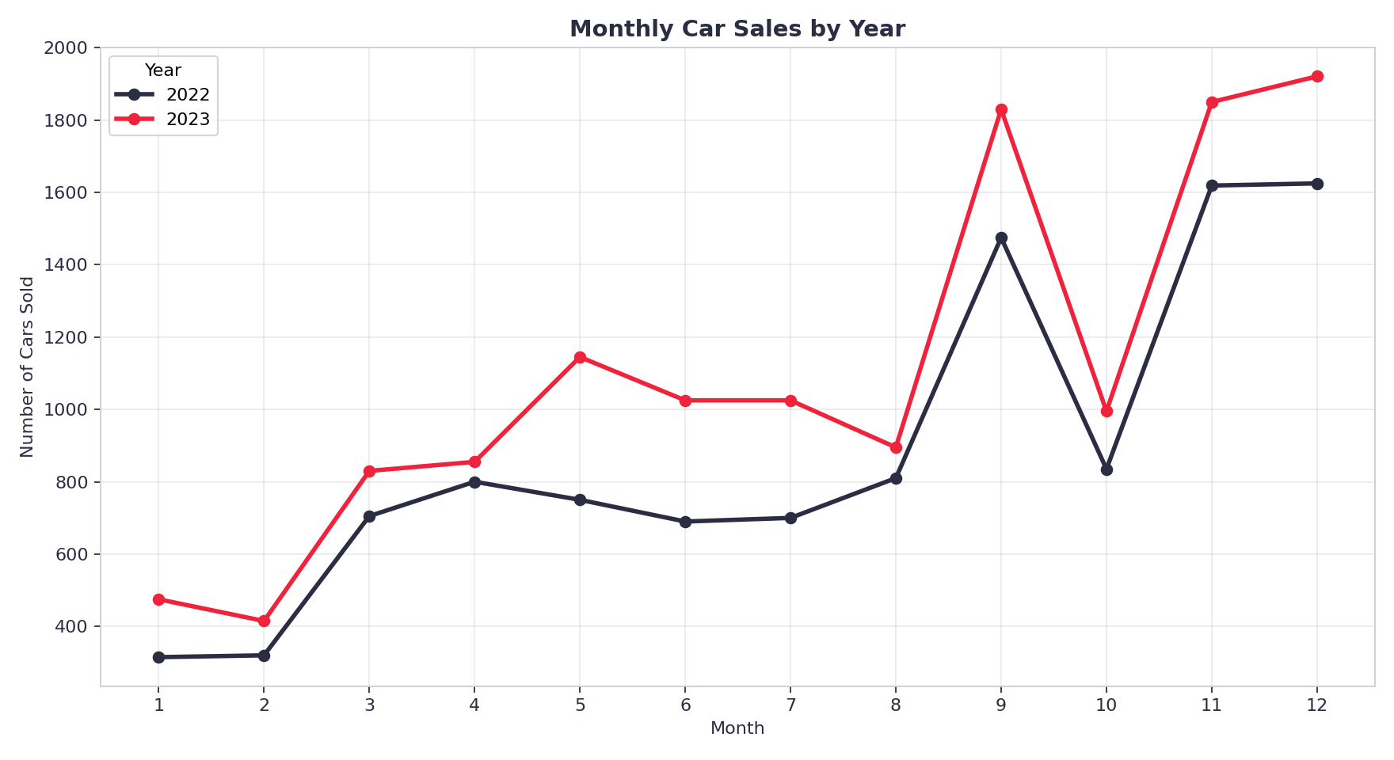
QUESTION 9
How do sales change over time?
Reveals seasonality to guide staffing, promotions, and cash-flow planning.
BUSINESS TAKEAWAY
Both 2022 and 2023 show a similar monthly pattern: a slower start in Jan-Feb, a rise through the year, a September peak, an October dip, and stronger sales in Nov-Dec. The repeated pattern suggests seasonality, although two years of data is a limited basis for confirming a long-term seasonal effect.
Car Sales Data Analysis | Graduation Project
Page 16 / 18

Slide 17
QUESTION 10
Which companies generate the highest total revenue?
Volume leaders and sales-value leaders are not always the same brand — this shows where the total sales value is concentrated.
BUSINESS TAKEAWAY
Chevrolet leads in both units and total sales value. Oldsmobile reaches the top 5 in sales value despite lower unit volume, indicating a relatively higher average selling price. Compare both volume and sales value when evaluating brand performance.
Car Sales Data Analysis | Graduation Project
Page 17 / 18

Slide 18
CONCLUSIONS
What the Owner Should Do Next
🏆
Protect top sellers
💲
Evaluate by sales value, not units alone
Keep Chevrolet, Dodge, and Ford — and the SUV/Hatchback body styles — always in stock.
Chevrolet leads both, while Oldsmobile's sales-value rank is stronger than its unit rank — consider both measures when allocating marketing spend.
📍
Expand where demand already is
⭐
Upsell through Sedans & premium brands
Austin and Janesville are proven regions; prioritize them for new outlets or added floor space.
Sedans and Cadillac/Saab/Lexus carry the highest average prices — target financing offers there.
📅
Plan for seasonality
🔍
Don't assume income drives price choice
Monthly sales vary substantially — align staffing, inventory, and promotions with the stronger months.
Income and price are essentially uncorrelated — build strategy on behavior, not income alone.
Car Sales Data Analysis | Graduation Project
Page 18 / 18

