Slide 1
FINAL TAKE HOME TEST
OPTIMIZATION OF DOT PRODUCT COMPUTATION OF TWO VECTORS USING VECTOR INSTRUCTIONS
ISMAIL AKRAM
12/15/2021
CSC 34200-G & CSC 34300-DE
PROFESSOR ISIDOR GERTNER
COMPUTER ORGANIZATION
THE CITY COLLEGE OF NEW YORK

Slide 2
OBJECTIVE
Implement a program to compute the Dot Product (I’m using pointers)
Use QueryPerformanceCounter() to calculate execution times (VS only)
Use clock_gettime() to calculate execution times (Linux GCC only)
Optimize compiler generated assembly code via vector instructions
Simulate these instructions in MS Visual Studio and Linux GCC environments
Compare results and show graphs

Slide 3
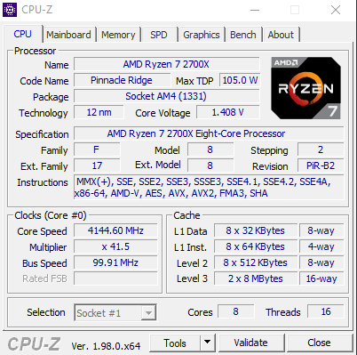
CPU INFO
To identify my hardware’s processor, I used CPU-Z application.
I took note of the instruction sets that are available.
Fig 1. My CPU Processor info from CUP-Z (AVX2)
Fig 1a: CPU Processor info in VM

Slide 4
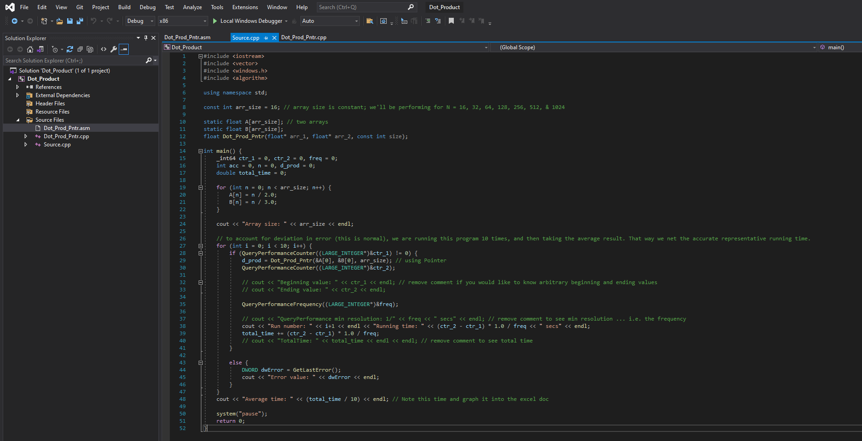
QueryPerformanceCounter()
Source.cpp (Fig 2) is the main function. The array size is const 16 for the first calculation and will change to various sizes to measure different times.
Two static arrays of the same size are declared. They are initialized to arbitrary numbers since the result of the dot product is irrelevant.
Note: QueryPerformanceCounter is used to measure the run-time of the dot product function.
Note: optimization, auto-vectorization, and auto-parallelization is disabled in Visual Studio.
The run-time is measured for the following array sizes; N = 16, 32, 64, 128, 256, 512, 1024 … 2^16.
Fig 2. Source.cpp (code)

Slide 5
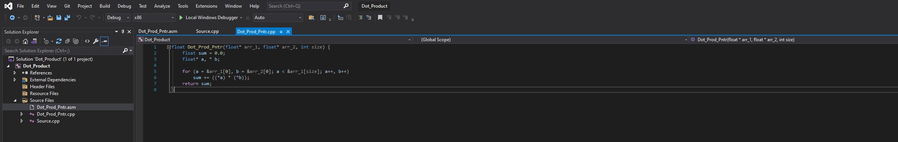
Dot Product Program
Fig 3: Dot_Prod_Pntr.cpp (Code)
Pointer arithmetic dot product. Note that we’re passing float.

Slide 6
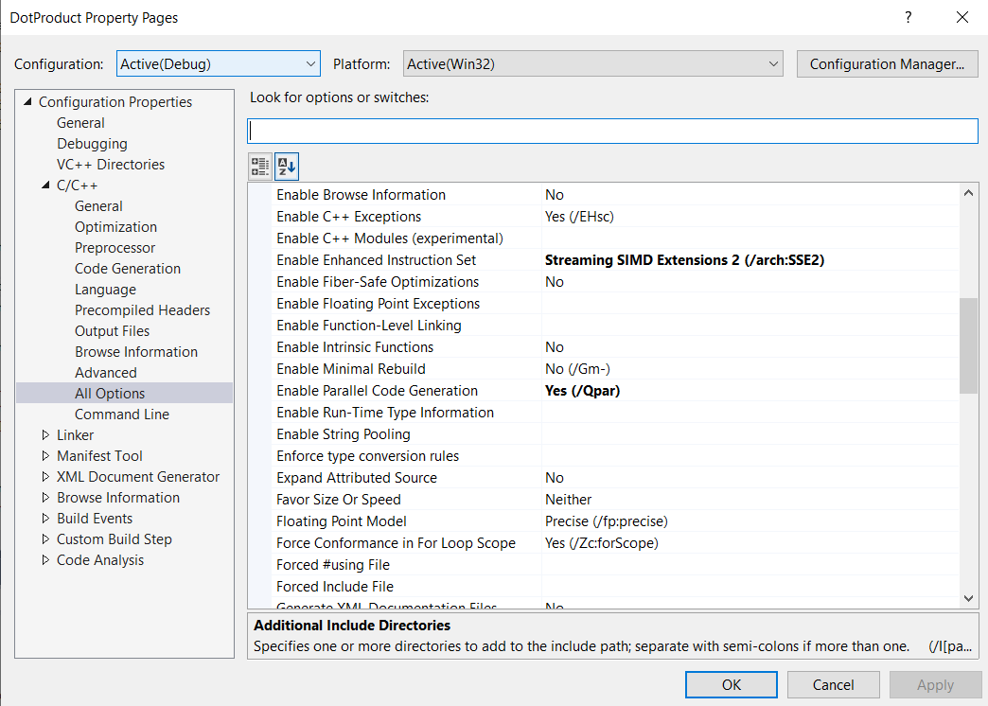
OPTIMIZATION SETTINGS (AUTO PARALLELIZATION/VECTORIZATION)
Auto Vectorization
Auto Parallelization

Slide 7
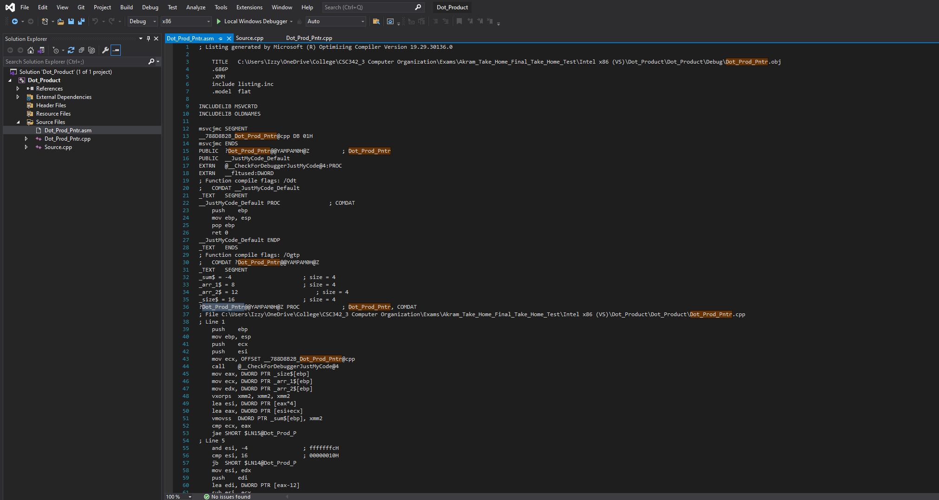
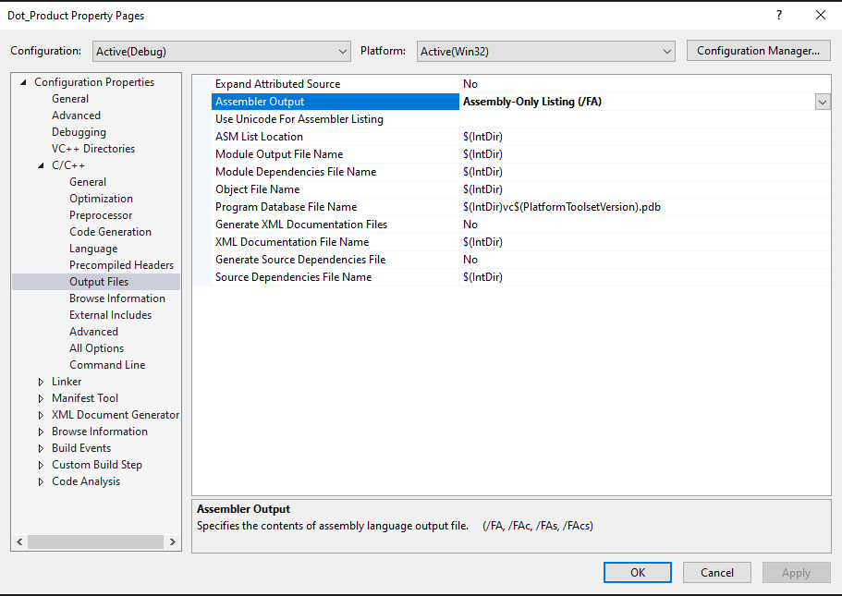
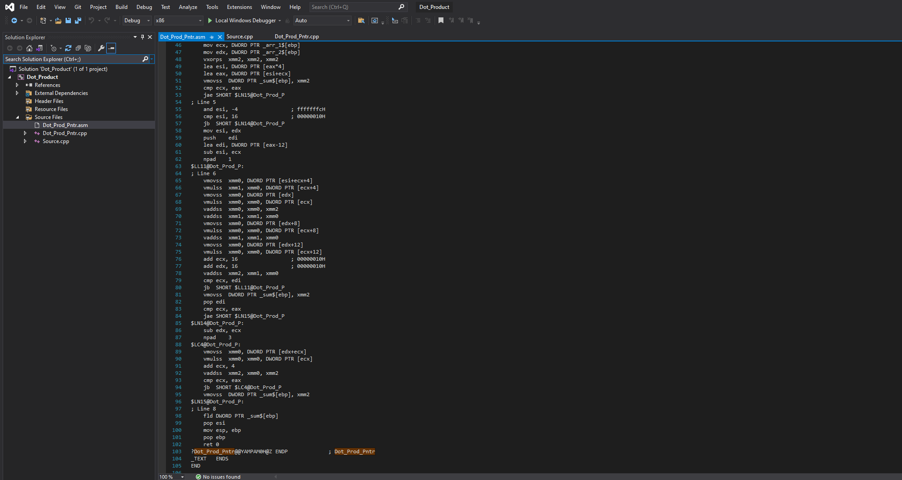
COMPILER GENERATED .asm FILE
The compiler optimizes the generated .asm code (Fig 4). We will then manually improve this code for the next tests. Parallelization and vectorization is enabled for these tests.
Fig 4: Dot_Prod_Pntr (Code) [Compiler Generated Optimization]

Slide 8
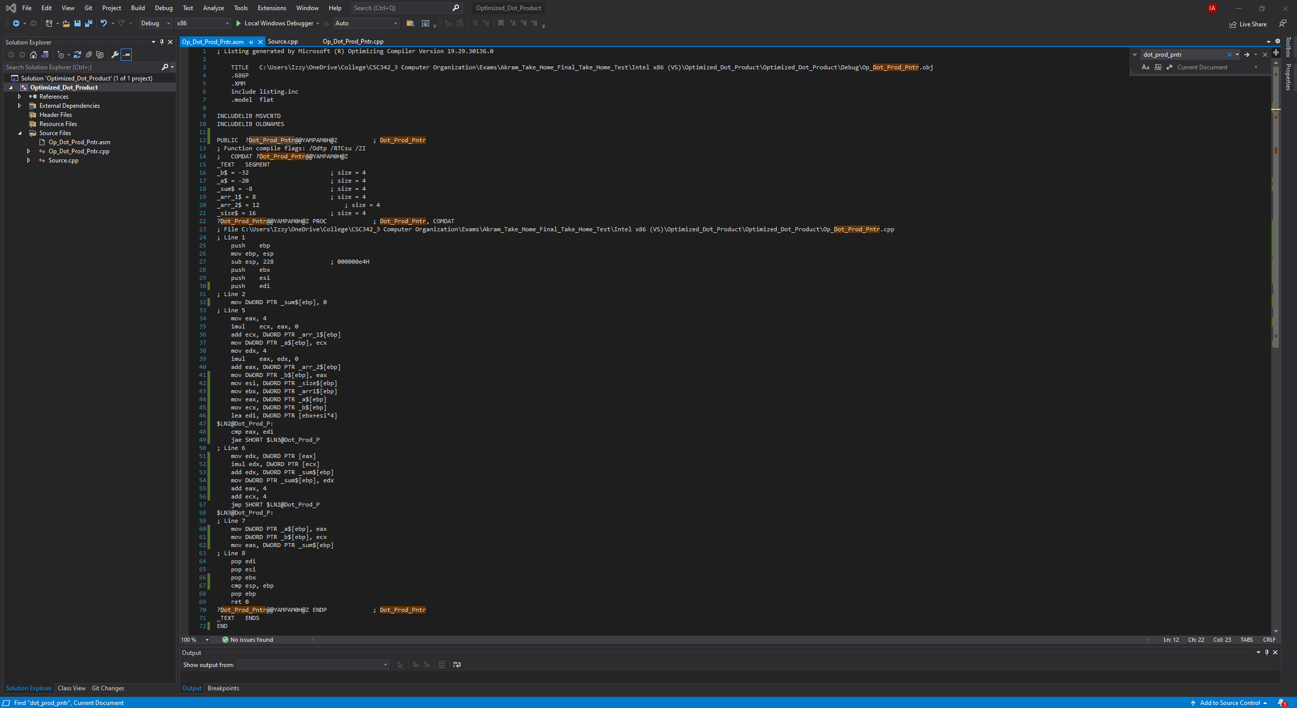
MANUAL OPTIMIZATION
For pointer arithmetic dot product, the assembly code has been manually optimized (Fig 5).
This was done by removing redundant/repetitive code and/or moved to out of the loop, so it’s not repeated unnecessarily.
We managed to reduce the 105 lines code down to 72 lines.
Fig 5: Opt_Dot_Prod_Pntr.asm (Code) [Manually Optimized]

Slide 9
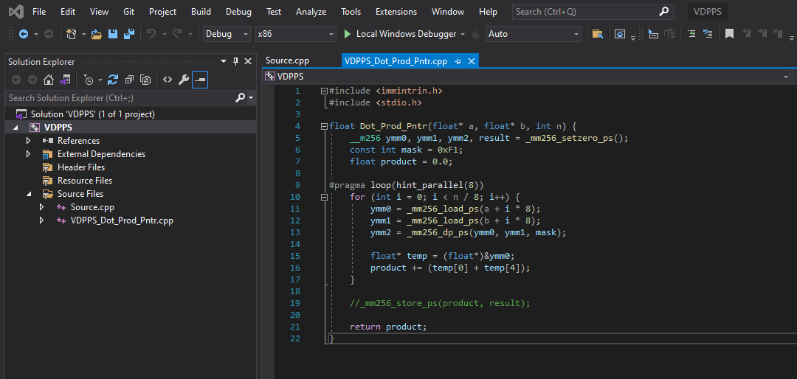
DOT PRODUCT (VECTOR INSTRUCTIONS)
For further optimization, we are using vector instruction DPPS to computer the dot product. We are then using the same QueryPerformanceCounter function to measure the execution time.
Fig 6: VDPPS_Dot_Prod_Pntr.cpp (Code)

Slide 10
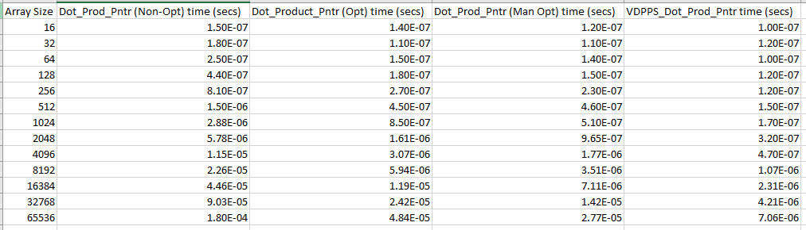
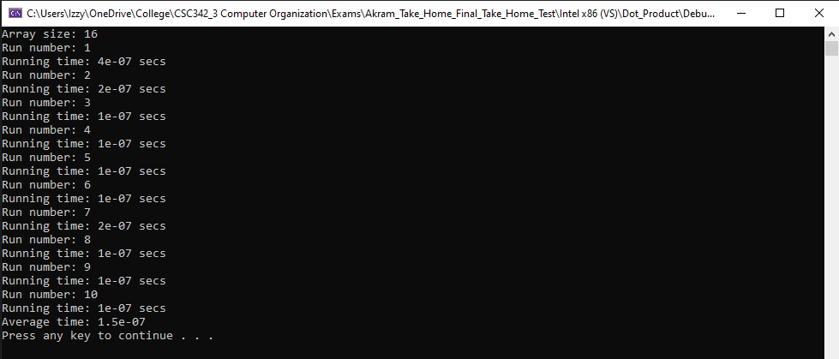
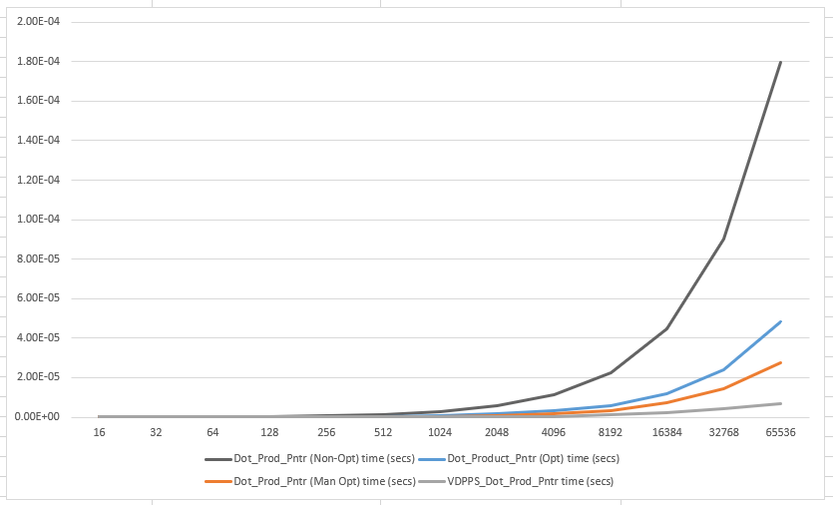

RESULTS (MS VISUAL STUDIO)
Fig 11: Dot_Prod_Pntr (16) w/0 Qpar and arch
Fig 19: Extraction times comparison of Dot_Prod_Pntr in VS
Fig 14l: VDPPS_Dot_Prod_Pntr (2^16) w/ Qpar and arch

Slide 11
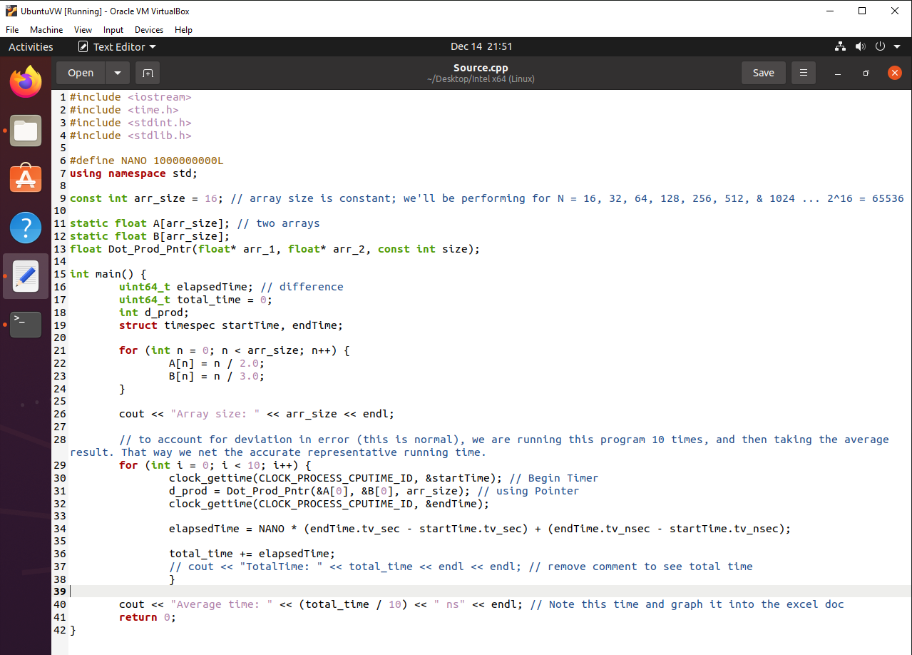
OPTIMIZATION (LINUX GCC) clock_gettime()
For out run in Linux 64-bit, we are using the same C++ codes for the function of dot product.
However, some modifications are needed for Source.cpp; we must use clock_gettime to measure the execution time.
We use the -o0 Optimization flag for no optimization.
Fig 7: Source.cpp (Code)

Slide 12
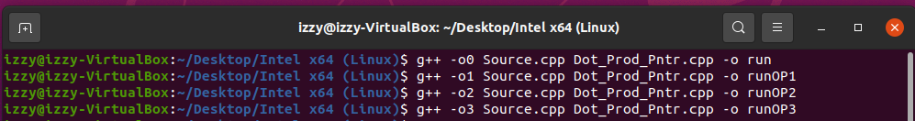
OPTIMIZATION (LINUX GCC) OPTIMIZATION FLAGS
Optimization Flag | Optimization Level | Execution Time | Optimization Notes
-o0 | O (Default) | + | None
-o1 | 1 | - | Basic
-o2 | 2 | -- | Recommended
-o3 | 3 (Highest) | --- | Not Guaranteed
For optimization in a Linux environment, it is much more efficient to use the compiler flags. These are enabled by using “-o” alongside an optimization level. We’re using the flags that reduce execution time.
There are tradeoffs to using optimization glass, namely in compilation time and memory usage.
Fig 8: Table summary of Optimization Flags (I MADE THIS TABLE)
Fig 9: Compiling Dot Product Programs using the optimization flags

Slide 13
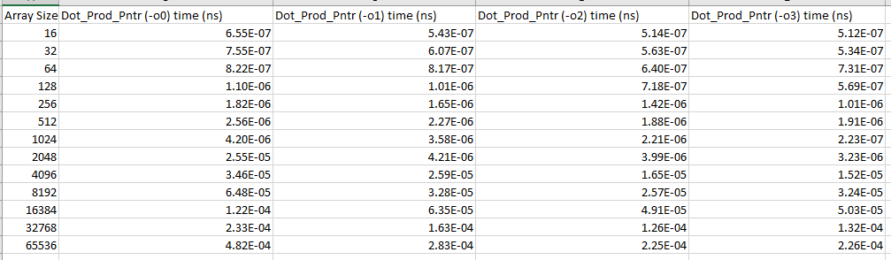
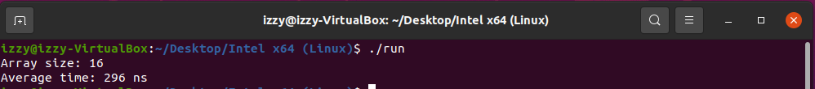
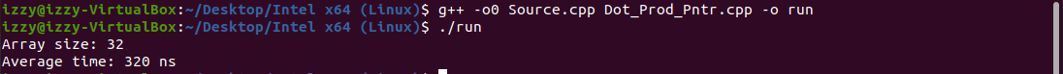
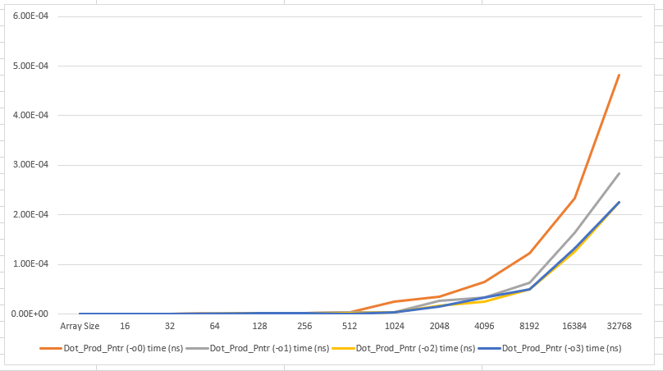
RESULTS (LINUX GCC)
Fig 19: Extraction times comparison of Dot_Prod_Pntr optimization level in Linux
Figs 15-15l: Dot_Prod_Pntr (-o0 optimization)

Slide 14
CONCLUSION
Looking at our results we see a largest difference between non-optimized and compiler optimized. We then achieve further optimization with manual optimization and vector instructions.
Dot_Prod_Pnt (Non-Opt)
Dot_Prod_Pntr (Opt)
Dot_Prod_Pntr (Man Opt)
VDPPS_Dot_Prod_Pntr
On the Linux side, we notice a decrease in compilation time with each optimization level:
-o0
-o1
-o2
-o3
Apply level 1 optimization drastically improves the execution time.
We can also conclude that optimization level 2 is faster than optimization level 1.
However, the difference between optimization levels 2 and 3 are not as drastic, which was expected.
Optimization level 2 is a much better option in reducing the execution time (since there is a tradeoff with memory usage). Optimization level 1 is also a good choice is maximum optimization is not needed.
Fig 19: Extraction times comparison of Dot_Prod_Pntr in VS
Fig 19: Extraction times comparison of Dot_Prod_Pntr optimization level in Linux

Slide 15
Thank You
Any questions?

