Slide 1
Take Home Test 1 Instruction Set Architecture Comparison Ismail Akram 11/17/2021 CSC 34200-G & CSC34300-DE
Professor Isidor Gertner
Computer Organization
The City College of New York

Slide 2
Objective:
The goal of this take-home test is to understand various set architectures;
32-bit MIPS processor (using MARS),
Intel x86 ISA (using Windows VS 32-bit compiler and debugger),
Intel x86 64-bit ISA processor (running on Linux, 64-bit GCC and GDB).
Compare and contrast the generated assembly code between different architecture sets looking at syntax and various other aspects of the code.

Slide 3
MIPS on MARS:
MIPS is an instruction set architecture. It’s a form of assembly language that produces an .asm file.
I’m running MIPS on MARS. MIPS operates using big endian, so it stores its least significant byte (LSB) in the highest memory address.

Slide 4
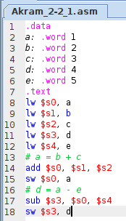
MIPS on MARS:
2-2_1.asm:
The code written for 2-2_1 in MIPS is shown in Fig 1. It uses five static variables: a, b, c, d, and e. Using these five variables; arithmetic is performed and stored in memory.
In our case, we’re adding the value of b and c and the sum is stored in a.
We’re also subtracting the values of a and e and storing that result in d. The results are stored in the data segment.
Fig 1. Akram_2-2_1.asm code displayed in MARS

Slide 5
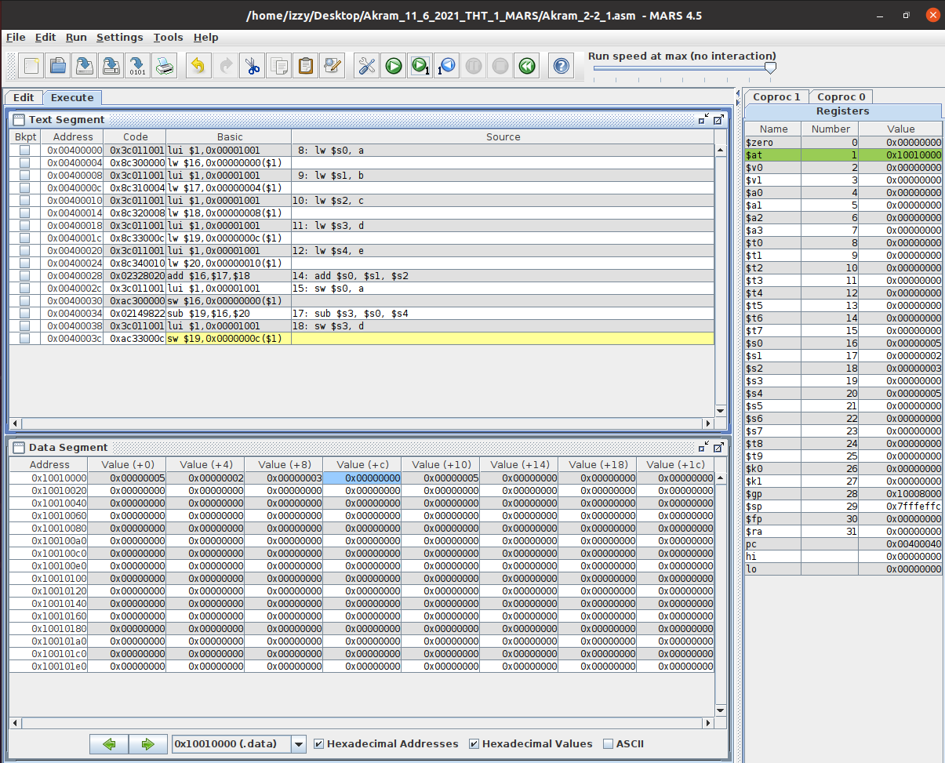
MIPS on MARS:
Text Segment: this window shows that the code. We added and subtracted the values of the registers and stored the result into another register and an address of the data segment.
Registers: this window shows that the:
value of $s1 and $s2 are added, and the result is stored into $s0,
value of $s0 and $s4 are subtracted, and the result is stored into $s3.
Local variables are stored on the stack
Data Segment: shows that values are stored in the address using BIG ENDIAN:
After the addition of $s1 and $s2, the result $s0 is stored into the address and allotted to the variable a. Address 0x1001000 contains the value 0x00000005.
After the subtraction of $s0 and $s4, the result $s3 is stored into the address and allotted to the variable d. Address 0x1001000c contains the value 0x00000000.
MIPS uses branch instruction (BNE: “branch if not equal) to implement loops and if-else statements.
Fig 4. Akram_2-2_1.asm executed in MARS (lines 14-18)

Slide 6
Intel X86 ISA on Windows 32-bit Compiler:
C is a programing language that produces a .c file.
I’m running C on Visual Studios for the Intel X86 ISA on Windows 32-bit compiler.
This compiler operates as little endian, so the least significant byte (LSB) is stored in the lowest memory address.

Slide 7
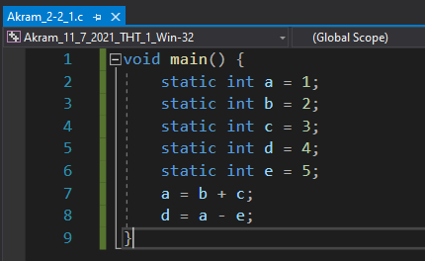
Intel X86 ISA on Windows 32-bit Compiler:
2-2_1.c:
The code written for 2-2_1 in C is shown in Fig 42. It uses five static variables: a, b, c, d, and e. Using these five variables; arithmetic is performed and stored in the variables.
In our case, we’re adding the value of b and c and the sum is stored in a. We’re also subtracting the values of a and e and storing that result in d.
Fig 42. Akram_2-2_1.c executed in VS Win-32 bit

Slide 8
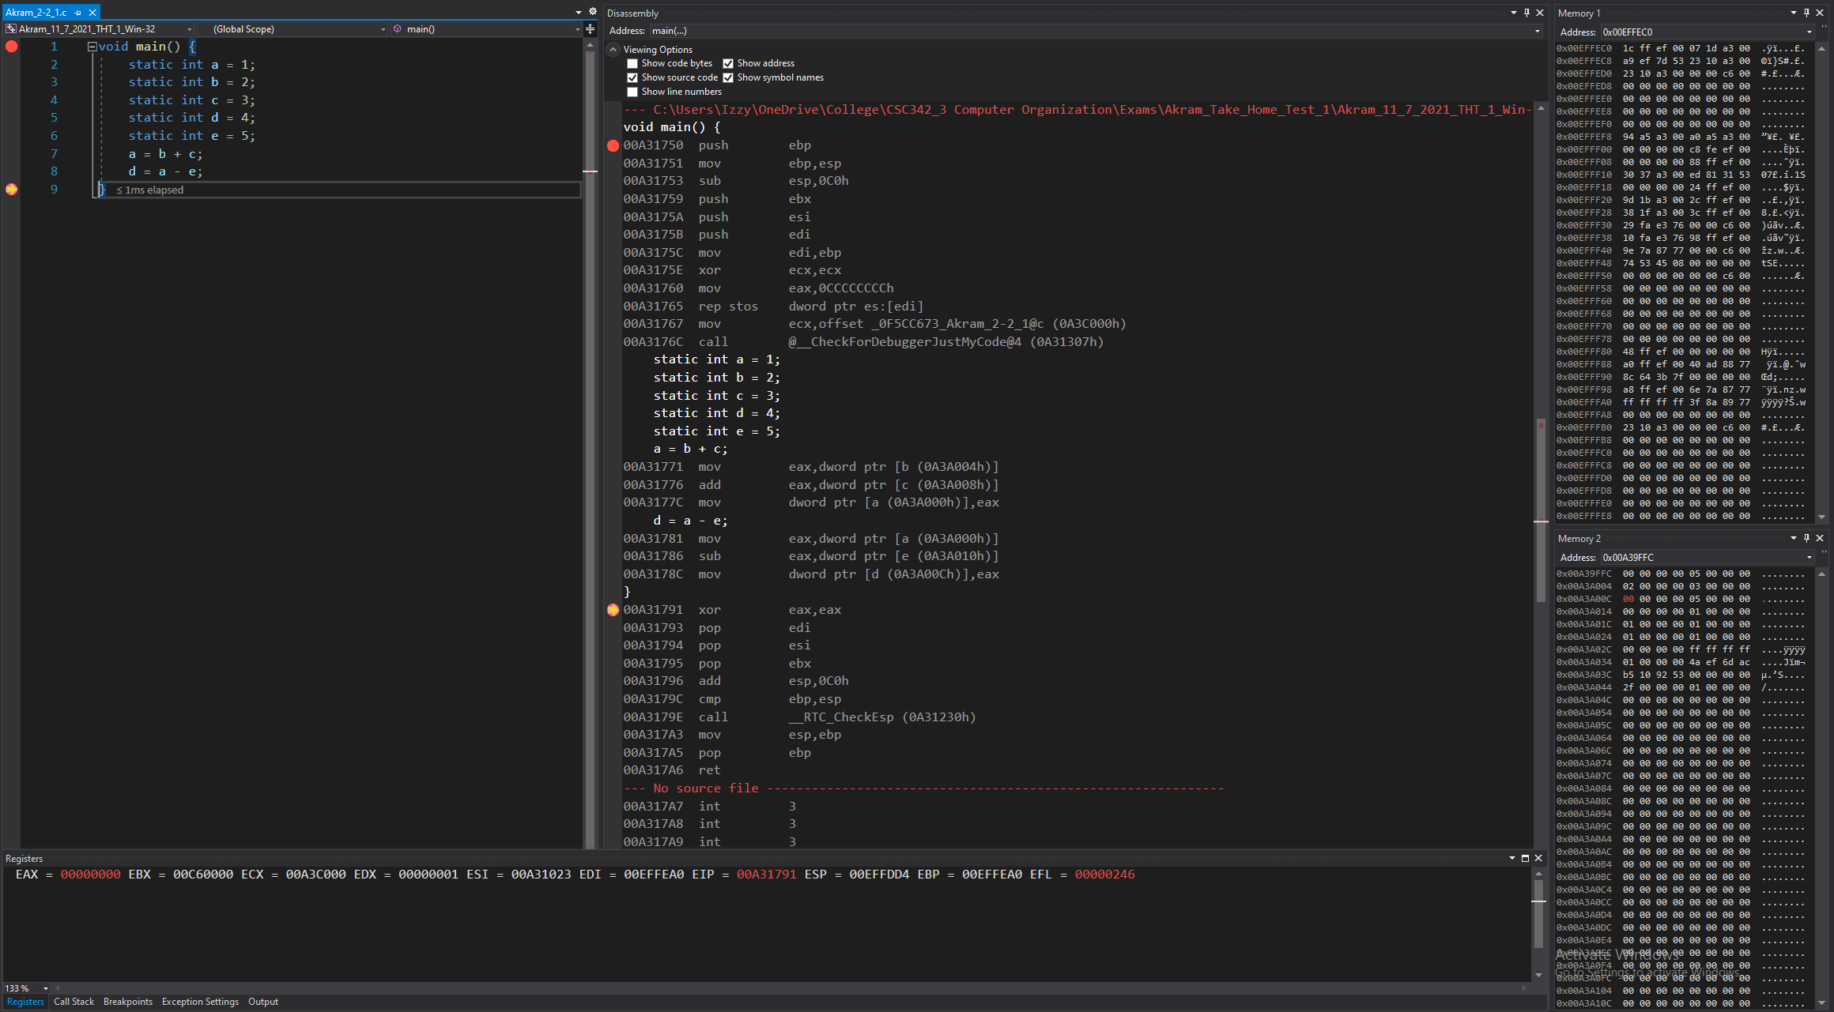
Intel X86 ISA on Windows 32-bit Compiler:
There are 8 registers in INTEL, unlike MIPS’ 32.
Disassembly: this window shows that the code. Static variables are initialized before the program is ran and stored in memory outside of the stack.
Registers: shows the value that’s stored in each register. Local variables are stored on the stack with an offset from Base Pointer Register.
Memory:
Memory window 1: displays the values around the stack pointer. INTEL can call memory location directly, unlike MIPS.
Memory window 2: displays variable d is stored in address: 0x00A3A00C, now containing the value: 00 00 00 00, using LITTLE ENDIAN.
INTEL uses “JNE” (jump if not equal) to implement loops and if-else statements.
Figure 44: Debugger on Visual Studios (Lines 8-9)

Slide 9
Intel X86 ISA on Linux 64-bit gcc and gdb:
C is a programing language that produces a .c file.
I’m running C on Linux for its gcc and gdb, Intel X86 ISA on Linux 64-bit compiler.
This compiler operates as little endian, so the least significant byte (LSB) is stored in the lowest memory address.

Slide 10
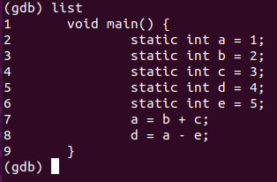
2-2_1.c:
The code written for 2-2_1 in C is shown in Fig 94. It uses five static variables: a, b, c, d, and e. Using these five variables; arithmetic is performed and stored in the variables.
In our case, we’re adding the value of b and c and the sum is stored in a. We’re also subtracting the values of a and e and storing that result in d.
Fig 94. Akram_2-2_1.c executed in Linux 64-32 bit

Slide 11
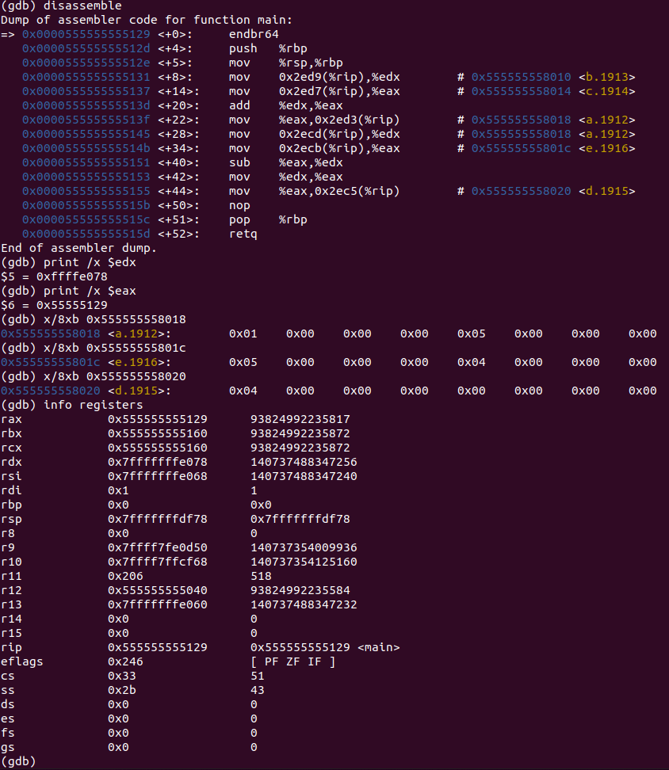
There are 16 registers in LINUX processor and 64-bit addressing.
Intel 32-bit: the result obtained from an arithmetic operation is stored on the right operand.
Intel 64-bit: the result obtained from an arithmetic operation is stored on the right operand. This also applies to the MOV instruction.
JNE and JMP instruction are used for if-else statements.
Disassembly: this window shows that the code. Static variables are initialized before the program is ran and stored in memory outside of the stack.
Registers: shows the value that’s stored in each register. Local variables are initialized on the stack with a negative offset.
Memory: shows the values stored in an address using BIG ENDIAN:
0x555555558018 contains 0x01 0x00 0x00 0x00 0x04 0x00 0x00 0x00
0x55555555801c contains 0x05 0x00 0x00 0x00 0x04 0x00 0x00 0x00
0x555555558020 contains 0x04 0x00 0x00 0x00 0x00 0x00 0x00 0x00
Fig 97. Akram_2-2_1.c GDB on Linux (Lines 8-9)

Slide 12
Conclusion:
In conclusion, although we’re running the same form of code on three different platforms, the disassembly and their debugging within their respective machines, all function in a similar manner albeit noticeable minor differences.
INTEL and LINUX share the most similarities compared to MIPS.

Slide 13
End of Presentation
Thank you!
any Questions?

