Slide 1
Shortest Path

Slide 2
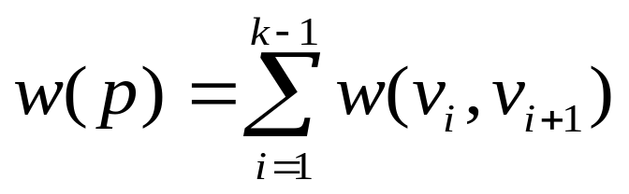

Shortest Path
Generalize distance to weighted setting
Digraph G = (V, E, W) with weight function W : E → R (assigning real values to edges)
Weight of path p = v₁ → v₂ → … → v_{k} is
Shortest path = a path of minimum weight (cost)

Slide 3
Shortest-Path Problems
Shortest-Path problems
  Single-source (single-destination). Find a shortest path from a given source (vertex s) to each of the vertices.
  Single-pair. Given two vertices, find a shortest path between them.
    Solution to single-source problem solves this problem efficiently, too.
  All-pairs. Find shortest-paths for every pair of vertices. Dynamic programming algorithm.
  Unweighted shortest-paths – BFS
Applications
  static/dynamic network routing
  robot motion planning
  map/route generation in traffic

Slide 4

Optimal Substructure
Theorem: subpaths of shortest paths are shortest paths
Proof:
  if some subpath were not the shortest path, one could substitute the shorter subpath and create a shorter total path

Slide 5
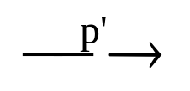
General Results
Lemma 24.1: Let p = ‹v₁, v₂, …, v_{k}› be a SP from v₁ to v_{k}. Then, p_{ij} = ‹v_{i}, v_{i+1}, …, v_{j}› is a SP from v_{i} to v_{j},
| where 1 ≤ i ≤ j ≤ k.
So, we have the optimal-substructure property.
Bellman-Ford’s algorithm uses dynamic programming.
Dijkstra’s algorithm uses the greedy approach.
Let δ(u, v) = weight of SP from u to v.
Corollary: Let p = SP from s to v, where p = s u →v. Then, δ(s, v) = δ(s, u) + w(u, v).
Lemma 24.10: Let s ∈ V. For all edges (u,v) ∈ E, we have δ(s, v) ≤ δ(s, u) + w(u,v).

Slide 6
Negative Weights and Cycles
Negative edges are OK, as long as there are no negative weight cycles (otherwise paths with arbitrary small “lengths” would be possible).
Shortest-paths can have no cycles (otherwise we could improve them by removing cycles).
  Any shortest-path in graph G can be no longer than n–1 edges, where n is the number of vertices

Slide 7
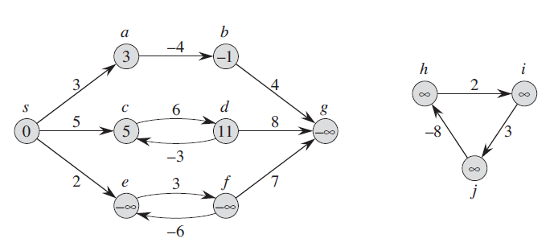
Negative Weights and Cycles

Slide 8
Shortest Path Tree
The result of the algorithms is a shortest path tree
For each vertex v, it
  records a shortest path from the start vertex s to v.
  v.pred is the predecessor of v in this shortest path
  v.dist is the shortest path length from s to v
  For each vertex v in the graph, we maintain v.dist, the estimate of the shortest path from s. It is initialized to ∞ at the start.

Slide 9
Relaxation
Algorithms keep track of d[v], π[v].
Initialized as follows:
Relaxing an edge (u,v) means testing whether we can improve the shortest path to v found so far by going through u.
Initialize(G, s)
for each v ∈ V[G] do
d[v] := ∞;
π[v] := NIL
od;
d[s] := 0
u
v
u
v
2
2
Relax (u,v,G)
if v.dist > u.dist + w(u,v) then
v.dist := u.dist + w(u,v)
v.pred := u
5
9
5
6
Relax(u,v)
Relax(u,v)
5
7
5
6
2
2
u
v
u
v

Slide 10
Properties of Relaxation
d[v], if not ∞, is the length of some path from s to v.
d[v] either stays the same or decreases with time
Therefore, if d[v] = δ(s, v) at any time, this holds thereafter
Note that d[v] ≥ δ(s, v) always

Slide 11
Triangle inequality
Lemma 24.10: Let s ∈ V. For all edges (u,v) ∈ E,
we have δ(s, v) ≤ δ(s, u) + w(u,v).

Slide 12
Properties of Relaxation
Consider any algorithm in which d[v], and π[v] are first initialized by calling Initialize(G, s) [s is the source], and are only changed by calling Relax. We have:
Upper-bound property
Lemma 24.11: (∀ v:: d[v] ≥ δ(s, v)) is an invariant.
Implies d[v] doesn’t change once d[v] = δ(s, v).
Proof:
Initialize(G, s) establishes invariant. If call to Relax(u, v, w) changes d[v], then it establishes:
  d[v] = d[u] + w(u, v)
  ≥ δ(s, u) + w(u, v) , invariant holds before call.
  ≥ δ(s, v) , by Lemma 24.10.
No-path property
Corollary 24.12: If there is no path from s to v, then d[v] = δ(s, v) = ∞ is an invariant.

Slide 13
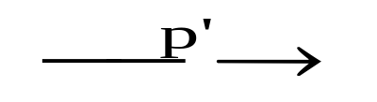
More Properties
Lemma 24.13: Immediately after relaxing edge (u, v) by calling Relax(u, v, w), we have d[v] ≤ d[u] + w(u, v).
Lemma 24.14: Let p = SP from s to v, where p = s u v.
If d[u] = δ(s, u) holds at any time prior to calling Relax(u, v, w), then d[v] = δ(s, v) holds at all times after the call.
Proof:
After the call we have:
  d[v] ≤ d[u] + w(u, v) , by Lemma 24.13.
  = δ(s, u) + w(u, v) , d[u] = δ(s, u) holds.
  = δ(s, v) , by corollary to Lemma 24.1.
By Lemma 24.11, d[v] ≥ δ(s, v), so d[v] = δ(s, v).

Slide 14
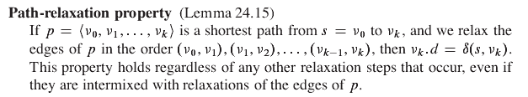


Slide 15
Dijkstra's Algorithm
Non-negative edge weights
Greedy, similar to Prim's algorithm for MST
Like BFS: If all edge weights are equal, then use BFS, otherwise use this algorithm
Use Q, a priority queue with keys v.dist, which is re-organized whenever some dist decreases
Basic idea
  maintain a set S of solved vertices
  at each step select "closest" vertex u, add it to S, and relax all edges from u

Slide 16
Dijkstra’s Pseudo Code
Input: Graph G, start vertex s
Relax (u,v,G)
if v.dist > u.dist + w(u,v) then
v.dist := u.dist + w(u,v)
v.pred := u
Dijkstra(G,s)
01 for each vertex u ∈ G.V
02 u.dist := ∞
03 u.pred := NIL
04 s.dist := 0
05 S := ∅ // S is used to explain the algorithm
06 init(Q, G.V) // Q is a priority queue
07 while not isEmpty(Q)
08 u := extractMin(Q)
09 S := S ∪ {u}
10 for each v ∈ u.adj do
11 Relax(u, v, G)
12 modifyKey(Q, v)
relaxing edges

Slide 17
Dijkstra’s Example
Dijkstra(G,s)
01 for each vertex u ∈ G.V
02 u.dist := ∞
03 u.pred := NIL
04 s.dist := 0
05 S := ∅
06 init(Q, G.V)
07 while not isEmpty(Q)
08 u := extractMin(Q)
09 S := S ∪ {u}
10 for each v ∈ u.adj do
11 Relax(u, v, G)
12 modifyKey(Q, v)
u
u
u
u
u
u
v
v
v
v
v
v
1
1
1
1
1
1
8
8
8
14
13
10
9
8
∞
∞
9
10
∞
10
10
10
10
10
9
9
9
9
9
9
2
2
2
2
3
3
3
2
3
2
3
s
0
3
s
s
0
0
0
s
0
0
4
4
4
6
6
4
6
4
6
4
6
6
7
7
7
7
7
7
5
5
5
5
5
5
5
5
5
5
∞
7
7
5
7
∞
7
∞
2
2
2
2
2
2
x
x
x
y
y
x
y
x
y
x
y
y
Relax (u,v,G)
if v.dist > u.dist + w(u,v) then
v.dist := u.dist + w(u,v)
v.pred := u

Slide 18
Dijkstra’s Algorithm
Observe :
Each vertex is extracted from Q and inserted into S exactly once
Each edge is relaxed exactly once
Greedy strategy: Always chooses the closest(lightest) vertex in Q = V-S to insert into S
S = set of vertices whose final shortest paths have already been determined
  i.e. , S = {v Î V: d[v] = δ(s, v) ≠ ∞ }

Slide 19
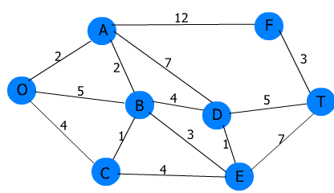
Dijkstra’s Exercise
Consider ‘0’ as start node for both:
∞ 10 9 8
10
2
0
0
∞ 6
3
5
1
∞ 5

Slide 20
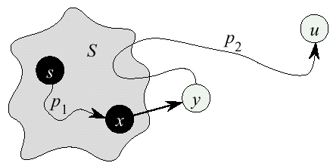
Dijkstra’s Correctness
We prove that whenever u is added to S, u.dist= δ(s,u), i.e., dist is minimum, and that equality is maintained thereafter.
Proof (by contradiction)
  Initially ∀v: v.dist ≥ δ(s,v)
  Let u be the first vertex such that there is a shorter path than u.dist, i.e., u.dist > δ(s,u)
  We will show that this assumption leads to a contradiction

Slide 21
...Dijkstra Correctness
Let y be the first vertex ∈ V–S on the actual shortest path from s to u, then it must be that y.dist = δ(s,y) because
  x.dist is set correctly for y's predecessor x∈S on the shortest path (by choice of u as the first vertex for which dist is set incorrectly)
  when the algorithm inserted x into S, it relaxed the edge (x,y) , setting y.dist to the correct value

Slide 22
...Dijkstra Correctness
But u.dist > y.dist ⇒ algorithm would have chosen y (from the PQ) to process next, not u
⇒ contradiction
Thus, u.dist = δ(s,u) at time of insertion of u into S, and Dijkstra's algorithm is correct
u.dist > δ(s,u) initial assumption
= δ(s,y) + δ(y,u) optimal substructure
= y.dist + δ(y,u) correctness of y.dist
≥ y.dist no negative weights

Slide 23
Dijkstra’s Running Time
Extract-Min executed |V| time
Decrease-Key executed |E| time
Time = |V| T_{Extract-Min} + |E| T_{Decrease-Key}
T depends on different Q implementations
Q | T(Extract-Min) | T(Decrease-Key) | Total
array | Ο(V) | Ο(1) | Ο(V ²)
binary heap | Ο(lg V) | Ο(lg V) | Ο(E lg V)

