Slide 1
Cross-Dataset Validation of a Sensor Agnostic Seismocardiography Peak Detection Method
Ismail Elnaggar, Sepehr Seifizarei, Jonas Sandelin, Antti Airola, Matti Kaisti, Tero Koivisto
University of Turku, Finland
IEEE/ACM Conference on Connected Health: Applications, Systems and Engineering Technologies
26.06.2025
Manhattan, NYC, USA

Slide 2
Overview
Introduction to Seismocardiography
Motivation
Data Overview
Data Processing Pipeline
Results
Limitations

Slide 3
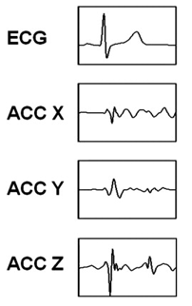
Seismocardiography
Seismocardiography (SCG) is the measure of the micro-vibrations of the chest caused by the heart’s contraction, valve movements and blood ejection into the vascular tree.
SCG is typically recorded by attaching an accelerometer to the chest approximately on top of the sternum.
Microelectromechanical-Systems (MEMS) technology have made this kind of data acquisition more practical and has renewed interest in using SCG to measure cardiac mechanics.

Slide 4
Practical Applications
SCG is currently being investigated to be used to monitor or screen patients for conditions such as atrial fibrillation, aortic stenosis, CAD, and heart failure remotely or in GP clinics.
Most SCG studies have either used custom devices or simply smartphones placed on the chest.
Currently diagnosing these conditions require advanced equipment (echocardiography, chest X-ray, Cardiac MRI, etc.) and sophisticated medical interpretations which makes them inapplicable for day-to-day life or home monitoring purposes.

Slide 5
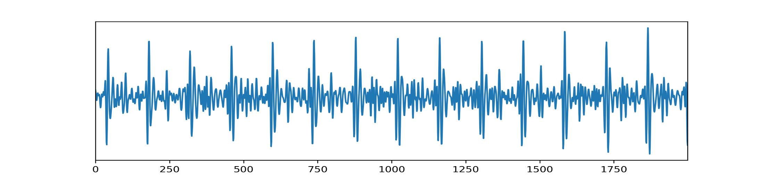
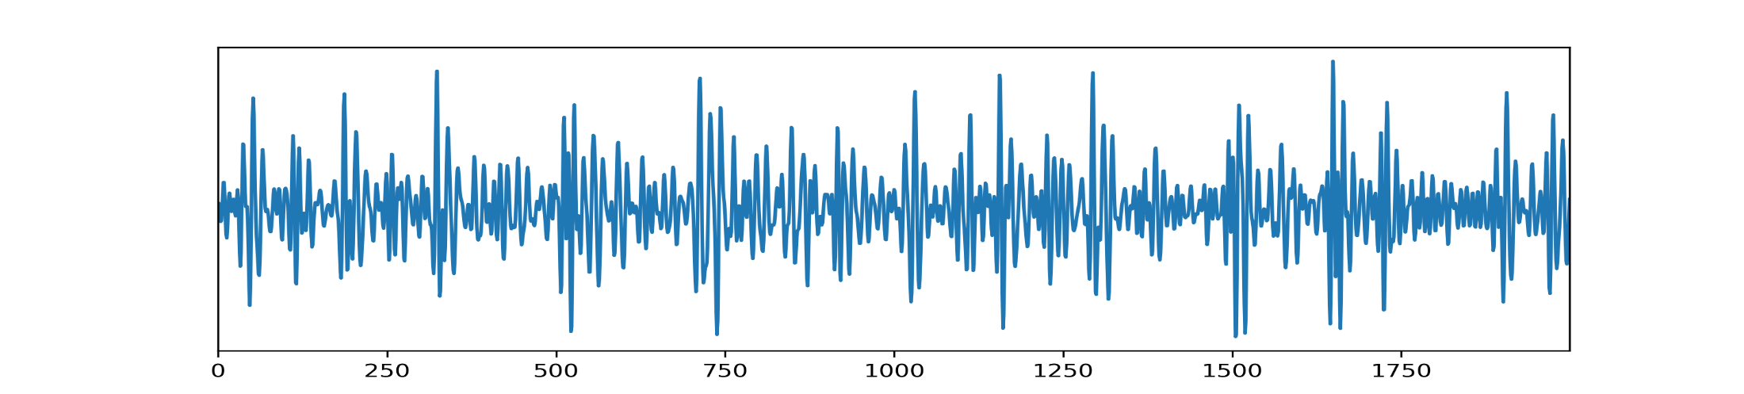
Data Collection Challenges
SCG signals are prone to several sources of noise, such as motion artifacts, subjects talking or coughing, and floor vibrations.
Sick or elderly subjects often produce signals with amplitudes that are much smaller than healthy young subjects.
Sensor placement on the chest can change signal characteristics.
[14]
[17]
Notes:
[14] measurement from a presumed healthy subject, dataset reference 14 in paper
[17] measurement from a subject with valvular heard disease, dataset reference 17 in paper.

Slide 6
Motivation
Past studies presenting SCG based peak detection methods have been validated using a single homogenous dataset.
These previous studies have shown promising results but it’s not clear how these algorithms preform across different sensing modalities as well as disease cohorts.
By testing our approach on five open access datasets, we aim to address limitations in past studies and investigate how well the proposed method generalizes across diverse recording conditions and subject demographics.

Slide 7
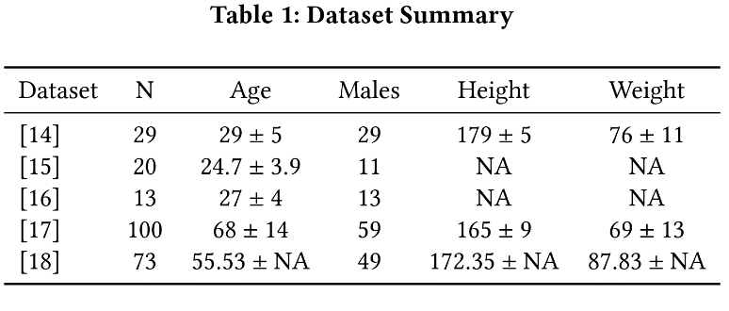
Data Overview
The method presented in this study was evaluated across five open access datasets consisting of 275 measurements taken across 235 different subjects.
Datasets [14,15,16] consisted of measurements taken from young presumed healthy individuals.
Datasets [17] consisted of measurements taken from subjects with diagnosed valvular heart disease.
Dataset [18] consisted of measurements taken from subjects during a right heart cather procedure who were diagnosed or suspected to have heart failure.

Slide 8
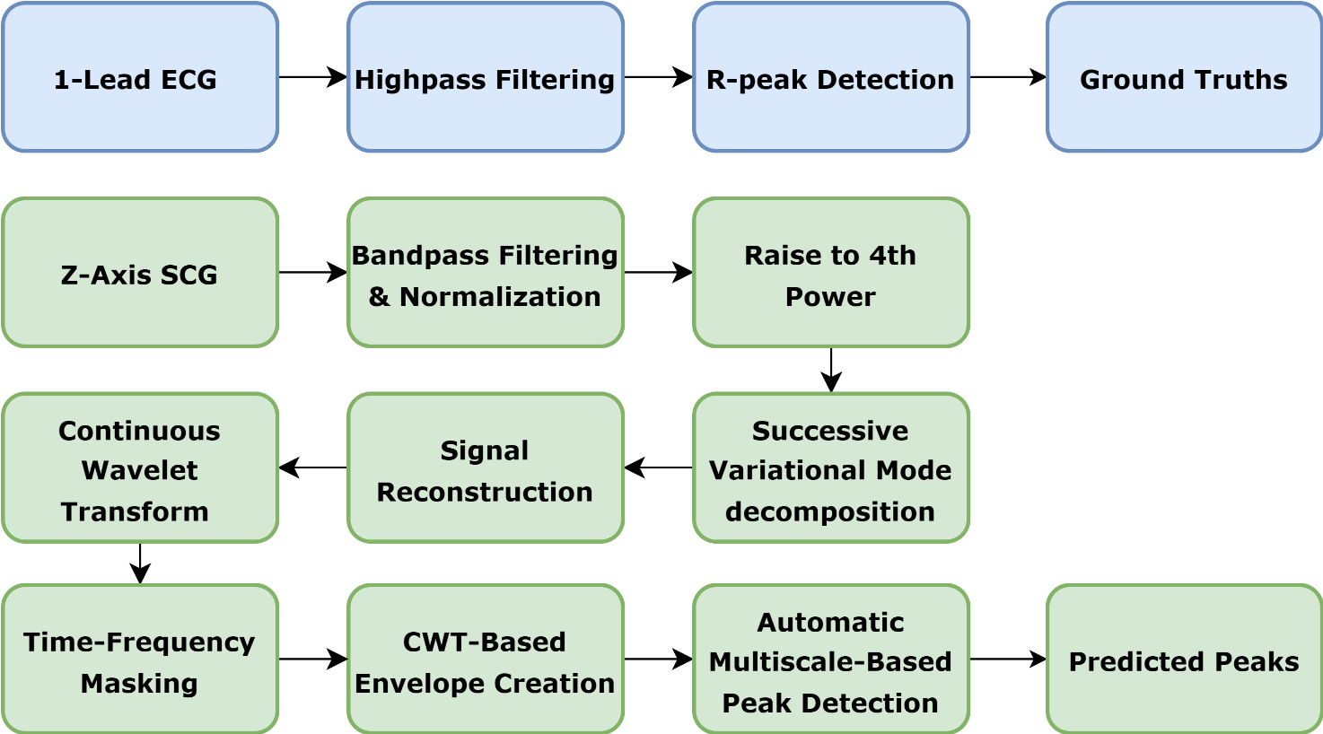
Data Processing Pipeline
ECG and SCG were acquired at varying sampling frequencies and were all resampled to 200 Hz.
Metrics used to evaluate peak detection method: True Positive Rate (Sensitivity), Positive Prediction Value (Precision), RMSE, and HR MAE.

Slide 9
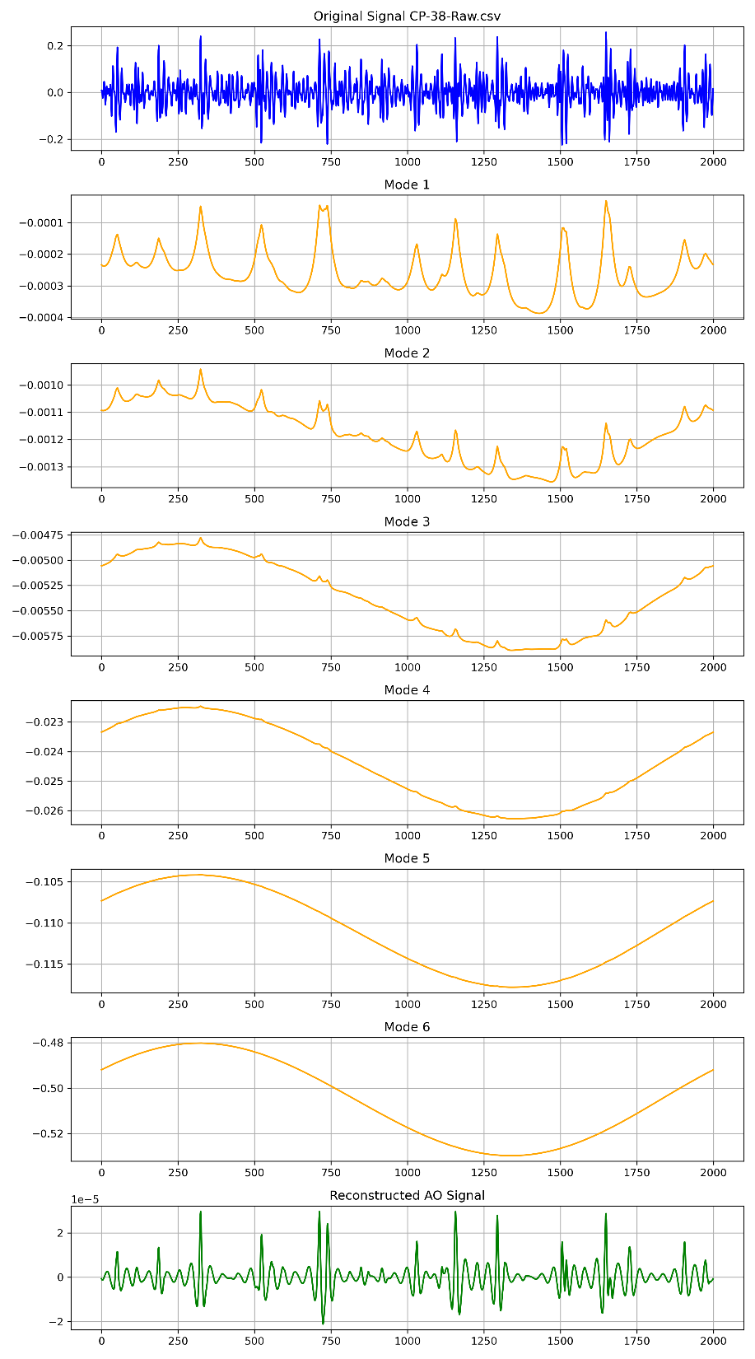
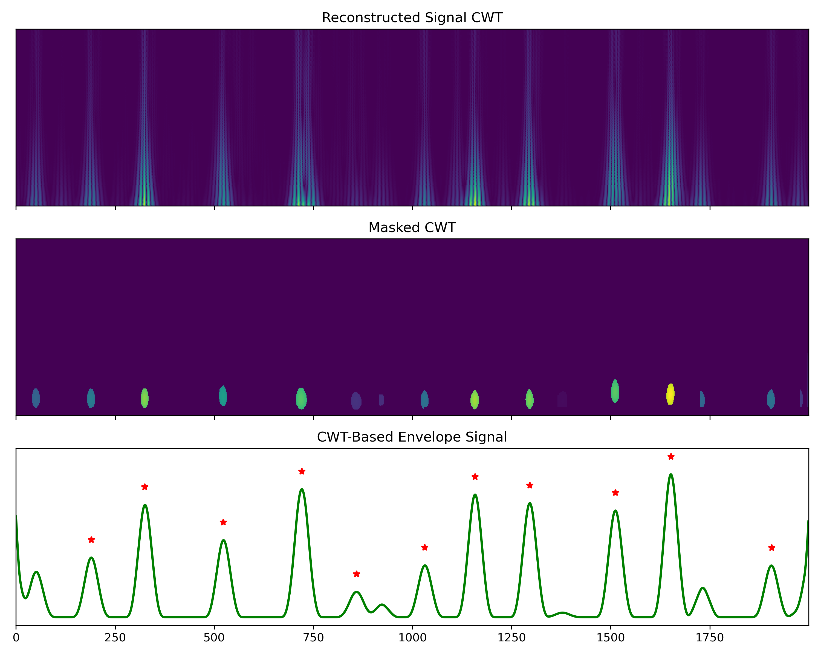
SVMD→ Reconstruction→ Envelope Creation
A.
B.
Notes:
SVMD at a high level basically does:
Isolate the strongest periodic feature first and extracting several intrinsixc mode functions
Remove it from the residual
Repeat on the diminishing residual until only noise or no significant oscillations remain
*SVMD gives fine-grained control over isolating and reconstructing only the most significant periodic components of a given time series
Reconstruction is done by examining the waveform factor of each mode. Modes that have a higher waveform factor than the average of all extracted modes are kept for the reconstructed signal by summing all IMFs that pass the criteria.
For the CWT we basicall apply 2d smoothing to the CWT and then high and low frequency thresholding to isolate the AO signal from the SCG Z-axis signal.

Slide 10
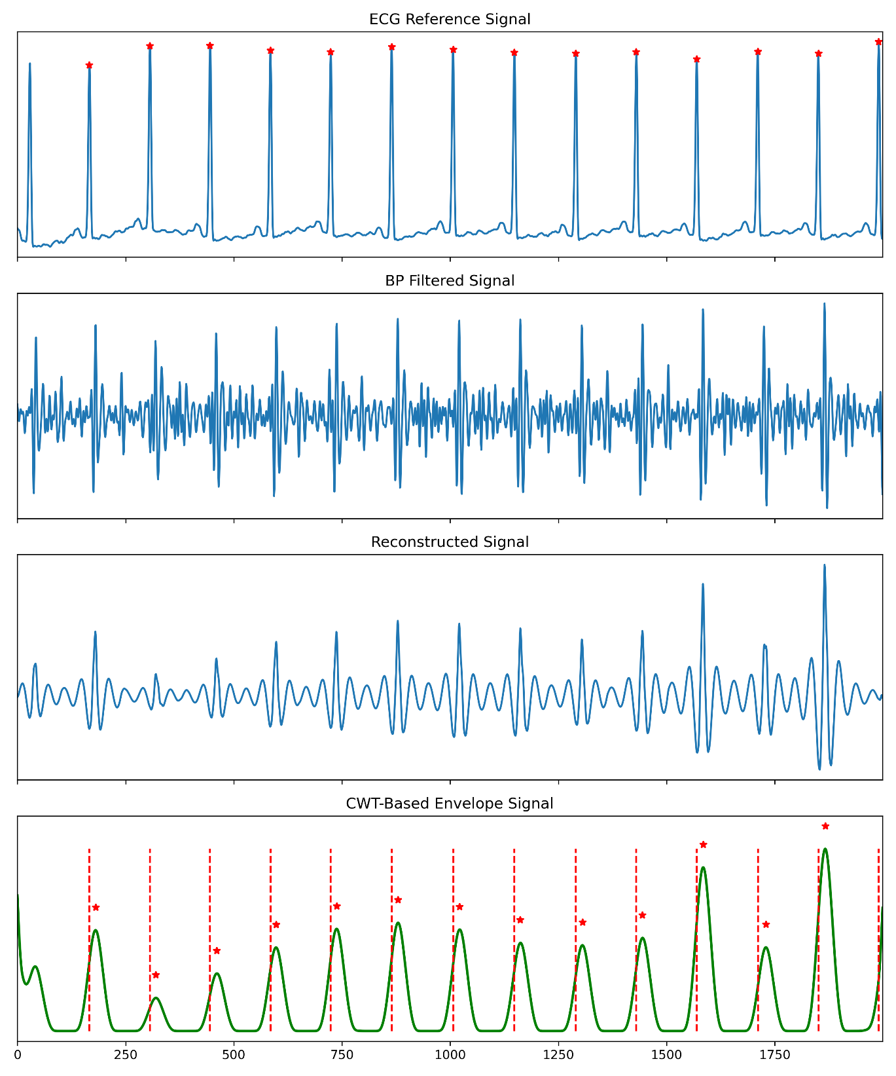
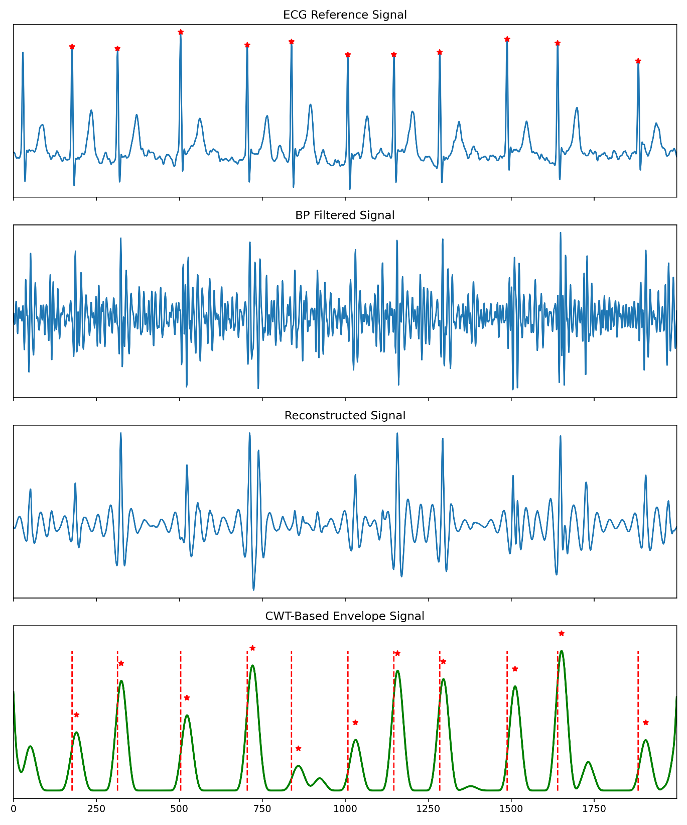
[14]
[17]

Slide 11
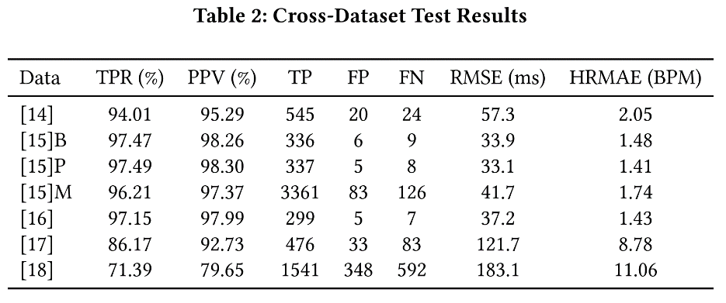
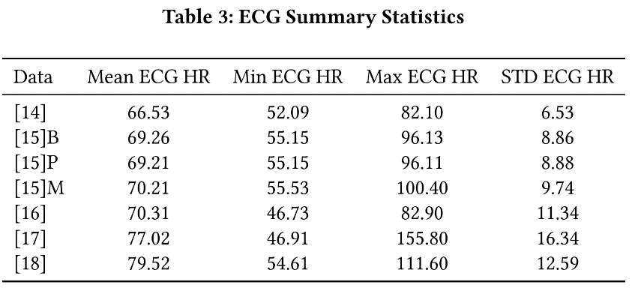
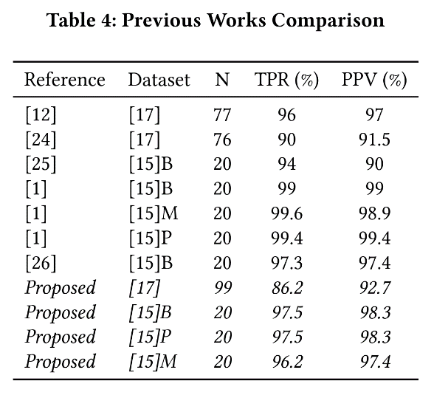
Results
Presumed healthy cohorts [14,15,16]: aggregated TPR, PPV, RMSE, and HRMAE of : 96.5%, 97.4%, 40.6 ms, and 1.6 BPM, respectively.
Noticeable reduction in performance in datasets [17,18], the VHD dataset and RHC dataset.
Evaluated on a large range of heart rates.
Proposed method produced results that were on par or performed slightly better than previous studies.

Slide 12
Conclusion and Limitations
Conclusion:
Results indicate that the proposed method demonstrates high precision in peak detection across presumed healthy subjects with different sensor set-ups and measurement protocols. Performance shows a notable decline in subjects with valvular heart disease and in subjects who had their measurements taken during a RHC procedure. Limitations:
All datasets were highly skewed to male subjects.
Currently inconclusive if algorithms reduced performance in heart disease cohorts was because of sensor type or the disease status of the patient.
Analysis was restricted to the Z-axis SCG, potential information in X- and Y-axes remains unexplored and gyroscope-based sensors were not considered in this study.
Ectopic beats, arrhythmias, and low signal-to-noise conditions not directly investigated on how they influence peak detection accuracy. Future Directions:
Extend to multi-axis fusion, include more diverse pathologies, and possibly collect a large collection of signals with a fixed sensor setup and protocol to investigate how disease status effects algorithm performance.

Slide 13
Thank You!
Contact Info: Ismail Elnaggar, imelna@utu.fi
Github link for paper: CHASE2025_Cross_Dataset_SCG_Benchmark
Interested in SCG? Take your own measurements with a smartphone using a free app!
https://phyphox.org/
Developed by RWTH Aachen University in Aachen, Germany.
Allows your phone to become a physics ”lab”
Can be found in app store for iOS/Android
Do not participate in data collection if you have an implanted pacemaker / defibrillator in your chest. If you can’t do the data collection email me imelna@utu.fi and I will provide you with sample data.

Slide 14
Thank you!
Ismail Elnaggar, imelna@utu.fi

