Slide 1

Chapter 6

Slide 2
Chapter Six
Cost-Volume-Profit Relationships
Notes:
6-<number>
This is one of the most important chapters in the text. It integrates much of what we have learned so far. We will learn the relationships among product costs, sales volumes and resulting profits.

Slide 3

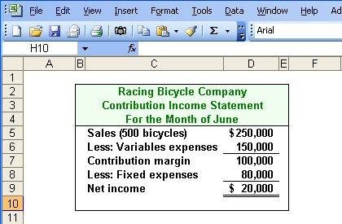
Basics of Cost-Volume-Profit Analysis
Contribution Margin (CM) is the amount remaining from sales revenue after variable expenses have been deducted.
Notes:
6-<number>
Contribution margin is defined as sales less variable expenses. In the case of Racing Bicycle Company, contribution margin is one hundred thousand dollars.

Slide 4
Basics of Cost-Volume-Profit Analysis
CM is used first to cover fixed expenses. Any remaining CM contributes to net operating income.
Notes:
6-<number>
Contribution margin is used first to cover fixed expenses. Any remaining contribution margin contributes to net operating income.

Slide 5
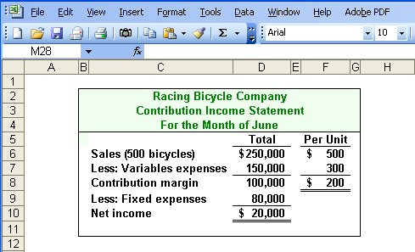
The Contribution Approach
Sales, variable expenses, and contribution margin can also be expressed on a per unit basis. If Racing sells an additional bicycle, $200 additional CM will be generated to cover fixed expenses and profit.
Notes:
6-<number>
Sales, variable expenses, and contribution margin can also be expressed on a per unit basis. For each additional unit Racing Bicycle Company sells, $200 more in contribution margin will help to cover fixed expenses and provide a profit.
Each month Racing Bicycle must generate at least $80,000 in total contribution margin to break-even (which is the level of sales at which profit is zero). If Racing sells 400 units a month, it will be operating at the break-even point. If Racing sells one more bike (401 bikes), net operating income will increase by $200.

Slide 6
The Contribution Approach
Each month Racing must generate at least $80,000 in total CM to break even.
Notes:
6-<number>
Each month Racing Bicycle must generate at least $80,000 in total contribution margin to break-even (which is the level of sales at which profit is zero).

Slide 7
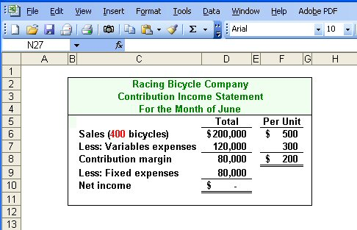
The Contribution Approach
If Racing sells 400 units in a month, it will be operating at the break-even point.
Notes:
6-<number>
If Racing sells 400 units a month, it will be operating at the break-even point. If Racing sells one more bike (401 bikes), net operating income will increase by $200.

Slide 8
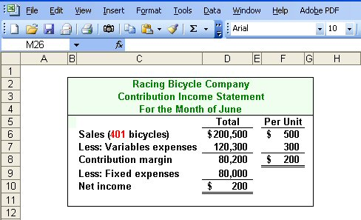
The Contribution Approach
If Racing sells one more bike (401 bikes), net
operating income will increase by $200.
Notes:
6-<number>
You can see that the sale of one unit above the break-even point yields net income of two hundred dollars for Racing Bicycle.

Slide 9

The Contribution Approach
We do not need to prepare an income statement to estimate profits at a particular sales volume. Simply multiply the number of units sold above break-even by the contribution margin per unit.
If Racing sells 430 bikes, its net income will be $6,000.
Notes:
6-<number>
If we develop equations to calculate break-even and net income, we will not have to prepare an income statement to determine what net income will be at any level of sales. For example, we know that if Racing Bicycle sells four hundred thirty bikes, net income will be six thousand dollars. The company will sell thirty bikes above the break-even unit sales and the contribution margin is two hundred dollars per bike. So, we multiply thirty bikes times two hundred dollars per bike and get net income of six thousand dollars..

Slide 10
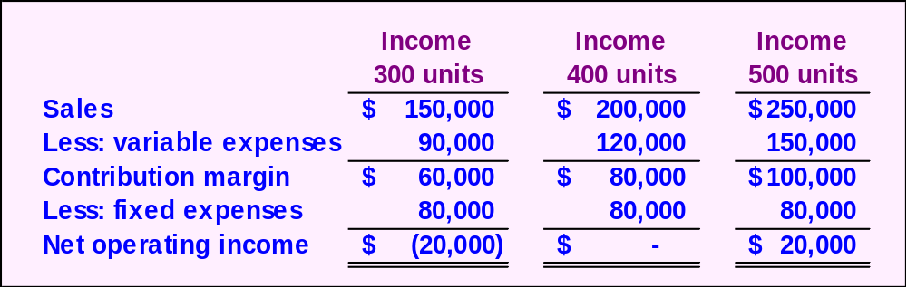
CVP Relationships in Graphic Form
The relationship among revenue, cost, profit and volume can be expressed graphically by preparing a CVP graph. Racing developed contribution margin income statements at 300, 400, and 500 units sold. We will use this information to prepare the CVP graph.
Notes:
6-<number>
The relationship among revenue, cost, profit and volume can be expressed graphically by preparing a cost-volume-profit (CVP) graph. To illustrate, we will use contribution income statements for Racing Bicycle Company at three hundred, four hundred, and five hundred units sold.

Slide 11
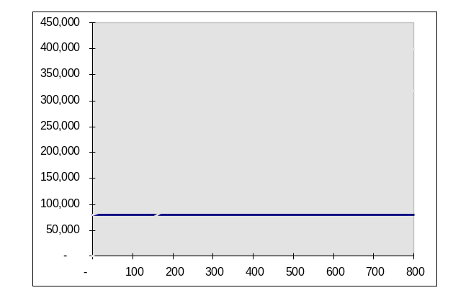
CVP Graph
Dollars
In a CVP graph, unit volume is usually represented on the horizontal (X) axis and dollars on the vertical (Y) axis.
Units
Notes:
6-<number>
In a CVP graph, unit volume is usually represented on the horizontal (X) axis and dollars on the vertical (Y) axis. Once we have settled on this convention we will plot the fixed cost.

Slide 12
CVP Graph
Dollars
Fixed Expenses
Units
Notes:
6-<number>
The first step begins by drawing a line parallel to the volume axis to represent total fixed expenses of eighty thousand dollars.

Slide 13
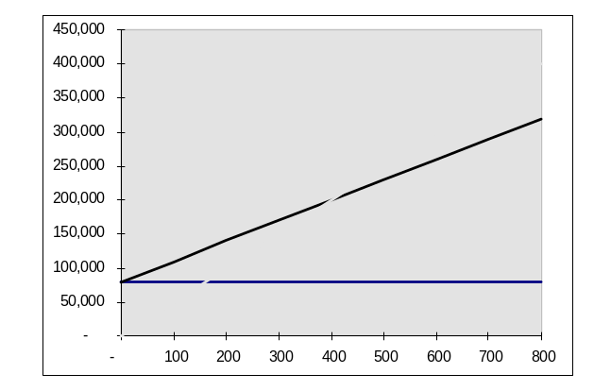
CVP Graph
Dollars
Total Expenses
Fixed Expenses
Units
Notes:
6-<number>
Next, choose some sales volume (for example, five hundred units) and plot the point representing total expenses (e.g., fixed and variable) at that sales volume. Draw a line through the data point back to where the fixed expenses line intersects the dollar axis.

Slide 14
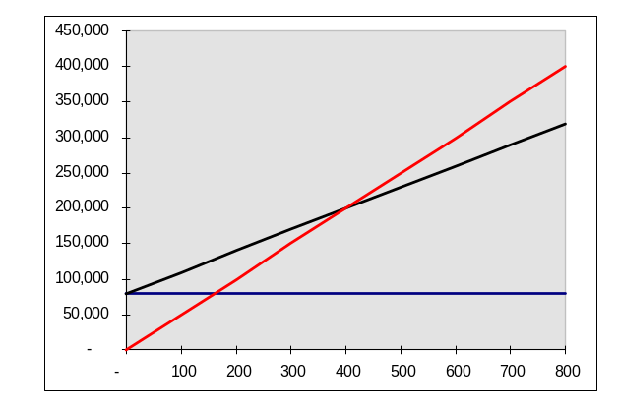
CVP Graph
Total Sales
Dollars
Total Expenses
Fixed Expenses
Units
Notes:
6-<number>
Finally, choose some sales volume (for example, five hundred units) and plot the point representing total sales dollars at the chosen activity level. Draw a line through the data point back to the origin.

Slide 15
CVP Graph
Break-even point
(400 units or $200,000 in sales)
Profit Area
Dollars
Loss Area
Units
Notes:
6-<number>
The break-even point is where the total revenue and total expenses lines intersect. In the case of Racing Bicycle, break-even is four hundred bikes sold, or sales revenue of two hundred thousand dollars.

Slide 16
Contribution Margin Ratio
The contribution margin ratio is:
For Racing Bicycle Company the ratio is:
Total CM
Total sales
CM Ratio =
$80,000
$200,000
= 40%
Each $1.00 increase in sales results in a total contribution margin increase of 40¢.
Notes:
6-<number>
We can calculate the contribution margin ratio of Racing Bicycle by dividing total contribution by total sales. In the case of Racing Bicycle, the contribution margin ratio is forty percent. This means that for each dollar increase in sales the company will produce forty cents in contribution margin.

Slide 17
Contribution Margin Ratio
Or, in terms of units, the contribution margin ratio is:
For Racing Bicycle Company the ratio is:
Unit CM
Unit selling price
CM Ratio =
$200
$500
= 40%
Notes:
6-<number>
We may also calculate the contribution margin ratio using per unit amounts.

Slide 18
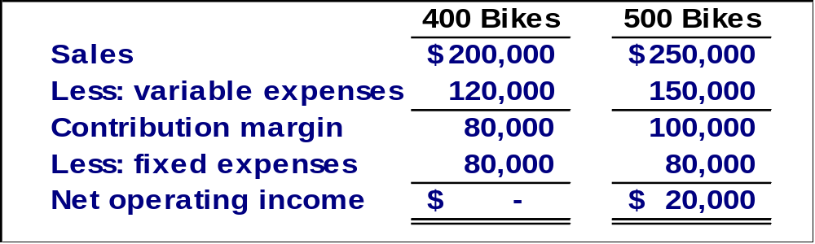
Contribution Margin Ratio
A $50,000 increase in sales revenue
results in a $20,000 increase in CM.
($50,000 × 40% = $20,000)
Notes:
6-<number>
Let’s see how we can use the contribution margin ratio to look at the contribution margin income statement of Racing Bicycle in a little different way. If Racing is able to increase its sales by fifty thousand dollars, it will increase contribution margin by twenty thousand dollars, that is, fifty thousand dollars times forty percent.

Slide 19
Quick Check ✓
Coffee Klatch is an espresso stand in a downtown office building. The average selling price of a cup of coffee is $1.49 and the average variable expense per cup is $0.36. The average fixed expense per month is $1,300. 2,100 cups are sold each month on average. What is the CM Ratio for Coffee Klatch?
  a. 1.319
  b. 0.758
  c. 0.242
  d. 4.139
Notes:
6-<number>
Can you calculate the contribution margin ratio for Coffee Klatch? The calculation may take a minute or so to complete.

Slide 20
Quick Check ✓
Coffee Klatch is an espresso stand in a downtown office building. The average selling price of a cup of coffee is $1.49 and the average variable expense per cup is $0.36. The average fixed expense per month is $1,300. 2,100 cups are sold each month on average. What is the CM Ratio for Coffee Klatch?
  a. 1.319
  b. 0.758
  c. 0.242
  d. 4.139
Unit contribution margin
Unit selling price
CM Ratio =
($1.49-$0.36)
$1.49
=
$1.13
$1.49
=
= 0.758
Notes:
6-<number>
How did you do? The CM ratio is seventy-five point eight percent.

Slide 21

Changes in Fixed Costs and Sales Volume
What is the profit impact if Racing can increase unit sales from 500 to 540 by increasing the monthly advertising budget by $10,000?
Notes:
6-<number>
Let’s assume that the management of Racing Bicycle believes it can increase unit sales from five hundred to five hundred forty if it spends ten thousand dollars on advertising. Would you recommend that the advertising campaign be undertaken? See if you can solve this problem before going to the next screen.

Slide 22
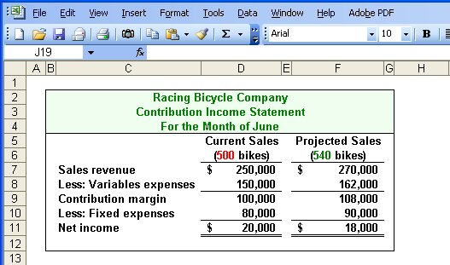
Changes in Fixed Costs and Sales Volume
$80,000 + $10,000 advertising = $90,000
Sales increased by $20,000, but net operating income decreased by $2,000.
Notes:
6-<number>
As you can see, even if sales revenue increases to two hundred seventy thousand dollars, Racing will experience a twelve thousand dollar increase in variable costs and a ten thousand dollar increase in fixed costs (the new advertising campaign). As a result net income will actually drop by two thousand dollars. The advertising campaign would certainly not be a good idea. We can help management see the problem before any additional monies are spent.

Slide 23
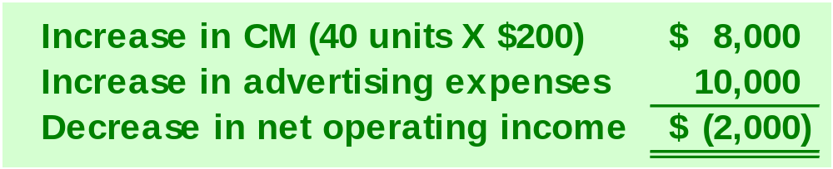
Changes in Fixed Costs and Sales Volume
The Shortcut Solution
Notes:
6-<number>
Here is a shortcut approach to looking at the problem. You can see that an increase in contribution margin is more than offset by the increased advertising costs.

Slide 24
Change in Variable Costs and Sales Volume
What is the profit impact if Racing can use higher quality raw materials, thus increasing variable costs per unit by $10, to generate an increase in unit sales from 500 to 580?
Notes:
6-<number>
Management at Racing Bicycle believes that using higher quality raw materials will result in an increase in sales from five hundred to five hundred eighty. The higher quality raw materials will lead to a ten dollar increase in variable costs per unit. Would you recommend the use of the higher quality raw materials?

Slide 25
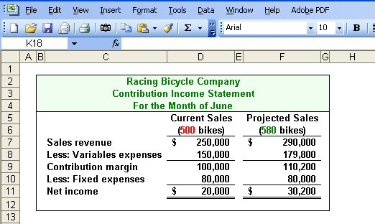
Change in Variable Costs and Sales Volume
580 units × $310 variable cost/unit = $179,800
Sales increase by $40,000, and net operating income increases by $10,200.
Notes:
6-<number>
As you can see, revenues will increase by forty thousand dollars (eighty bikes times five hundred dollars per bike), and variable costs will increase by twenty-nine thousand eight hundred dollars. Contribution margin will increase by ten thousand two hundred dollars. With no change in fixed costs, net income will also increase by ten thousand two hundred dollars.
The use of higher quality raw materials appears to be a profitable idea.

Slide 26
Change in Fixed Cost, Sales Price and Volume
What is the profit impact if Racing (1) cuts its selling price $20 per unit, (2) increases its advertising budget by $15,000 per month, and (3) increases unit sales from 500 to 650 units per month?
Notes:
6-<number>
Here is a more complex situation because we will experience a change in selling price, advertising expense, and unit sales. Would you support this plan?

Slide 27
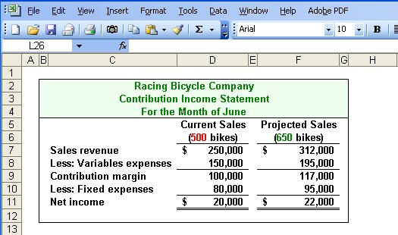
Change in Fixed Cost, Sales Price and Volume
Sales increase by $62,000, fixed costs increase by $15,000, and net operating income increases by $2,000.
Notes:
6-<number>
This appears to be a good plan because net income will increase by two thousand dollars. Take a few minutes and analyze the change in sales revenue, variable expenses and fixed expenses.

Slide 28
Change in Variable Cost, Fixed Cost and Sales Volume
What is the profit impact if Racing (1) pays a $15 sales commission per bike sold instead of paying salespersons flat salaries that currently total $6,000 per month, and (2) increases unit sales from 500 to 575 bikes?
Notes:
6-<number>
Here is another complex question involving cost-volume-profit relationships. In this question we eliminate a fixed cost and substitute a variable cost while increasing the units sold. Be careful with your calculation of the profit impact of these changes.

Slide 29
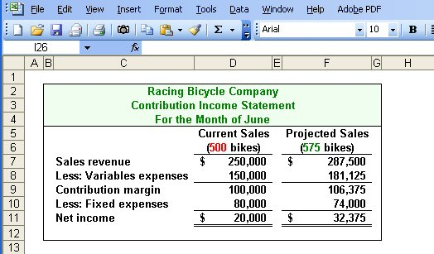
Change in Variable Cost, Fixed Cost and Sales Volume
Sales increase by $37,500, variable costs increase by $31,125, but fixed expenses decrease by $6,000.
Notes:
6-<number>
Net income increases by twelve thousand three hundred seventy-five dollars. Notice that sales revenue and variable expenses increased as well. Fixed expenses were decreased as a result of making sales commissions variable in nature.
How did you do? We hope you are beginning to see the potential power of CVP analysis.

Slide 30
Change in Regular Sales Price
If Racing has an opportunity to sell 150 bikes to a wholesaler without disturbing sales to other customers or fixed expenses, what price would it quote to the wholesaler if it wants to increase monthly profits by $3,000?
Notes:
6-<number>
Suppose Racing Bicycle has a one-time opportunity to sell one hundred fifty bikes to a wholesaler. There would be no change in the cost structure as a result of this sale. Racing wants the one-time sale to produce a profit of three thousand dollars. What selling price should Racing quote to the wholesaler?

Slide 31
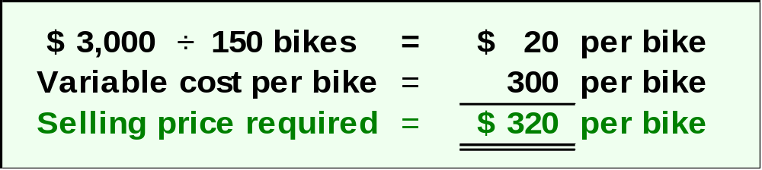
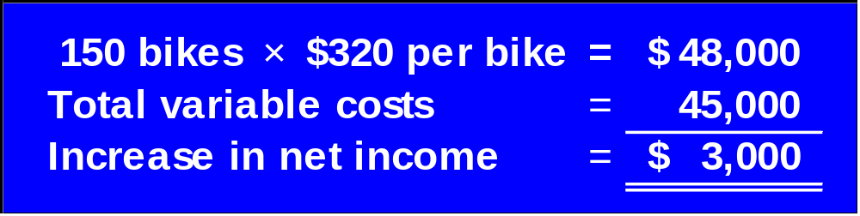

Change in Regular Sales Price
Notes:
6-<number>
If we desire a profit of three thousand dollars on the sale of one hundred fifty bikes, we must have a profit of twenty dollars per bike. The variable expenses associated with each bike are three hundred dollars, so we would quote a selling price of three hundred twenty dollars.
You can see the proof of the quote in the blue schedule.

Slide 32

Break-Even Analysis
Break-even analysis can be approached in two ways:
  Equation method
  Contribution margin method
Notes:
6-<number>
We can accomplish break-even analysis in one of two ways. We can use the equation method or the contribution margin method. We get the same results regardless of the method selected. You may prefer one method over the other. It’s a personal choice, but be aware there are some problems associated with either method. Some are easier to solve using the equation method, while others can be quickly solved using the contribution margin method.

Slide 33
Equation Method
Profits = (Sales – Variable expenses) – Fixed expenses
OR
Sales = Variable expenses + Fixed expenses + Profits
At the break-even point
profits equal zero
Notes:
6-<number>
The equation method is based on the contribution approach income statement. The equation can be stated in one of two ways:
Profits equal Sales less Variable expenses, less Fixed Expenses, or
Sales equal Variable expenses plus Fixed expenses plus Profits
Remember that at the break-even point profits are equal to zero.

Slide 34
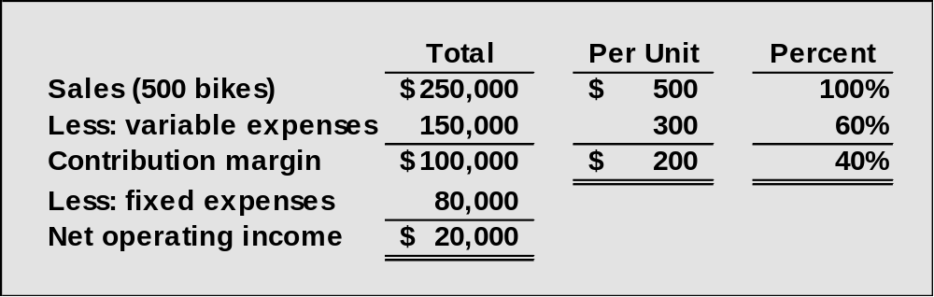
Break-Even Analysis
Here is the information from Racing Bicycle Company:
Notes:
6-<number>
Here is some information provided by Racing Bicycle that we will use to solve some problems. We have the contribution margin income statement, the selling price and variable expenses per unit, and the contribution margin ratio.

Slide 35
Equation Method
We calculate the break-even point as follows:
Sales = Variable expenses + Fixed expenses + Profits
$500Q = $300Q + $80,000 + $0
Where:
Q = Number of bikes sold
$500 = Unit selling price
$300 = Unit variable expense
$80,000 = Total fixed expense
Notes:
6-<number>
The break-even point in units is determined by creating the equation as shown, where Q is the number of bikes sold, five hundred dollars is the unit selling price, three hundred dollars is the unit variable expense, and eighty thousand dollars is the total fixed expense.
We need to solve for Q.

Slide 36
Equation Method
We calculate the break-even point as follows:
Sales = Variable expenses + Fixed expenses + Profits
$500Q = $300Q + $80,000 + $0
$200Q = $80,000
Q = $80,000 ÷ $200 per bike
Q = 400 bikes
Notes:
6-<number>
Solving this equation shows that the break-even point in units is 400 bikes. We want to be careful with the algebra when we group terms.

Slide 37
Equation Method
The equation can be modified to calculate the break-even point in sales dollars.
Sales = Variable expenses + Fixed expenses + Profits
X = 0.60X + $80,000 + $0
Where:
X = Total sales dollars
0.60 = Variable expenses as a % of sales $80,000 = Total fixed expenses
Notes:
6-<number>
The equation can be modified as shown to calculate the break-even point in sales dollars. In this equation, X is total sales dollars, point six zero (or sixty percent) is the variable expense as a percentage of sales, and eighty thousand dollars is the total fixed expense.
We need to solve for X.

Slide 38
Equation Method
The equation can be modified to calculate the break-even point in sales dollars.
Sales = Variable expenses + Fixed expenses + Profits
X = 0.60X + $80,000 + $0
0.40X = $80,000
X = $80,000 ÷ 0.40
X = $200,000
Notes:
6-<number>
Solving this equation shows that the break-even point is sales dollars is two hundred thousand dollars. Once again, be careful when you combine the X values in the equation.

Slide 39
Contribution Margin Method
The contribution margin method has two key equations.
Break-even point
in units sold
Fixed expenses
Unit contribution margin
=
Break-even point in
total sales dollars
Fixed expenses
CM ratio
=
Notes:
6-<number>
The contribution margin method has two key equations:
Break-even point in units sold equals Fixed expenses divided by CM per unit, and
Break-even point in sales dollars equals Fixed expenses divided by CM ratio.

Slide 40
Contribution Margin Method
Let’s use the contribution margin method to calculate the break-even point in total sales dollars at Racing.
Break-even point in
total sales dollars
Fixed expenses
CM ratio
=
$80,000
40%
= $200,000 break-even sales
Notes:
6-<number>
Part I
Let’s use the contribution margin method to calculate break-even in total sales dollars.
Part II
The break-even sales revenue is two hundred thousand dollars.

Slide 41
Quick Check ✓
Coffee Klatch is an espresso stand in a downtown office building. The average selling price of a cup of coffee is $1.49 and the average variable expense per cup is $0.36. The average fixed expense per month is $1,300. 2,100 cups are sold each month on average. What is the break-even sales in units?
  872 cups
  b. 3,611 cups
  c. 1,200 cups
  d. 1,150 cups
Notes:
6-<number>
Now use the contribution margin approach to calculate the break-even point in cups of coffee sold.

Slide 42
Quick Check ✓
Coffee Klatch is an espresso stand in a downtown office building. The average selling price of a cup of coffee is $1.49 and the average variable expense per cup is $0.36. The average fixed expense per month is $1,300. 2,100 cups are sold each month on average. What is the break-even sales in units?
  a. 872 cups
  b. 3,611 cups
  c. 1,200 cups
  d. 1,150 cups
Fixed expenses
Unit CM
Break-even =
$1,300
$1.49/cup - $0.36/cup
=
$1,300
$1.13/cup
=
= 1,150 cups
Notes:
6-<number>
The contribution margin per cup of coffee is one dollar and thirteen cents. The number of cups to sell to reach break-even is one thousand one hundred fifty.

Slide 43
Quick Check ✓
Coffee Klatch is an espresso stand in a downtown office building. The average selling price of a cup of coffee is $1.49 and the average variable expense per cup is $0.36. The average fixed expense per month is $1,300. 2,100 cups are sold each month on average. What is the break-even sales in dollars?
  a. $1,300
  b. $1,715
  c. $1,788
  d. $3,129
Notes:
6-<number>
Let’s calculate the break-even in sales dollars for Coffee Klatch.

Slide 44
Quick Check ✓
Coffee Klatch is an espresso stand in a downtown office building. The average selling price of a cup of coffee is $1.49 and the average variable expense per cup is $0.36. The average fixed expense per month is $1,300. 2,100 cups are sold each month on average. What is the break-even sales in dollars?
  a. $1,300
  b. $1,715
  c. $1,788
  d. $3,129
Break-even
sales
Fixed expenses
CM Ratio
=
$1,300
0.758
=
= $1,715
Notes:
6-<number>
With a contribution margin ratio of seventy-five point eight percent rounded, break-even sales revenue is one thousand seven hundred fifteen dollars.

Slide 45
Target Profit Analysis
The equation and contribution margin methods can be used to determine the sales volume needed to achieve a target profit.
Suppose Racing Bicycle Company wants to know how many bikes must be sold to earn a profit of $100,000.
Notes:
6-<number>
We can use either method to determine the revenue or units needed to achieve a target level of profits.
Suppose Racing Bicycle wants to earn net income of one hundred thousand dollars. How many bikes must the company sell to achieve this profit level?

Slide 46
The CVP Equation Method
Sales = Variable expenses + Fixed expenses + Profits
$500Q = $300Q + $80,000 + $100,000
$200Q = $180,000
Q = 900 bikes
Notes:
6-<number>
Instead of setting profit to zero like we do in a break-even analysis, we set the profit level to one hundred thousand dollars. Solving for Q, we see that the company will have to sell nine hundred bikes to achieve the desired profit level.

Slide 47
The Contribution Margin Approach
The contribution margin method can be used to determine that 900 bikes must be sold to earn the target profit of $100,000.
Unit sales to attain
the target profit
Fixed expenses + Target profit
Unit contribution margin
=
$80,000 + $100,000
$200/bike
= 900 bikes
Notes:
6-<number>
A quicker way to solve this problem is to add the desired profits to the fixed cost and divide the total by the contribution margin per unit. Notice we get the same result of nine hundred bikes.

Slide 48
Quick Check ✓
Coffee Klatch is an espresso stand in a downtown office building. The average selling price of a cup of coffee is $1.49 and the average variable expense per cup is $0.36. The average fixed expense per month is $1,300. How many cups of coffee would have to be sold to attain target profits of $2,500 per month?
  a. 3,363 cups
  b. 2,212 cups
  c. 1,150 cups
  d. 4,200 cups
Notes:
6-<number>
The Coffee Klatch wants to earn a monthly profit of two thousand five hundred dollars. How many cups of coffee must the company sell to reach this profit goal?

Slide 49
Quick Check ✓
Unit sales
to attain
target profit
Fixed expenses + Target profit
Unit CM
=
Coffee Klatch is an espresso stand in a downtown office building. The average selling price of a cup of coffee is $1.49 and the average variable expense per cup is $0.36. The average fixed expense per month is $1,300. How many cups of coffee would have to be sold to attain target profits of $2,500 per month?
  a. 3,363 cups
  b. 2,212 cups
  c. 1,150 cups
  d. 4,200 cups
$1,300 + $2,500
$1.49 - $0.36
=
$3,800
$1.13
=
= 3,363 cups
Notes:
6-<number>
We add the desired profit to the fixed cost and divide by the unit contribution of one dollar thirteen cents. The company must sell three thousand three hundred and sixty-three cups of coffee to reach its profit goal.

Slide 50
The Margin of Safety
The margin of safety is the excess of budgeted (or actual) sales over the break-even volume of sales.
Margin of safety = Total sales - Break-even sales
Let’s look at Racing Bicycle Company and determine the margin of safety.
Notes:
6-<number>
The margin of safety helps management assess how far above or below the break-even point the company is currently operating. To calculate the margin of safety we take total current sales and subtract break-even sales.
Let’s calculate the margin of safety for Racing Bicycle.

Slide 51
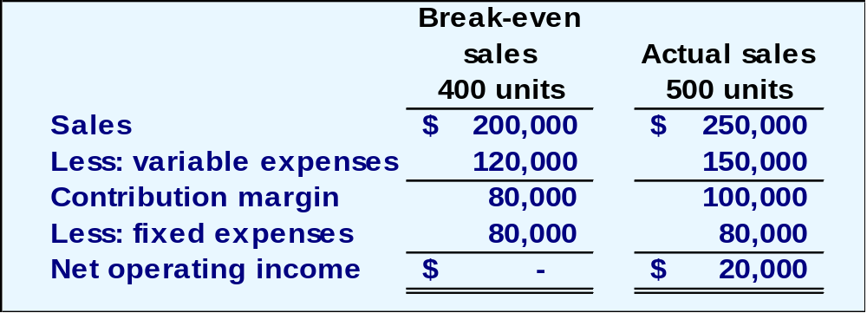
The Margin of Safety
If we assume that Racing Bicycle Company has actual sales of $250,000, given that we have already determined the break-even sales to be $200,000, the margin of safety is $50,000 as shown
Notes:
6-<number>
Racing Bicycle is currently selling five hundred bikes and producing total sales revenue of two hundred fifty thousand dollars. Sales at the break-even point are two hundred thousand dollars, so the company’s margin of safety is fifty thousand dollars.

Slide 52
The Margin of Safety
The margin of safety can be expressed as 20% of sales.
($50,000 ÷ $250,000)
Notes:
6-<number>
We can express the margin of safety as a percent of sales. In the case of Racing Bicycle, the margin of safety is twenty percent (fifty thousand dollars divided by two hundred fifty thousand dollars).

Slide 53
The Margin of Safety
The margin of safety can be expressed in terms of the number of units sold. The margin of safety at Racing is $50,000, and each bike sells for $500.
Margin of
Safety in units
$50,000
$500
=
= 100 bikes
Notes:
6-<number>
We can express the margin of safety as a percent of sales. In the case of Racing Bicycle, the margin of safety is twenty percent (fifty thousand dollars divided by two hundred fifty thousand dollars).

Slide 54
Quick Check ✓
Coffee Klatch is an espresso stand in a downtown office building. The average selling price of a cup of coffee is $1.49 and the average variable expense per cup is $0.36. The average fixed expense per month is $1,300. 2,100 cups are sold each month on average. What is the margin of safety?
  a. 3,250 cups
  b. 950 cups
  c. 1,150 cups
  d. 2,100 cups
Notes:
6-<number>
Let’s see if you can calculate the margin of safety in cups of coffee for the Coffee Klatch.

Slide 55
Quick Check ✓
Coffee Klatch is an espresso stand in a downtown office building. The average selling price of a cup of coffee is $1.49 and the average variable expense per cup is $0.36. The average fixed expense per month is $1,300. 2,100 cups are sold each month on average. What is the margin of safety?
  a. 3,250 cups
  b. 950 cups
  c. 1,150 cups
  d. 2,100 cups
Margin of safety = Total sales – Break-even sales
= 2,100 cups – 1,150 cups
= 950 cups
or
Margin of safety percentage
950 cups
2,100 cups
=
= 45%
Notes:
6-<number>
The margin of safety is nine hundred fifty cups, or we can calculate the margin of safety as forty five percent.

Slide 56

Cost Structure and Profit Stability
Cost structure refers to the relative proportion of fixed and variable costs in an organization. Managers often have some latitude in determining their organization’s cost structure.
Notes:
6-<number>
A company’s cost structure refers to the relative proportion of fixed and variable expenses. Some companies have high fixed expenses relative to variable expenses. Do you remember our discussion of utility companies? Because of the heavy investment in property, plant and equipment, many utility companies have a high proportion of fixed costs.

Slide 57
Cost Structure and Profit Stability
There are advantages and disadvantages to high fixed cost (or low variable cost) and low fixed cost (or high variable cost) structures.
An advantage of a high fixed
cost structure is that income
will be higher in good years
compared to companies
with lower proportion of
fixed costs.
A disadvantage of a high fixed
cost structure is that income
will be lower in bad years
compared to companies
with lower proportion of
fixed costs.
Notes:
6-<number>
Generally, companies with a high fixed cost structure will show higher net income in good years than companies with lower fixed cost structures. Just the opposite is true in bad years.

Slide 58
Operating Leverage
A measure of how sensitive net operating income is to percentage changes in sales.
Degree of
operating leverage
Contribution margin
Net operating income
=
Notes:
6-<number>
The degree of operating leverage is a measure, at any given level of sales, of how a percentage change in sales volume will affect profits. It is computed by dividing contribution margin by net operating income.
Let’s look at Racing Bicycle.

Slide 59
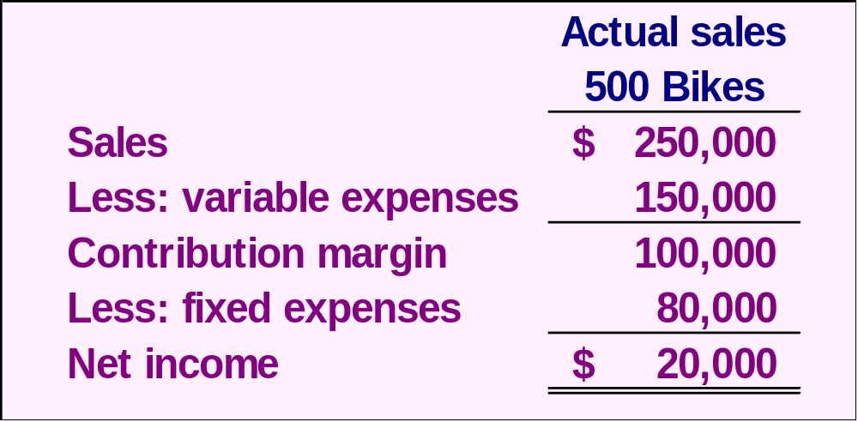
Operating Leverage
At Racing, the degree of operating leverage is 5.
$100,000
$20,000
= 5
Notes:
6-<number>
Recall that Racing is currently selling five hundred bikes and producing net income of twenty thousand dollars. Contribution margin is one hundred thousand dollars.
Operating leverage is five. We determine this by dividing the one hundred thousand contribution by net income of twenty thousand dollars.
Now that we calculated the degree of operating leverage for Racing, let’s see exactly what this means to management.

Slide 60
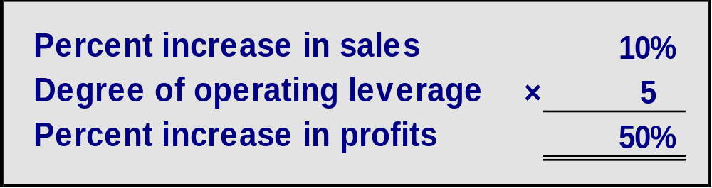
Operating Leverage
With an operating leverage of 5, if Racing increases its sales by 10%, net operating income would increase by 50%.
Here’s the verification!
Notes:
6-<number>
If Racing is able to increase sales by ten percent, net income will increase by fifty percent. We multiply the percentage increase in sales by the degree of operating leverage. Let’s verify the fifty percent increase in profit.

Slide 61
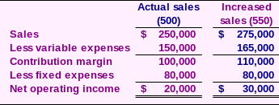
Operating Leverage
10% increase in sales from
$250,000 to $275,000 . . .
. . . results in a 50% increase in
income from $20,000 to $30,000.
Notes:
6-<number>
A ten percent increase in sales would increase bike sales from the current level of five hundred to five hundred fifty. Look at the contribution margin income statement and notice that income increased from twenty thousand to thirty thousand dollars. That ten thousand dollar increase in net income is a fifty percent increase.
So it is true that a ten percent increase in sales results in a fifty percent increase in net income. This is powerful information for a manager to have.

Slide 62
Quick Check ✓
Coffee Klatch is an espresso stand in a downtown office building. The average selling price of a cup of coffee is $1.49 and the average variable expense per cup is $0.36. The average fixed expense per month is $1,300. 2,100 cups are sold each month on average. What is the operating leverage?
  a. 2.21
  b. 0.45
  c. 0.34
  d. 2.92
Notes:
6-<number>
See if you can calculate the degree of operating leverage for the Coffee Klatch.

Slide 63
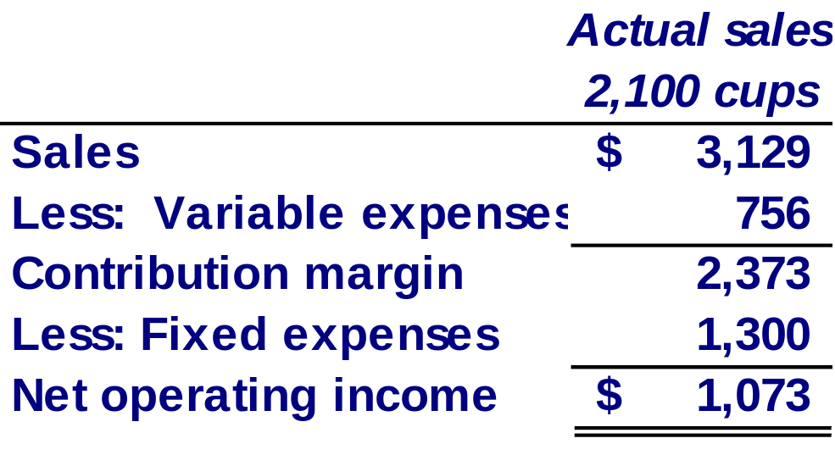
Quick Check ✓
Coffee Klatch is an espresso stand in a downtown office building. The average selling price of a cup of coffee is $1.49 and the average variable expense per cup is $0.36. The average fixed expense per month is $1,300. 2,100 cups are sold each month on average. What is the operating leverage?
  a. 2.21
  b. 0.45
  c. 0.34
  d. 2.92
Operating leverage
Contribution margin
Net operating income
=
$2,373
$1,073
=
= 2.21
Notes:
6-<number>
The computations took a while to complete, didn’t they. You can see that operating leverage is two point two one.

Slide 64
Quick Check ✓
At Coffee Klatch the average selling price of a cup of coffee is $1.49, the average variable expense per cup is $0.36, and the average fixed expense per month is $1,300. 2,100 cups are sold each month on average.
If sales increase by 20%, by how much should net operating income increase?
  a. 30.0%
  b. 20.0%
  c. 22.1%
  d. 44.2%
Notes:
6-<number>
If the Coffee Klatch is able to increase sales by twenty percent, what will be the increase in net income?

Slide 65
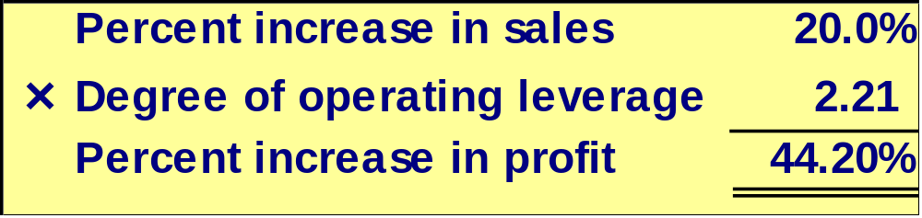
Quick Check ✓
At Coffee Klatch the average selling price of a cup of coffee is $1.49, the average variable expense per cup is $0.36, and the average fixed expense per month is $1,300. 2,100 cups are sold each month on average.
If sales increase by 20%, by how much should net operating income increase?
  a. 30.0%
  b. 20.0%
  c. 22.1%
  d. 44.2%
Notes:
6-<number>
You are right. The increase in net income is forty-four point two percent.

Slide 66
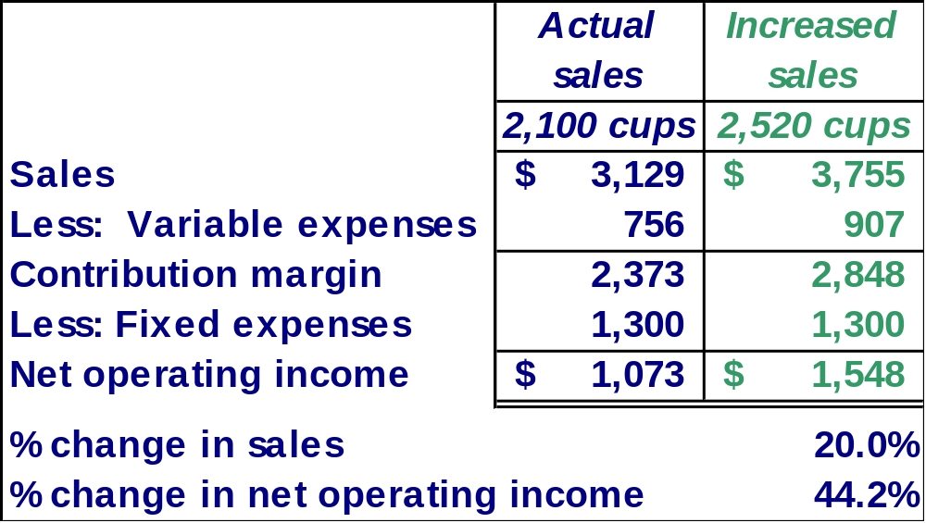
Verify Increase in Profit
Notes:
6-<number>
Here is our verification of the increase in net income. Take a few minutes and make sure you understand how we calculated all the numbers.

Slide 67
Structuring Sales Commissions
Companies generally compensate salespeople by paying them either a commission based on sales or a salary plus a sales commission. Commissions based on sales dollars can lead to lower profits in a company.
Let’s look at an example.
Notes:
6-<number>
You have probably heard that salespersons can be compensated on a commission basis. The commission is usually based on sales revenue generated. Some salespersons work on a salary plus commission.
When salespersons are paid a commission based on sales dollars generated, the income statement impact may not be fully understood.
Let’s look at an example.

Slide 68

Structuring Sales Commissions
Pipeline Unlimited produces two types of surfboards, the XR7 and the Turbo. The XR7 sells for $100 and generates a contribution margin per unit of $25. The Turbo sells for $150 and earns a contribution margin per unit of $18.
The sales force at Pipeline Unlimited is compensated based on sales commissions.
Notes:
6-<number>
This company produces two surfboards. The XR7 model sells for one hundred dollars and has a contribution margin per unit of twenty-five dollars. The second surfboard, the Turbo model, sells for one hundred fifty dollars and has a contribution margin of eighteen dollars per unit sold. The sales force at Pipeline is paid on sales commissions.

Slide 69
Structuring Sales Commissions
If you were on the sales force at Pipeline, you would push hard to sell the Turbo even though the XR7 earns a higher contribution margin per unit.
To eliminate this type of conflict, commissions can be based on contribution margin rather than on selling price alone.
Notes:
6-<number>
If you were on the sales force, you would try to sell all the Turbo models you could because it has a higher selling price per unit. The problem is that the XR7 model produces a higher contribution margin to the company.
It might be a good idea for Pipeline to base its sales commissions on contribution margin rather than selling price alone.

Slide 70
The Concept of Sales Mix
Sales mix is the relative proportion in which a company’s products are sold.
Different products have different selling prices, cost structures, and contribution margins.
Let’s assume Racing Bicycle Company sells bikes and carts and that the sales mix between the two products remains the same.
Notes:
6-<number>
When a company sells more than one product, break-even analyses become more complex because of the relative mix of the products sold. Different products will have different selling prices, cost structures and contribution margins.
Let’s expand the product line at Racing Bicycle and see what impact this has on break-even. We are going to assume that the sales mix between the products remains the same in our example.

Slide 71
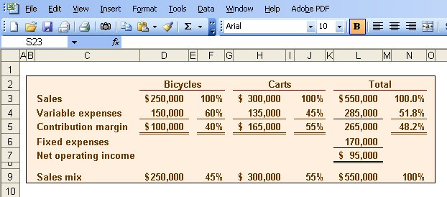
Multi-product break-even analysis
Racing Bicycle Co. provides the following information:
$265,000
$550,000
= 48.2% (rounded)
Notes:
6-<number>
Racing Bicycle sells both bikes and carts. Look at the contribution margin for each product. Notice that we subtract fixed expenses from the total contribution margin. We do not allocate the fixed costs to each product.
The sales mix shows that forty-five percent of the company’s sales revenue comes from the sale of bikes and fifty-five percent comes from the sale of carts.
The combined contribution margin ratio is forty-eight point two percent (rounded). Let’s look at break-even.

Slide 72
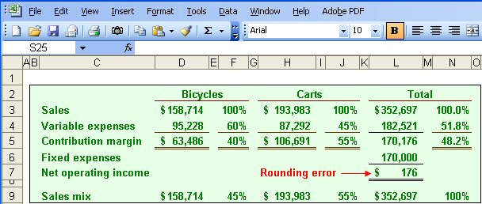
Multi-product break-even analysis
Break-even
sales
Fixed expenses
CM Ratio
=
$170,000
48.2%
=
= $352,697
Notes:
6-<number>
Part I
Break-even in sales dollars is three hundred fifty-two thousand six hundred ninety-seven dollars. We calculate this amount in the normal way. We divide total fixed expenses of one hundred seventy thousand dollars by the combined contribution margin ratio.
Part II
We begin by allocating total break-even sales revenue to the two products. Forty-five percent of the total is assigned to the bikes and fifty-five percent to the carts.
The variable costs-by-product are determined by multiplying the variable expense percent times the assigned revenue. The contribution margin is the difference between the assigned revenue and the variable expenses. Once again we subtract fixed expenses from the combined total contribution margin for the two products. Because we used a rounded contribution margin percent, we have a rounding error of one hundred seventy-six dollars.
Obviously, the more products a company has, the more complex the break-even analysis becomes.

Slide 73

Key Assumptions of CVP Analysis
Selling price is constant.
Costs are linear.
In multi-product companies, the sales mix is constant.
In manufacturing companies, inventories do not change (units produced = units sold).
Notes:
6-<number>
Here are the four key assumptions of cost-volume-profit analysis. You are probably familiar with the first three by now. The forth assumption tells us that there can be no change in inventory levels. That is, all units produced are sold in the current period.

Slide 74

End of Chapter 6
Notes:
6-<number>
This chapter covered a number of important concepts for business managers. If you wish to become an effective manager after leaving college, it is important that you understand CVP analysis and how to apply it.

