Slide 1
COM421 AE2 Presentation
By: Ismail Kefokeris
Begin
Notes:
Hello and welcome to my COM421 Assignment 2 presentation, this presentation will cover what data structures and algorithms were used in my program aswell as how I implemented them and why.
Lets get started

Slide 2
Data Structures
Dictionaries
Deques
Lists
Next
Notes:
First thing I will speak about is data structures, there are 3 main data structures used in my program, 1. Dictionaries 2. Deques and 3. Lists …..Lets start with dictionaries
Now deques
And finally lists

Slide 3
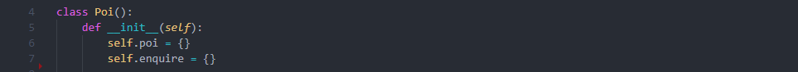
Dictionaries
Used to store values under a specific key
Less memory consumption
Time complexity of O(1) – on average
Used in storage of POI and enquiries
Back
Notes:
Dictionaries were a big part of my program as they stored all the POIs and their values,
I chose to use dictionaries because of its time complexity of O(1) and the amount of memory it consumes (which is much less compared to other data structures like lists).
Additionally for my program to locate specific POIs all I would need is the key of the POI meaning regardless of dictionary size the performance will not be effected.

Slide 4
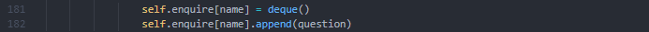
Deque
Used to store questions on POI
Located inside a dictionary (specific to the POI)
Faster than lists with a time complexity of O(1)
Used in storage of questions inside dictionary “enquire”
Back
Notes:
Deques are used in the storage of all enquiries made by the user, they are stored inside a dictionary “enquire”. (allows for separation between POIs)
Deques were chosen over lists specifically because of its much better performance with a time complexity of O(1) compared to a lists time complexity of O(n)
this is primarily because deques avoid the need in using shifting operations during appending or popping.

Slide 5
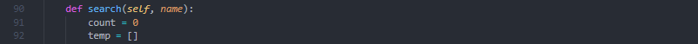
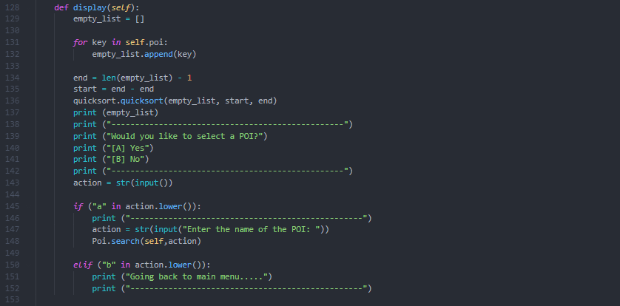
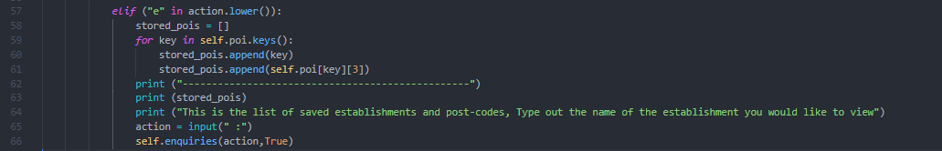
Lists
Used as a temporary variable
Allows the tracking of order (indexing)
Used in most methods
Back
Notes:
Lists are used in the program multiple times but only really ever as temporary variables, The main use of lists in the program were to store all POI keys so that they can be sorted and displayed to the user this is possible with lists and not dictionaries because lists keep track of the order through indexing unlike dictionary which uses keys to access values (stored in memory)

Slide 6


Algorithms
Quicksort – Only algorithm used in the program
Recursion based
Utilises Hoare Partitioning Algorithm
Time Complexity of O(n) or worst case O(n^2)
Notes:
The two algorithms utilised inside my code is the quicksort algorithm and the Hoare algorithm (which is used inside quicksort). Quick sort is a recursion based algorithm which means it will take the list and split it up into smaller parts until it has sorted the whole list. To do this it makes use of the Hoare Partitioning Algorithm which is a very efficient algorithm which works by having two points on either end of a list move up and simultaneously compare their values to the “pivot” which is the mid point splitting the list up into two partitions (A bigger than section on the right of the pivot and a smaller than section on the left) unfortunately even though this is one of the more efficient ways to program quicksort it still degrades the time complexity to about O(n^2)

