Slide 1
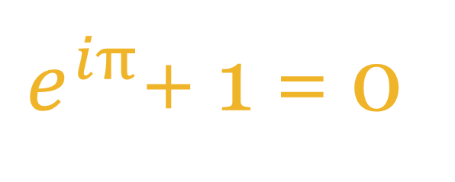
$e^{iπ}$+ 1 = 0
Euler's Identity
The Most Beautiful Equation in Mathematics
Ismail Noorudin • Shehryar Rind
Engineering Mathematics Project • December 2025

Slide 2

The Mystery
How can an irrational number raised to the power of
an imaginary multiple of another irrational number
equal exactly
negative one?
$e^{iπ}$ = -1
The answer lies in Taylor series and complex analysis.

Slide 3
Five Fundamental Constants
e
i
π
1
0
≈ 2.71828
= √(−1)
≈ 3.14159
a × 1 = a
a + 0 = a
Natural base Calculus
Imaginary unit Complex Numbers
Circle constant Geometry
Multiplicative Identity
Additive Identity
Five constants from different branches of mathematics — united in one equation

Slide 4
The Cyclic Pattern of i
i¹ = i
WHY THIS MATTERS
When we substitute i^x into the exponential series, powers of i create the alternating signs we see in sine and cosine!
i² = −1
cycle
i⁰ = 1
i⁰ = 1 → positive real
i¹ = i → positive imaginary
i² = −1 → negative real
i³ = −i
i³ = −i → negative imaginary
i⁴ = 1 → Pattern repeats every 4 powers

Slide 5
Taylor Series: The Key Tool
Taylor series express any smooth function as an infinite polynomial:
f(x) = f(0) + f′(0) . x + (f″(0) / 2!) . x² + (f ‴(0)/3!) . x³ + ⋯
Why It Works
Why It Matters
Key Insight
We match the function's value and all its derivatives at a single point
Turns complex functions into sums we can manipulate algebraically
More terms = better approximation to the actual function

Slide 6
Taylor Series: Simulation

Slide 7



Taylor Series for $e^{x}$
KEY PROPERTY
$\frac{d}{dx}$ ($e^{x}$) = $e^{x}$
THE EXPONENTIAL SERIES
e = 1 + x + x²/2! + x³/3! + x⁴/4! + ⋯
Since e^x equals its own derivative, each coefficient can be found by repeated differentiation:
Set x = 0: e = 1 → a = 1
= Σ x/n!
Differentiate, x = 0 → b = 1
Again → c = 1/2!
Contains ALL powers of x with positive coefficients
Pattern: coefficient of x is 1/n!

Slide 8

Taylor Series for sin(x) and cos(x)
sin(x)
= x − x³/3! + x⁵/5! − x⁷/7! + ⋯
Only odd powers with alternating signs
cos(x)
= 1 − x²/2! + x⁴/4! − x⁶/6! + ⋯
Only even powers with alternating signs
💡 KEY OBSERVATION
The exponential series contains all terms from both sine and cosine, but with all positive signs. This hints at a deep connection!

Slide 9

Deriving Euler's Formula
STEP 1: Substitute ix
$e^{ix}$ = 1 + ix + (ix)²/2! + (ix)³/3! + (ix)⁴/4! + ⋯
STEP 2: Apply powers of i
= 1 + ix − x²/2! − ix³/3! + x⁴/4! + ix⁵/5! − ⋯
STEP 3: Separate real and imaginary
= (1 − x²/2! + x⁴/4! − ⋯) + i(x − x³/3! + x⁵/5! − ⋯)
STEP 4: Recognize the series!
= cos(x) + i · sin(x)
EULER'S FORMULA
$e^{ix}$ = cos(x) + i · sin(x)

Slide 10


Arriving at Euler's Identity
Substitute x = π into Euler's Formula:
$e^{iπ}$ = cos(π) + i · sin(π)
$e^{iπ}$ = −1 + i · 0 = −1
Add 1 to both sides:
$e^{iπ}$ + 1 = 0
Five constants from different branches of mathematics, united in perfect harmony.

Slide 11

Geometric Interpretation
THE UNIT CIRCLE
θ = 0 → e = 1 (right)
θ = π/2 → e = i (top)
θ = π → e = −1 (left)
θ = 3π/2 → e = −i (bottom)
WHAT $e^{iθ}$ MEANS
$e^{iθ}$represents a point on the unit circle at angle θ radians from the positive real axis.
Real part = cos(θ) → horizontal position
Imaginary part = sin(θ) → vertical position
e means "rotate by π radians (180°)" — taking us from 1 to −1.
$e^{iθ}$traces the unit circle as θ varies

Slide 12

Connection to Course
PARAMETRIC CURVES
CAUCHY-RIEMANN EQUATIONS
$e^{iθ}$ = cos(θ) + i·sin(θ) is equivalent to:
For analytic functions f(z) = u + iv:
r⃗(θ) = ⟨cos(θ), sin(θ)⟩
∂u/∂x = ∂v/∂y, ∂u/∂y = −∂v/∂x
The standard unit circle parameterization used in line integrals!
Related to conservative fields: ∇ × F⃗ = 0
GREEN'S THEOREM CONNECTION
Cauchy's integral theorem in complex analysis is essentially Green's theorem applied to complex functions. The line integral machinery from this course extends directly into complex analysis.
The tools we've learned for vector fields and line integrals form the foundation of complex analysis.

Slide 13
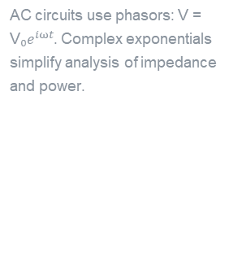
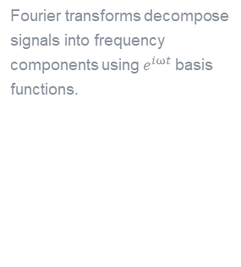
Real-World Applications
Electrical Engineering
Signal Processing
Quantum Mechanics
Control Systems
AC circuits use phasors: V = V₀$e^{iωt}$. Complex exponentials simplify analysis of impedance and power.
Fourier transforms decompose signals into frequency components using $e^{iωt}$ basis functions.
Wave functions are complex exponentials. Schrödinger's equation relies on complex analysis.
Transfer functions and stability analysis use poles and zeros in the complex plane.
Euler's formula is the mathematical foundation behind modern technology

Slide 14

CONCLUSION
$e^{iπ}$+ 1 = 0
Five fundamental constants from different branches of mathematics
united through Taylor series and complex analysis.
"The most remarkable formula in mathematics"
— Richard Feynman

Slide 15
Thank You
Presented by
Ismail Noorudin & Shehryar Rind
Engineering Mathematics • MATH 202 • December 2025

