Slide 1
EDES 301 ACL Rehab Device Proposal
10/5/2025
Ismail Tambawala

Slide 2
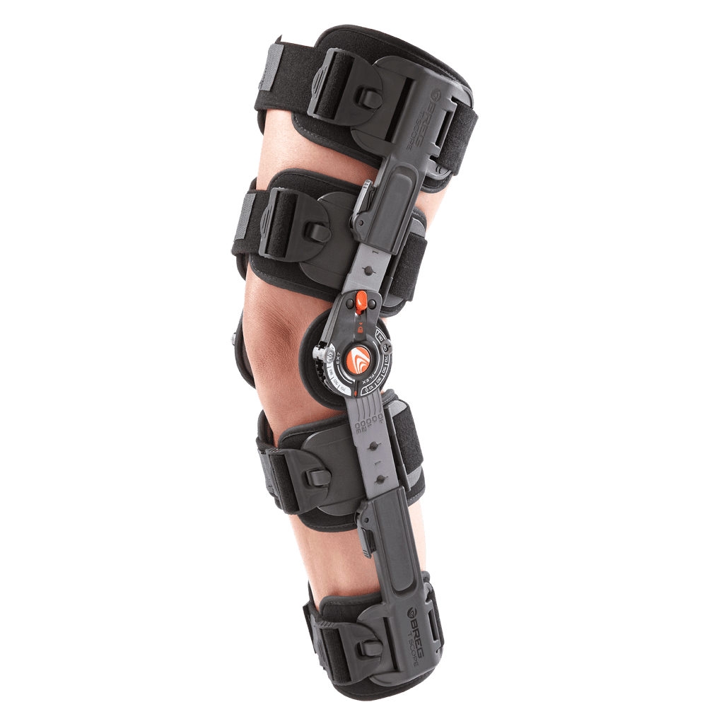
Background Information
Improvements to ACL rehab device. Using ACL post-surgery brace and incorporating electrical devices commonly used for rehab and that would be beneficial to track progress. Using muscle sensors to track activation and how it improves over time. Using motion tracking to measure rotation for flexion/extension data as well as acceleration/deceleration to see force outputs and torque (data commonly collected during physiotherapy visits to gauge rehab progress.
Link to existing muscle sensing project: https://myoware.com/project/conductive-fabric-electrodes/

Slide 3
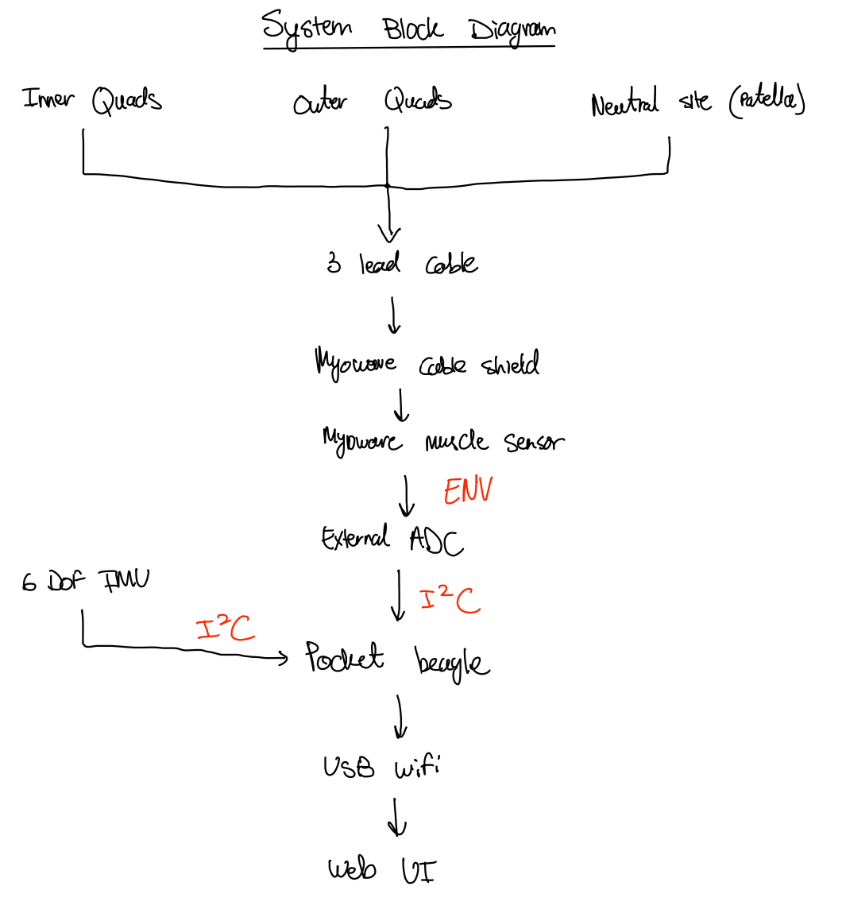
System Block Diagram

Slide 4
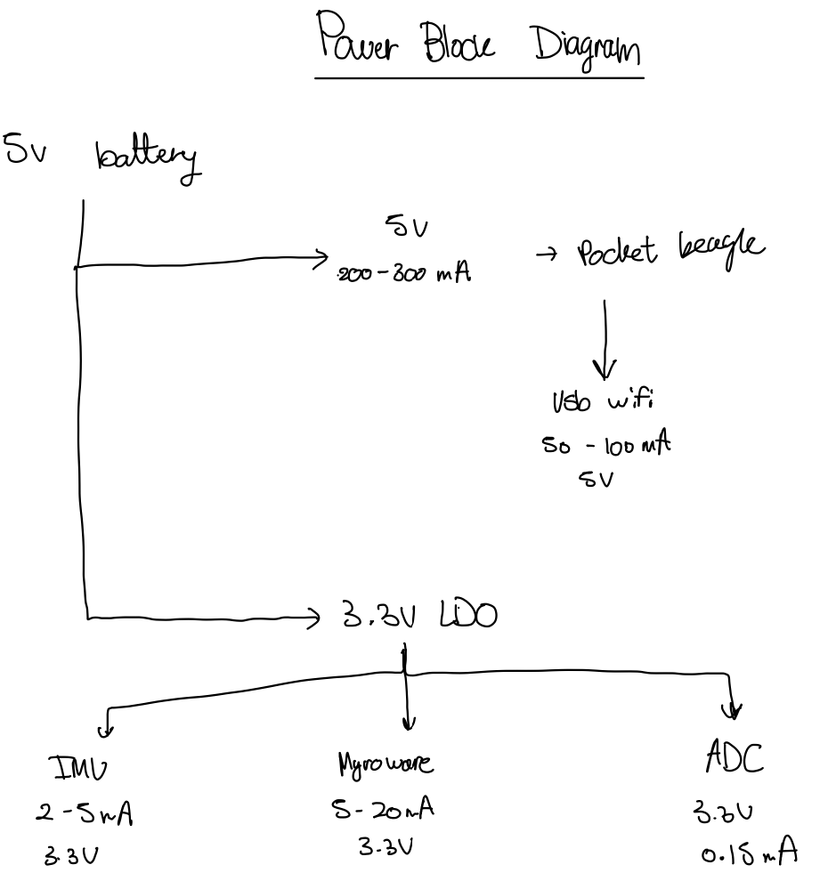
Power Block Diagram

Slide 5
Components / Budget
Component | EDES301 to Buy? | Cost
6 axis IMU – Amazon - https://tinyurl.com/3btbam6e | Yes | $2.10/each
MyoWare 2.0 Muslce Sensor – Adafruit - https://tinyurl.com/ykjbhzjz | No | $45
MyoWare Cable Shield – Sparkfun - https://tinyurl.com/5e7rd3ye | Yes | $6.10
Sensor Cable (3 electrode pads) – Sparkfun - https://www.sparkfun.com/sensor-cable-electrode-pads-3-connector.html | Yes | $8.75
12mm snap buttons – Amazon - https://tinyurl.com/2tbwepv9 | Yes | $6.99
Conductive Fabric – Adafruit - https://tinyurl.com/yc48k5mb | Yes | $4.95
5V battery suuply – not sure where yet – maybe https://tinyurl.com/mb5tf6 ?? | Yes | $14.00
Usb wifi hub – Amazon - https://www.amazon.com/wifi-adapter-usb-pc-network/dp/B008IFXQFU?th=1 | No | $9.99
3.3V ldo – Digikey - https://www.digikey.com/en/products/detail/diodes-incorporated/AZ1117CH-3-3TRG1/4470985 | Yes | $0.2
External ADC – not sure if needed yet?? | Yes | $2 (max)

