Slide 1

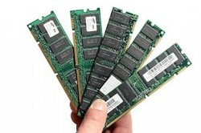
Primary Memory
Week 5
Basic Concepts of Computer Science

Slide 2
Today’s Topics
Purpose of Memory
RAM , ROM
SRAM, DRAM, and VRAM.
PROM – Programmable Read Only Memory
EPROM – Erasable Programmable Read Only Memory
EEPROM – Electrically Erasable Programmable Read Only Memory
SIMM vs DIMM
Basic Concepts of Computer Science a.pradeep@newuzbekistanuniversity.uz

Slide 3
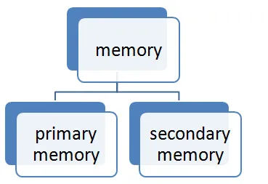
Memory
Memory is an internal storage area in a computer, which is available to store data and programs either permanently or temporarily.
Computer memory is broadly divided into two groups and they are:
Primary memory
Secondary memory
Basic Concepts of Computer Science a.pradeep@newuzbekistanuniversity.uz
Notes:
Memory can be divided into two categories: It can store permanently or temporarily. Primary memory can store data temporarily other hand secondary storage can store data permanently.

Slide 4
Classification by priority
a) Primary - storage of intermediate data
- necessary to run the computer
- RAM, Cache
b) Secondary - long-term storage of data
- HDD
c) Tertiary - CD, DVD,
d) Off-line - disconnected storage
- unplugged USB flash drive
Basic Concepts of Computer Science a.pradeep@newuzbekistanuniversity.uz
Notes:
RAM or random access memory stores intermediate data only while using computer. Secondary memory is long term storage HDD or CD or DVD. offline storage cloud storage.

Slide 5
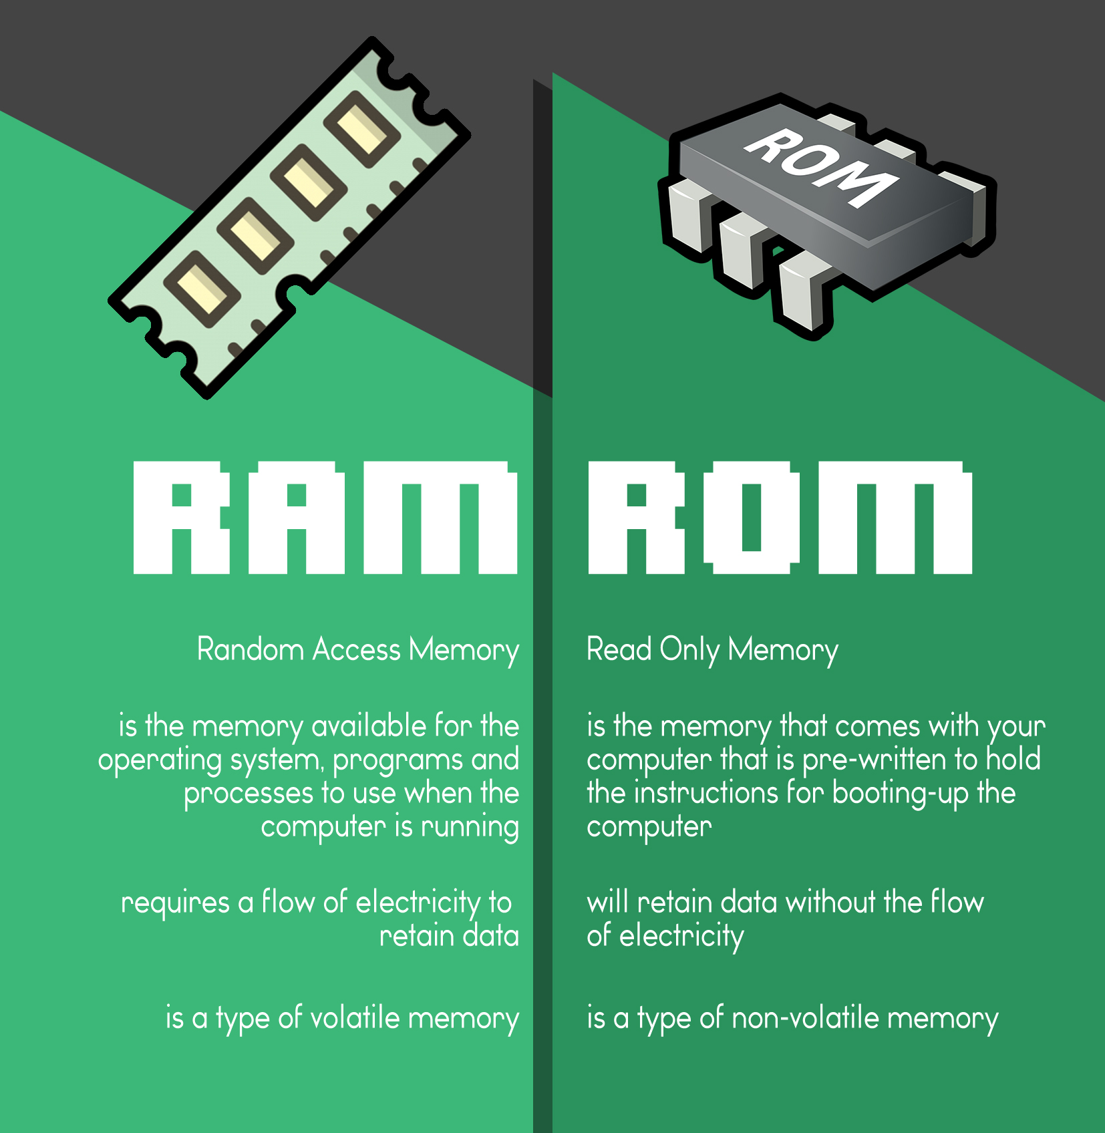
Classification by access
Read-Only Memory
Read-Write Memory
Basic Concepts of Computer Science a.pradeep@newuzbekistanuniversity.uz
Notes:
Random access memory also can be divided into two categories: Read only memory and read-write memory. As we know already RAM is in the classification read and write memory.
Read only memory or ROM we will see in a short in more detail.

Slide 6
Volatile vs Non Volatile memory
Volatile - requires constant power to maintain the stored information
Non-volatile - stores the information even without power supply
Examples ?
Basic Concepts of Computer Science a.pradeep@newuzbekistanuniversity.uz

Slide 7
Primary Memory
Primary memory is the only type of memory which is directly accessed by the CPU. The CPU continuously reads instructions stored in the primary memory and executes them.
Any data that has to be operated by the CPU is also stored. The information is transferred to various locations through the BUS. Primary memories are of two types. They are:
ROM
RAM
Basic Concepts of Computer Science a.pradeep@newuzbekistanuniversity.uz

Slide 8
ROM
It stands for Read Only Memory. In this, the data will be furnished by the manufacturers regarding the system, so this information can simply be read by the user but cannot add new data or it cannot be modified. ROMs are of distinct types:
MROM (Mask Read-Only Memory)
PROM (Programmable Read-Only Memory)
EPROM (Erasable Programmable Read-Only Memory)
EEPROM (Electrically Erasable Programmable Read-Only Memory)
Basic Concepts of Computer Science a.pradeep@newuzbekistanuniversity.uz

Slide 9
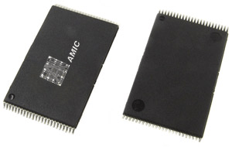
MROM (Mask Read-Only Memory)
its content is programmed by manufacturer not by user
then we can use it only for reading
the oldest type of ROM
Basic Concepts of Computer Science a.pradeep@newuzbekistanuniversity.uz

Slide 10
MROM (Mask Read-Only Memory)
In high volumes, mask read-only memory (ROM) is a cost-effective alternative
Mask ROM (MROM) chips are used in computer systems that require long-term sustainability. Examples of computer systems that use Mask ROM chips or MROM chips include network operating systems and server operating systems.
Basic Concepts of Computer Science a.pradeep@newuzbekistanuniversity.uz

Slide 11
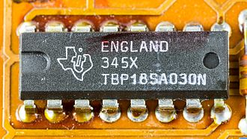
PROM (Programmable Read-Only Memory)
A (PROM) is a form of digital memory where the setting of each bit is locked by a fuse or antifuse.
The data in them are permanent and cannot be changed.
PROMs are used in digital electronic devices to store permanent data, usually low level programs such as firmware or microcode.
Texas Instruments PROM type TBP18SA030N
Basic Concepts of Computer Science a.pradeep@newuzbekistanuniversity.uz

Slide 12
PROM (Programmable Read-Only Memory)
Blank PROM chips are programmed by plugging them into a device called a PROM programmer.
A typical PROM comes with all bits reading as "1". Burning a fuse bit during programming causes the bit to be read as "0" by "blowing" the fuses, which is an irreversible process.
These types of memories are frequently used in microcontrollers, video game consoles, mobile phones, radio-frequency identification (RFID) tags, implantable medical devices, high-definition multimedia interfaces (HDMI)
Basic Concepts of Computer Science a.pradeep@newuzbekistanuniversity.uz

Slide 13
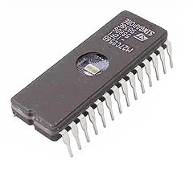
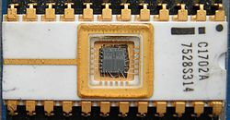
EPROM (Erasable Programmable Read-Only Memory)
Can be erased by UV light
Recognizable by the transparent window in the top
Basic Concepts of Computer Science a.pradeep@newuzbekistanuniversity.uz

Slide 14
EPROM (Erasable Programmable Read-Only Memory)
"Erasable" means that the data on it can be removed. With these chips, erasure is carried out by exposure to intensive ultraviolet light in the area of 254 nm wavelength.
This memory type can be burned (programmed) by a programming device and then retains its data until an erasing device erases it. During the programming process, any desired number of bits from one to zero can be programmed. Eproms can also be programmed repeatedly without being erased as long as the bits are only changed from one to zero or remain on zero. To change a bit from zero to one, erasuing is necessary
Basic Concepts of Computer Science a.pradeep@newuzbekistanuniversity.uz

Slide 15
EEPROM (Electrically Erasable Programmable Read-Only Memory)
EEPROM is user-modifiable read-only memory (ROM) that can be erased and reprogrammed (written to) repeatedly through the application of higher than normal electrical voltage
Unlike EPROM chips, EEPROMs do not need to be removed from the computer to be modified.
Basic Concepts of Computer Science a.pradeep@newuzbekistanuniversity.uz

Slide 16
EEPROM (Electrically Erasable Programmable Read-Only Memory)
EEPROM chip has to be erased and reprogrammed in its entirety, not selectively. It also has a limited life - that is, the number of times it can be reprogrammed is limited to tens or hundreds of thousands of times. In an EEPROM that is frequently reprogrammed while the computer is in use, the life of the EEPROM can be an important design consideration.
What is flash memory ( type of EEPROM) ?
Basic Concepts of Computer Science a.pradeep@newuzbekistanuniversity.uz

Slide 17
RAM
It stands for Random Access Memory. Here data can be stored temporarily, so this type of memory is called as temporary memory or volatile memory because when power fails the data from RAM will be erased. The information stored in the RAM is basically loaded from the computer’s disk and includes information related to the operating system and applications that are currently executed by the processor.
RAM is considered random access because any memory cell can be directly accessed if its address is known.
Basic Concepts of Computer Science a.pradeep@newuzbekistanuniversity.uz

Slide 18
SRAM
SRAM (static RAM) is random access memory (RAM) that retains data bits in its memory as long as power is being supplied.
Unlike dynamic RAM (DRAM), which stores bits in cells consisting of a capacitor and a transistor, SRAM does not have to be periodically refreshed.
Static RAM provides faster access to data and is more expensive than DRAM.
SRAM is used for a computer's cache memory and as part of the random access memory digital-to-analog converter on a video card.
The term is pronounced "S-RAM", not "sram."
Homework - https://www.youtube.com/watch?v=kU2SsUUsftA
Basic Concepts of Computer Science a.pradeep@newuzbekistanuniversity.uz

Slide 19
SRAM
While SRAM can operate at higher speeds than DRAM, it is more expensive to manufacture because of its complex internal structure, so most of the RAM on the motherboard is DRAM.
As well, due to its condensed size it is not ideal for main memory. SRAM is best suited for secondary operations like the CPU’s fast cache memory and storing registers.
SRAM’s access time is a lot faster than DRAM’s. SRAM is about 10 nanoseconds; DRAM’s access time is about 60 nanoseconds.
Basic Concepts of Computer Science a.pradeep@newuzbekistanuniversity.uz

Slide 20
DRAM
DRAM is widely used as a computer’s main memory. Each DRAM memory cell is made up of a transistor and a capacitor within an integrated circuit, and a data bit is stored in the capacitor.
Since transistors always leak a small amount, the capacitors will slowly discharge, causing information stored in it to drain; hence, DRAM has to be refreshed (given a new electronic charge) every few milliseconds to retain data.
Basic Concepts of Computer Science a.pradeep@newuzbekistanuniversity.uz

Slide 21
DRAM
The main advantages of DRAM are its simple design and low cost in comparison to alternative types of memory. The main disadvantages of DRAM are its high volatility and high power consumption relative to other options.
Homework - https://www.youtube.com/watch?v=EWDirCg-Wu8
Basic Concepts of Computer Science a.pradeep@newuzbekistanuniversity.uz

Slide 22
DRAM - Advantages
When cost-efficient storage is required, then DRAM is used.
DRAM used in personal computers.
It also used in networking.
It used in battery operated synchronous and asynchronous applications.
DRAM memories also used for the enhancement of graphics functions of a computer.
Basic Concepts of Computer Science a.pradeep@newuzbekistanuniversity.uz

Slide 23
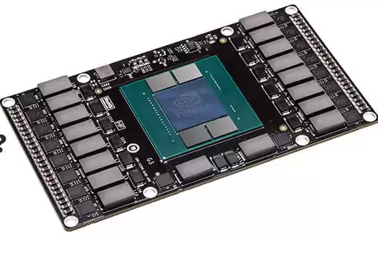
VRAM
VRAM (video RAM) refers to any type of random access memory (RAM) specifically used to store image data for a computer display. VRAM's purpose is to ensure the even and smooth execution of graphics display.
It is most important in applications that display complex image textures or render polygon-based three-dimensional (3D) structures. People commonly use VRAM for applications such as video games or 3D graphic design programs.
Basic Concepts of Computer Science a.pradeep@newuzbekistanuniversity.uz

Slide 24
VRAM
All types of VRAM are special arrangements of dynamic RAM (DRAM). VRAM is a buffer between the computer processor and the display and is often called the frame buffer. When images are to be sent to the display, they are first read by the processor as data from some form of main (non-video) RAM and then written to VRAM.
From VRAM, the data is sent as a digital signal via a digital video interface or high-definition multimedia interface, or HDMI
Homework - https://www.youtube.com/watch?v=XKxs0_BXWiU
Basic Concepts of Computer Science a.pradeep@newuzbekistanuniversity.uz

Slide 25
SIMM vs DIMM
A SIMM (Single In-Line Memory Module) has a single line of connectors. Connectors on each side of the Board are the same. SIMMs are now obsolete.
A DIMM (Dual In-Line Memory Module) has 2 lines of connectors. Connectors on each side of the board are not connected. The most popular types of DIMM are DDR, DDR2 and DDR3
Basic Concepts of Computer Science a.pradeep@newuzbekistanuniversity.uz

Slide 26
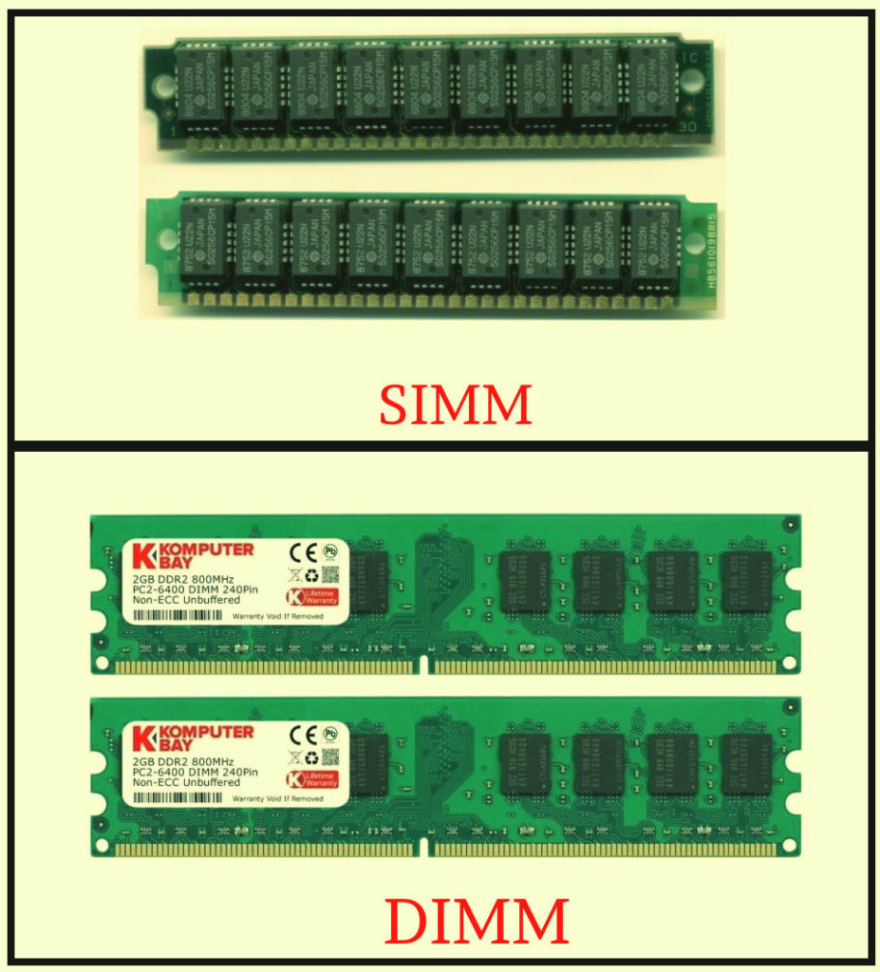
SIMM vs DIMM
There are two type of SIMM, one with 30 pins and another one is with 72 pins.
DIMM supports 64 bit channel for data transferring while SIMM supports only maximum of 32 bit channel.
DIMM slots support DDR, DDR2, DDR3, DDR4 and DDR5 RAM.
Basic Concepts of Computer Science a.pradeep@newuzbekistanuniversity.uz

Slide 27
Research
DDR SDRAM
Double Data Rate Synchronous Dynamic Random-Access Memory (DDR SDRAM) is a double data rate (DDR) synchronous dynamic random-access memory (SDRAM) class of memory integrated circuits used in computers. DDR SDRAM, also retroactively called DDR1 SDRAM,
DDR2, DDR3, DDR4 and DDR5 memory modules
Basic Concepts of Computer Science a.pradeep@newuzbekistanuniversity.uz

Slide 28


Course Materials
Telegram Group
cutt.ly/YRl9y6d
t.me/basicNUU
Basic Concepts of Computer Science a.pradeep@newuzbekistanuniversity.uz

