Slide 1

Assignment
Course Code : CSE 417
Course Title : Web Engineering
Submitted To :
Mushfiqur Rahman
Lecturer
Department Of CSE
Daffodil International University
Submitted By :
Ismail Hasan Sarker
ID : 181-15-1815
Sec: PC-C
Department Of CSE
Daffodil International University

Slide 2
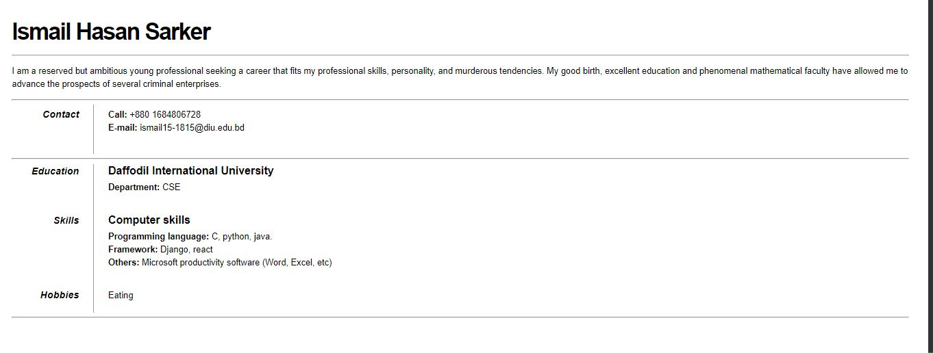
Question 1: Make a CV in HTML format.
Output :

Slide 3
Code : html
<!DOCTYPE html>
<html lang="en">
<head>
<meta charset="UTF-8" />
<meta name="viewport" content="width=device-width, initial-scale=1.0" />
<title>CV</title>
<link rel="stylesheet" type="text/css" href="style.css" />
</head>
<body>
<div id="resume">
<img src="Ismail.jpg"/>
<h1>Ismail Hasan Sarker</h1>
<p id="objective">
I am a reserved but ambitious young professional seeking a career that
fits my professional skills, personality, and murderous tendencies. My
good birth, excellent education and phenomenal mathematical faculty have
allowed me to advance the prospects of several criminal enterprises.
</p>

Slide 4
<hr>
<dl>
<dt>Contact</dt>
<dd>
<h2></h2>
<p>
<strong>Call:</strong> +880 1684806728<br/>
<strong>E-mail:</strong> ismail15-1815@diu.edu.bd<br/>
</p>
</dd>
</dl>
<hr>
<dl>
<dt>Education</dt>
<dd>
<h2>Daffodil International University</h2>
<p>
<strong>Department:</strong> CSE<br />
</p>
</dd>
</dl>
<dl>
<dt>Skills</dt>
<dd>
<h2>Computer skills</h2>

Slide 5
<p>
<strong>Programming language: </strong>
C, python, java.<br/>
<strong>Framework: </strong>Django,
react <br/>
<strong>Others: </strong>
Microsoft productivity software (Word, Excel, etc)
</p>
</dd>
</dl>
<dl>
<dt>Hobbies</dt>
<dd>Eating</dd>
</dl>
</div>
<hr>
</body>
</html>

Slide 6
Code: CSS
* {
box-sizing: border-box
}
body {
margin: 2.2rem
}
div#resume {
min-width: 310px;
font: 16px Helvetica, Avernir, sans-serif;
line-height: 24px;
color: #000
}
div#resume h1 {
margin: 0 0 16px 0;
padding: 0 0 16px 0;
font-size: 42px;
font-weight: bold;
letter-spacing: -2px;
border-bottom: 1px solid #999;
line-height: 50px
}
div#resume h2 {
font-size: 20px;
margin: 0 0 6px 0;
position: relative
}

Slide 7
div#resume h2 span {
position: absolute;
bottom: 0;
right: 0;
font-style: italic;
font-family: Georgia, serif;
font-size: 16px;
color: #999;
font-weight: normal
}
div#resume p {
margin: 0 0 16px 0
}
div#resume a {
color: #999;
text-decoration: none;
border-bottom: 1px dotted #999
}
div#resume a:hover {
border-bottom-style: solid;
color: #000
}

Slide 8
div#resume p.objective {
font-family: Georgia, serif;
font-style: italic;
color: #666
}
div#resume dt {
font-style: italic;
font-weight: bold;
font-size: 18px;
text-align: right;
padding: 0 26px 0 0;
width: 150px;
border-right: 1px solid #999
}
div#resume dl {
display: table-row
}
div#resume dl dt,
div#resume dl dd {
display: table-cell;
padding-bottom: 20px;
}
div#resume dl dd {
width: 500px;
padding-left: 26px
}

Slide 9
div#resume img {
float: right;
padding: 10px;
background: #fff;
margin: 0 30px;
width: 30%;
max-width: 220px
}
@media screen and (max-width:1100px) {
div#resume h2 span {
position: static;
display: block;
margin-top: 2px
}
}
@media screen and (max-width:550px) {
body {
margin: 1rem
}
div#resume img {
transform: rotate(0deg)
}
}
@media screen and (max-width:400px) {
div#resume dl dt {
border-right: none;
border-bottom: 1px solid #999
}

Slide 10
div#resume dl,
div#resume dl dd,
div#resume dl dt {
display: block;
padding-left: 0;
margin-left: 0;
padding-bottom: 0;
text-align: left;
width: 100%
}
div#resume dl dd {
margin-top: 6px
}
div#resume h2 {
font-style: normal;
font-weight: 400;
font-size: 18px
}
div#resume dt {
font-size: 20px
}
h1 {
font-size: 36px;
margin-right: 0;
line-height: 0
}

Slide 11
div#resume img {
margin: 0
}
}
@media screen and (max-width:320px) {
body {
margin: 0
}
img {
margin: 0;
margin-bottom: -40px
}
div#resume {
width: 320px;
padding: 12px;
overflow: hidden
}
p,
li {
margin-right: 20px
}
}

Slide 12
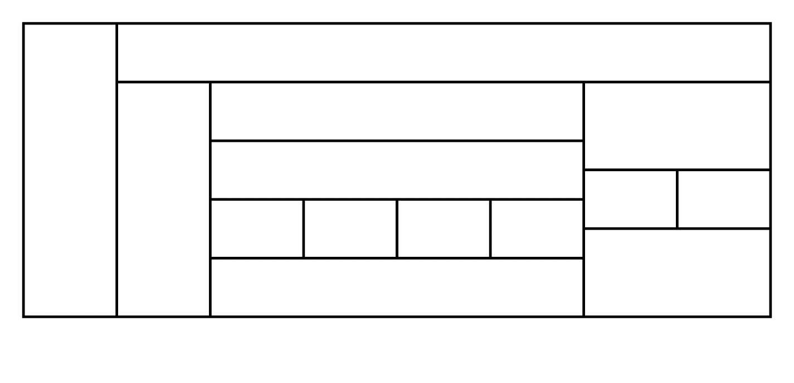
Question 2: Construct the following table.
Output : HTML Table
Code :
<html>
<style>
table, th, td {
border: 1px solid black;
border-collapse: collapse;}
</style>
<body>
<table width='100%'>
<tr>
<td rowspan="7"></td>
<td colspan="7"></td>
</tr>
<tr>
<td rowspan="6"></td>
<td colspan="4"></td>

Slide 13
<td colspan="2" rowspan="2"></td>
</tr>
<tr>
<td colspan="4" rowspan="2"></td>
</tr>
<tr>
<td rowspan="2"></td>
<td rowspan="2"></td>
</tr>
<tr>
<td rowspan="2"></td>
<td rowspan="2"></td>
<td rowspan="2"></td>
<td rowspan="2"></td>
</tr>
<tr>
<td colspan="2" rowspan="2"></td>
</tr>
<tr>
<td colspan="4"></td>
</tr>
</table>
</body>
</html>

