Slide 1
CSE 3252: Natural Language Processing
Instructor: Dr. Volkan Altıntaş Computer Engineering
University of Manisa Celal Bayar
1

Slide 2
Agenda
What are n-grams?
How are n-grams classified?
An example of n-grams
Step-by-step implementation of n-grams in Python
2

Slide 3
What are n-grams?
N-grams are continuous sequences of words or symbols or tokens in a document. In technical terms, they can be defined as the neighbouring sequences of items in a document. They come into play when we deal with text data in NLP(Natural Language Processing) tasks.
3
Notes:
You can refer to this website or others for the project topic.
There is different machine learning model in literature. You can use these models NLP problems.

Slide 4
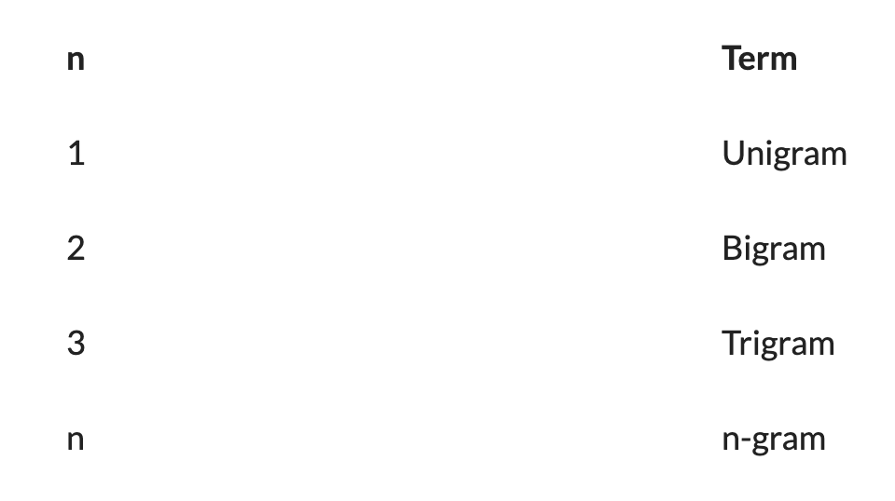
How are n-grams classified?
’n’ is just a variable that can have positive integer values including 1,2,3 and so on.’n’ basically refers to multiple.
Thinking in the same lines, n-grams are classified into the following types, depending on the value that ‘n’ takes.
4
Notes:
proposal form content will announce next week.
one person will present from each team as a presenter.

Slide 5
An example of n-grams
“I reside in Manisa
SL.No. | Type of n-gram | Generated n-grams
1 | Unigram | [“I”,”reside”,”in”,“Manisa”]
2 | Bigram | [“I reside”,”reside in”,”in Manisa”]
3 | Trigram | [“I reside in”, “reside in Manisa”]
5

Slide 6
Stop Words in NLP
In computing, stop words are words that are filtered out before or after the natural language data (text) are processed. While “stop words” typically refers to the most common words in a language, all-natural language processing tools don’t use a single universal list of stop words.
Stopwords are the words in any language which does not add much meaning to a sentence. They can safely be ignored without sacrificing the meaning of the sentence.
If we have a task of text classification or sentiment analysis then we should remove stop words as they do not provide any information to our model, i.e keeping out unwanted words out of our corpus, but if we have the task of language translation then stopwords are useful, as they have to be translated along with other words.
6

Slide 7
Stop Words in NLP
Removing stop words if our task to be performed is one of Language Classification, Spam Filtering, Caption Generation, Auto-Tag Generation, Sentiment analysis, or something that is related to text classification.
if our task is one of Machine Translation, Question-Answering problems, Text Summarization, Language Modeling, it’s better not to remove the stop words as they are a crucial part of these applications.
7

Slide 8
How to remove stop words in python using:
Removing stop words using python libraries is pretty easy and can be done in many ways.
*NLTK Library * SpaCy Library * Gensim Library * Custom stop words
8

Slide 9
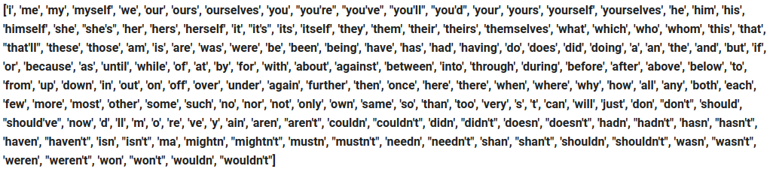
NLTK stop words
9

Slide 10
Steps:
Explore the dataset
Feature extraction
Train-test split
Basic pre-processing
Code to generate N-grams
Creating unigrams
Creating bigrams
Creating trigrams
10

Slide 11

Explore Dataset
https://www.kaggle.com/datasets/ankurzing/sentiment-analysis-for-financial-news
11

Slide 12
References
https://www.analyticsvidhya.com/blog/2021/09/what-are-n-grams-and-how-to-implement-them-in-python/
https://medium.com/@saitejaponugoti/stop-words-in-nlp-5b248dadad47#:~:text=What%20are%20stop%20words%3F,at%2C%20which%2C%20and%20on.

