Slide 1
CSE 3252: Natural Language Processing
Instructor: Dr. Volkan Altıntaş Computer Engineering
University of Manisa Celal Bayar
1

Slide 2
Stemming and Lemmatization
Stemming and Lemmatization are Text Normalization (or sometimes called Word Normalization) techniques in the field of Natural Language Processing that are used to prepare text, words, and documents for further processing.
Stemming and Lemmatization have been studied, and algorithms have been developed in Computer Science since the 1960's.

Slide 3
Stemming and Lemmatization
Languages we speak and write are made up of several words often derived from one another.
When a language contains words that are derived from another word as their use in the speech changes is called Inflected Language.
"In grammar, inflection is the modification of a word to express different grammatical categories such as tense, case, voice, aspect, person, number, gender, and mood. An inflection expresses one or more grammatical categories with a prefix, suffix or infix, or another internal modification such as a vowel change" [Wikipedia]

Slide 4
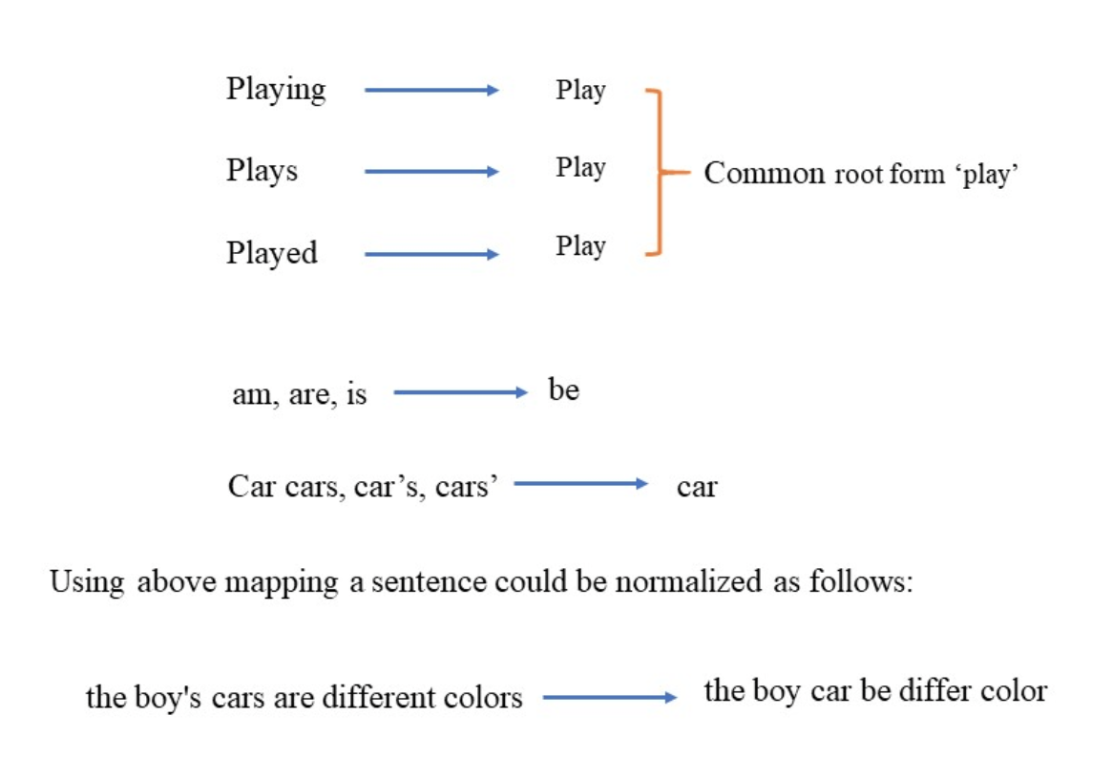
Stemming and Lemmatization
The degree of inflection may be higher or lower in a language. As you have read the definition of inflection with respect to grammar, you can understand that an inflected word(s) will have a common root form.

Slide 5
Stemming and Lemmatization
Above examples must have helped you understand the concept of normalization of text, although normalization of text is not restricted to only written document but to speech as well.
Stemming and Lemmatization helps us to achieve the root forms (sometimes called synonyms in search context) of inflected (derived) words.
Stemming is different to Lemmatization in the approach it uses to produce root forms of words and the word produced.

Slide 6
Stemming and Lemmatization
Stemming and Lemmatization are widely used in tagging systems, indexing, SEOs, Web search results, and information retrieval.
For example, searching for fish on Google will also result in fishes, fishing as fish is the stem of both words.

Slide 7
Stemming with Python nltk package
"Stemming is the process of reducing inflection in words to their root forms such as mapping a group of words to the same stem even if the stem itself is not a valid word in the Language.”
Stem (root) is the part of the word to which you add inflectional (changing/deriving) affixes such as (-ed,-ize, -s,-de,mis). So stemming a word or sentence may result in words that are not actual words. Stems are created by removing the suffixes or prefixes used with a word.

Slide 8
What is Python nltk package?
Natural Language Tool Kit (NLTK) is a Python library to make programs that work with natural language.
It provides a user-friendly interface to datasets that are over 50 corpora and lexical resources such as WordNet Word repository.
The library can perform different operations such as tokenizing, stemming, classification, parsing, tagging, and semantic reasoning.
It is an Open Source and free library. It is available for Windows, Mac OS, and Linux.

Slide 9
Installing python nltk
NLTK requires Python versions 2.7, 3.4, 3.5, or 3.6. You can install nltk using pip installer if it is not installed in your Python installation. To test the installation:
open your Python IDE or the CLI interface (whichever you use normally)
Type import nltk and press enter if no message of missing nltk is shown then nltk is installed on your computer.
run pip install nltk on your cmd.exe bash to install nltk on Windows.
You can use the nltk library for Stemming and Lemmatization using Python.

Slide 10
Applications of Stemming and Lemmatization
Stemming and Lemmatization are itself form of NLP and widely used in Text mining. Text Mining is the process of analysis of texts written in natural language and extract high-quality information from text.
Text mining tasks include text categorization, text clustering, concept/entity extraction, production of granular taxonomies, sentiment analysis, document summarization.
Developers have to prepare text using lexical analysis, POS (Parts-of-speech) tagging, stemming and other Natural Language Processing techniques to gain useful information from text.

Slide 11
Applications of Stemming and Lemmatization
Stemming and Lemmatization are itself form of NLP and widely used in Text mining. Text Mining is the process of analysis of texts written in natural language and extract high-quality information from text.
Text mining tasks include text categorization, text clustering, concept/entity extraction, production of granular taxonomies, sentiment analysis, document summarization.
Developers have to prepare text using lexical analysis, POS (Parts-of-speech) tagging, stemming and other Natural Language Processing techniques to gain useful information from text.

Slide 12
Stemming or lemmatization?
Stemming and Lemmatization both generate the root form of the inflected words. The difference is that stem might not be an actual word whereas, lemma is an actual language word.
Stemming follows an algorithm with steps to perform on the words which makes it faster. Whereas, in lemmatization, you used WordNet corpus and a corpus for stop words as well to produce lemma which makes it slower than stemming. You also had to define a parts-of-speech to obtain the correct lemma.

