Slide 1



Artificial Intelligence for Patient Management
and Clinical Research in Rheumatology
Developed by:
Mr. Ismail Bakraoui
Under the supervision of :
Dr. Housbane Samy and Dr. Ajbal Khaoula
16 February 2025 - 1st Meeting
EMSI - FMPC

Slide 2
Plan
Problem Statement
Objectives
Choice of technologies
AI Implications
DEMO
Discussion
2

Slide 3
Problem statement
3

Slide 4
Problem statement
Rheumatologists face challenges in analyzing large and complex patient data from electronic records, making diagnosis, treatment decisions, and research time-consuming and error-prone.
4

Slide 5



Problem statement
Inefficient use of medical resources
and time.
Delayed or incorrect diagnosis
Missed opportunities for clinical research and discovery.
5

Slide 6
Objectives
6

Slide 7
Objectives
To develop an AI-based system that:
Analyzes rheumatology patient records
Supports clinicians in diagnosis and treatment decisions
Facilitates clinical research to improve patient care and outcomes.
7

Slide 8
Choice of technologies
8

Slide 9

VM isolation
Role - VM isolation
Medium complexity
Moderate Hardware demand
Feasibility in a 6 month period
Offes buil-in snapshots functionality
Metrics
VM startup time
CPU overhead
memory overhead
Recovery Time (VM restore)
Our case
On-premise hospital server
Limited number of services
Controlled users
No public internet exposure
9

Slide 10

Database
Role - Database layer
Low complexity
Moderate Hardware demand
Feasibility in a 6 month period
Evaluation Criteria
Acid Compliance
Transaction latency
Query execution time
Schema flexibility
10

Slide 11


Semantic retrieval
Role - Semantic retrieval
Medium complexity
Advanced Filtering
Scalability
Moderate Hardware demand
Role - Semantic retrieval
Low complexity
low Hardware demand
Easier integration
Higher hallucination risk
Both highly feasable in the time frame
11

Slide 12
Local LLM for RAG based reasoning
Mistral 7B
Evaluation Criteria
GPU memory usage
Medical terminology accuracy
Hallucination rate
French language quality
Privacy compliance
Bio-Mistral
Problem at hand
GPU obligations
Regulatory issues with APIs
Llama 3 8B
12

Slide 13
Local LLM for RAG based reasoning
Mistral 7B
Bio-Mistral
Llama 3 8B
Evaluation Criteria
high Hardaware & Performance dependencies
easier integration
Evaluation Criteria
Medical Domain Accuracy
Better medical french terminology
Rag Compatibility in Medical Grouding
Stability under long medical notes
Evaluation Criteria
RAG Compatibility in instruction following
Strong ecosystem / community
All LLMs have the same integration methodology with a high feasibility in the 6 months period wih no API externalization and fully cndp compliance
13

Slide 14


BE & FE
Evaluation Criteria
Low complexity
High performance
excellent security control
comfortable with
Optimal for RAG + ML integratio
JWT + RB Access
Evaluation Criteria
Low complexity
High Scalability
Mobile support
14

Slide 15
Final Tech Stack
Feasible & Balanced Architecture:
Proxmox VE (3 VMs)
Mysql
Qdrant (vector DB)
BioMistral or Mistral 7B
FastAPI backend
React frontend
JWT + RB access
15

Slide 16
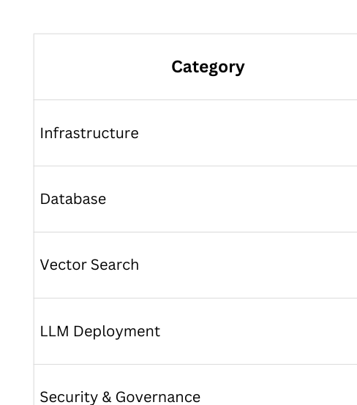
FEASIBILTY SUMMARY
16

Slide 17
AI Implications
17

Slide 18
AI Implications
Enhanced Data Analysis
AI can process large volumes of structured and unstructured patient data, extracting meaningful patterns from clinical notes, lab results, and imaging.
Clinical Decision Support
AI models can assist rheumatologists in diagnosing conditions, predicting disease progression, and suggesting personalized treatment plans.
Predictive Analytics
AI can identify patients at risk of flares or complications, enabling earlier interventions and preventive care.
Research Facilitation
AI can analyze cohorts across DPIs, identify trends, and support clinical studies without manual data extraction.
Decision Transparency
Advanced models can provide interpretable insights, explaining recommendations to clinicians for better trust and adoption.
18

Slide 19
DEMO
19

Slide 20
Discussion & Suggestions
20

Slide 21
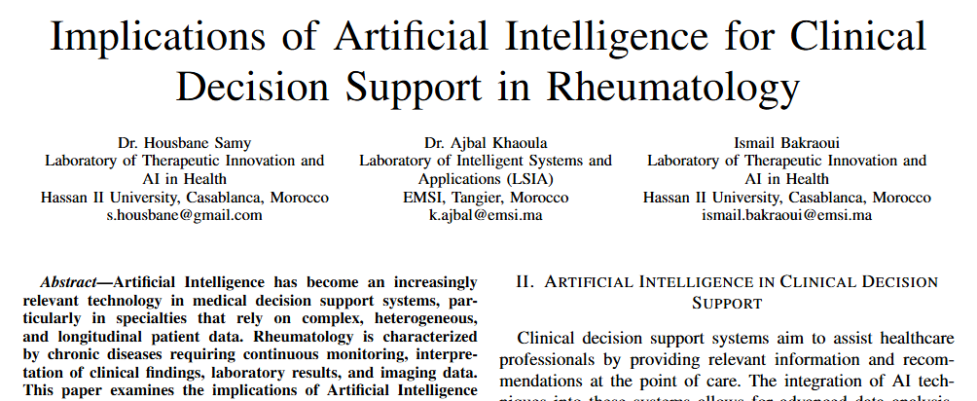
21

Slide 22
Artificial Intelligence for Patient Management
and Clinical Research in Rheumatology
Developed by:
Mr. Ismail Bakraoui
Under the supervision of :
Dr. Housbane Samy and Dr. Ajbal Khaoula
16 February 2025 - 1st Meeting
EMSI - FMPC

