Slide 1





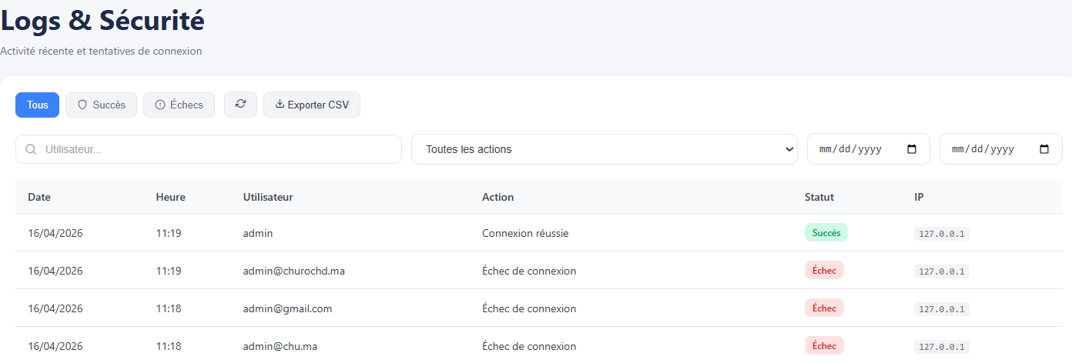
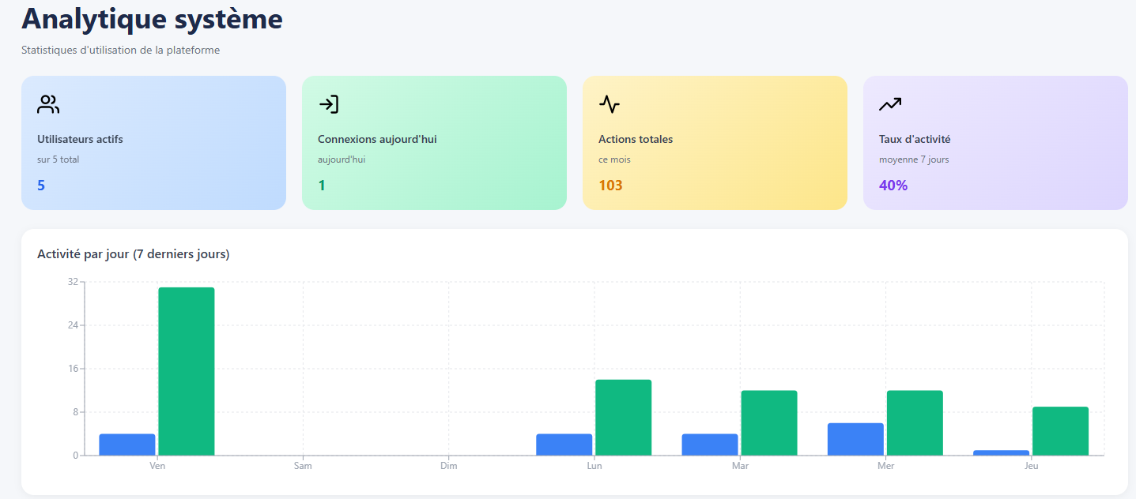
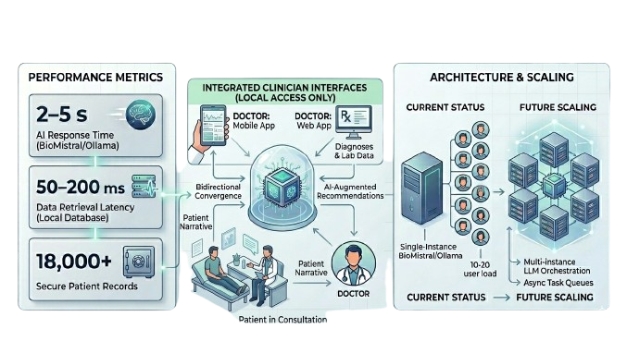
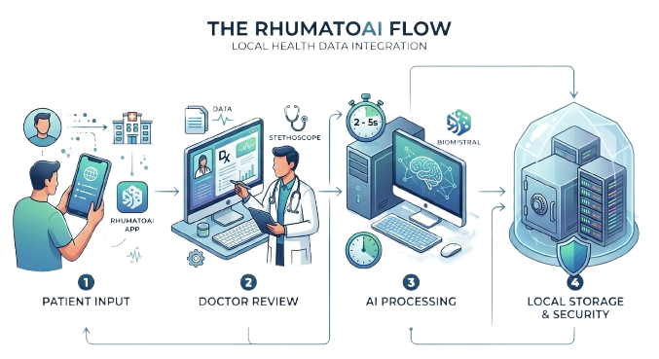
2ᵉ Journée Doctorant · LSIA & ENSA Tanger · 17 Avril 2026
Implications of Artificial Intelligence for Clinical Decision Support in Rheumatology
M. Ismail Bakraoui ¹ · Mme. Khaoula Ajbal ¹ · M. Samy Housbane ²~³
1 – Laboratory of intelligent systems and applications, EMSI Tangier
2 – Laboratory of Therapeutic innovation and artificial intelligence in health, FMPC – Hassan II, University of Casablanca
3 – IBN ROCHD University Hospital Center, Casablanca
ABSTRACT
EVALUATION
The integration of AI into clinical practice is constrained not only by model capability, but also by challenges in data governance, system integration, and real-world usability. This study introduces RhumatoAI — a locally deployed, full-stack clinical decision support system designed for rheumatology, combining structured patient management with large language model (LLM) inference.
Deployed at CHU Ibn Rochd (Casablanca), the system enables secure, real-time interaction with patient data and AI-assisted clinical support within a fully on-premise infrastructure. Leveraging a FastAPI backend, cross-platform interfaces, and BioMistral inference via Ollama, the platform achieves response latencies of 2–5 seconds under operational conditions.
The findings suggest that clinically viable AI systems can be realized without reliance on cloud architectures, provided that system design explicitly addresses latency, privacy constraints, and workflow integration.
The system maintains sub-5 s latency for AI-assisted consultations, with API response times of 50–200 ms and PDF generation within 0.5–3 s. It supports up to 20 concurrent clinical users per department without performance degradation. Security and compliance are ensured through JWT-based authentication, RBAC, and full audit logging aligned with CNDP requirements. Identified bottlenecks are mitigated via fallback strategies, with production deployment underway including replication and automated backups.
INTRODUCTION
RESULTS & DISCUSSION
Recent advances in machine learning have significantly expanded clinical decision support in rheumatology. Supervised models predict disease activity and guide therapeutic choices, while unsupervised approaches stratify patients into clinically meaningful phenotypes, enabling more personalized care ¹.
Generative AI — particularly large language models such as GPT-4 represents a further paradigm shift, demonstrating promising diagnostic support, enhanced patient education, and accelerated research workflows ⁴.
However, translation into routine clinical practice remains limited due to algorithmic bias, insufficient external validation, lack of model transparency, and gaps in clinician training ². These constraints underscore the need for rigorous evaluation frameworks and structured integration strategies.
RhumatoAI implements bidirectional care coordination model integrating patient-generated symptom narratives with clinician-derived diagnoses and laboratory data computational environment. AI-mediated processing generates clinical recommendations institutional governance. Core modules include patient and clinical history management, appointment scheduling, medical documentation, LLM-assisted decision support. Role-based access control (RBAC) enforces hierarchical permissions supported audit logging institutional accountability. A single-instance BioMistral/Ollama deployment supports clinical load (10–20 concurrent practitioners per department). Future scaling being evaluated through multi-instance LLM orchestration and asynchronous task queues ⁵.
METHODOLOGY
The system follows a layered architecture connecting client applications to a centralized backend, which orchestrates service-level processing and AI-driven analysis ³. User inputs are transmitted from client interfaces to the backend, where they are structured and routed through dedicated services for processing. These services interact with a combined data and AI layer, integrating database storage with a local inference engine to generate diagnostic insights and recommendations. The design ensures efficient data flow, secure handling, and seamless integration between application logic and AI-supported decision-making.
CONCLUSION & PERSPECTIVES
This work presents the first complete implementation of a locally-governed clinical AI platform that preserves data sovereignty while enabling sophisticated decision support. The bidirectional care coordination model positions AI as a knowledge synthesis layer — not an autonomous authority — maintaining clinical judgment as the primary accountability locus.
Demonstrated performance characteristics (50–200 ms retrieval · 2–5 s consultation) establish benchmarks suitable for routine clinical workflows. Comprehensive audit logging and RBAC mechanisms provide institutional compliance verification essential under CNDP frameworks.
Future research should examine: comparative effectiveness of local vs. distributed architectures; patient outcomes across coordination models; economic analysis of deployment approaches; and interoperability standards for independent institutional systems.
RhumatoAI demonstrates that sophisticated clinical intelligence need not depend on external infrastructure or compromise institutional autonomy.
REFERENCES
1 - Chen YM, Hsiao TH, Lin CH, Fann YC. Unlocking precision medicine: clinical applications of integrating health records, genetics, and immunology through artificial intelligence. J Biomed Sci. 2025 Feb 7.
2 - Hügle T. Advancing rheumatology care through machine learning. Pharm Med. 2024 Mar.
3 - Knitza J, Gupta L, Hügle T. Rheumatology in the digital health era: status quo and quo vadis? Nat Rev Rheumatol. 2024 Dec 20.
4 - Kunal Chandwar, Misra DP. What does artificial intelligence mean in rheumatology? Arch Rheumatol. 2024 Mar).
5 - Sequé-Sabater JM, Benavent D. Artificial intelligence in rheumatology research: what is it good for? RMD Open. 2025.

