Slide 1
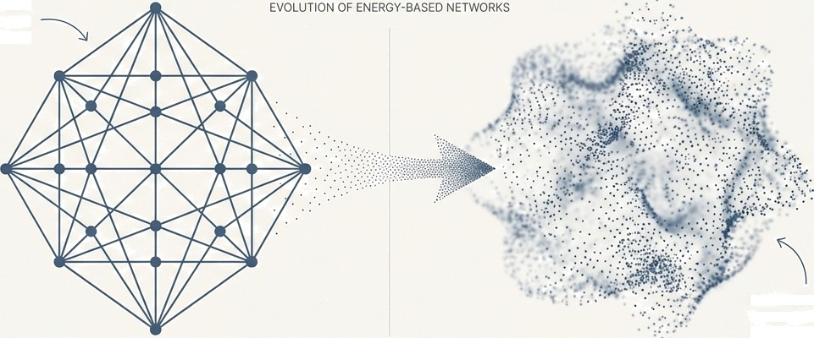
From Memory to Models:
The Evolution of Energy-Based Networks
The journey from the deterministic recall of Hopfield Networks to the generative power of Boltzmann Machines.
HOPFIELD NETWORK
Deterministic Recall Rigid, Discrete Memory States
BOLTZMANN MACHINE
Generative Power
Probabilistic, Dynamic Point Cloud
W NotebookLM

Slide 2
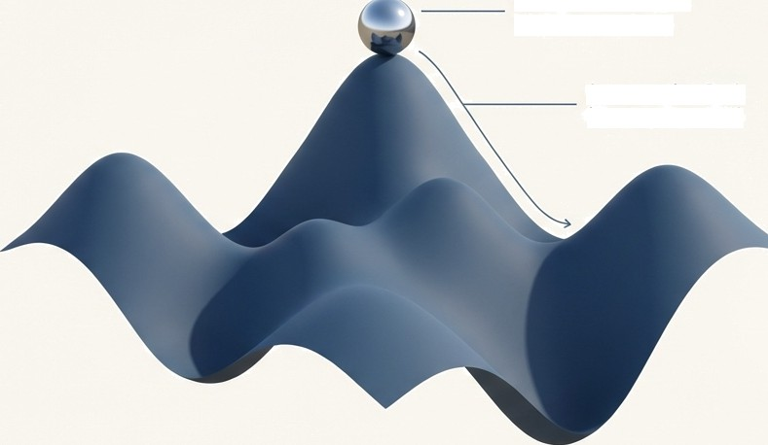
The Core Idea: Computation as an Energy Landscape
Both Hopfield Networks and Boltzmann Machines operate on a shared principle: a global "energy function." Every possible configuration of the network's units corresponds to a specific energy level, creating a vast, multi-dimensional landscape.
The network's primary goal is to find a low-energy stat a valley in this landscape.
The process of computation is the process of moving ’downhill" on this surface.
As stated by John Hopfield, if the connections between units are symmetric, this global energy function is guaranteed to exist, and the network will always
settle to an energy minimum.
Computation Origin: High Energy State
Computation Path (MOVing Downhill)
Stable State:
Low-Energy Minimum

Slide 3
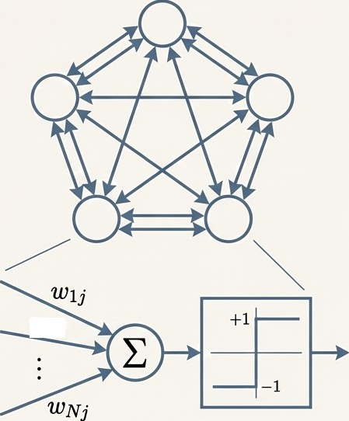



The Hopfield Network: A Machine for Perfect Recall
Architecture: A recurrent network of interconnected binary units (+1/-1). Key features are symmetric weights (W,t Wk)) and no self- connections (Wtt = 0).
Purpose: To function as a Content-Addressable Memory (CAM). Retrieve a full memory by providing only a partial or corrupted piece of it.
Analogy: “it's like reconstructing a dinosaur from a
few bones.“
Behavior: The network is deterministic. It uses a binary threshold decision rule that always moves the network's state towards a lower energy configuration.
ri

Slide 4
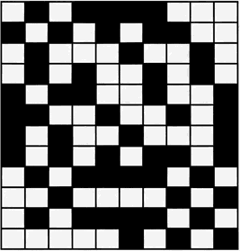
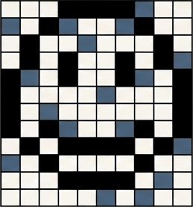
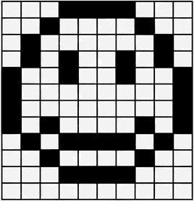


How It Works: Settling into a Stored Memory
The network retrieves a memory through an iterative process:
Initialization: An incomplete or noisy pattern is presented, setting the network's initial, high-energy state.
Asynchronous Updates: Units are updated one at a time. Each unit flips its state only if the flip reduces the global energy of the network.
Convergence: The process stops when no single flip can lower the energy further. The network has reached a
stable state—an energy minimum.
Initial State (High Energy)
Final State (Energy Minimum)

Slide 5
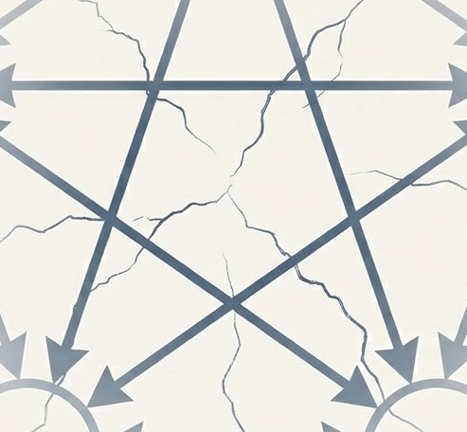
The Challenge: Cracks in the Crystalline Memory
While elegant, the Hopfield Network's deterministic nature and simple learning rule (Hebbian learning) lead to significant practical limitations.
These limitations restrict its reliability and efficiency, especially as the number of stored memories increases. The ’perfect’ memory machine begins to show its faults.
Two major problems emerge: the creation of false memories and a severe bottleneck on storage capacity.

Slide 6
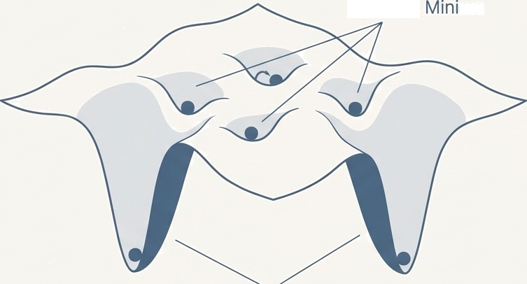
The Problem of Spurious Minima: Memories That Never Were
The process of storing desired patterns (creating deep energy valleys) inadvertently creates other, unintended stable states in the network. These "spurious minima" are false memories. If the network starts from certain initial states, it can get trapped in these valleys, retrieving a pattern that was never explicitly stored.
Spurious
ma
The source text notes these can be random patterns or blends of stored patterns, and their number increases with the number of memories stored.
True Memories
G
NotebookLM

Slide 7






The Capacity Bottleneck: A Strict Limit on Knowledge
The Limitation: A fully connected Hopfield Network with N units has a surprisingly low storage capacity. It can only reliably store approximately 0.15N memory patterns.
100 Units (N)
Implication: To store just 15 patterns, you need a network of 100 units. This scaling is highly inefficient.
H H
" ■
The Cost: Storing these memories requires N²/2 weights. The information storage is vastly inefficient compared to the number of parameters used.
15 Stored Patterns (-0.15N)

Slide 8
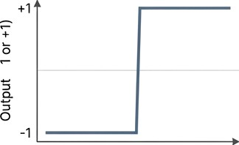
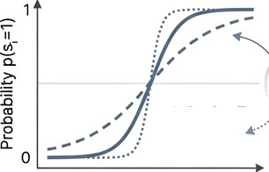

The Evolutionary Leap: Introducing Stochasticity
Deterministic
Hopfield Network Unit
Stochastic
Boltzmann Machine Unit
T
( -
0
Adjusting T changes steepness
Net Input
Net Input (AE,)
The Innovation: The Boltzmann Machine, an extension of the Hopfield network, replaces deterministic
units with stochastic ones.
Mechanism: A unit's state is no longer a fixed outcome. Instead, it flips its state with a probability
governed by the energy change (AE) and a new parameter: Temperature (T). p(z, 1) — ¹
1-Fe-’'*
The Power of Noise: This probabilistic behavior is the key. It allows the network to occasionally make
'uphill' moves, enabling it to jump out of shallow, undesirable minima.

Slide 9
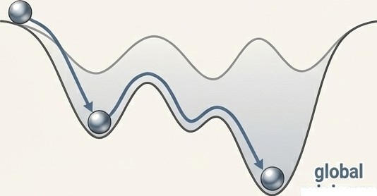
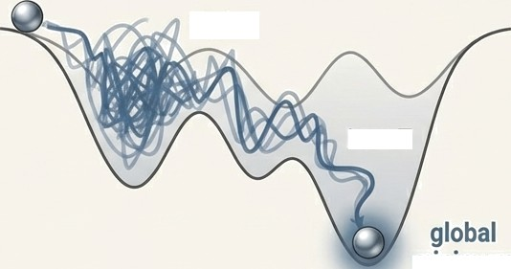
Simulated Annealing: A Strategy for Finding the Deepest Truth
The network harnesses temperature to find better solutions through a process analogous to annealing metal:
1. High Temperature: The system starts 'hot.' Randomness is high, allowing the network to explore the entire landscape and easily escape local minima.
2. GradualCooling: The temperature is slowly lowered, decreasing the probability of large ’uphill'jumps.
3. Freezing: As T approaches zero, the network settles into a very Ion-energy state, having had a much
better chance of finding the global minimum.
deterministic Search (Hopfield)
Stochastic Search (Annealing)
High T
Low T
minimum
minimum

Slide 10
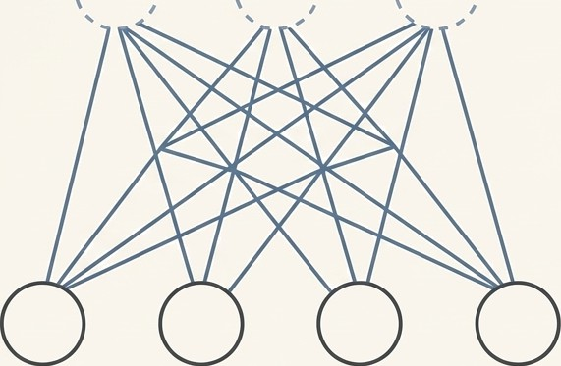
The Second Leap: Hidden Units and the Power of Interpretation
Architectural Shik: Unlike the single-layer Hopfield Network, a Boltzmann machine can have hidden units.
Visible Units: Interface with the external
world. Data is clamped onto these units.
Hidden Units: Have no direct connection to the outside. They are free to learn and represent abstract features and correlations within the data.
A New Purpose: With hidden units, the network‘s new role is to construct an internal model or interpretation of the sensory input. The hidden units learn to represent the underlying structure that explains the visible data.
Hidden Layer (Internal Representation)
Visible Layer (Input Data)

Slide 11
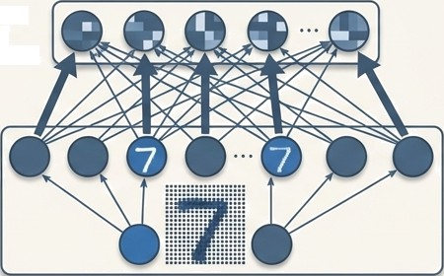
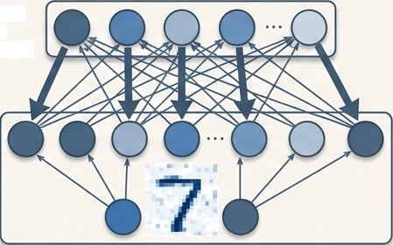
From Storing Memories to Building Generative Models
The network's objective is now to learn a probability distribution over its training data. It learns what
makes the data “typical.”
Two Key Operations:
1. Inference 2. Generation
Hidden Layer (Internal Representation)
Hidden Layer (Internal Representation)
Visible Layer
(Input Data)
Visible Layer Data)
Given an input, the network infers a rich, abstract feature representation in the hidden units.
Running freely, the network can generate new, novel samples drawn from the learned probability distribution.

Slide 12
A Tale of Two Networks: A Direct Comparison
Hopfield Network
Units Deterministic
Architecture
Single Layer (No Hidden Units)
Behavior
Finds Nearest Local Minimum
Function
Associative Memory (Pattern Completion)
Learning Phase
Storage Phase / Retrieval Phase
Boltzmann Machine
Units
StochasGc
Architecture
Can have Hidden Units
Behavior
Finds Global Minimum (via Annealing)
Function
Generative Model (Learns Data Distribution)
Learning Phase
Clamping Phase / Free-Running Phase

Slide 13











Distinct Tools for Distinct Problems
Hopfield Network Applications: Built for retrieval and optimization.
Pattern Completion & Image Restoration: Cleaning up noisy or incomplete data.
Combinatorial Optimization: Finding efficient solutions to problems like the Travelling Salesman Problem (TSP).
Boltzmann Machine Applications: Designed for modeling and generation.
Feature Detection & Collaborative Filtering: Uncovering hidden structures in data (e.g., recommendation systems).
Generative Modeling: Creating new data samples (e.g., character or face recognition).
Foundation for Deep Learning: Served as the building blocks for modern architectures like Deep Belief Networks.

Slide 14
The Legacy: From Energy Landscapes to Deeq Learning
Summary of the Journey: The Hopfield Network pioneered the powerful paradigm of using energy functions for computation, giving us a model for content-addressable memory. Its limitations spurious minima and low capacity created the need for a more robust approach. The Boltzmann Machine's innovations of stochasticity and hidden units solved these problems, shifting the goal from simple memory recall to complex, generative modeling of data.
The Lasting Impact: This evolutionary step was crucial. The principles developed for
Boltzmann Machines laid the theoretical groundwork for modern generative models and the rise
deep learning.
The Lasting Impact: This evolutionary step was crucial. The principles developed for
Boltzmann Machines laid the theoretical groundwork for modern generative models and the rise of
deep learning.

Slide 15


Source Material Further Exploration
Sathasivam, S., & Sagir, A. M. (2014). An Overview of Hopfield Network and Boltzmann Machine. International Journal of Computational and Electronics Aspects in Engineering (IJCEAE), 1(1), 20-26.
Hinton, G., et al. Neural Networks for Machine Learning, Lecture 11: Hopfield Nets and Boltzmann Machines. University of Toronto.
W NotebookLM

