Slide 1
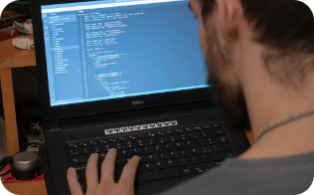
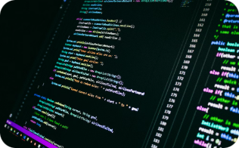
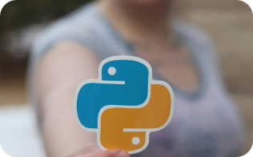
Barcode & QR Code Scanner
Computer Vision Project
Big Data & AI Engineering — 2026
Team
GitHub
Tech Stack
EL MANSSOURI Ismail
EL AZIZI Mohamed Taha
IBENOUAZI Ismail
EL KHAYATI Mouataze
github.com/ismailelmanssouri/barcode-qr-scanner
Python · OpenCV · pyzbar · Tkinter

Slide 2
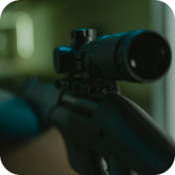
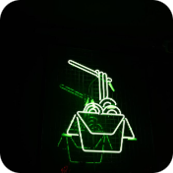
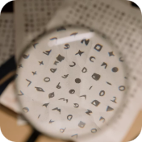
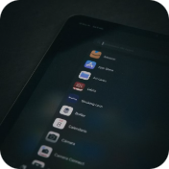
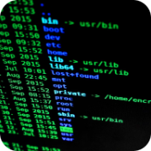
Project Overview
This project builds a robust computer vision pipeline to detect, localize, and decode both QR codes and several barcode formats from images and desktop input. It's designed for reliability, clarity of results, and easy extension to video or cloud workflows.
Detect
Localize
Decode
GUI App
Find QR codes & barcodes in any image — single or multiple codes.
Draw bounding boxes and precise polygons around detected codes.
Extract embedded text, URLs, and structured data using pyzbar.
Interactive desktop application for live testing and export.
Export
Save detection results to TXT and CSV for downstream analysis.

Slide 3
Computer Vision Concepts
Core image-processing techniques and decoding principles used in the scanner.
Grayscale Conversion
Thresholding (Otsu)
Reduces BGR image to one channel to simplify computation and reduce noise sensitivity.
Converts gray pixels to binary (black/white); Otsu finds an optimal global threshold automatically.
Edge Detection (Canny)
Contour Analysis
Detects boundaries using Gaussian blur, Sobel gradients, non-maximum suppression, and hysteresis thresholds.
Trace object contours to identify rectangular regions that likely contain codes.
Polygon Fitting
Pattern Matching
Extracts exact corner points for precise localization — superior to axis-aligned bounding rectangles.
pyzbar wraps ZBar for decoding; includes Reed–Solomon error correction for robust reading.

Slide 4
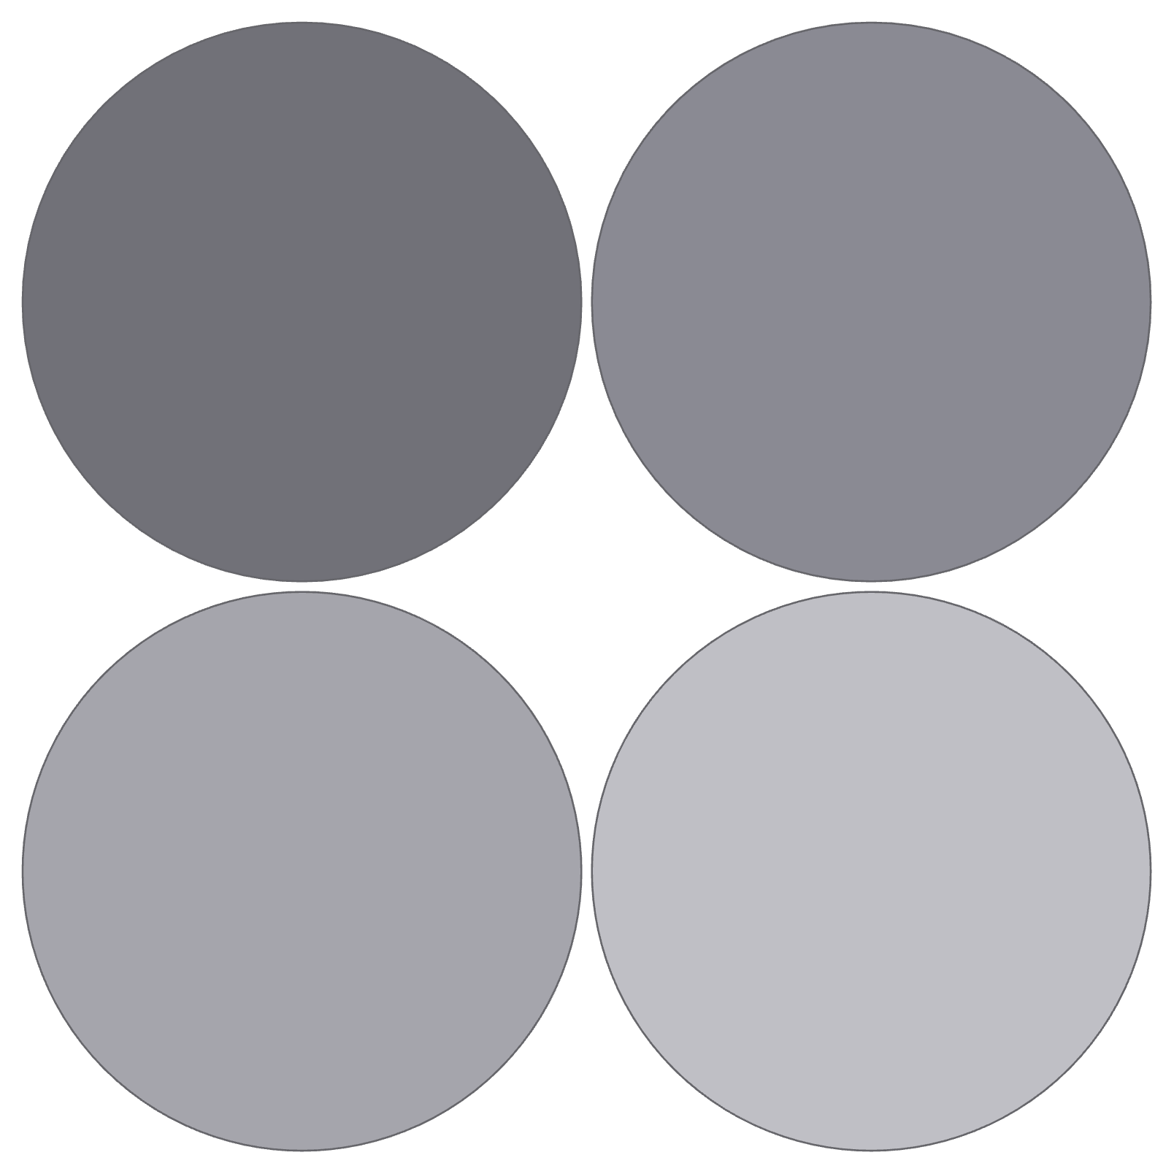
Detection Pipeline
Load
Grayscale
Read raw image with cv2.imread()
Convert to gray via cv2.cvtColor()
Detect
Localize
Find barcodes using pyzbar.decode()
Get polygon from code.polygon()
Each stage transforms image data toward the final decoded output — from raw pixels to annotated images and structured data exports.

Slide 5
Project Structure
Organized repository for development, demos, and documentation.
app.py
scanner.py
multi_scanner.py
load_image.py
GUI desktop application — live image input, annotate, save.
Core detection & decoding functions used by utilities and the GUI.
Detects multiple codes per image and assigns unique colors.
Simple demo for loading and preprocessing test images.
notebook.ipynb
generate_report.py
requirements.txt
README.md
Exploratory analysis, visualizations, and step-by-step explanations.
Project dependencies and exact package versions for reproducibility.
Setup, usage, architecture notes, and contribution guidelines.
Creates PDF summaries of detection sessions and results.

Slide 6
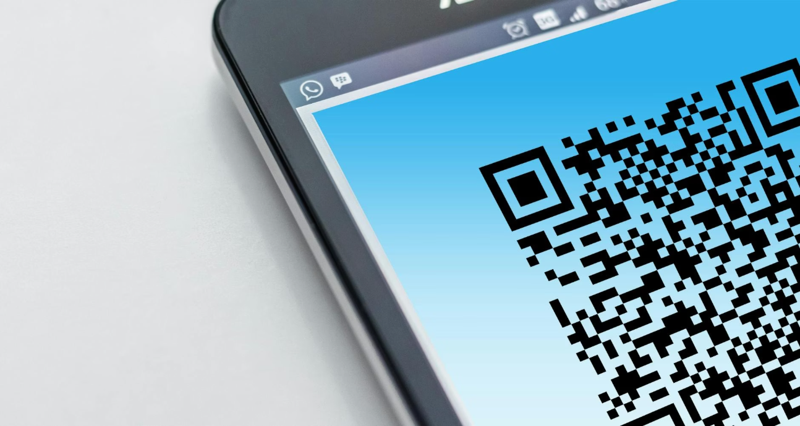
Live Demo & Results
We validated detection accuracy and annotation quality across common code types. The table summarizes typical outputs produced by the scanner.
Code Type
Detection
Output
QR Code
Detected
Decoded text/URL, polygon + box
EAN-13 Barcode
Detected
Decoded digits, polygon + box
Key achievements
CODE-128 Barcode
Detected
Decoded string, polygon + box
Handles multiple code types simultaneously with unique color labels
Precise polygon localization for accurate cropping & readouts
Real-time desktop GUI with save/export functionality
Multiple Codes
Detected
Each code annotated in unique color

Slide 7
Key Takeaways
Images as Arrays
Grayscale Formula
Canny Pipeline
Images are NumPy arrays with shape (height, width, channels). Efficient indexing enables fast preprocessing.
Gray = 0.114B + 0.587G + 0.299R — used for luminance-preserving conversions.
Blur → gradient calculation → non-maximum suppression → hysteresis thresholding for robust edge maps.
Decoding
Modular Design
pyzbar leverages ZBar and Reed–Solomon error correction; we integrate it rather than implementing correction manually.
Pipeline components are modular and extensible — easy to add webcam input, cloud processing, or additional code types.

Slide 8
Thank You!
Questions & Discussion
EL MANSSOURI Ismail · EL AZIZI Mohamed Taha · IBENOUZI Ismail · EL KHIYATI Mouataze
github.com/ismailelmanssouri/barcode-qr-scanner
Python
OpenCV
pyzbar
Tkinter
NumPy
Matplotlib

