Slide 1
WEB PROGRAMMING | CS23531
Job Application
Tracker
A responsive web application to organize,
monitor, and manage job applications.
Done by
Mohamed Ismail Fawaz K P
240701324

Slide 2
Abstract
Project overview and purpose
Managing multiple job and internship applications can become difficult when details, deadlines, and interview updates are scattered across different platforms.
The Job Application Tracker provides a centralized interface to record applications, monitor their progress, and review application statistics. Users can organize applications by status, search and filter records, and update details when their application stage changes.
Centralized records
Clear progress
Easy access
Store key details such as company, role, date, link, and status.
View applications by stage and understand current progress.
Use a responsive interface with browser-based data persistence.
WEB PROGRAMMING • CS23531
02

Slide 3
Modules
Main functional components of the application
01 Dashboard
02 Application Management
03 Search & Filters
Displays summary counts for total applications, interviews, offers, and rejections.
Add, edit, view, and delete job or internship application records.
Search by company or role; filter by status and sort by application date.
04 Kanban Pipeline
05 Local Storage
06 Responsive UI
Groups applications into Applied, Interview, Offer, and Rejected stages.
Uses localStorage to retain records across browser refreshes.
Adapts layouts for desktop, tablet, and mobile screens.
WEB PROGRAMMING • CS23531
03

Slide 4
Tech Stack & Architecture
Frontend-focused implementation
TECHNOLOGY STACK
HIGH-LEVEL ARCHITECTURE
HTML
User Interface
Forms, cards, filters, and Kanban board
↓
CSS
React Components & State
Renders UI and tracks user interactions
↓
JavaScript + React
Application Logic
Add/edit/delete, search, sorting, statistics
↓
Vite + localStorage
localStorage
Saves and retrieves application records
Data is stored locally in the user's browser; a backend is not required for the initial version.
WEB PROGRAMMING • CS23531
04

Slide 5
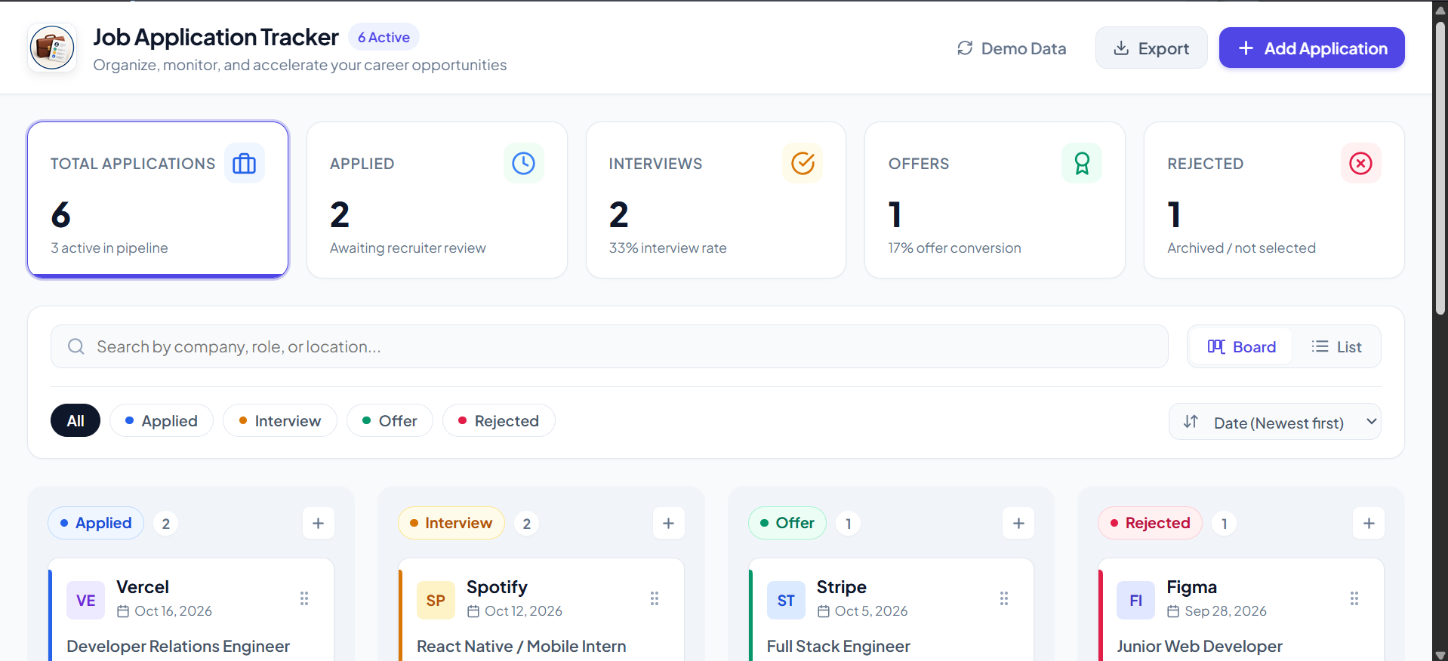
Output & Source Code
https://github.com/Ismailfawaz/Job-Application-Tracker
GitHub link:
05
WEB PROGRAMMING • CS23531

Slide 6
Conclusion & Future Scope
Project outcome and possible enhancements
Conclusion
Future Scope
• Centralizes job and internship application details.
• Makes it easier to track each application's current status.
• Search, filters, and summary cards improve visibility.
• React components support a reusable and maintainable interface.
• Add user authentication and cloud database storage.
• Send reminders for interviews and application deadlines.
• Add analytics for response rates and application trends.
• Enable resume management and exportable reports.
The project can evolve from a local tracking tool into a personalized job-search management platform.
WEB PROGRAMMING • CS23531
06

Slide 7
THANK YOU
Job Application Tracker
Web Programming Project • CS23531
Mohamed Ismail Fawaz K P | 240701324
Questions?

