Slide 1


Slide 2
THE QUESTION
02
GDP is not the whole story
A strong economy can still be exposed to structural weaknesses.
Economic size measures output.
Resilience measures exposure.
01
02
03
TRADE
MACROECONOMIC
FISCAL
This study looks beyond headline growth to identify vulnerabilities that emerge when trade, macroeconomic, and fiscal conditions are examined together.
Dependence on a narrow set of export products or destinations.
Instability in growth, prices, and labor-market conditions.
Debt burdens and deficits that can constrain government flexibility.
CENTRAL RESEARCH QUESTION
What hidden weaknesses emerge when trade, macroeconomic, and fiscal indicators are combined?
THE HIDDEN FRAGILITY OF NATIONAL ECONOMIES
ISMAIL WEHBI • KHOSSE-BAKHOS HANNA

Slide 3
DATA
03
One integrated view of 197 economies
Two source datasets were combined into an annual country-level panel.
SOURCE 01
FROM RAW DATA TO ECONOMIC INSIGHT
INTEGRATED PANEL
International trade data
01
Clean & integrate
2,951
Exports • imports • trade concentration
02
Economic analysis
country-year observations
SOURCE 02
Build the EFI
03
World Bank indicators
197 countries • 2010–2024
Growth • inflation • debt • public finance
04
Machine Learning
05
SHAP + dashboard
26 variables in the integrated dataset
Python • Pandas • NumPy • Scikit-learn • SHAP • Power BI
THE HIDDEN FRAGILITY OF NATIONAL ECONOMIES
ISMAIL WEHBI • KHOSSE-BAKHOS HANNA

Slide 4
ECONOMIC ANALYSIS
04
The macroeconomic snapshot
Averages show the broad picture; the extremes reveal how uneven conditions can be.
2.95%
6.17%
7.61%
61.79%
AVERAGE GDP GROWTH
AVERAGE INFLATION
AVERAGE UNEMPLOYMENT
AVERAGE PUBLIC DEBT
Median: 3.14%
Median: 3.20%
Median: 5.74%
Of GDP • median: 51.43%
GOVERNMENT FINANCES
INTERNATIONAL TRADE
−0.81%
$92.36B
$92.89B
−$529.45M
Average fiscal balance (% GDP)
Average exports
Average imports
Average trade balance
Averages are calculated over available observations; coverage varies by indicator.
THE HIDDEN FRAGILITY OF NATIONAL ECONOMIES
ISMAIL WEHBI • KHOSSE-BAKHOS HANNA

Slide 5
ECONOMIC ANALYSIS
05
The averages hide extreme shocks
A few country-year observations illustrate the scale of economic disruption.
HIGHEST INFLATION
−54.34%
+86.83%
557.20%
MACAO SAR, CHINA • 2020
LIBYA • 2012
Lowest GDP growth
Highest GDP growth
Zimbabwe / 2020
249.37%
35.36%
The highest inflation observation in the study dataset.
GREECE • 2020
ESWATINI • 2022
Highest public debt (% GDP)
Highest unemployment
Extreme observations are not representative averages; they demonstrate why country-level context matters.
THE HIDDEN FRAGILITY OF NATIONAL ECONOMIES
ISMAIL WEHBI • KHOSSE-BAKHOS HANNA

Slide 6
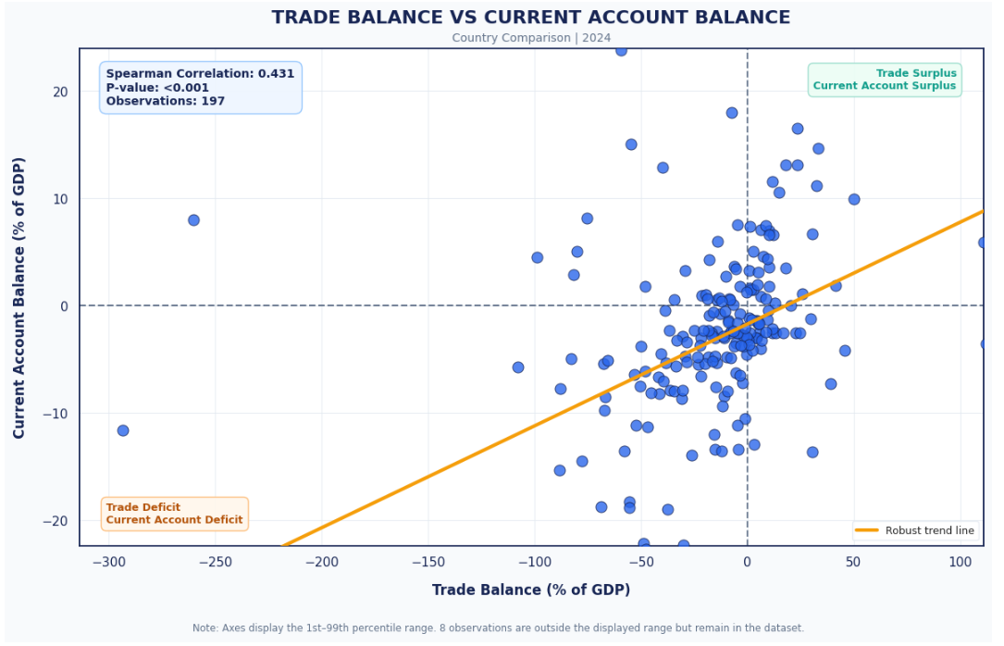
TRADE
06
Trade integration is not the same as resilience
Trade scale, external balances, and export concentration reveal different dimensions of exposure.
112.18%
AVERAGE TRADE OPENNESS
Median: 60.00% of GDP
r = 0.940
EXPORTS VS IMPORTS
Strong positive Pearson correlation
2024 COUNTRY COMPARISON
ρ = 0.431 • p < 0.001 • n = 197
Trade balance and current account balance are both expressed as % of GDP.
THE HIDDEN FRAGILITY OF NATIONAL ECONOMIES
ISMAIL WEHBI • KHOSSE-BAKHOS HANNA

Slide 7
THE MODEL
07
The Economic Fragility Index
Three normalized dimensions are combined into one comparative measure.
T
TRADE VULNERABILITY
M
MACROECONOMIC INSTABILITY
F
FISCAL VULNERABILITY
Export Partner HHI
Export Product HHI
5-year GDP growth volatility
CPI inflation • Unemployment
Public Debt (% GDP)
Fiscal Deficit Risk
T = (Partner + Product) / 2
M = (Growth volatility + Inflation + Unemployment) / 3
F = (Debt + Deficit risk) / 2
OVERALL INDEX
EFI = (T + M + F) / 3
Min–Max normalized to [0, 1] • equal weights • higher EFI = greater relative fragility
THE HIDDEN FRAGILITY OF NATIONAL ECONOMIES
ISMAIL WEHBI • KHOSSE-BAKHOS HANNA

Slide 8
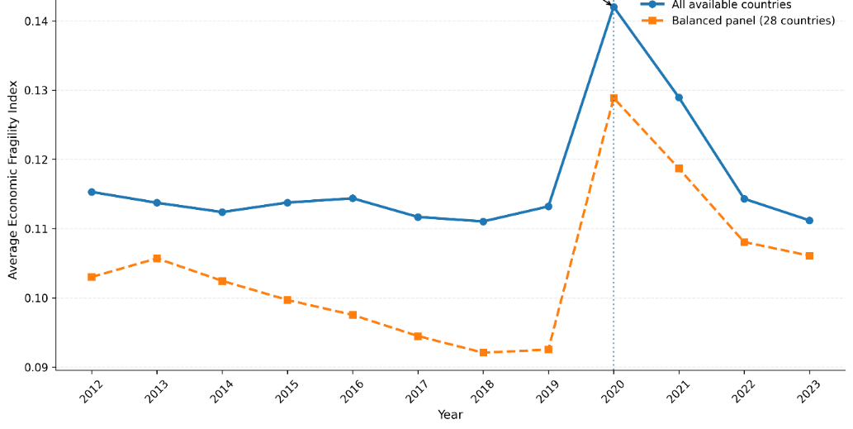
NUMERICAL RESULTS
08
Coverage is the main constraint
The index is calculated only when all three vulnerability dimensions are available.
ANNUAL AVERAGE EFI | 2012–2023
VALID EFI OBSERVATIONS
714
of 2,951 country-year records
24.20% coverage
81 countries • 2012–2023
2,237
records unavailable for EFI
Public Debt alone has 2,107 missing values.
2020 recorded the highest annual average EFI: 0.1420 (vs 0.1132 in 2019).
Coverage varied by year; a balanced 28-country panel also showed an increase from 0.0925 in 2019 to 0.1289 in 2020.
THE HIDDEN FRAGILITY OF NATIONAL ECONOMIES
ISMAIL WEHBI • KHOSSE-BAKHOS HANNA

Slide 9
COUNTRY COMPARISON
09
Fragility differs sharply across countries
Country averages are compared only for 58 countries with at least eight valid EFI observations.
HIGHEST AVERAGE EFI
LOWEST AVERAGE EFI
Palau
0.2555
Thailand
0.0463
Greece
0.2415
Switzerland
0.0493
Marshall Islands
0.2204
Estonia
0.0495
Bhutan
0.2139
Botswana
0.2086
714
valid observations
0.1168
mean EFI
0.1071
median EFI
0–1
index scale
THE HIDDEN FRAGILITY OF NATIONAL ECONOMIES
ISMAIL WEHBI • KHOSSE-BAKHOS HANNA

Slide 10
ROBUSTNESS
10
The ranking is robust; category labels can move
Alternative weights test whether the EFI's conclusions depend on the equal-weight assumption.
WEIGHTING SCENARIO
MEAN EFI
SPEARMAN ρ
CATEGORY AGREEMENT
BASELINE
1/3
Trade-oriented
0.1136
0.9509
75.77%
weight for each
of T, M, and F
Macroeconomic-oriented
0.1108
0.9692
80.25%
Fiscal-oriented
0.1261
0.9513
79.97%
Mean EFI
0.1168
0.9509–0.9692
Spearman rank correlation range
75.77–80.25%
category agreement range
The ordering of observations stays similar, but individual fragility categories can change with the weights.
THE HIDDEN FRAGILITY OF NATIONAL ECONOMIES
ISMAIL WEHBI • KHOSSE-BAKHOS HANNA

Slide 11
MACHINE LEARNING
11
How the Machine Learning test was designed
The models classify EFI-derived fragility categories; they do not predict future crises.
FIVE INPUT FEATURES
COUNTRY-GROUPED 80 / 20 SPLIT
Trade Openness (% GDP)
573
141
Trade Balance (% GDP)
TRAINING • 66 COUNTRIES
TESTING • 15 COUNTRIES
Current Account Balance (% GDP)
StratifiedGroupKFold (5 folds) kept each country in only one split to reduce country-level data leakage.
GDP per Capita
SIX CLASSIFIERS COMPARED
Year
Logistic Regression
K-Nearest Neighbors
TARGET: FOUR EFI CLASSES
Decision Tree
Random Forest
LOW
MODERATE
HIGH
CRITICAL
Support Vector Machine
Gradient Boosting
THE HIDDEN FRAGILITY OF NATIONAL ECONOMIES
ISMAIL WEHBI • KHOSSE-BAKHOS HANNA

Slide 12
MODEL RESULTS
12
Random Forest ranked first — but performance stayed low
Test-set results across 141 observations from 15 countries.
TEST ACCURACY
Random Forest
26.95%
F1 0.2464
BEST MODEL
26.95%
K-Nearest Neighbors
23.40%
F1 0.2277
23.40%
F1 0.2168
accuracy
Gradient Boosting
Support Vector Machine
21.99%
F1 0.0901
0.2464
Decision Tree
19.86%
F1 0.1905
macro F1-score
Logistic Regression
17.73%
F1 0.1523
Best at Critical: 21 of 37 correctly classified.
Important: these models classify EFI categories, not future crises. Low accuracy limits practical prediction.
THE HIDDEN FRAGILITY OF NATIONAL ECONOMIES
ISMAIL WEHBI • KHOSSE-BAKHOS HANNA

Slide 13
EXPLAINABLE AI
13
What drives the Random Forest classifications?
Global SHAP values show the relative contribution of each feature to model predictions.
GLOBAL SHAP IMPORTANCE
LOCAL CASE
Trade Openness
0.06219
Albania
GDP per Capita
0.04649
2012
Trade Balance
0.04317
Predicted class
LOW
Current Account
0.02927
SHAP explains the model's decision; it does not establish causality.
Year
0.02280
Interpret cautiously: the selected model's accuracy was 26.95% and macro F1 was 0.2464.
THE HIDDEN FRAGILITY OF NATIONAL ECONOMIES
ISMAIL WEHBI • KHOSSE-BAKHOS HANNA

Slide 14
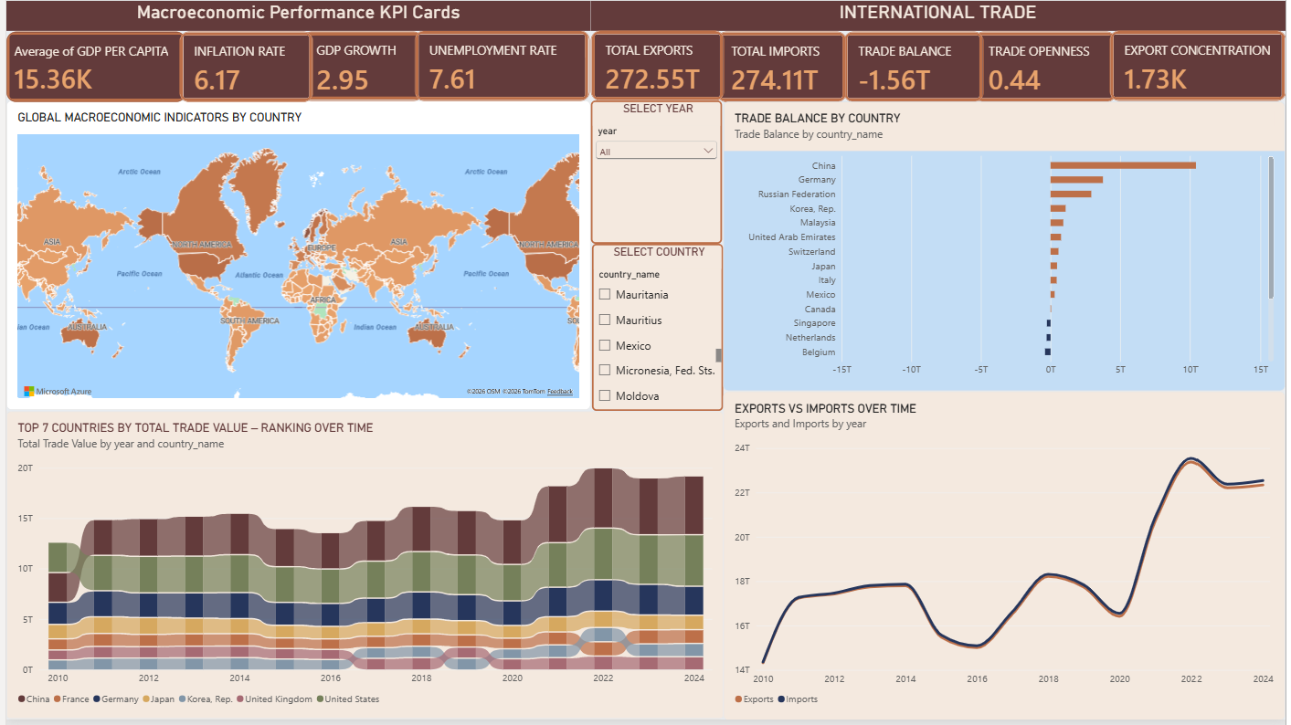
DASHBOARD
14
From analysis to exploration
The Power BI dashboard brings macroeconomic performance and international trade into one view.
DASHBOARD
2010–24
— 9 KPIs
— Country map
— Trade balance
— Top-7 ranking
— Exports vs imports
— Country + year filters
A dynamic view for comparing countries and tracking changes over time.
THE HIDDEN FRAGILITY OF NATIONAL ECONOMIES
ISMAIL WEHBI • KHOSSE-BAKHOS HANNA

Slide 15
CONCLUSION
15
What the study tells us
Economic fragility is multidimensional — and the evidence must be interpreted with care.
KEY FINDINGS
RECOMMENDATIONS
The EFI combines trade, macroeconomic, and fiscal vulnerability.
Diversify export products and trading partners.
Only 714 of 2,951 observations had complete data for the three dimensions.
Monitor growth volatility, inflation, and unemployment.
Average EFI peaked in 2020; country experiences varied considerably.
Strengthen fiscal sustainability and debt monitoring.
Alternative weights preserved ranking patterns, but some category labels changed.
Track vulnerability using integrated indicators.
Random Forest performed best, but its classification accuracy remained low.
Improve data coverage and predictive features.
LIMITATIONS
Missing public-debt data • Min–Max sensitivity to extremes • equal weights are an assumption • ML results are not crisis forecasts
THE HIDDEN FRAGILITY OF NATIONAL ECONOMIES
ISMAIL WEHBI • KHOSSE-BAKHOS HANNA

