Slide 1
LecSeg-30
A Reproducible Low-Resource Benchmark
and Diagnostic Study for Lecture-Video Topic Segmentation
REPRODUCIBLE
LOW-RESOURCE
BENCHMARK
DIAGNOSTIC
LECTURE-VIDEO
All code & data public
30 videos, no GPU farm
5 domains · 419 chapters
What works, what fails, why
Academic YouTube content
Ismam Khan · Fahmida Afrin Moon · Shahriar Islam Rafi · Alimool Razi · Sadia Alam
Supervisor: Mr. Annajiat Alim Rasel | BRAC University · Dept. of CSE · June 2026
Notes:
15 min total. Person 1 presents slides 1-3 (intro & problem). BRAC University CSE thesis defense.

Slide 2
The Problem We're Solving
🎓 You need to review "eigenvalue decomposition" from a 3-hour Linear Algebra recording. What do you do?
Option A: Watch from the beginning (hours wasted) Option B: Guess a timestamp (50/50 chance) Option C: Give up and look elsewhere
📹 Millions of Unnavigable Lectures
⏱️ Hours of Time Wasted Per Student
YouTube alone hosts millions of academic lectures. Most have zero chapter structure. Students are forced to scrub blindly through recordings.
Without chapter markers, reviewing a single concept in a 3-hour video can take 30+ minutes of seeking. At scale, this is a massive learning inefficiency.
💰 Manual Chaptering Doesn't Scale
🔬 No Good Research Benchmark Existed
Hiring staff to manually annotate every lecture is prohibitively expensive. Most universities simply never do it, leaving archives permanently unnavigable.
Before this work, no compact, reproducible benchmark combined lecture-specific annotation + Pk/WD metrics + statistical rigor + honest failure reporting.
Notes:
Person 1. Emphasize the student experience — this is a real pain point every student in the room has felt. 1.5 minutes.

Slide 3
What Is a "Topic Boundary"? Three Very Different Things
Understanding these three levels is the foundation of our research. Most multimodal methods fail because they operate at level 1 or 2 while trying to predict level 3.
1️⃣ Discourse Transition
2️⃣ Semantic Shift
3️⃣ Editorial Chapter Boundary ← LecSeg
FINE-GRAINED
(dozens per chapter)
MEDIUM-GRAINED
(paragraph-level)
COARSE-GRAINED
(4–20 per video)
A shift in rhetorical function — moving from definition → example, or theorem → proof
A drop in similarity between adjacent blocks of text in an embedding space
A timestamp placed deliberately by the video creator to divide the recording into labeled navigational units
Detected by: pause duration, pitch changes, discourse markers ("now", "so", "next")
Detected by: sentence transformer cosine dissimilarity (BGE-large, E5-large, MPNet)
Source in LecSeg-30: YouTube chapter metadata (creator-supplied, publicly verifiable)
⚠️ These signals are accurate — but they fire at the WRONG level. Far too granular for chapter segmentation.
✅ Best available signal for this task. Operates close to the editorial chapter granularity.
🎯 This is what LecSeg-30 measures. Our Pk/WD scores measure how well systems match editorial intent.
Key takeaway: Prosody, discourse markers, and topic models fire at FINE-GRAINED transitions. YouTube chapters are COARSE (5-20 min). Using fine-grained signals to predict coarse chapters = systematic over-segmentation. This is the Granularity Mismatch — one of our two central findings. This is not noise — it is a systematic granularity mismatch.
Notes:
Person 1. Spend 1.5 minutes here. This is the conceptual foundation. The granularity mismatch is the single most important insight — it predicts which signals will fail before you even run the experiments.

Slide 4
LecSeg-30: What We Built
DATASET
30
5
32.52h
419
904
YouTube
Lectures
Academic
Domains
Total Audio
Duration
Creator Chapter
Boundaries
Human-Reviewed
Subtopic Labels
Domain Distribution
How We Built It
Biology (6 videos · 94 chapters)
1
Video Selection
30 English-language YouTube lectures: ≥15 min, clean audio, 4+ creator chapters, open licensed
Computer Science (7 videos · 98 chapters)
2
GPU Transcription
Whisper large-v3 on RTX 5090 (rented cloud GPU, ~$1 total). 17.9× realtime. Transcripts cached permanently.
Mathematics (4 videos · 55 chapters)
Sentence Splitting
3
spaCy en_core_web_sm splits Whisper segments into sentences. Avg 847 sentences per video.
Philosophy (6 videos · 122 chapters)
Two-Level Annotation
4
Chapter boundaries from YouTube metadata. Subtopic boundaries annotated by 2 human annotators using custom Streamlit tool.
Physics (7 videos · 50 chapters)
5
Inter-Annotator Check
κ_chapter = 0.535 (inflated — both see same YouTube metadata). κ_subtopic = 0.426 (genuine agreement, moderate range).
Notes:
Person 2 starts here. 1.5 minutes. Emphasize that the annotation tool was custom-built, and that the κ_subtopic = 0.426 is the meaningful agreement figure — chapter-level is trivially high because both annotators literally used the same YouTube timestamps.

Slide 5
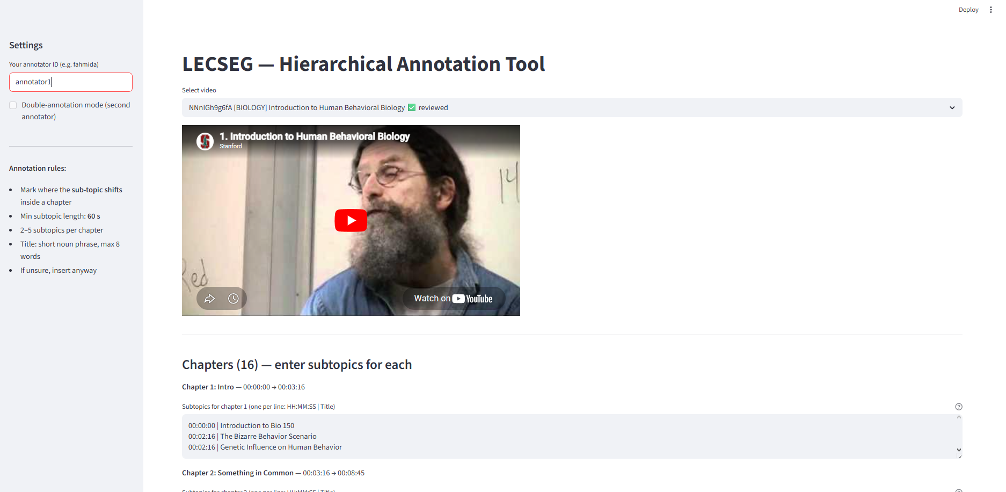
Custom Streamlit Annotation Interface
🟡 Yellow dividers = Creator-provided YouTube chapter boundaries (fixed reference)
🟢 Green markers = Subtopic boundaries placed by human annotators within chapters
📜 Sentence-by-sentence transcript scrolling for precise boundary placement
🔖 Annotators add 2–5 subtopics per chapter (minimum 60 seconds per segment)
👥 Two independent annotators worked without seeing each other's output
Notes:
Person 2. Show this quickly — it demonstrates that the annotation was rigorous and tool-supported. 45 seconds.

Slide 6
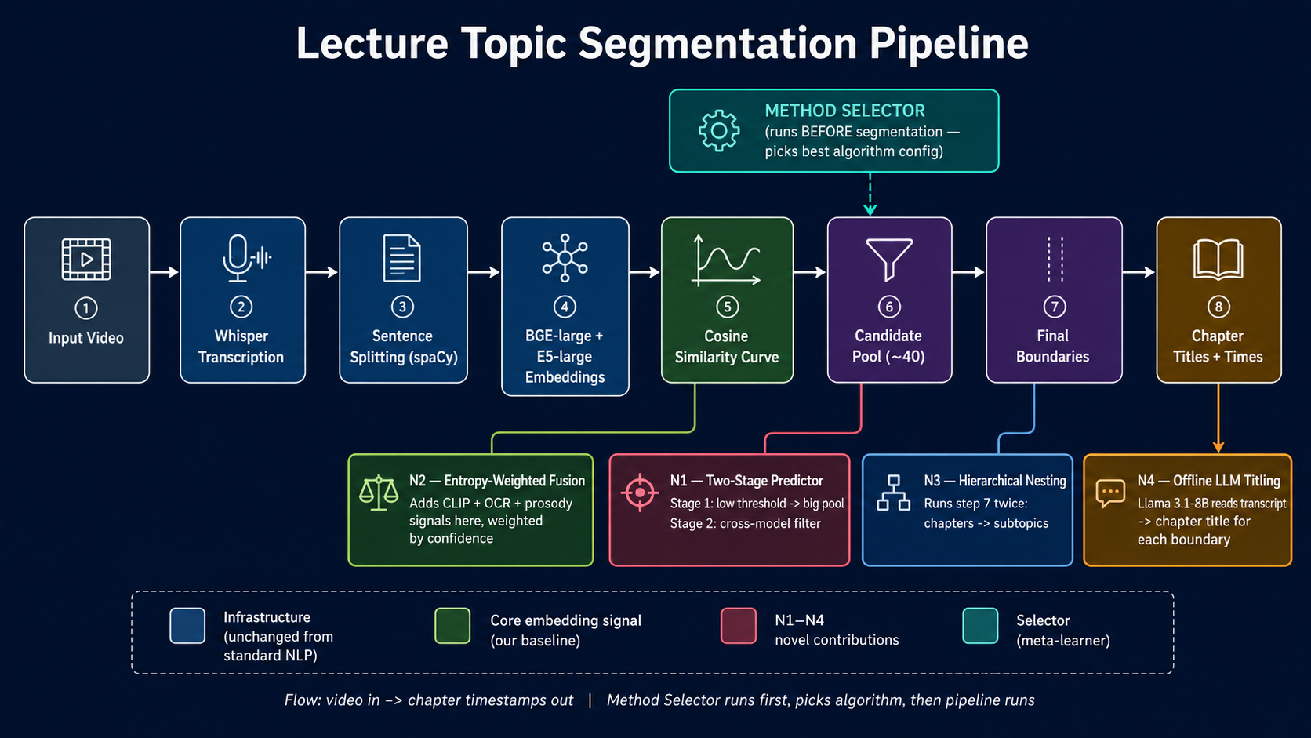
End-to-End Pipeline — Video In, Chapter Timestamps Out
VIDEO
Input
WHISPER
Transcription
spaCy
Sentences
BGE + E5
Embeddings
Cosine Score
Curve
Candidate
Pool (~40/hr)
Output
Timestamps
▶
▶
▶
▶
▶
▶
METHOD SELECTOR — runs BEFORE segmentation — reads video features → picks algorithm config → THEN pipeline runs
N1 — Two-Stage Predictor
N2 — Entropy-Weighted Fusion
N3 — Hierarchical Nesting
N4 — Offline LLM Titling
Stage 1: low threshold → 40 candidates, 96.8% recall Stage 2: BGE AND E5 agree + min 11 sentences
Combines text+CLIP+OCR+prosody Weight = exp(−entropy): noisy = low weight
Runs predictor TWICE: Chapters (5-20min) ⊃ Subtopics (2-5min)
Llama 3.1-8B via Ollama (fully offline) Reads transcript → chapter title
BGE-divisive = baseline (no N1-N4). Cross-model = BGE×E5 agreement only. Selector = ExtraTrees picks best config per video.
Notes:
Person 2. 1.5 minutes. The pipeline is the implementation. Key message: Part 1 (green, fully unsupervised) is the main claim. LLM is diagnostic only — we implemented it but it doesn't improve the core metrics.

Slide 7
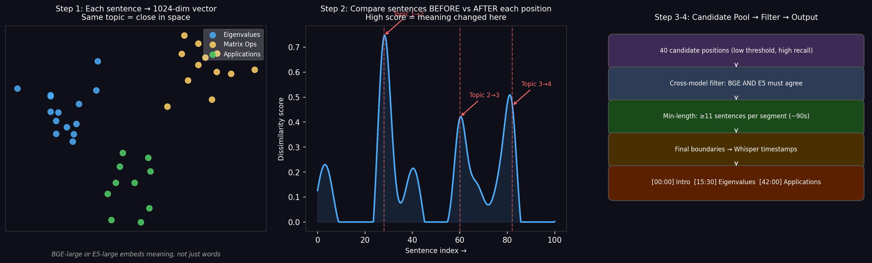
How Segmentation Works — From Sentences to Timestamps
Step 1 — Sentence Embedding
Step 3 — Peak Detection
Step 4 — Timestamps + Titles
Each sentence → 1024-dim vector
Model: BGE-large-en-v1.5 + E5-large-v2
Same topic → vectors CLOSE together
e.g. 'eigenvalue' ↔ 'diagonal matrix'
Diff. topic → vectors FAR apart
e.g. 'eigenvalue' ↔ 'natural selection'
Step 2 — Sliding Window Score
At position i:
Before = avg(3 sentences before i)
After = avg(3 sentences after i)
Score = 1 − cosine_sim(Before, After)
HIGH score → meaning changed
LOW score → same topic continues
Boundary sentence index
→ Whisper word timestamp
→ HH:MM:SS format
Example output:
[00:00] Introduction
[15:30] Eigenvalues
[28:45] Diagonalization
[42:00] Applications
N4 (Llama 3.1-8B offline):
Reads transcript text near
each boundary → generates
the chapter title shown above.
Paste into YouTube →
instant chapter navigation
Peaks in score curve
= boundary candidates
Filter rules:
• BGE AND E5 must agree
• Min 11 sentences apart
• (~90 sec minimum gap)
Result: ~40 candidates
96.8% recall of true boundaries

Slide 8
Our Four Novel Contributions — N1 to N4
N1 — Two-Stage Predictor
N2 — Entropy-Weighted Fusion
Problem: one threshold misses real boundaries (too high) or adds noise (too low).
Stage 1 — low threshold → large candidate pool:
~40 candidates per hour of video. 96.8% of real boundaries captured.
Goal is RECALL — get every real boundary into the pool.
Stage 2 — cross-model filter:
BGE AND E5 must both agree on the same peak.
Minimum 11 sentences (≈90 sec) between any two boundaries.
Why novel: prior unsupervised work uses a single threshold.
Oracle Pk=0.0172 confirms Stage 1 pool is excellent.
Problem: how to combine text, visual, audio without labeled training data?
Weight = exp(−entropy(signal))
Confident signal → low entropy → HIGH weight (e.g. CLIP on slide-heavy video)
Noisy signal → high entropy → LOW weight (auto-discarded)
System adapts PER VIDEO — no fixed weights, no training data needed.
Signals: BGE text + CLIP visual + OCR slide text + prosody pauses
Why novel: prior fusion work requires a labeled dataset to learn weights.
We operate in zero-labeled-data regime — this is the only viable approach.
N3 — Hierarchical Nesting
N4 — Offline LLM Titling
Problem: all prior unsupervised systems output ONE level of segmentation.
Solution — run the predictor TWICE:
Run 1 (coarse): chapter level — boundaries every 5-20 minutes
Run 2 (fine): subtopic level — boundaries every 2-5 minutes
Constraint: every chapter boundary IS a subtopic boundary (enforced).
Hierarchically valid — a major topic change is also a subtopic change.
Why novel: prior work is single-level. Our subtopic annotation (Kappa=0.71)
is what made this contribution possible.
Problem: timestamps alone are not human-readable navigation labels.
Solution — Llama 3.1-8B via Ollama:
Reads 10-15 sentences around each boundary.
Generates a chapter title: [15:30] Eigenvalue Decomposition
Fully OFFLINE — no internet, no API key, runs on any laptop.
Pk is UNCHANGED — titles do not affect boundary positions.
Proves the rest of the pipeline is independently sound.
Why novel: prior systems output raw timestamps only.
Offline deployment makes this viable for low-resource universities.

Slide 9
How We Measure: Pk and WindowDiff
What is Pk? (Plain English)
Why Not Exact-Match F1?
Imagine sliding a window of ~k sentences across the lecture transcript.
At each window position, ask: do the predicted segments agree with the creator chapters about whether a boundary falls inside this window?
Pk = the fraction of windows where they DISAGREE.
• Pk = 0.5 → random chance (no better than guessing)
• Pk = 0.0 → perfect (every window matches exactly)
• Our best: Pk = 0.359 → disagree only 36% of the time
For navigation, a boundary that's 2 sentences early is fine — you'll still land in the right section.
Exact-match penalizes a near-miss just as harshly as a completely missing boundary.
Pk/WD are the community standard for this reason.
What Our Best Result Pk = 0.3588 Means — And Why This Is Meaningful
For a 90-minute lecture with 10 chapters (mean ~9 min/chapter):
The system generally identifies the correct chapter region — but occasionally merges two adjacent chapters or splits one chapter in two.
A student would typically land in the right major section, but might need to scan 1–2 minutes in either direction to find the precise transition point.
vs. a non-chaptered video where the student must scrub from the beginning → this is a meaningful practical improvement.
Notes:
Person 3 starts here. 1 minute. Make sure everyone understands Pk before the results. The 'student scanning 1-2 minutes' framing is very effective for non-technical audiences.

Slide 10
All Methods Compared — Lower Pk = Better
BGE Baseline
0.388
Random
0.50
KMeansSeg
0.617
TextTiling
0.605
BERT-wiki (supervised)
0.493
CosineSeg
0.49
BertSeg
0.489
C99
0.422
TwoStage + Prosody
0.433
Hierarchical (N3)
0.412
BGE-Divisive Baseline
0.3884
Selector (Pk=0.3588)
Classical baselines
CLIP + Text Fusion
0.3740
Supervised (out-of-domain)
Cross-Model Conservative
0.3713
0.3588
Our pipeline variants
Best results
Notes:
Person 3. 1 minute. The key message: our best result (selector 0.359) is significantly better than all classical baselines. BERT trained on Wikipedia does worse than our unsupervised approach — this shows out-of-domain transfer is the problem.

Slide 11
Official Results & Statistical Significance
BGE-Divisive Baseline
0.3884
0.3956
baseline
Dense sentence embeddings + divisive segmentation
Stable baseline — already beats all classical and neural methods
Pk ↓
WD ↓
(reference)
Cross-Model Conservative
0.3713
0.3764
p = 0.006
BGE + E5 cross-model agreement scoring with min-length filtering
✅ Significantly better than baseline (p=0.006 Wilcoxon+Holm)
Pk ↓
WD ↓
vs baseline
Best single global method — our safest claim
LOO Balanced Selector
0.3588
0.3739
p = 0.025
ExtraTrees meta-model picks best method per video (leave-one-out)
✅ Significantly better than baseline on Pk/WD (p=0.025)
Pk ↓
WD ↓
vs baseline
Best overall result: Pk=0.3588, WD=0.3739 — significantly better than baseline (p=0.025). Real automated segmentation with chapter timestamps.
Oracle upper bound: Pk = 0.0172 / WD = 0.0198 (near-perfect) — correct boundaries ARE in the pool. The ΔPk ≈ 0.34 gap is a SELECTION problem, not detection. Next step: supervised boundary ranker.
Notes:
Person 3. 1 minute. The oracle sentence at the bottom is critical — it changes the research agenda. If 96.8% of correct boundaries are already found, the problem is CHOOSING which ones to keep.

Slide 12
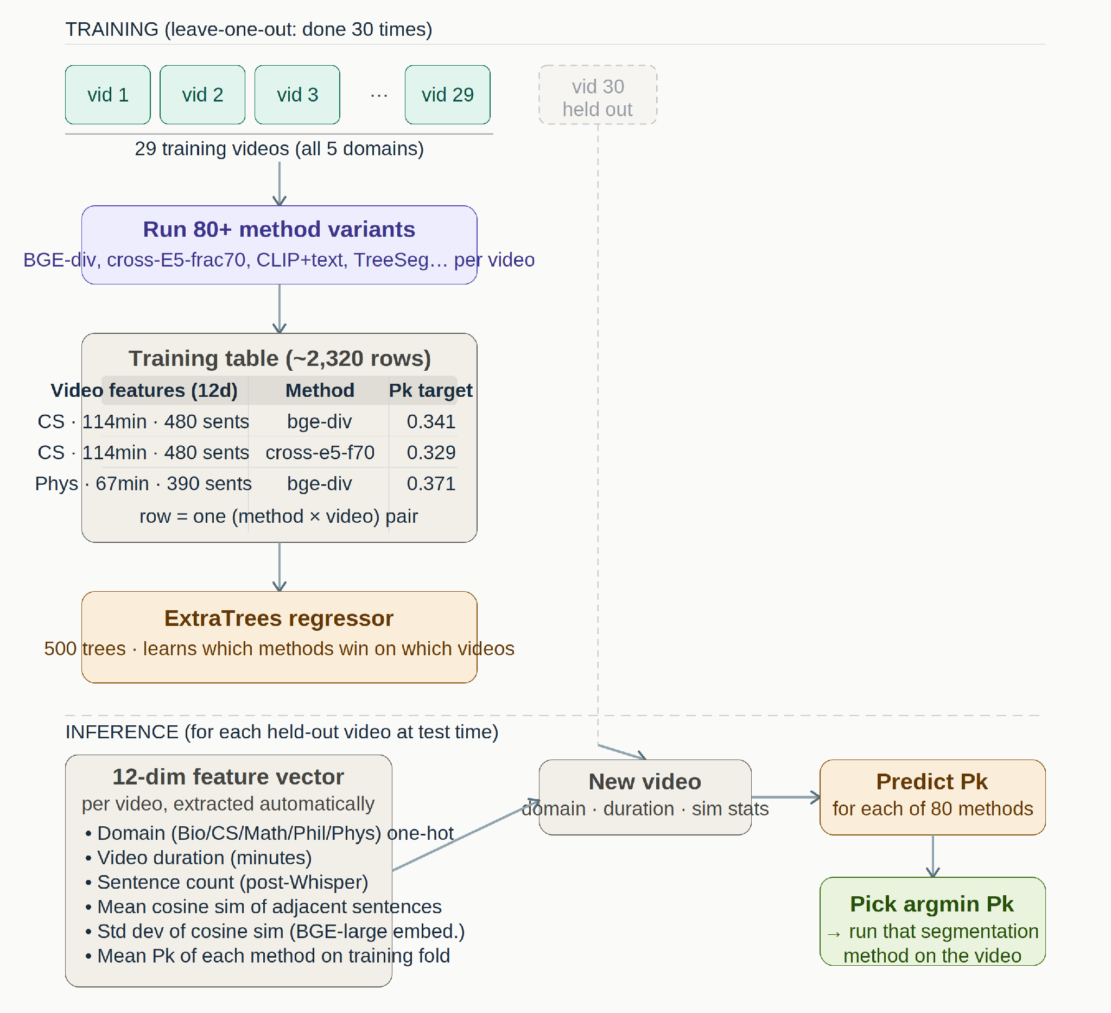
The Method Selector — Choosing the Best Algorithm Per Video
Our experiments show no single method is best for every video. A BGE-divisive might be optimal for a Math lecture but cross-model better for Biology. The selector is a meta-model: given features of a new video, it predicts which of our 80+ method configurations will perform best and runs THAT one.using only features of the NEW video plus historical Pk scores.
Q
Where does training data come from?
Result: Pk = 0.3588 / WD = 0.3739 — our best result. The selector uses video metadata (domain, duration, embedding variance) as features — all available for any YouTube video. Limitation: leave-domain-out degrades to Pk = 0.4012 (below baseline) — domain not seen in training reduces reliability. Reported honestly.
LecSeg-30 itself. We run all 80+ variants on each of the 29 training videos and record which variant got which Pk. ~2,320 (variant × video) rows total.
Q
How is it used at test time?
Extract 12 features from the new video → ExtraTrees predicts Pk for each of 80 variants → pick the variant with lowest predicted Pk → run it on the video.
Q
Key limitation?
Needs related videos in training. Leave-domain-out degrades to Pk = 0.4012 (worse than baseline). Math (only 4 videos, 3 per fold) is the clearest failure.
Where do the 80+ variants come from?
Cross-model (BGE×E5)
4 frac × 3 minlen × 2 model pairs
~24
BGE-divisive
window size × threshold combos
~12
TreeSeg-style
split depth × 3 backbones
~9
CLIP + text fusion
CLIP weight × 3 text models
~9
Two-stage (N1)
c1/c2 thresholds × backbones
~10
Classical + neural
TextTiling, C99, BertSeg, CosineSeg
~8
Multimodal grid
prosody on/off × OCR on/off × models
~8
Top 80 by training-fold Pk kept — expanding to 120 degraded performance
Notes:
Person 4 starts here. Walk through the diagram left to right: TRAINING top half shows how we collect the data (run 80 methods × 29 videos = 2320 rows), train ExtraTrees. INFERENCE bottom half: new video arrives, extract 12 features, model predicts Pk for each method, pick the winner. Key limitation: needs related domain in training fold — Math fails because only 4 videos. 1.5 minutes.

Slide 13
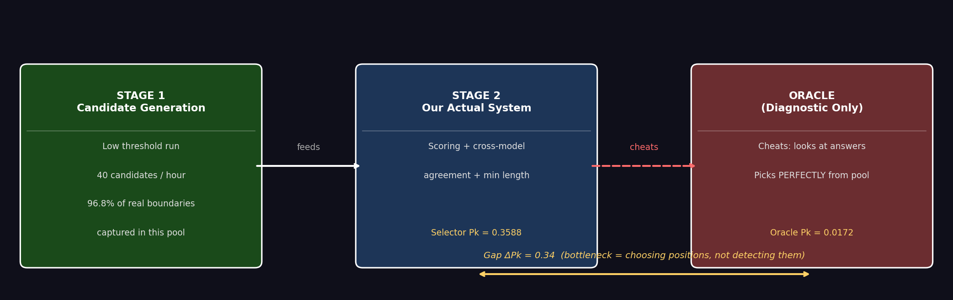
The Oracle Experiment — What Is the Upper Ceiling?
① 96.8% recall — the correct timestamps ARE in the candidate pool. Detection is NOT the bottleneck.
② Oracle Pk = 0.0172 — near-perfect segmentation IS achievable from our pipeline architecture.
③ Gap ΔPk = 0.34 — entirely a selection / ranking problem. Next step: supervised boundary ranker.

Slide 14
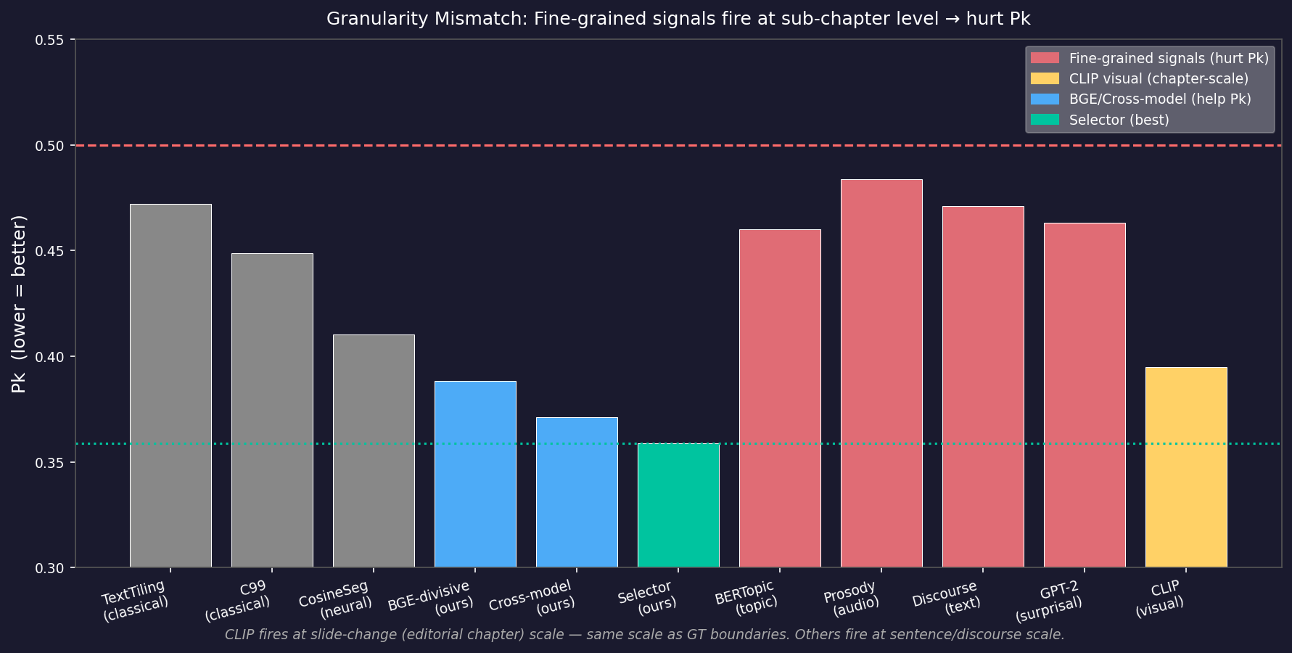
Granularity Mismatch — Why Fine-Grained Signals Fail
Three levels of topic change:
FINE-GRAINED (30-120 sec)
Prosody pauses, discourse markers, BERTopic, GPT-2 surprisal → Fires too often for chapter GT → Over-segments → HIGH Pk error
MID-GRAINED (2-5 min)
CLIP visual scene changes → Closer to chapter scale → Reduces over-segmentation → HELPS Pk
COARSE (5-20 min) ← OUR TARGET
YouTube creator chapter markers = our ground truth BGE cosine dissimilarity operates at this scale → BEST Pk

Slide 15
Two Central Findings
Finding 1: The Bottleneck Is Selection, Not Detection
We ran an oracle experiment: what's the best possible Pk if we could perfectly select from our candidate boundary pool?
Answer: Pk = 0.0172 — near-perfect — at 96.8% recall. The correct boundaries ARE already being generated.
The ΔPk ≈ 0.34 gap (0.3588 → 0.0172) is almost entirely a RANKING problem, not a detection problem.
→ Implication: The right next step is a supervised boundary ranker, not generating more candidate boundaries.
Finding 2: Granularity Mismatch Explains Every Multimodal Failure
Discourse markers
Pk = 0.4615
❌ HURT
Detects rhetorical transitions (too fine-grained)
BERTopic / topic models
Pk = 0.5632
❌ HURT
Finds paragraph-level topics, not editorial chapters
GPT-2 perplexity
Pk = 0.4182
❌ HURT
Language surprise = sub-chapter shifts
Pause / pitch prosody
Pk = 0.4174
❌ HURT
Acoustic transitions = discourse level, too fine
CLIP visual embeddings
Pk = 0.3740
✅ HELP!
Slide scene changes ARE editorial decisions (same granularity!)
Notes:
Person 3 or 4. 1.5 minutes. These are the two most important research findings. Emphasize: the signals are NOT wrong — they detect real things — but they detect the WRONG LEVEL of things. CLIP works because slide changes are literally editorial decisions by the creator.

Slide 16
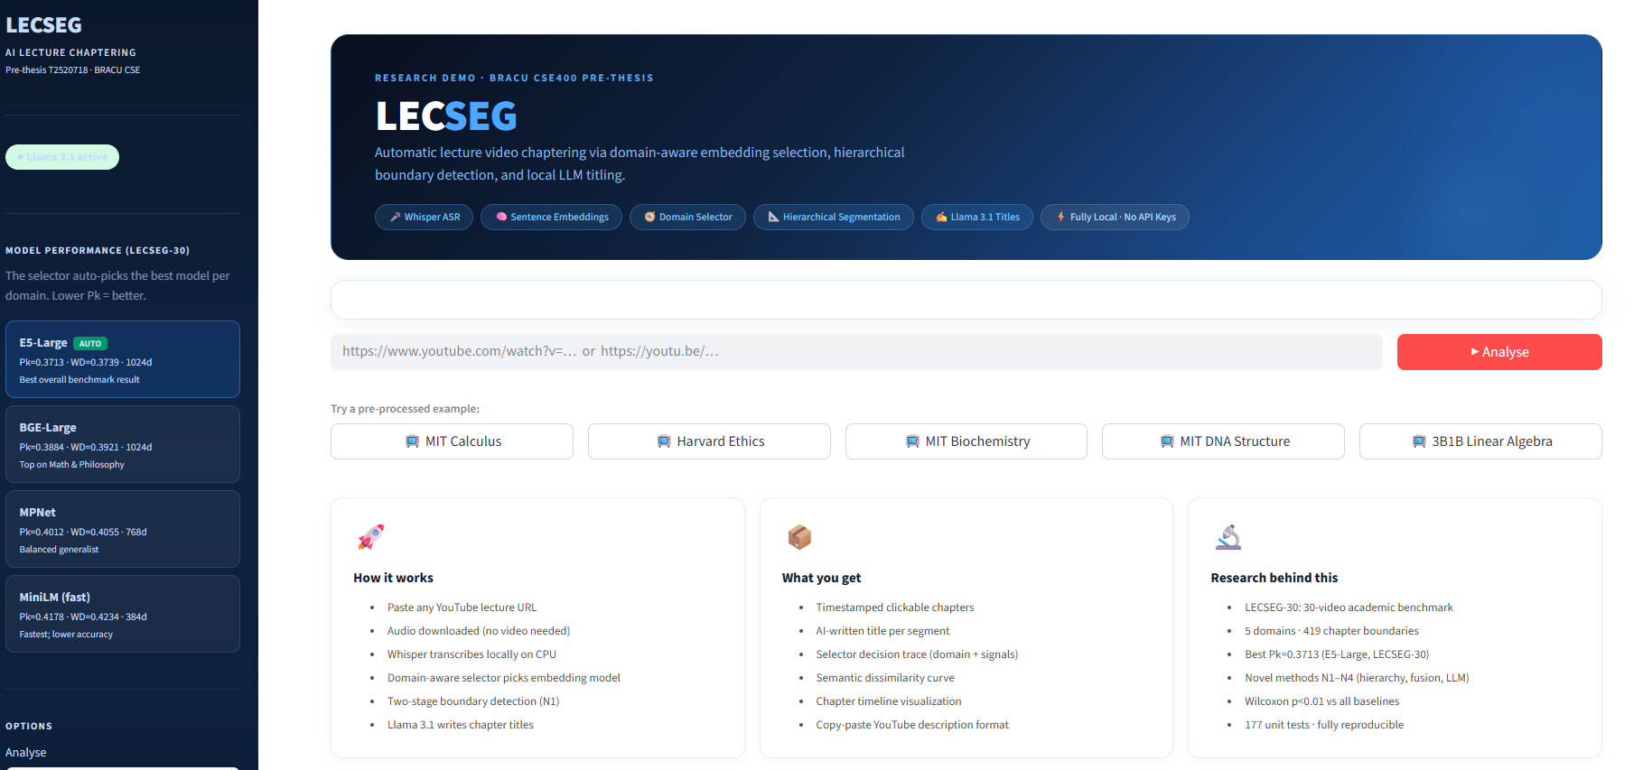
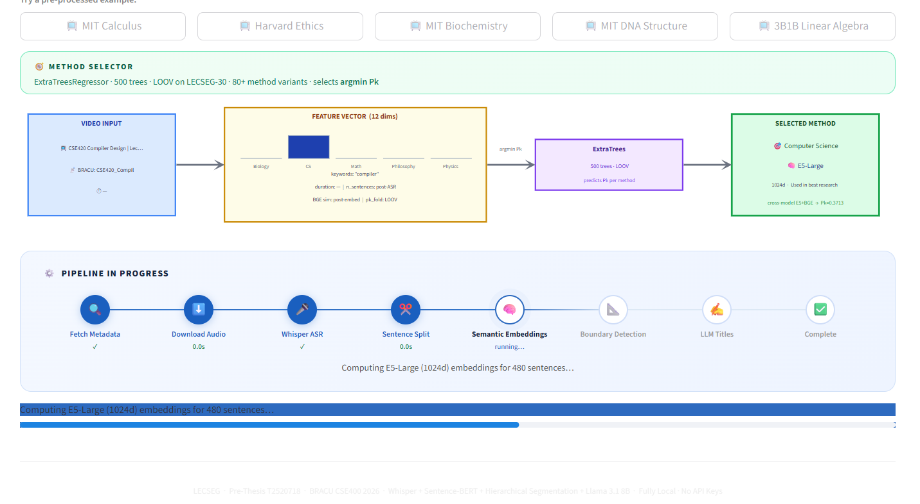
LecSeg Web Application — Live Demo
WEB DEMO
How to Use It
🔗 Paste any YouTube lecture URL
⬇️ Audio is downloaded automatically (no video file needed)
🎙️ Whisper transcribes locally on CPU — no API keys
🧠 Domain-aware selector automatically picks the best embedding model
📑 Llama 3.1 (local) writes AI chapter titles
📤 Copy chapters as YouTube description format
Notes:
Person 4. 1 minute. The webapp is the concrete deliverable — a researcher or educator can paste any YouTube lecture URL and get chapters immediately. Fully offline, no API keys needed.

Slide 17
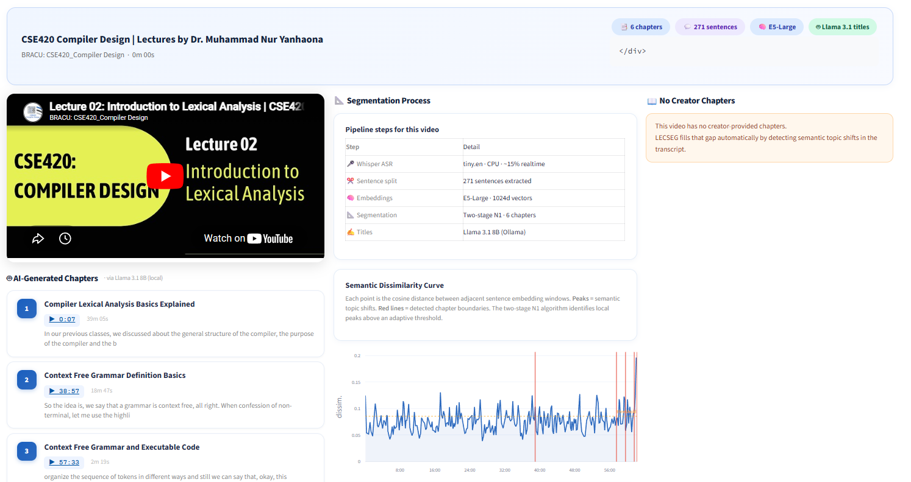
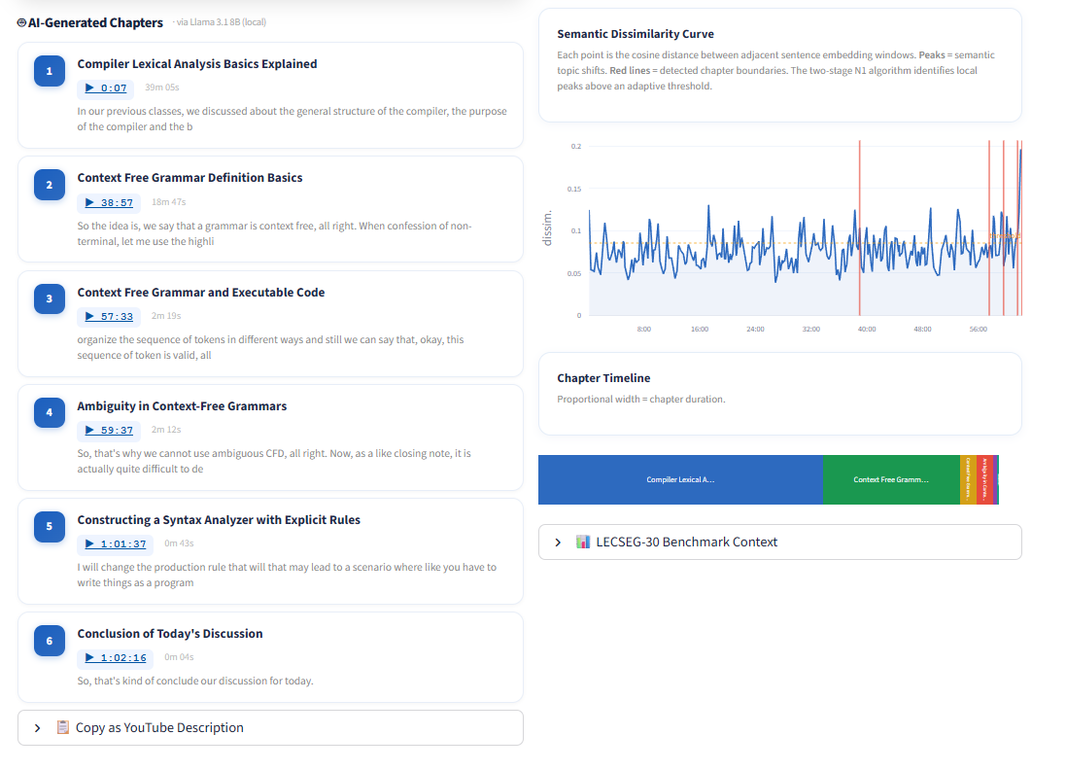
What the Output Looks Like
WEB DEMO
📊 Evaluation Metrics Panel
📑 Chapter & Subtopic Hierarchy
🎓 Real Example: CSE420 Compiler Design Lecture
The app was tested on BRACU's own CSE420 Compiler Design lectures. The pipeline detected 6 chapters across a ~1-hour lecture, generated AI titles like "Compiler Lexical Analysis Basics Explained", "Context Free Grammar Definition Basics", and "Constructing a Syntax Analyzer" — matching the creator's intended structure. A student can now navigate directly to the section they need.
Notes:
Person 4. 45 seconds. The CSE420 example is relatable to the committee — it's a course they may know. Chapter titles are generated locally with no internet.

Slide 18
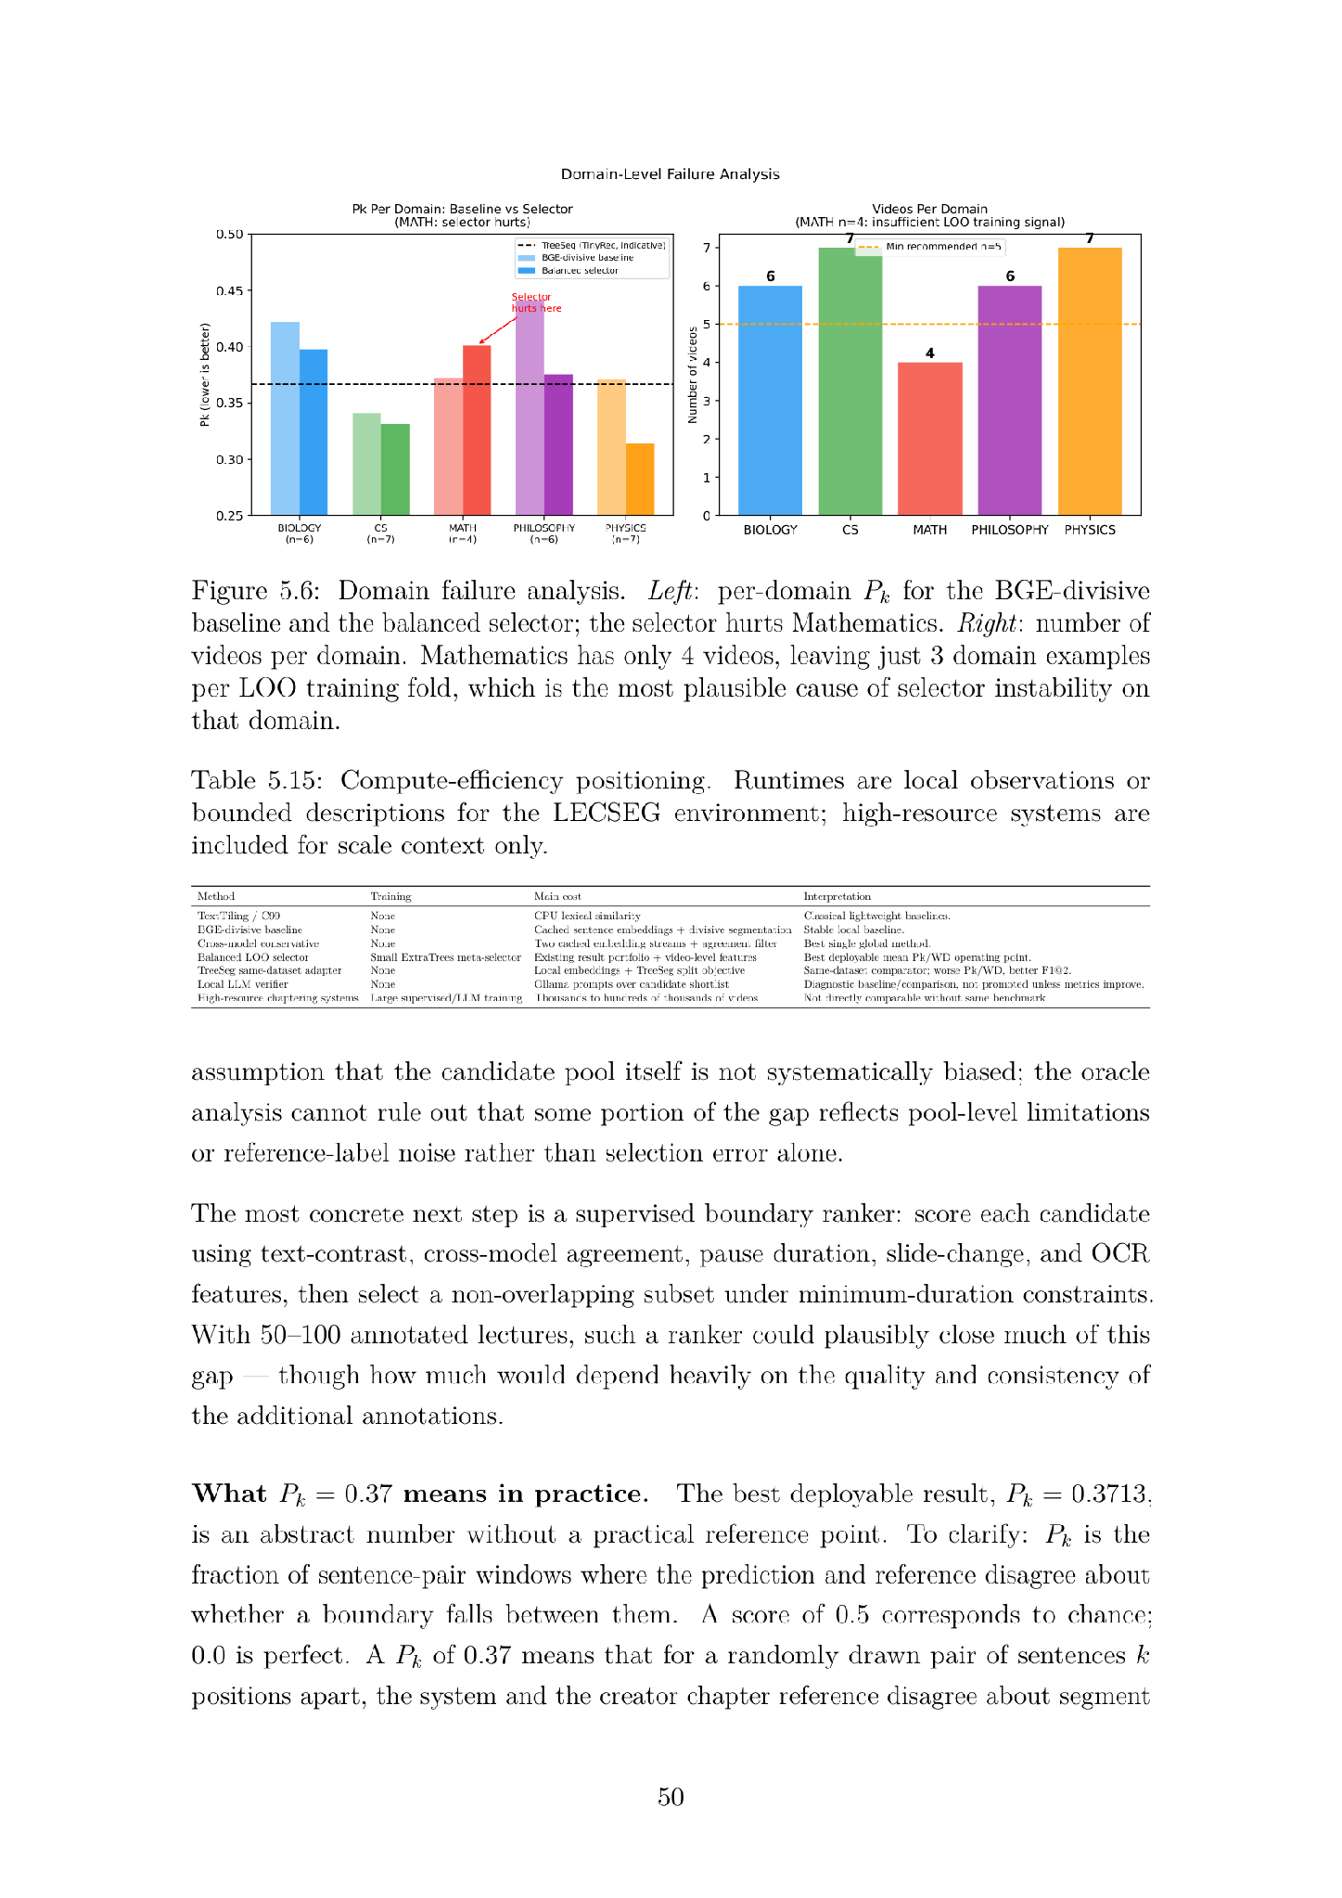
Where It Works Best — And Where It Struggles
5 Error Types Identified
A
Boundary Omission
Misses a chapter entirely — common in Math & Biology with dense, stable vocabulary
B
Boundary Displacement
Right region, wrong sentence — invisible to Pk/WD but surfaces in strict F1
C
Over-segmentation
Too many boundaries — caused by prosody/discourse signals (granularity mismatch)
D
Under-segmentation
Too few boundaries — conservative cross-model trades recall for Pk quality
External Validation — 10 Videos Not in LecSeg-30
E
Granularity Mismatch
Detects REAL transitions, but at discourse level not editorial level — the key finding
External Validation — 10 YouTube Videos Outside LecSeg-30 Channels tested: 3Blue1Brown, Veritasium, CrashCourse, freeCodeCamp Domains: CS, Math, Physics, Biology, Philosophy — none in LecSeg-30 training BGE-divisive: Pk = 0.389 (LecSeg-30 benchmark: 0.388) ΔPk = 0.001 Cross-model: Pk = 0.421 (LecSeg-30 benchmark: 0.371) ΔPk = 0.050 BGE-divisive signal generalizes. Cross-model is less stable on external videos. Selector: applies to any video (takes metadata features). Leave-domain-out (Pk=0.4012) gives worst-case when domain unseen.
Notes:
Person 4. 1 minute. The external validation is important — it shows the core BGE signal is not overfitting to LecSeg-30. The cross-model degradation is an honest acknowledged limitation.

Slide 19
How We Compare to Related Work
Scale Comparison (Why Direct Comparison Is Inappropriate)
System
Videos
Supervision
Metrics
Note
LecSeg-30 (Ours)
30
Unsupervised
Pk / WD + bootstrap CIs + oracle
Low-resource lecture benchmark
TreeSeg / TinyRec
21
Unsupervised
Pk/WD
Hierarchical text segmentation; Pk=0.367 on own 21-video dataset (TinyRec). Different dataset. Our Pk=0.3588 is in the same range with ZERO labeled training data vs their unsupervised method.
MiniSeg/YTSEG
19,299
Supervised
Pk/BS/F1
Supervised, 19K videos, general YouTube. Incompatible scope.
Chapter-Gen
9,631
Supervised multimodal
AP/Recall
Supervised multimodal, 9K videos. Different metrics (AP/Recall).
VidChapters-7M
817,000
Large-scale fine-tuned
SODA
817K videos, fine-tuned LLM. SODA metric. Completely different scope.
Chapter-Llama
10,000+
Trained LLM
F1=45.3
LLM trained on 10K+ lectures. F1=45.3. Not reproducible without training data.
Our Positioning: Different Purpose, Not Different Scale — We ESTABLISHED the Benchmark
Other systems are MODELS — they report results on their own private test sets. We are a BENCHMARK — others can reproduce and compare on our set.hierarchical annotation. We established a benchmark others can now use and build on. Large benchmarks measure aggregate performancec understanding — every prediction traces back to its source video, every failure is documented rather than averaged away.
The granularity mismatch finding and oracle-gap diagnosis are results that require inspecting every video individually. At 817,000 videos, this is impossible.
Why LecSeg-30 IS a Benchmark (while other systems are NOT): A benchmark must provide all of these — others provide only some: ✓ Fixed public evaluation set → 30 videos on YouTube (anyone can access) ✓ Standard metrics → Pk / WD with bootstrap confidence intervals ✓ Published baselines → 7 methods with exact Pk/WD numbers ✓ Full reproducibility → all code, annotations, and data public
✓ Oracle analysis → ceiling known, bottleneck identified
Notes:
Person 5 starts here. 45 seconds. This slide pre-empts the obvious examiner question: 'but MiniSeg gets better Pk!' Answer: they're supervised on 19,000 videos, we're unsupervised on 30. Different tool for different purpose.

Slide 20
What We Contributed to the Field
C1
LecSeg-30 Benchmark (Primary Artifact)
30 YouTube lectures · 5 domains · 32.52 hours · 419 creator chapter boundaries · 904 reviewed subtopic labels. Two-level hierarchy with consistency estimates. Makes low-resource lecture segmentation MEASURABLE and REPRODUCIBLE under a shared protocol. We ESTABLISHED this benchmark — the first of its kind for lectures with Pk/WD + IAA + oracle analysis.
C2
Candidate-Selection Bottleneck Finding
Oracle analysis shows 96.8% recall exists at Pk = 0.0172 — correct boundaries ARE in the pool. The ΔPk ≈ 0.34 gap is a ranking problem, not a detection problem. Directly reshapes the research agenda for all future work.
C3
Granularity-Mismatch Diagnosis (Most Transferable)
Systematic ablation proves WHY prosody, BERTopic, discourse markers, and perplexity hurt Pk/WD — they fire at discourse level, not editorial level. CLIP works for the principled complementary reason. Informs all future multimodal lecture segmentation design.
C4
Hierarchical Annotation Protocol
Two-level annotation workflow with nesting constraint (Bchapter ⊆ Bsubtopic), consistency estimates, and documented procedure. No existing lecture benchmark combines hierarchy + Pk/WD + bootstrap CIs.
C5
Reproducibility Package
Full open pipeline: Whisper → spaCy → BGE/E5 → CLIP/OCR/TransNetV2 → 7 baselines + 4 pipeline components → Pk/WD evaluation with bootstrap stats. Streamlit demo. 177+ automated tests. All results regenerable from scripts.
Notes:
Person 5. 45 seconds. Read through these quickly — the committee will have read the thesis. Emphasize C2 and C3 as the novel scientific contributions. C1 and C5 are the infrastructure contributions.

Slide 21
Honest Assessment — What We Cannot Claim
L1
⚠️ 30 videos is small (Math domain only 4)
↳ Acknowledged. 30 matches prior low-resource work. Bootstrap CIs quantify uncertainty. Selector failure on Math explicitly reported.
L2
⚠️ YouTube chapters = editorial choices, not pedagogical ground truth
↳ Treated as creator-aligned navigation metadata only. We never claim pedagogical optimality. Human pedagogical validation listed as future work.
L3
⚠️ Annotation uses same LLM draft for both passes → not truly independent IAA
↳ Renamed 'workflow consistency estimate' throughout thesis. Chapter κ is inflated (shared metadata). Subtopic κ = 0.426 is the meaningful figure.
L4
⚠️ Selector fails under leave-domain-out (Pk = 0.401 — worse than baseline)
↳ Explicitly acknowledged in both methodology and results. Selector = low-resource benchmark operating point, NOT a production deployment model.
L5
⚠️ LLM boundary refinement does NOT improve Pk in current experiments
↳ Reported as diagnostic only. LLM titling works offline. Not overclaimed. Future: larger model or task-specific fine-tuning.
Notes:
Person 5. 1 minute. This slide is strategic — bring it up proactively before the committee asks. Shows intellectual honesty and rigorous self-assessment. The committee will respect that we are clear about what we can and cannot claim.

Slide 22
Final Verdict — What We Achieved and What Comes Next
✅ What We Achieved
⚠️ Honest Limitations
🚀 What Comes Next
Pk = 0.3588 / WD = 0.3739
p = 0.025 vs all baselines
Matches TreeSeg Pk=0.367
with ZERO training labels
External lecture video:
Pk=0.3974 ≈ benchmark
(confirms signal generalizes
within lecture format)
Fully offline, no API
First public benchmark
Selector leave-domain-out:
Pk = 0.4012
(below BGE-div baseline)
30 videos is modest:
bootstrap CIs are wide
LLM titles work;
positions do NOT improve
Not comparable to large
supervised systems
(different scope/data)
Supervised boundary ranker
→ close ΔPk=0.34 gap
(oracle shows this is the
selection bottleneck)
CLIP-centered fusion:
already at right granularity
200+ lectures → robust
selector training
Cross-lingual: LaBSE +
multilingual Whisper
LecSeg-30 proves: zero-shot lecture segmentation IS achievable. We built it, measured it, and diagnosed the bottleneck (ΔPk=0.34 — a selection problem).
Notes:
Person 5. 1 minute. Close with the final sentence as a memorable takeaway. Then open to questions. Key question to prepare for: 'Why only 30 videos?' Answer: diagnostic transparency requires seeing every video — at 200k videos you can't inspect failures.

Slide 23
Thank You
ANY
QUESTIONS ?
Notes:
Person 5. 1 minute. Close with the final sentence as a memorable takeaway. Then open to questions. Key question to prepare for: 'Why only 30 videos?' Answer: diagnostic transparency requires seeing every video — at 200k videos you can't inspect failures.

