Slide 1

Sales Forecasting
Ramil Valiyev
Elgun Mammadsaatov
Ismat Samadov
Vuqar Aliyev

Slide 2
Overview
This project demonstrates a simple sales forecasting model using Linear Regression. It predicts total sales based on key factors such as price per unit, units sold, and operating profit. By analyzing these variables, the model helps estimate future sales trends, supporting better decision-making in business planning and strategy.

Slide 3
Technologies Used
Jupyter Notebook (Anaconda)
Python
HTML / CSS
Javascript
Libraries Used
Pandas
Scikit-learn
Joblib

Slide 4
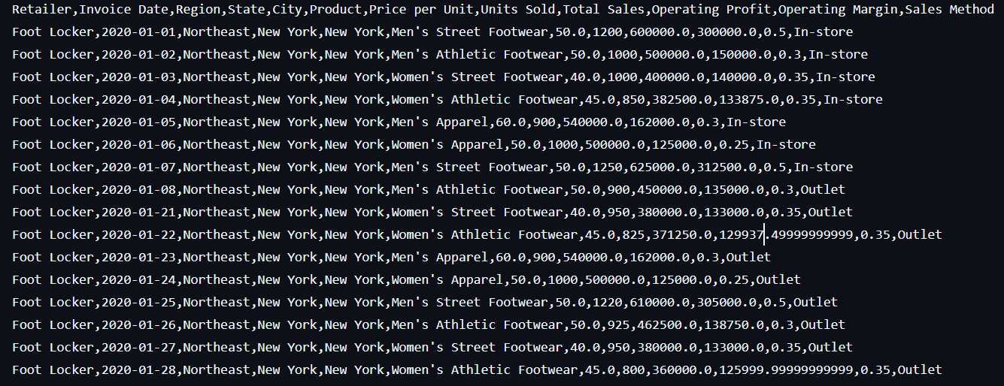

Dataset View

Slide 5

Dataset Specification
The dataset contains key columns such as:
• Price per Unit: Price of each product.
• Units Sold: Number of products sold.
• Operating Profit: Profit generated from operations.
• Total Sales: The target variable to predict.

Slide 6


Model
• Predicts Total Sales based on factors like Price per Unit, Units Sold, and Operating Profit.
• Uses a Linear Regression model to make predictions.

Slide 7
Model Process
1
2
3
4
1. Load the dataset and select features.
2. Train-test split: Use 80% of the data for training, 20% for testing.
3. Train a Linear Regression model.
4. Predict Total Sales and evaluate with Mean Squared Error (MSE).

Slide 8
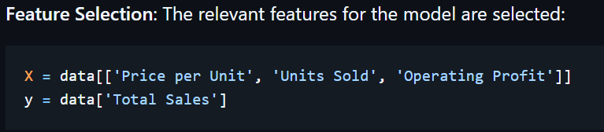
Feature Selection

Slide 9
Train-Test Split

Slide 10

Evaluation

Slide 11

Save Trained Model .pkl

Slide 12
Demo
https://sales-forecasting-wiun.onrender.com/

