Slide 1
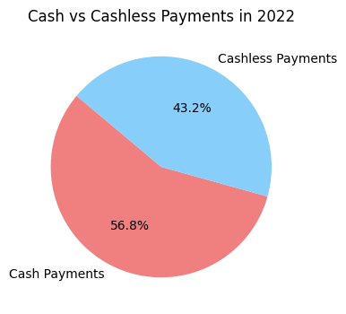

Slide 2
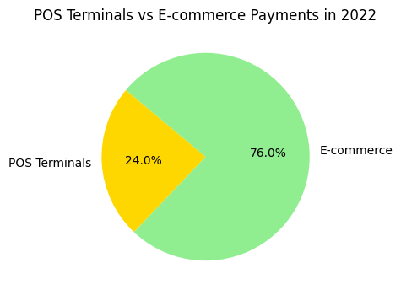

Slide 3
Insights and Analysis
1. Dominance of Cash Payments: In 2022, cash payments accounted for 56.8% of the total card payments in Azerbaijan, highlighting a continued reliance on cash.
2. Significant Shift to Cashless Payments: Despite the dominance of cash, 43.2% of the total payments were cashless, indicating a growing trend towards digital payment methods.
3. E-commerce Leading Cashless Transactions: Within cashless payments, e-commerce transactions made up 76% of the total, demonstrating the increasing preference for online shopping among consumers. POS terminals accounted for 24%, but in absolute terms, they processed a larger amount due to the high volume of transactions.
4. Digital Economy Growth: The significant volume of transactions through both POS terminals and e-commerce platforms reflects the expanding digital economy in Azerbaijan, with a clear shift towards cashless and online transactions.

