Slide 1
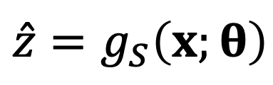
TEACHING EDITION • UNDERGRADUATE CHEMICAL ENGINEERING
Symbolic regression
From data to interpretable
surrogate models
THE CENTRAL IDEA
$$\hat{z}=g_{S}\left(x;θ\right)$$
Principles, a Peaks benchmark and a
green-methanol process example
Learn the structure.
Fit the coefficients.
Validate the decisions.
Yuanjing Zhao | University of Surrey
A step-by-step lecture with worked calculations and speaker notes
SYMBOLIC REGRESSION / CHEMICAL ENGINEERING
01
Notes:
TEACHING NOTES
This lecture introduces symbolic regression as a surrogate-modelling method for undergraduate chemical engineers. The central objective is not to obtain an attractive equation: it is to construct an approximation that is accurate enough within a defined operating domain to support engineering calculations and decisions. The lecture progresses from the engineering need to expression search, then a reproducible mathematical example, and finally an illustrative hybrid chemical-process model. Explain at the outset that the Peaks results are computed results from a finite-library experiment, whereas the electrolyser relation is deliberately specified for teaching and is not an industrial fit. The presentation contains editable Office Math equations and native diagram shapes. Expanded explanations, caveats and prompts appear in these speaker notes.
SOURCES
[1] Cranmer, M. (2023). Interpretable Machine Learning for Science with PySR and SymbolicRegression.jl. arXiv:2305.01582.
https://arxiv.org/abs/2305.01582
[8] IDAES documentation. ALAMOPY: ALAMO Python — algebraic surrogate modelling.
https://idaes-pse.readthedocs.io/en/stable/explanations/modeling_extensions/surrogate/api/alamopy/index.html

Slide 2
01 • FOUNDATIONS
What you should be able to do
Five questions organise the lecture.
01
Why a surrogate?
Connect an expensive calculation to an engineering decision.
02
What is being learnt?
Distinguish formula structure from numerical coefficients.
03
How does the search work?
Follow candidate generation, selection and parameter fitting.
04
What do the examples show?
Interpret Peaks results and coupled process calculations.
05
When should you trust it?
Check unseen data, physics, numerical safety and decisions.
SYMBOLIC REGRESSION / CHEMICAL ENGINEERING
02
Notes:
TEACHING NOTES
The prerequisite knowledge is basic calculus, least-squares regression and material balances. No previous knowledge of genetic programming is assumed. By the end, students should be able to specify an input–output surrogate task, distinguish structure search from parameter estimation, and explain why an impressive test score alone is insufficient for engineering deployment. The chemical example is intentionally modular: a learnt or assumed unit relationship is combined with exact balances rather than treating an entire plant as an unconstrained black box. Suggested teaching format: pause at the two knowledge checks and ask students to explain their answer before showing the answer in the notes. The material can be taught in two sessions by pausing after the Peaks case.

Slide 3
01 • FOUNDATIONS
Two examples, two different kinds of evidence
CASE 1 • PEAKS
CASE 2 • GREEN METHANOL
A numerical experiment actually computed.
Noise-free samples; fixed candidate library; independent test data.
An illustrative engineering calculation.
Assumed voltage relation; exact balances; no fitted plant or experimental dataset.
Keep computational evidence separate from teaching assumptions.
SYMBOLIC REGRESSION / CHEMICAL ENGINEERING
03
Notes:
TEACHING NOTES
This distinction is essential. The Peaks benchmark is reproduced using the accompanying numerical script. Its dictionary deliberately includes the generating terms of the target function. It therefore demonstrates restricted symbolic model selection, not a fair comparison of unrestricted genetic-programming algorithms. In the chemical case, all voltage coefficients and the fixed Faradaic efficiency are assumptions chosen to expose engineering trade-offs. The resulting area and power values are consequences of those assumptions, not measurements and not predictions validated against an electrolyser. Likewise, the recycle example assumes a fixed single-pass conversion and ideal product removal. A real green-methanol study would require validated unit models, a complete process model and independent data or high-fidelity verification.

Slide 4
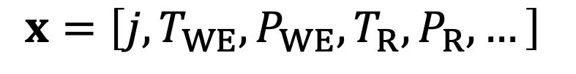
01 • FOUNDATIONS
Begin with an engineering question
How should we operate an integrated green-methanol process?
Operating conditions
High-fidelity model
Engineering performance
$$x=\left[j,T_{WE},P_{WE},T_{R},P_{R},…\right]$$
INPUTS
OUTPUTS
Current density, temperatures, pressures and other controllable conditions.
Methanol production, electricity demand, carbon utilisation and equipment scale.
Context: [8]. Process layout and notation are teaching schematics.
SYMBOLIC REGRESSION / CHEMICAL ENGINEERING
04
Notes:
TEACHING NOTES
First specify a decision rather than immediately selecting a machine-learning algorithm. The vector x contains independent operating choices: j is current density, WE denotes water electrolysis and R denotes the methanol reactor. The full simulator may solve material and energy balances, reaction kinetics, phase equilibria and recycle convergence. The outputs must be quantities relevant to the intended decision. For example, current density may affect electrolyser area and electricity consumption in opposing directions. Not every process variable is independently adjustable: a current-controlled cell produces a voltage determined by its operating condition. Avoid including dependent quantities as independent decisions without physical justification. The proposed workflow is an example of algebraic surrogate use in process modelling, not a complete specification of a particular plant.
SOURCES
[8] IDAES documentation. ALAMOPY: ALAMO Python — algebraic surrogate modelling.
https://idaes-pse.readthedocs.io/en/stable/explanations/modeling_extensions/surrogate/api/alamopy/index.html

Slide 5
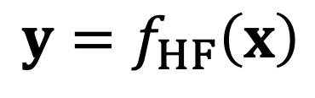
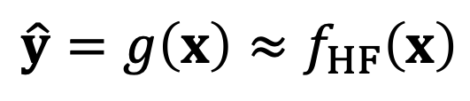
01 • FOUNDATIONS
A surrogate replaces a costly input–output calculation
HIGH-FIDELITY MODEL
SURROGATE MODEL
$$y=f_{HF}\left(x\right)$$
$$\hat{y}=g\left(x\right)≈f_{HF}\left(x\right)$$
ONE EVALUATION
10,000 EVALUATIONS
Use the surrogate to screen many candidates; verify the important ones with the original model.
30 seconds
83.3 hours
Training data, model development and validation still have a cost.
Method context: [8]. Runtime figures are an illustrative calculation, not a software benchmark.
SYMBOLIC REGRESSION / CHEMICAL ENGINEERING
05
Notes:
TEACHING NOTES
The notation HF means high fidelity. A surrogate approximates a specified mapping over a specified operating domain; it does not automatically replace every physical equation. The timing example is arithmetic: 30 seconds multiplied by 10,000 is 300,000 seconds, or approximately 83.3 hours of serial computation. It is not an observed runtime for Aspen, gPROMS or any particular solver. Savings are useful when enough later evaluations are required to justify the cost of generating training data and developing the model. A practical workflow uses the surrogate for screening or optimisation and then checks a much smaller number of key candidates with the high-fidelity model. Surrogate training itself can also be expensive, especially when searching a large expression space.
SOURCES
[8] IDAES documentation. ALAMOPY: ALAMO Python — algebraic surrogate modelling.
https://idaes-pse.readthedocs.io/en/stable/explanations/modeling_extensions/surrogate/api/alamopy/index.html

Slide 6
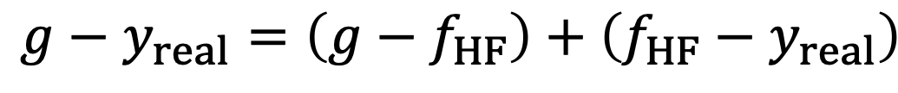
01 • FOUNDATIONS
A perfect simulator fit is not a perfect real-world model
$$g−y_{real}=\left(g−f_{HF}\right)+\left(f_{HF}−y_{real}\right)$$
TOTAL ERROR
SURROGATE ERROR
ORIGINAL-MODEL ERROR
Surrogate versus the real system.
Approximation of the original simulator.
Simulator versus the real system.
SYMBOLIC REGRESSION / CHEMICAL ENGINEERING
06
Notes:
TEACHING NOTES
This is a pointwise algebraic identity, obtained by adding and subtracting the simulator output. It distinguishes approximation error from the original simulator's discrepancy relative to the real system. Reproducing a flawed simulator accurately cannot validate that simulator. The displayed identity concerns signed errors at the same input; it is not an assertion that the corresponding RMSE values add, because squared errors contain a cross term. The same reasoning applies component by component for a vector output. When teaching, ask students what evidence is required for each term: simulator-to-surrogate validation assesses approximation, whereas experiment-to-simulator comparison addresses fidelity to reality.
TEACHING CUE
Ask: what does an R² of 1 against a simulator prove—and what does it not prove?

Slide 7
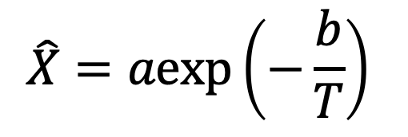
01 • FOUNDATIONS
Ordinary regression: specify the structure first
QUADRATIC RESPONSE SURFACE
$$\hat{X}=a_{0}+a_{1}T+a_{2}P+a_{3}T^{2}+a_{4}TP+a_{5}P^{2}$$
FIXED NONLINEAR STRUCTURE
The computer estimates coefficients.
The functional form has already been chosen by the modeller.
$$\hat{X}=aexp\left(−\frac{b}{T}\right)$$
Nonlinear regression is not automatically symbolic regression.
SYMBOLIC REGRESSION / CHEMICAL ENGINEERING
07
Notes:
TEACHING NOTES
In the response-surface example, X denotes reactor conversion, T temperature and P pressure. The six-term polynomial structure is fixed in advance; least squares estimates its six coefficients. The exponential example is nonlinear in its parameters but still has a fixed structure. Finding a and b does not constitute a search over mathematical structures. Coefficients must carry the units required for dimensional consistency; for example b has temperature units if T is dimensional. In practice, centre and scale inputs to improve conditioning. The purpose of this slide is to separate nonlinearity in input variables, nonlinearity in parameters, and a genuinely unknown expression structure. These are distinct ideas.

Slide 8
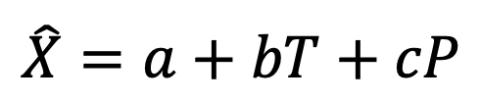
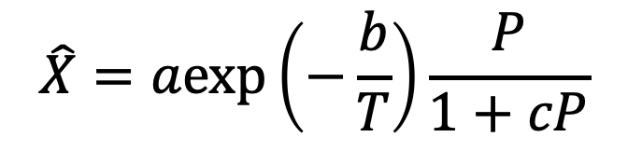
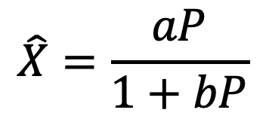
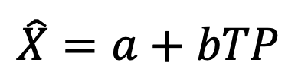
01 • FOUNDATIONS
Symbolic regression also searches the formula structure
LINEAR
INTERACTION
$$\hat{X}=a+bT+cP$$
$$\hat{X}=a+bTP$$
SATURATION
COMBINED STRUCTURE
$$\hat{X}=\frac{aP}{1+bP}$$
$$\hat{X}=aexp\left(−\frac{b}{T}\right)\frac{P}{1+cP}$$
Outer problem: choose a structure. Inner problem: fit its numerical parameters.
Methods: [1, 2]. Candidate expressions below are schematic, not fitted models.
SYMBOLIC REGRESSION / CHEMICAL ENGINEERING
08
Notes:
TEACHING NOTES
These candidates are illustrations of different functional forms, not alternative kinetic models validated for methanol synthesis. Symbolic regression may change the operators, arrangement of variables and inclusion of interactions, while optimising the associated numerical constants. The two-layer description is a useful conceptual model rather than a requirement that every software package uses a formally nested optimiser. Evolutionary methods often interleave structure changes, simplification and constant fitting. A saturation expression is only meaningful over a domain in which its denominator is non-zero, and the parameters must ensure dimensional consistency. Candidate simplicity, interpretability and physical admissibility are separate considerations from training fit.
SOURCES
[1] Cranmer, M. (2023). Interpretable Machine Learning for Science with PySR and SymbolicRegression.jl. arXiv:2305.01582.
https://arxiv.org/abs/2305.01582
[2] gplearn documentation. Introduction to Genetic Programming; API reference (protected operators).
https://gplearn.readthedocs.io/en/stable/intro.html

Slide 9
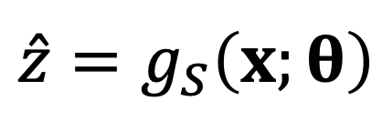
02 • HOW FORMULA SEARCH WORKS
Write the model as structure plus parameters
$$\hat{z}=g_{S}\left(x;θ\right)$$
S • STRUCTURE
θ • PARAMETERS
x • INPUTS
Which operators, terms and interactions are present?
Which numerical coefficients best fit this structure?
Which measured or simulated conditions enter the model?
Conceptual formulation: [1].
SYMBOLIC REGRESSION / CHEMICAL ENGINEERING
09
Notes:
TEACHING NOTES
Use z for a scalar output and bold x for its input vector. S indexes an expression structure; theta collects the numeric constants inside that expression. For example, a + b ln(1 + cx) contains the chosen logarithmic structure and three adjustable coefficients. Adding a new term is a structural change, whereas moving an existing coefficient from one value to another is a parameter change. Both choices influence predictive accuracy. In many chemical applications it is helpful to train one model per target or to couple several constrained unit models rather than fitting unrelated outputs independently. This lecture uses scalar notation for clarity, then reconnects the outputs through balances.
SOURCES
[1] Cranmer, M. (2023). Interpretable Machine Learning for Science with PySR and SymbolicRegression.jl. arXiv:2305.01582.
https://arxiv.org/abs/2305.01582

Slide 10
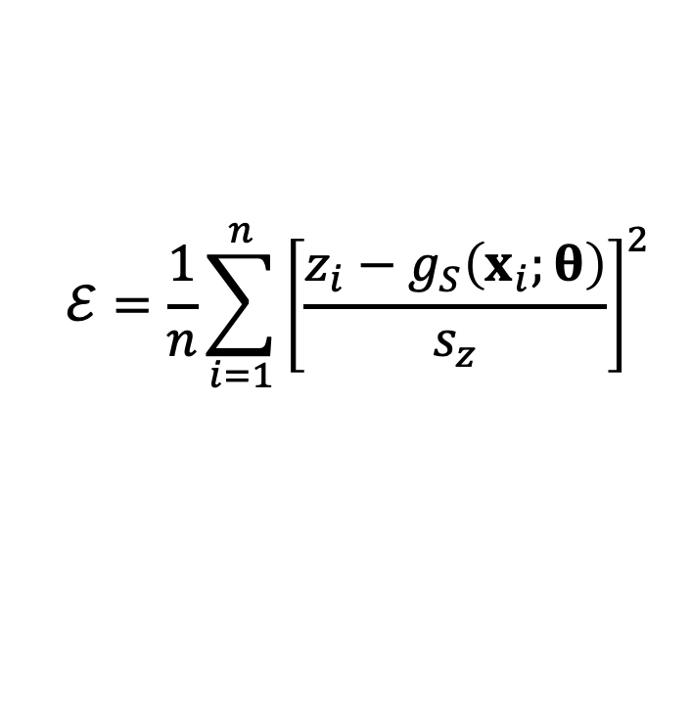

02 • HOW FORMULA SEARCH WORKS
Optimise accuracy without rewarding needless complexity
SCALED TRAINING ERROR
$$ℰ=\frac{1}{n}\sum_{i=1}^{n}{{\left[\frac{z_{i}−g_{S}\left(x_{i};θ\right)}{s_{z}}\right]}^{2}}$$
PENALISED OBJECTIVE
n: number of training samples
sz: output scale learnt from training data
C(S): expression complexity
λ: penalty strength
$$ℒ=ℰ+λC\left(S\right)$$
A small training error is necessary, but not sufficient, for a useful model.
General model-selection formulation: [1].
SYMBOLIC REGRESSION / CHEMICAL ENGINEERING
10
Notes:
TEACHING NOTES
The error is a mean squared residual normalised by an output scale such as the training standard deviation. The scale must be calculated from training data only and must be non-zero. Normalisation makes the error dimensionless; it does not remove noise or guarantee equal engineering relevance across targets. Complexity may count expression-tree nodes or assign different costs to operators. Lambda sets how much additional structure is accepted for an improvement in error. Alternatively, maintain an error–complexity Pareto set instead of collapsing both criteria into one number. Avoid assuming that the number of additive terms and the number of tree nodes are interchangeable. A single highly nested term can contain many operations.
SOURCES
[1] Cranmer, M. (2023). Interpretable Machine Learning for Science with PySR and SymbolicRegression.jl. arXiv:2305.01582.
https://arxiv.org/abs/2305.01582

Slide 11
02 • HOW FORMULA SEARCH WORKS
Define a mathematical grammar before searching
TERMINALS
OPERATORS
Inputs and constants
Examples: temperature, pressure, current density and fitted numbers.
Rules for combining terminals
Choose useful operations; exclude invalid or unnecessary ones.
+ − × ÷ exp ln square
More operators mean more expressive freedom—and a larger search space.
Genetic-programming primitives: [2]. Unit-aware search: [7].
SYMBOLIC REGRESSION / CHEMICAL ENGINEERING
11
Notes:
TEACHING NOTES
Terminals are the leaves of an expression tree: variables and constants. Operators form its internal nodes. Including exponential terms may help describe temperature-sensitive relationships, while division permits rational and saturation-like forms. An unrestricted menu is usually inefficient and can generate invalid candidates: logarithms require suitable arguments, denominators must not vanish and exponentials may overflow. Physical units and known constraints can substantially restrict the search space. The chosen grammar must be expressive enough for the intended relationship, but including the correct building blocks does not guarantee that a finite search will discover the target expression. Explain the difference between representability and successful discovery.
SOURCES
[2] gplearn documentation. Introduction to Genetic Programming; API reference (protected operators).
https://gplearn.readthedocs.io/en/stable/intro.html
[7] Tenachi, W., Ibata, R. & Diakogiannis, F. I. (2023). Deep symbolic regression for physics guided by units constraints: toward the automated discovery of physical laws. ApJ 959, 99.
https://doi.org/10.3847/1538-4357/ad014c

Slide 12
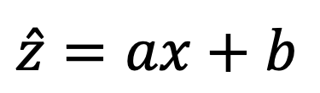
02 • HOW FORMULA SEARCH WORKS
An expression tree makes a formula editable by an algorithm
+
$$\hat{z}=ax+b$$
×
b
Leaves are inputs or constants.
Internal nodes are operations.
a
x
Replace a subtree to change part of the formula.
Expression-tree representation: [2]. Diagram created for this lecture.
SYMBOLIC REGRESSION / CHEMICAL ENGINEERING
12
Notes:
TEACHING NOTES
Read the expression from the leaves upwards. Multiply a by x, then add b. The tree provides a structured data representation that makes local changes possible. Replacing the leaf b by a subtree representing exp(-y²) changes the formula in a well-defined way. Trees also make complexity measures concrete: one possible measure is simply the number of nodes, although operator-weighted measures are common. Single letters in the nodes denote terminals; they are not distinct learnt laws. This diagram is intentionally small so that students can trace every evaluation. Ask them to sketch the tree for (x + y)² and compare its structure with x² + y².
TEACHING CUE
Ask a student to evaluate this tree from the bottom upwards, then replace b by y².
SOURCES
[2] gplearn documentation. Introduction to Genetic Programming; API reference (protected operators).
https://gplearn.readthedocs.io/en/stable/intro.html

Slide 13
02 • HOW FORMULA SEARCH WORKS
Genetic programming: propose, evaluate, modify, repeat
1 Initialise
2 Fit and score
3 Select
Generate candidate
formula populations.
Fit constants; score
error and complexity.
Favour promising
candidate expressions.
6 Validate
5 Repeat
4 Vary
Choose on validation;
evaluate on test data.
Refit, simplify and repeat
within a fixed budget.
Apply crossover
and mutation.
Here, GP means genetic programming—not a Gaussian process.
Algorithmic principles: [1, 2]. This is a schematic workflow, not a recorded run.
SYMBOLIC REGRESSION / CHEMICAL ENGINEERING
13
Notes:
TEACHING NOTES
A population is a collection of candidate mathematical expressions. The algorithm generates or maintains variation, evaluates each candidate against data and favours stronger candidates for further modification. Constant fitting and algebraic simplification may be interleaved with structural changes, as in PySR's evolve–simplify–optimise strategy. Evolutionary algorithms are stochastic: different random seeds can yield different equations. There is no guarantee of finding a globally best formula within a finite compute budget. The final validation stage should not be confused with the training fitness used during search. When introducing the abbreviation GP, make the ambiguity explicit: this slide concerns genetic programming, not Gaussian-process regression, which is a different surrogate-modelling approach.
SOURCES
[1] Cranmer, M. (2023). Interpretable Machine Learning for Science with PySR and SymbolicRegression.jl. arXiv:2305.01582.
https://arxiv.org/abs/2305.01582
[2] gplearn documentation. Introduction to Genetic Programming; API reference (protected operators).
https://gplearn.readthedocs.io/en/stable/intro.html

Slide 14

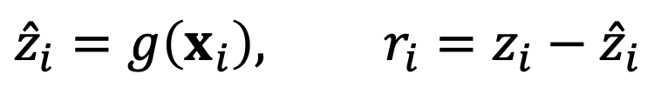


02 • HOW FORMULA SEARCH WORKS
Data provide the selection pressure
$$g_{1}=x+y$$
$$g_{2}=xy$$
$$g_{3}=exp\left(−x^{2}\right)$$
PREDICT EVERY TRAINING POINT AND CALCULATE RESIDUALS
$${\hat{z}}_{i}=g\left(x_{i}\right), r_{i}=z_{i}−{\hat{z}}_{i}$$
A simple expression may fit poorly.
A complicated expression may overfit.
Training fitness: [2]. Candidate formulas are illustrative.
SYMBOLIC REGRESSION / CHEMICAL ENGINEERING
14
Notes:
TEACHING NOTES
The candidates shown here are starting points, not successful fits. For every candidate, evaluate all training inputs, obtain predictions and calculate residuals. The scoring function provides feedback that favours useful structures while penalising excessive complexity. Random variation by itself is not intelligent search: it becomes a search procedure because candidates are repeatedly assessed against a defined objective. Some implementations use tournament selection or maintain a hall of fame. Exact selection details vary across packages. A model with many terms may reduce training residuals by tracking noise rather than learning a stable response. This is why the validation and complexity controls introduced earlier are required.
SOURCES
[2] gplearn documentation. Introduction to Genetic Programming; API reference (protected operators).
https://gplearn.readthedocs.io/en/stable/intro.html

Slide 15
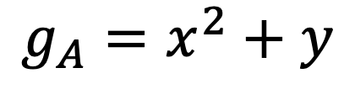
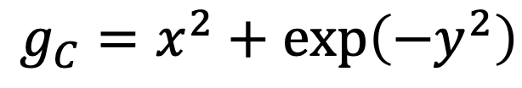
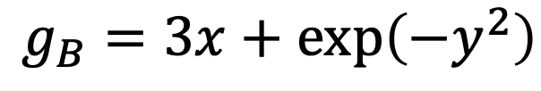
02 • HOW FORMULA SEARCH WORKS
Crossover exchanges parts of two expressions
PARENT A
PARENT B
$$g_{A}=x^{2}+y$$
$$g_{B}=3x+exp\left(−y^{2}\right)$$
ONE POSSIBLE OFFSPRING
$$g_{C}=x^{2}+exp\left(−y^{2}\right)$$
An offspring must be refitted and re-evaluated. It is not automatically better.
Crossover principle: [2]. Examples are schematic.
SYMBOLIC REGRESSION / CHEMICAL ENGINEERING
15
Notes:
TEACHING NOTES
Crossover replaces a selected subtree in one parent with a subtree taken from another. In this simple example, y is replaced by exp(-y²), while x² is retained. The resulting child is only one possible outcome; a real implementation chooses crossover points according to its own rules. Validity checks may reject children that are too large, dimensionally inconsistent or numerically unsafe. The child must then be fitted, simplified if appropriate, and evaluated. Recombining two reasonably good formulas need not produce a better formula, because useful interactions can be disrupted. The key point is structured recombination followed by objective assessment, rather than an assumption that biological terminology itself guarantees progress.
SOURCES
[2] gplearn documentation. Introduction to Genetic Programming; API reference (protected operators).
https://gplearn.readthedocs.io/en/stable/intro.html

Slide 16
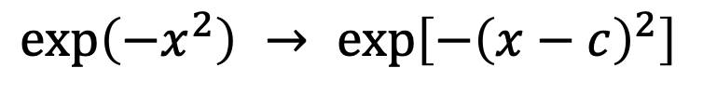
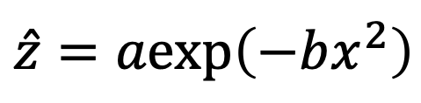
02 • HOW FORMULA SEARCH WORKS
Mutation changes structure; parameter fitting changes numbers
STRUCTURAL MUTATION
PARAMETER OPTIMISATION
Introduce a shifted peak or replace an operator.
Retain the structure; refine its numerical coefficients.
$$exp\left(−x^{2}\right) → exp\left[−{\left(x−c\right)}^{2}\right]$$
$$\hat{z}=aexp\left(−bx^{2}\right)$$
Fit a and b for the current candidate.
The two searches interact: a good structure can look poor before its constants are fitted.
Mutation and constant optimisation: [1, 2].
SYMBOLIC REGRESSION / CHEMICAL ENGINEERING
16
Notes:
TEACHING NOTES
A mutation might replace an operator, alter a terminal, add or delete a subtree, or change a constant. Adding a shift c to an exponential is a structural change because it introduces a new degree of freedom and arrangement. Optimising the current values of a, b and c is a continuous parameter-estimation problem. Some parameter fits are linear least squares, others require nonlinear optimisation. Local optimisers may depend on initial guesses. Therefore, the apparent quality of a candidate can reflect both its structure and how well its constants have been fitted. Symbolic regression is not simply generating a large list of expressions with arbitrary numbers and selecting one without coefficient estimation.
SOURCES
[1] Cranmer, M. (2023). Interpretable Machine Learning for Science with PySR and SymbolicRegression.jl. arXiv:2305.01582.
https://arxiv.org/abs/2305.01582
[2] gplearn documentation. Introduction to Genetic Programming; API reference (protected operators).
https://gplearn.readthedocs.io/en/stable/intro.html

Slide 17
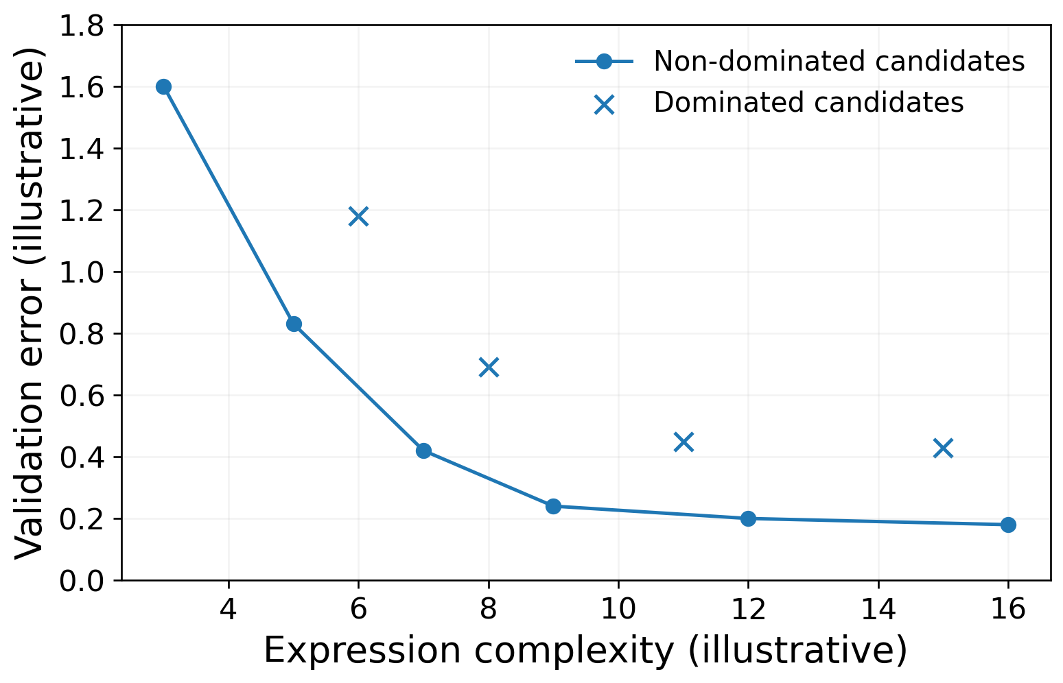
02 • HOW FORMULA SEARCH WORKS
Keep the useful accuracy–complexity trade-offs
NON-DOMINATED
No other candidate is both simpler and more accurate.
Choose a useful compromise with validation data. Do not select the winner using the test set.
Prefer sufficient accuracy with a stable, interpretable expression—not maximum length.
Model-selection principle: [1]. Plot is schematic, not a measured search trajectory.
SYMBOLIC REGRESSION / CHEMICAL ENGINEERING
17
Notes:
TEACHING NOTES
The plotted points are invented solely to illustrate Pareto dominance. They are not results of the Peaks experiment or a genetic-programming run. A candidate is non-dominated when another candidate cannot improve one objective without worsening the other. In a two-objective error–complexity problem, useful candidates often trace a decreasing frontier. Selecting a knee is a heuristic, not a physical law. Engineering tolerance may make a simple model sufficient even if a more complex model has slightly lower error. When validation data are used repeatedly during model selection, the independent test set remains important as an untouched evaluation. Distinguish this model-selection Pareto problem from the later energy–cost–carbon process-design Pareto problem.
SOURCES
[1] Cranmer, M. (2023). Interpretable Machine Learning for Science with PySR and SymbolicRegression.jl. arXiv:2305.01582.
https://arxiv.org/abs/2305.01582

Slide 18
02 • HOW FORMULA SEARCH WORKS
Separate fitting, selection and final evaluation
TRAIN
VALIDATE
TEST
Fit coefficients.
Choose preprocessing scales.
Search candidate structures.
Tune settings.
Compare candidates.
Select the model.
Evaluate once after choices are fixed.
Do not use it to tune or choose seeds.
Group correlated observations by experiment, scenario or trajectory when appropriate.
Data leakage and preprocessing: [6].
SYMBOLIC REGRESSION / CHEMICAL ENGINEERING
18
Notes:
TEACHING NOTES
Training data determine fitted coefficients and any learnt preprocessing. Validation data support tuning and candidate selection. Test data provide an evaluation after the development decisions have been fixed. Choosing a random seed, a threshold or an operator set because it scores better on the test set contaminates that test. Scaling and feature selection performed before the split can also leak information. Random splits are not always appropriate: nearby observations from one experiment or trajectory may be strongly correlated. Grouped or time-aware splits should reflect the intended deployment question. If active learning adds new development data, do not silently absorb the original lockbox into training while continuing to report it as independent.
SOURCES
[6] scikit-learn documentation. Common pitfalls and recommended practices: preprocessing and data leakage.
https://scikit-learn.org/stable/common_pitfalls.html

Slide 19
02 • KNOWLEDGE CHECK
Before the examples: three questions
1
Is this symbolic regression?
Fit a and b in a preselected exponential equation.
2
Does a richer grammar guarantee success?
The search is allowed to use the exact target operators.
3
Which data choose the final model?
Training, validation or test data?
SYMBOLIC REGRESSION / CHEMICAL ENGINEERING
19
Notes:
TEACHING NOTES
Answers. (1) No: fitting a and b in a preselected exponential is fixed-structure regression, even if the model is nonlinear. Symbolic regression additionally searches the expression structure. (2) No: the target may be representable in the chosen grammar, but a finite stochastic search may fail to discover it. Data quality, search budget, conditioning, constants and constraints all matter. (3) Validation data choose the model; test data evaluate the final, frozen choice. Training data estimate the coefficients and support the search. Ask students to explain each answer in one sentence. This checkpoint is a good place to correct the misconception that symbolic regression automatically reveals true physical laws.

Slide 20
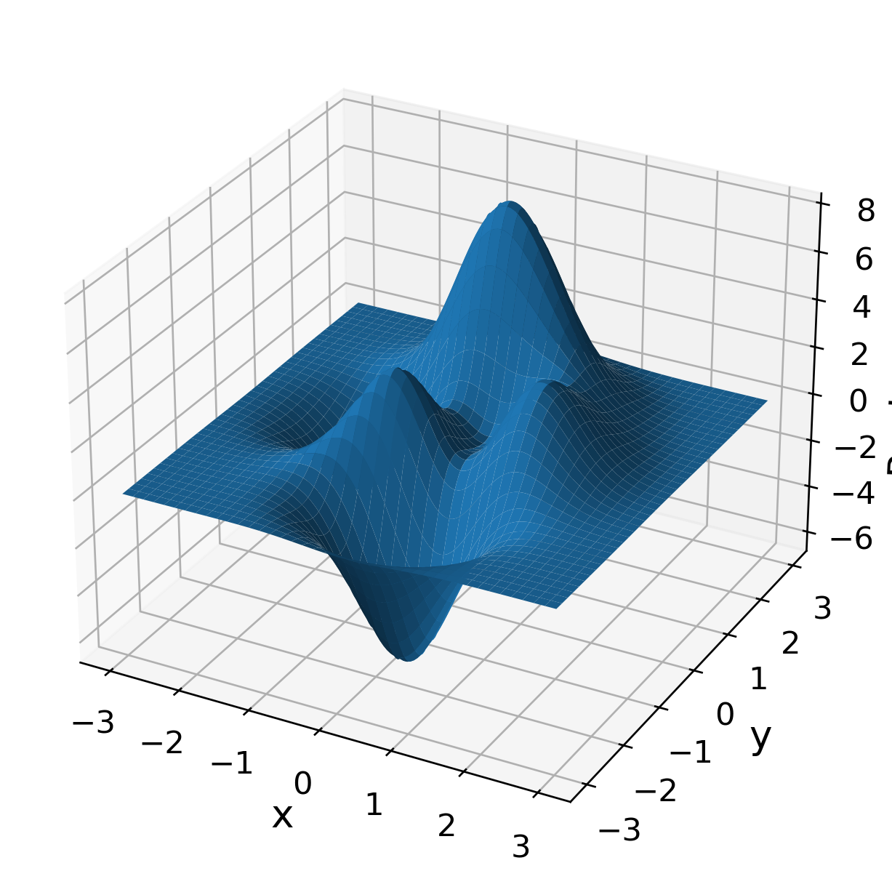

03 • CASE 1 — PEAKS
A two-input function with several peaks and troughs
Treat a known function
as a black-box simulator.
OPERATING DOMAIN
$$x,y∈\left[−3,3\right]$$
Inputs: x and y
Output: a scalar height z
Data: no added observation noise
Reference function: MathWorks [4]. Surface generated from the exact function.
SYMBOLIC REGRESSION / CHEMICAL ENGINEERING
20
Notes:
TEACHING NOTES
Peaks is a standard MATLAB example function built from translated and scaled Gaussian terms multiplied by polynomials. It is useful here because students can visualise a genuinely nonlinear response with just two inputs. We use the square domain from -3 to 3 in both coordinates. Although the target expression is known to us, the regression algorithm is supplied only with input–output samples. In a chemical application, those labels would come from experiments or a high-fidelity simulator. This example isolates model representation and selection without experimental noise, failed runs or uncertain reference-model physics. The absence of those complications is deliberate and limits the conclusions that can be drawn.
SOURCES
[4] MathWorks. MATLAB documentation: peaks — Peaks function.
https://www.mathworks.com/help/matlab/ref/peaks.html

Slide 21
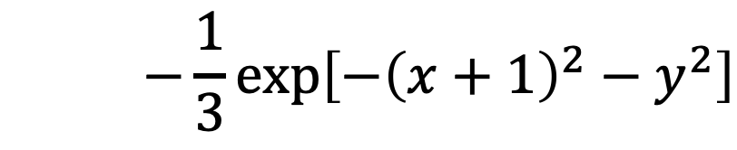
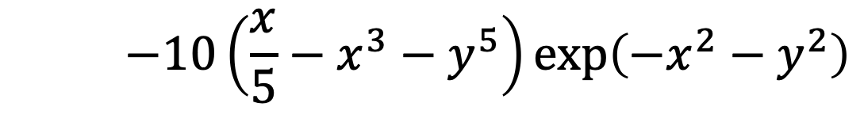
03 • CASE 1 — PEAKS
Read the target as three localised contributions
$$z=f\left(x,y\right)=3{\left(1−x\right)}^{2}exp\left[−x^{2}−{\left(y+1\right)}^{2}\right]$$
$$−10\left(\frac{x}{5}−x^{3}−y^{5}\right)exp\left(−x^{2}−y^{2}\right)$$
$$−\frac{1}{3}exp\left[−{\left(x+1\right)}^{2}−y^{2}\right]$$
Gaussian envelopes localise the response; polynomial factors change its shape.
Exact Peaks definition: [4]. Line breaks are for teaching clarity.
SYMBOLIC REGRESSION / CHEMICAL ENGINEERING
21
Notes:
TEACHING NOTES
The three displayed lines form one equation. The first Gaussian envelope is centred at (0, -1), the second at (0, 0), and the third at (-1, 0), before accounting for the polynomial factors. A Gaussian envelope is largest near its centre and decays away from it. Multiplication by (1-x)² or by the polynomial in the second term changes the local amplitude and shape. This provides an intuitive reason why a single quadratic surface may struggle. At the origin, the exact value is 3/e - 1/(3e) = 8/(3e), approximately 0.9810. Emphasise that an unsuitable function family cannot be repaired simply by fitting its coefficients more carefully.
SOURCES
[4] MathWorks. MATLAB documentation: peaks — Peaks function.
https://www.mathworks.com/help/matlab/ref/peaks.html

Slide 22
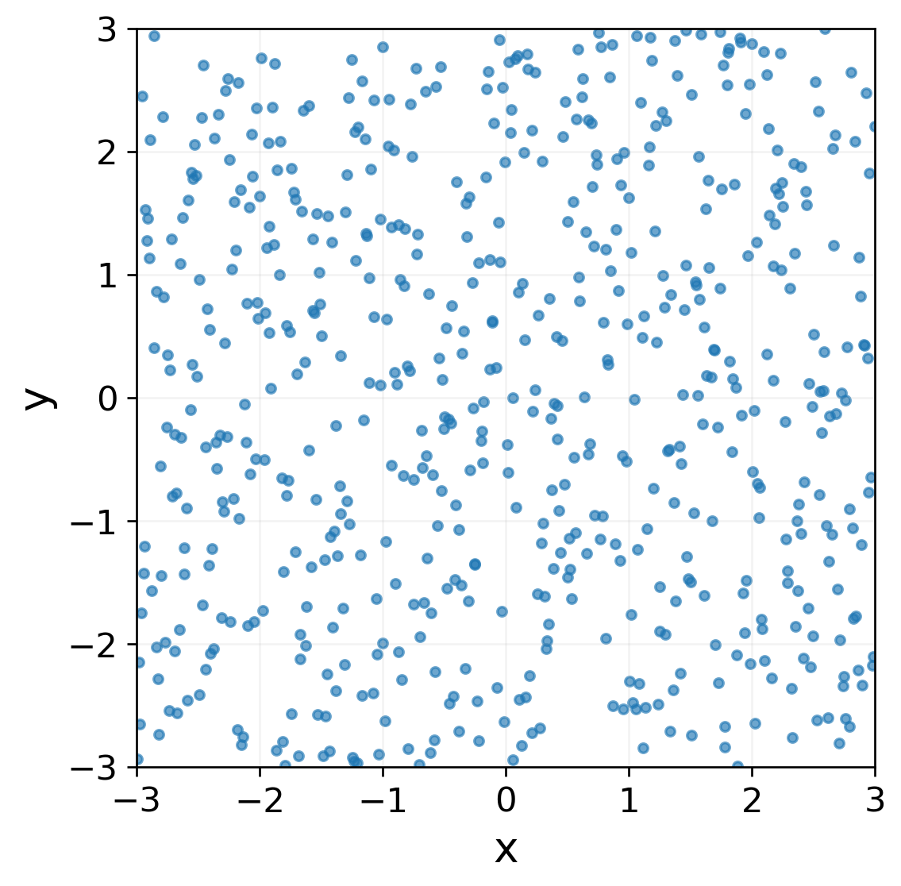
03 • CASE 1 — PEAKS
Generate independent designs for each data role
Dataset | Samples | Seed
Training | 600 | 42
Validation | 200 | 43
Test | 2,000 | 44
Latin hypercube sampling stratifies each input range; it does not enumerate every input combination.
LHS method: [5]. Dataset sizes and seeds: reproduced teaching experiment.
SYMBOLIC REGRESSION / CHEMICAL ENGINEERING
22
Notes:
TEACHING NOTES
The plot shows the actual 600-point training design. Three separate two-dimensional Latin-hypercube designs are generated with seeds 42, 43 and 44, then mapped from the unit square to [-3, 3]². Each response is calculated from the exact Peaks function, with no added noise. LHS stratifies each marginal input range and places one sample within each interval, but it is not a full factorial design and does not cover all combinations. Training, validation and test designs are separate. In a real process application, sample counts should follow dimensionality, nonlinearity, noise, convergence behaviour and learning curves; the numbers used here are not a universal recommendation. The test set is never used to fit, choose a threshold or select a random seed.
SOURCES
[5] SciPy documentation. scipy.stats.qmc.LatinHypercube.
https://docs.scipy.org/doc/scipy/reference/generated/scipy.stats.qmc.LatinHypercube.html

Slide 23
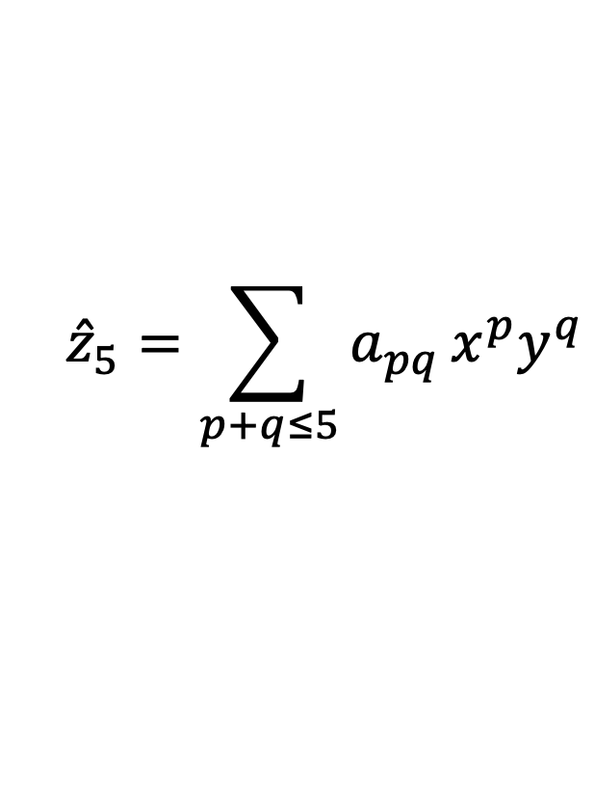
03 • CASE 1 — PEAKS
Establish simple baselines before searching richer formulas
QUADRATIC RESPONSE SURFACE — 6 TERMS
$${\hat{z}}_{2}=a_{0}+a_{1}x+a_{2}y+a_{3}x^{2}+a_{4}xy+a_{5}y^{2}$$
TOTAL-DEGREE-FIVE POLYNOMIAL — 21 TERMS
A better coefficient fit cannot overcome a fundamentally unsuitable function family.
$${\hat{z}}_{5}=\sum_{p+q≤5}^{​}{a_{pq}}x^{p}y^{q}$$
The baseline shows what is gained by changing representation, not merely adding parameters.
SYMBOLIC REGRESSION / CHEMICAL ENGINEERING
23
Notes:
TEACHING NOTES
Both baselines are ordinary least-squares fits to the same 600 training points. The quadratic polynomial has six monomials: a constant, two linear terms and three second-order terms. For two variables, a polynomial of total degree at most d has (d+1)(d+2)/2 terms, so degree five gives 21. Higher degree improves expressiveness but may still be inefficient for spatially localised features. The comparison does not imply that polynomials are generally poor surrogates: low-order response surfaces can be excellent over sufficiently local operating regions. The aim here is to establish a transparent reference before using a representation specifically suited to the Peaks function.

Slide 24
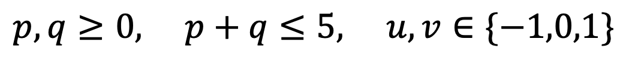
03 • CASE 1 — PEAKS
Restrict the search to a finite dictionary
CANDIDATE FUNCTION
$$φ_{pquv}\left(x,y\right)=x^{p}y^{q}exp\left[−{\left(x−u\right)}^{2}−{\left(y−v\right)}^{2}\right]$$
$$p,q≥0, p+q≤5, u,v∈\{−1,0,1\}$$
21
×
9
=
189
polynomial factors
specified Gaussian centres
candidate terms
Sparse-library principle: [3]. This experiment fits a static function, not dynamical equations.
SYMBOLIC REGRESSION / CHEMICAL ENGINEERING
24
Notes:
TEACHING NOTES
Each candidate is a monomial multiplied by a Gaussian envelope. There are 21 monomials of total degree up to five, combined with nine specified centres, giving 189 columns in the candidate library. The Gaussian width is fixed in advance. The model is linear in the coefficients multiplying these nonlinear candidate functions. This is a deliberately restricted symbolic-model-selection problem: it asks which supplied terms to retain. The dictionary contains the exact generating terms of Peaks by construction. Neither the Gaussian centres nor the widths are discovered by an unrestricted expression-tree search. Sparse-library identification is conceptually related to SINDy, but this example approximates a static scalar surface rather than identifying a differential equation.
SOURCES
[3] Brunton, S. L., Proctor, J. L. & Kutz, J. N. (2016). Discovering governing equations from data by sparse identification of nonlinear dynamical systems. PNAS 113, 3932–3937.
https://doi.org/10.1073/pnas.1517384113

Slide 25
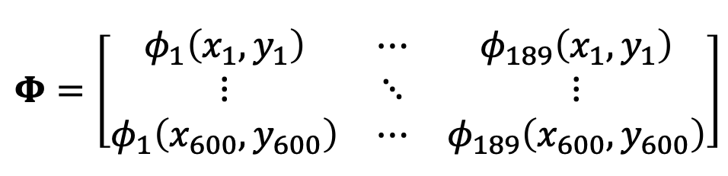

03 • CASE 1 — PEAKS
Turn the dictionary into a regression matrix
EVALUATE EVERY CANDIDATE AT EVERY TRAINING POINT
$$Φ=\left[\begin{matrix}φ_{1}\left(x_{1},y_{1}\right) & ⋯ & φ_{189}\left(x_{1},y_{1}\right) \\ ⋮ & ⋱ & ⋮ \\ φ_{1}\left(x_{600},y_{600}\right) & ⋯ & φ_{189}\left(x_{600},y_{600}\right)\end{matrix}\right]$$
Nonlinear in the inputs.
Linear in the coefficients.
Sparse if most coefficients are zero.
$$z≈Φc$$
SYMBOLIC REGRESSION / CHEMICAL ENGINEERING
25
Notes:
TEACHING NOTES
Rows correspond to training observations and columns correspond to candidate functions. The matrix has 600 rows and 189 columns. Once the inputs and dictionary are fixed, fitting coefficients is a linear regression problem even though the basis functions are nonlinear in x and y. A dense least-squares solution allows every candidate column to contribute. A sparse solution retains only a subset of non-zero coefficients. For this teaching experiment, selection uses coefficient thresholding and refitting, not a genetic algorithm. Correlated or nearly dependent columns can produce unstable coefficient estimates. This matters here because the dictionary is highly ill-conditioned; the later numerical caveat is not optional.

Slide 26
03 • CASE 1 — PEAKS
Select terms, refit coefficients, then validate
1
Scale columns
Estimate column norms using the training design only.
2
Fit the dense model
Solve least squares; convert coefficients back to the original basis.
3
Threshold and refit
Retain coefficients above each candidate threshold; refit those terms.
4
Choose by validation
Among numerically equivalent candidates, retain the fewest terms.
Thresholds and selection tolerance are fixed without consulting the test set.
Actual procedure in symbolic_regression_tutorial.py; not a genetic-programming run.
SYMBOLIC REGRESSION / CHEMICAL ENGINEERING
26
Notes:
TEACHING NOTES
The training dictionary columns are scaled by their Euclidean norms. A dense least-squares solution is calculated with a relative cutoff of 10^-12, then converted back to the original coefficient basis. Candidate absolute coefficient thresholds are 10^-5, 10^-4, 10^-3, 10^-2, 0.1, 0.5, 1, 2 and 5. For each threshold, the active columns are refitted using the original training dictionary. Validation RMSE selects candidates, with a numerical equivalence tolerance of 10^-10; the simplest eligible model is preferred. The selected threshold in this run is 10^-5 and seven terms remain. Thresholding unscaled coefficients is a specific teaching choice, not a universal scale-invariant sparse-regression recipe. Appropriate regularisation and stability analysis are needed for noisy industrial data.

Slide 27
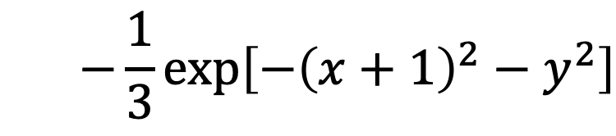
03 • CASE 1 — PEAKS
The selected seven terms recover the target expression
$$\hat{z}=\left(3−6x+3x^{2}\right)exp\left[−x^{2}−{\left(y+1\right)}^{2}\right]$$
$$+\left(−2x+10x^{3}+10y^{5}\right)exp\left(−x^{2}−y^{2}\right)$$
$$−\frac{1}{3}exp\left[−{\left(x+1\right)}^{2}−y^{2}\right]$$
Factorisation shows equivalence to Peaks; Gaussian centres and widths were already supplied.
Computed noise-free finite-library fit. Equivalence is within numerical precision.
SYMBOLIC REGRESSION / CHEMICAL ENGINEERING
27
Notes:
TEACHING NOTES
The first envelope contributes three active terms with coefficients 3, -6 and 3. The central envelope contributes -2x, 10x³ and 10y⁵. The final envelope contributes the constant factor -1/3. These are seven active dictionary terms in total. Factor 3-6x+3x² as 3(1-x)²; factor -2x+10x³+10y⁵ as -10(x/5-x³-y⁵). The result is algebraically the same target formula. Computed coefficients agree within floating-point precision. This is not independent discovery of the Gaussian locations or a proof of noise robustness: the correct terms were available from the beginning. Also distinguish the seven additive library terms from the number of operations or expression-tree nodes.

Slide 28
03 • CASE 1 — PEAKS
Evaluate on 2,000 untouched test points
Model | Terms | Test RMSE | Test R²
Quadratic polynomial | 6 | 1.6959 | 0.1803
Degree-five polynomial | 21 | 1.2170 | 0.5779
Restricted-library SR | 7 | < 10⁻¹² | ≈ 1.0000
A better representation can outperform a larger polynomial.
Values reproduced from the teaching script. RMSE uses the original Peaks output scale.
SYMBOLIC REGRESSION / CHEMICAL ENGINEERING
28
Notes:
TEACHING NOTES
The reproduced test RMSEs are approximately 1.6958557 for the quadratic polynomial and 1.2169658 for the degree-five polynomial. Their R² values are 0.1803155 and 0.5778900. The restricted-library fit has an RMSE near 10^-15 in this noise-free calculation; reporting it as less than 10^-12 avoids attaching meaning to insignificant machine-precision differences. The table's term count is not a universal measure of complexity across model families. These are performance results for this particular function, sampling design and favourable dictionary. They should not be presented as evidence that symbolic regression always outperforms response-surface methods or that an industrial process can be recovered exactly.

Slide 29
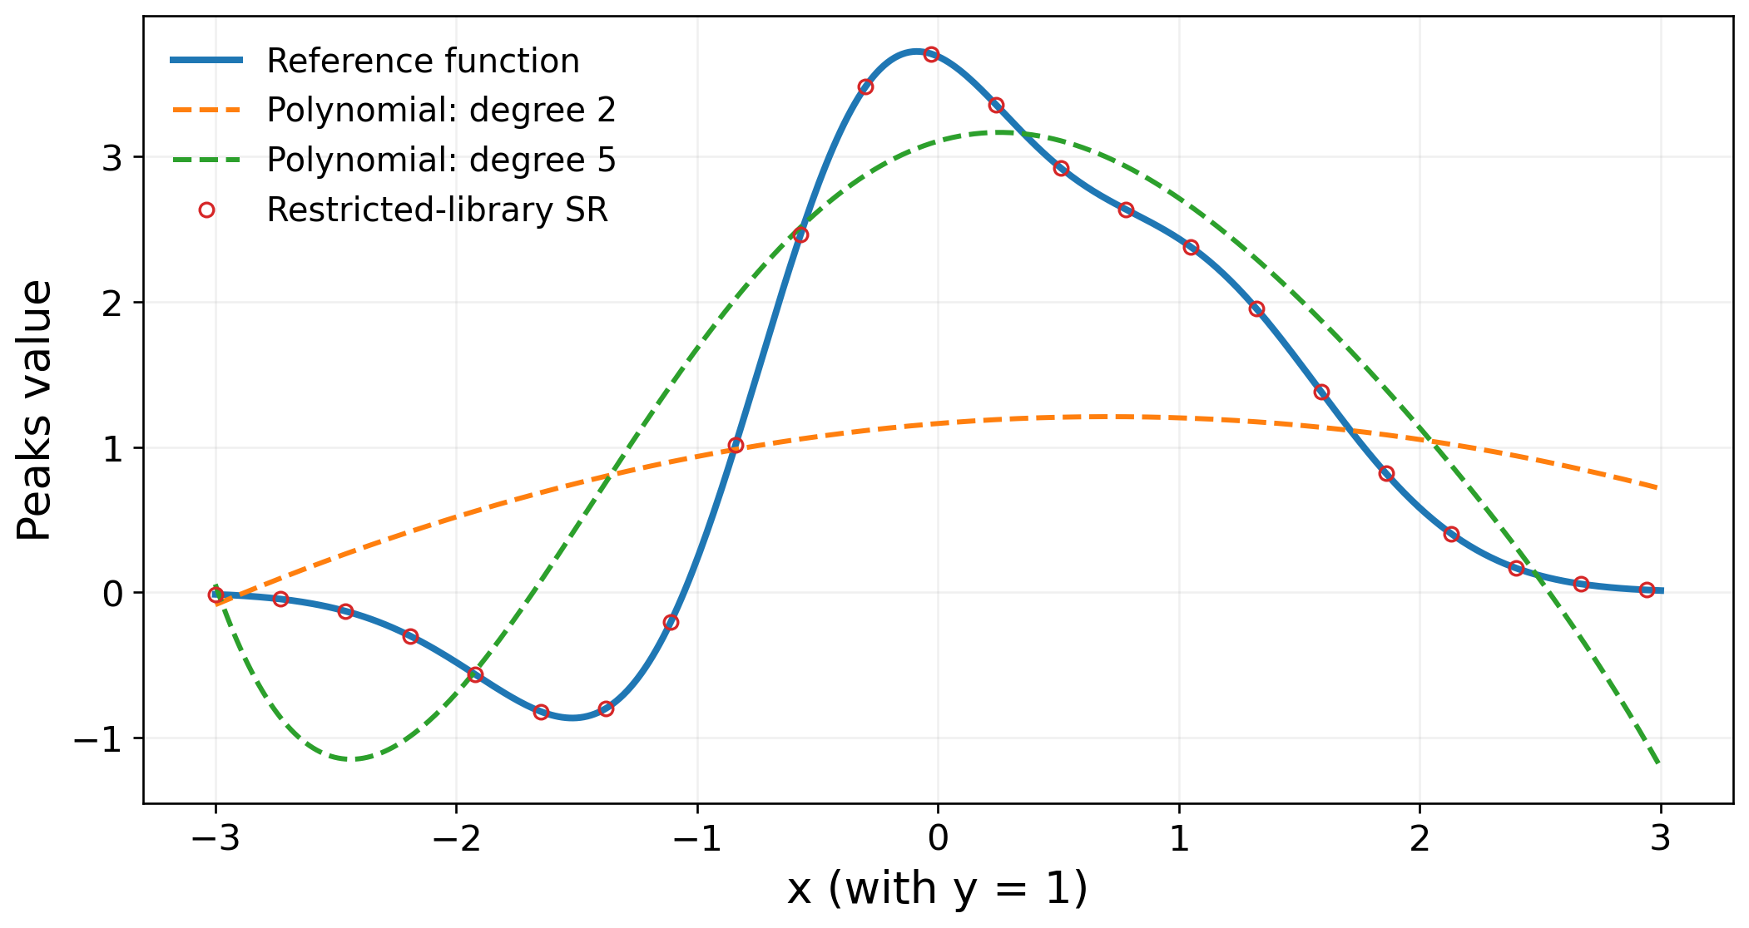
03 • CASE 1 — PEAKS
Inspect the shape—not only a scalar score
Slice through the computed models at y = 1. No fitting is performed on the slice.
SYMBOLIC REGRESSION / CHEMICAL ENGINEERING
29
Notes:
TEACHING NOTES
The slice uses continuously spaced x values with y fixed at 1 and evaluates all trained models without refitting. The reference and the restricted symbolic model coincide, shown with line and hollow markers to make both visible. The quadratic model misses the local trough and peak structure. The degree-five polynomial is more flexible but still shows substantial shape error. This plot helps students connect the test metrics with a physical-looking response surface. A single slice is not a complete validation: it is an interpretable diagnostic alongside the two-dimensional test results. In a chemical problem, inspect analogous operating slices near high load, boundaries and the conditions recommended by the optimiser.
TEACHING CUE
Ask: where would the quadratic model give the wrong engineering trend?

Slide 30
03 • CASE 1 — PEAKS
Why this success is deliberately favourable
THE RIGHT TERMS EXIST
NO ADDED NOISE
NOT A GP BENCHMARK
The supplied dictionary contains the exact target terms. Centres and widths are fixed.
The scaled dictionary has a condition number of about 1.55 × 10¹¹. Noise stability is not established.
The computation uses finite-library thresholding and refitting, not unrestricted tree search.
Performance depends on data, representation and selection—not the algorithm name alone.
Dictionary conditioning calculated from the training design. Method context: [3].
SYMBOLIC REGRESSION / CHEMICAL ENGINEERING
30
Notes:
TEACHING NOTES
The scaled training dictionary has a condition number of approximately 1.5455 × 10^11, indicating severe near-collinearity. Exact recovery in a favourable noise-free problem does not imply stable coefficient identification when the labels are perturbed. The appropriate next experiments would add controlled noise, alter the dictionary, repeat the sampling and evaluate term-selection stability using training and validation data. A new test protocol would then be required for the final chosen procedure. A different target function may not be represented sparsely by this library. The general lesson is that representation, data and model-selection design jointly determine success. Do not call this numerical experiment a measured result for PySR or gplearn.
SOURCES
[3] Brunton, S. L., Proctor, J. L. & Kutz, J. N. (2016). Discovering governing equations from data by sparse identification of nonlinear dynamical systems. PNAS 113, 3932–3937.
https://doi.org/10.1073/pnas.1517384113

Slide 31
04 • CASE 2 — GREEN METHANOL
From a mathematical surface to a coupled chemical process
CO₂ supply
H₂
Methanol
synthesis
Cooling /
separation
Water electrolysis
Compression
Recycle gas
Crude liquid
Unit behaviour changes the recycle.
The recycle changes unit behaviour.
Distillation
Purge
Methanol
Conceptual process schematic. No full plant dataset is fitted in this teaching case.
SYMBOLIC REGRESSION / CHEMICAL ENGINEERING
31
Notes:
TEACHING NOTES
This is an editable conceptual process diagram, not a detailed process-flow diagram for a validated plant. Hydrogen from water electrolysis is compressed and combined with carbon dioxide. The synthesis product is cooled and separated; liquid product proceeds to purification while unreacted gas is partly recycled and partly purged. The system couples electrochemical performance, reaction, separation and recycle convergence. Changing reactor conversion changes the circulating flow; that altered inlet flow and composition can in turn change conversion. This feedback is the main conceptual step beyond a direct two-input function. A real plant may require CO₂ capture, additional compression, heat integration, water treatment and further auxiliaries, which are not all shown here.

Slide 32
04 • CASE 2 — GREEN METHANOL
Preserve what physics already tells you
RETAIN EXPLICITLY
APPROXIMATE SELECTIVELY
Material and energy balances
Chemical stoichiometry
Known equipment connections
Recycle consistency
Expensive unit responses
Electrolyser voltage and efficiency
Reactor conversion
Other difficult constitutive relations
$$\text{hybrid} \text{model}=\text{known} \text{physics}+\text{symbolic} \text{unit} \text{models}$$
Algebraic process surrogates: [8]. Physics-constrained model discovery: [9].
SYMBOLIC REGRESSION / CHEMICAL ENGINEERING
32
Notes:
TEACHING NOTES
A hybrid model combines known physical relationships with data-based approximations for selected difficult relationships. The surrogate need not relearn conservation of carbon or charge. For example, learn a cell-voltage relation but calculate hydrogen production from Faraday's law; learn reactor conversion but calculate component consumption from stoichiometry. This approach does not guarantee perfect physics: unit constraints, closure assumptions and the original high-fidelity models still require scrutiny. Alternatively, a full-plant input–output surrogate can be useful for screening, but conservation and coupled-output consistency must then be addressed explicitly. This lecture chooses the modular route to make the engineering reasoning visible to undergraduate students.
SOURCES
[8] IDAES documentation. ALAMOPY: ALAMO Python — algebraic surrogate modelling.
https://idaes-pse.readthedocs.io/en/stable/explanations/modeling_extensions/surrogate/api/alamopy/index.html
[9] de Carvalho Servia, M. Á. et al. (2025). Constraint-Guided Symbolic Regression for Data-Efficient Kinetic Model Discovery. arXiv:2507.02730 (preprint).
https://arxiv.org/abs/2507.02730

Slide 33
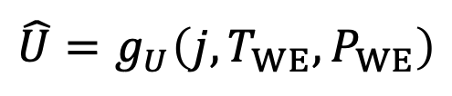
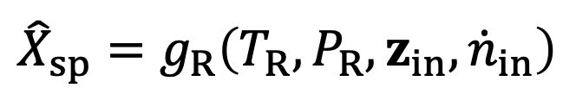
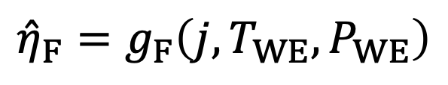
04 • CASE 2 — GREEN METHANOL
Define the targets and the operating mode
ELECTROLYSER VOLTAGE
$$\hat{U}=g_{U}\left(j,T_{WE},P_{WE}\right)$$
FARADAIC EFFICIENCY
$${\hat{η}}_{F}=g_{F}\left(j,T_{WE},P_{WE}\right)$$
REACTOR SINGLE-PASS CONVERSION
$${\hat{X}}_{sp}=g_{R}\left(T_{R},P_{R},z_{in},{\dot{n}}_{in}\right)$$
For a current-controlled cell, current density is an input and voltage is a response.
Proposed modelling structure for this teaching case; not fitted relations.
SYMBOLIC REGRESSION / CHEMICAL ENGINEERING
33
Notes:
TEACHING NOTES
U is single-cell voltage and eta_F is Faradaic efficiency. X_sp is single-pass reactor conversion, z_in the inlet composition vector, and n_dot_in the inlet molar flow. These equations specify surrogate targets, not trained formulas. In a current-controlled experiment, the voltage responds to current density and other conditions. Treating current density and voltage as independent optimisation variables without an additional physical constraint can create impossible operating points. For a voltage-controlled experiment, the input–output specification may instead be reversed. Include inlet composition and flow in a reactor surrogate when they vary through recycle coupling; a model of conversion against only temperature and pressure may be insufficient.

Slide 34
04 • CASE 2 — GREEN METHANOL
Design the dataset around the process, not the algorithm
Record | Why it matters
Independent inputs | Sample feasible operating choices and realistic ranges.
Physical outputs | Store voltage, conversion, flow, purity and relevant duties.
Convergence status | Separate numerical failure from a valid poor operating point.
Mode / scenario | Record branch, feed composition and operating regime.
Do not convert a failed simulation into “zero production”. That creates false training labels.
SYMBOLIC REGRESSION / CHEMICAL ENGINEERING
34
Notes:
TEACHING NOTES
Start with an explicit domain and feasibility rules. Collect both outputs and diagnostic metadata. Numerical non-convergence, physical infeasibility and low performance are different outcomes; a simulator failure does not establish that the true product rate is zero. In difficult domains, consider a separate feasibility classifier or a structured failure-handling policy rather than forcing all outcomes into one continuous regressor. Use sampling and learning curves to determine whether additional data are needed, rather than borrowing the Peaks sample count. Group observations by scenario when assessing generalisation to new scenarios. Sampling only along a narrow line can confound the apparent influence of two process variables, limiting interpretation even when the fitted equation is short.

Slide 35
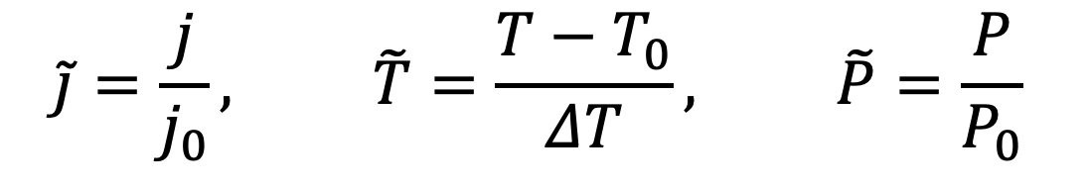
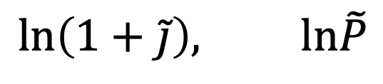
04 • CASE 2 — GREEN METHANOL
Scale variables before applying logarithms or exponentials
DIMENSIONLESS VARIABLES
$$\tilde{j}=\frac{j}{j_{0}}, \tilde{T}=\frac{T−T_{0}}{ΔT}, \tilde{P}=\frac{P}{P_{0}}$$
Reference scales carry units.
A raw expression such as exp(T) is not dimensionally defined unless T has been made dimensionless.
MEANINGFUL ARGUMENTS
$$ln\left(1+\tilde{j}\right), ln\tilde{P}$$
Dimensional constraints in symbolic search: [7].
SYMBOLIC REGRESSION / CHEMICAL ENGINEERING
35
Notes:
TEACHING NOTES
j0 and P0 are positive reference values with the same units as current density and pressure. T0 is a reference temperature and delta T is a non-zero temperature scale. Their numerical choices must be documented. Pressure ratios should use an appropriate absolute pressure definition when physical thermodynamic relations require it. Logarithms and exponentials require dimensionless arguments; unit-aware symbolic regression can enforce compatible expressions during search. Scaling also influences numerical conditioning and the meaning of coefficients. It does not by itself prove the physical validity of a chosen mathematical form. The teaching model uses j0 = 0.30 A cm^-2 and later fixes temperature and pressure at their reference conditions.
SOURCES
[7] Tenachi, W., Ibata, R. & Diakogiannis, F. I. (2023). Deep symbolic regression for physics guided by units constraints: toward the automated discovery of physical laws. ApJ 959, 99.
https://doi.org/10.3847/1538-4357/ad014c

Slide 36
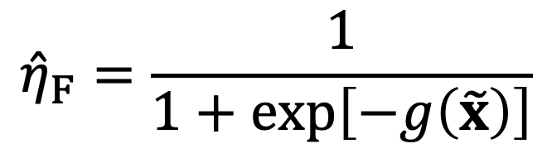
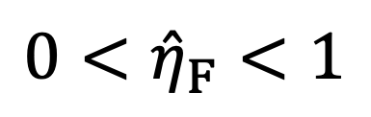
04 • CASE 2 — GREEN METHANOL
A transformation can enforce an output range
SEARCH THE INTERNAL FUNCTION G
$${\hat{η}}_{F}=\frac{1}{1+exp\left[−g\left(\tilde{x}\right)\right]}$$
Range consistency is useful.
It is not a complete physical model.
$$0<{\hat{η}}_{F}<1$$
A bounded expression can still have inaccurate trends, poor calibration or unreliable extrapolation.
SYMBOLIC REGRESSION / CHEMICAL ENGINEERING
36
Notes:
TEACHING NOTES
The logistic transformation maps any finite real-valued inner prediction to a number strictly between zero and one. It can therefore prevent negative efficiencies and efficiencies above unity. Symbolic regression searches the inner function g rather than eta_F directly. This does not enforce conservation, correct derivatives, a particular electrochemical mechanism or valid extrapolation. Exact boundary observations of zero or one require care when transforming labels with the inverse logit, and numerical implementations should avoid overflow in the exponential. Loss definitions and weighting should reflect the target quantity and engineering tolerance. In the worked calculation that follows, efficiency is fixed at an assumed 0.96 to isolate the current-density trade-off.

Slide 37
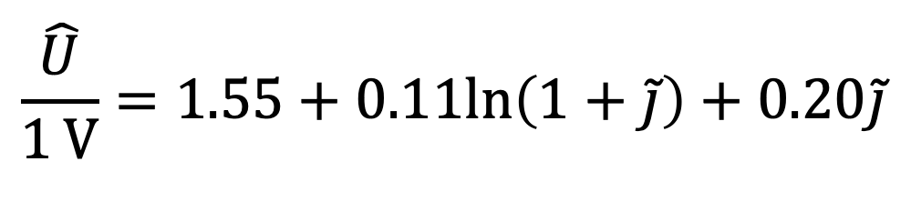
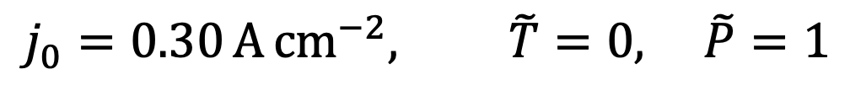
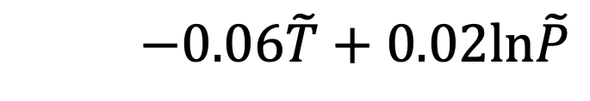
04 • CASE 2 — GREEN METHANOL
An illustrative voltage relation makes the trade-off visible
$$\frac{\hat{U}}{1 V}=1.55+0.11ln\left(1+\tilde{j}\right)+0.20\tilde{j}$$
$$−0.06\tilde{T}+0.02ln\tilde{P}$$
REFERENCE CONDITIONS USED BELOW
$$j_{0}=0.30 A cm^{−2}, \tilde{T}=0, \tilde{P}=1$$
The following numbers are consequences of this specified relation—not validated electrolyser predictions.
Author-defined teaching relation. Coefficients are assumed, not fitted to experimental or plant data.
SYMBOLIC REGRESSION / CHEMICAL ENGINEERING
37
Notes:
TEACHING NOTES
Every coefficient on this slide is an explicit teaching assumption. The left side U/(1 V) is dimensionless, so the coefficients on the right are dimensionless. The normalised inputs were defined on the previous slides. At the reference temperature and pressure, the temperature and log-pressure contributions vanish. The remaining relation is 1.55 + 0.11 ln(1+j_tilde) + 0.20 j_tilde. At j = 0.30 A cm^-2, j_tilde = 1 and U = 1.826246 V. At j = 0.60 A cm^-2, j_tilde = 2 and U = 2.070847 V. The shape is intended to illustrate increasing electrical losses with increasing load, not to identify a unique electrochemical mechanism.

Slide 38
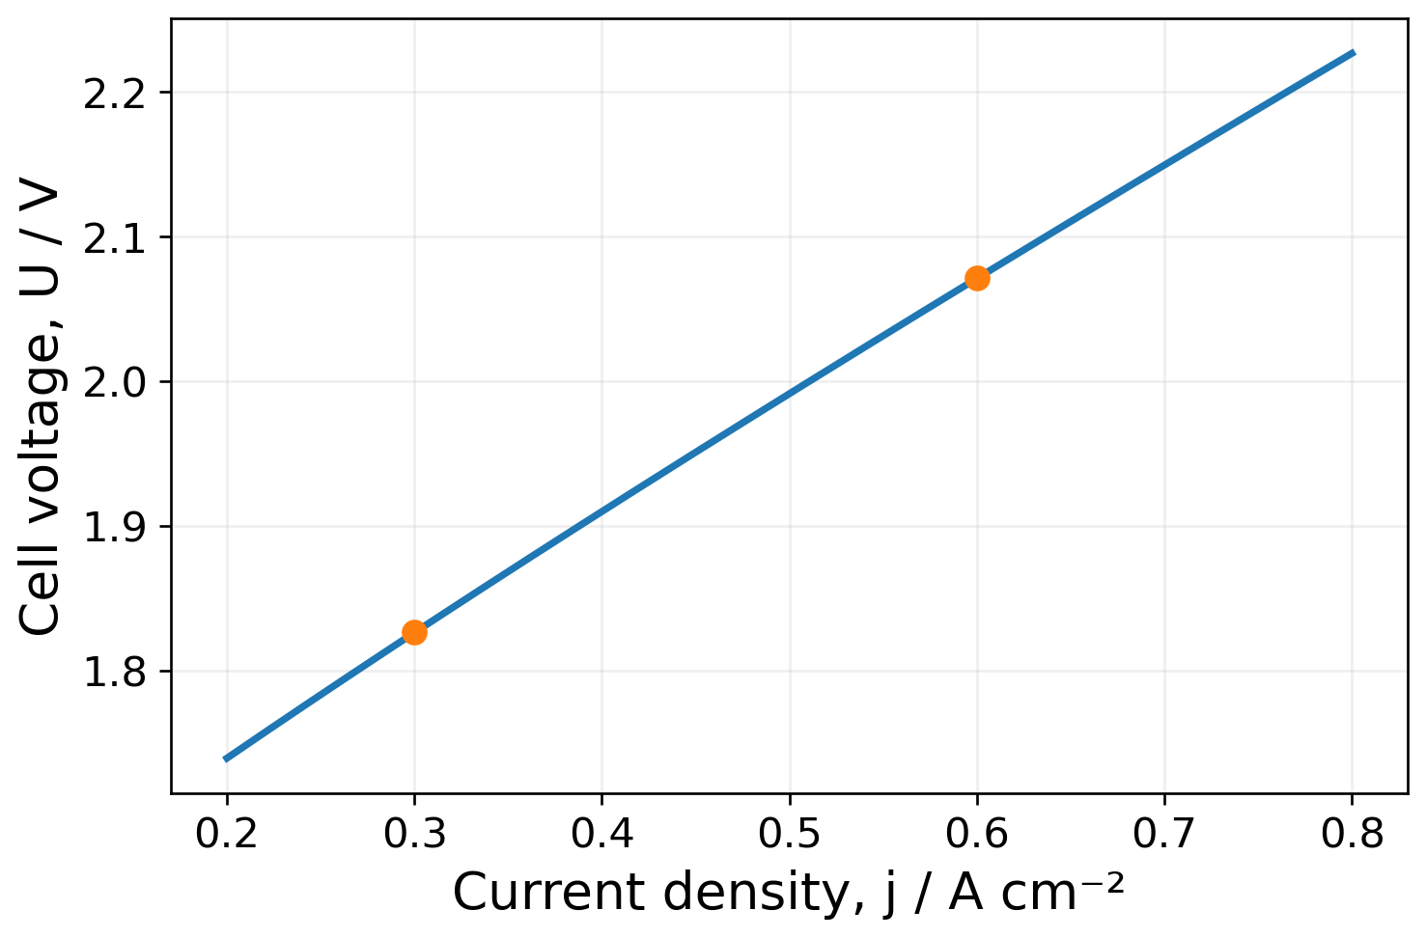
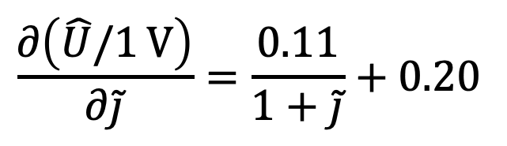
04 • CASE 2 — GREEN METHANOL
Use the explicit formula to inspect trends
$$\frac{∂\left(\hat{U}/1 V\right)}{∂\tilde{j}}=\frac{0.11}{1+\tilde{j}}+0.20$$
The derivative is positive for positive current density.
Interpretation does not establish causation or prove a mechanism.
Curve and derivative calculated from the assumed voltage relation at reference temperature and pressure.
SYMBOLIC REGRESSION / CHEMICAL ENGINEERING
38
Notes:
TEACHING NOTES
Differentiate with respect to the dimensionless current density. Both terms are positive for positive j_tilde, so this relation predicts increasing voltage over the positive-current domain. The curve is generated directly from the assumed equation and is not a regression-validation plot. An analytic expression allows quick inspection of derivatives, limiting behaviour and curvature, which is useful for debugging and optimisation. However, the presence of a logarithm does not establish that a specific activation mechanism has been discovered. Multiple expressions may fit a limited dataset well. Mechanistic attribution requires independent physical arguments and evidence. Also, fitting function values does not automatically guarantee accurate derivatives when the surrogate is trained on real data.

Slide 39
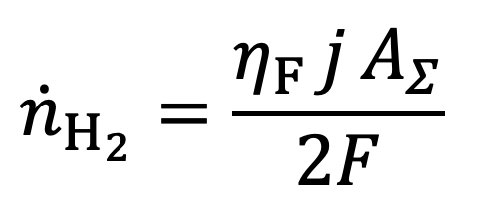
04 • CASE 2 — GREEN METHANOL
Retain Faraday’s law for hydrogen production
$${\dot{n}}_{H_{2}}=\frac{η_{F} j A_{Σ}}{2F}$$
Symbol | Meaning
ṅH₂ | Hydrogen production rate, mol s⁻¹
j | Current density, A m⁻² in the area calculation
AΣ | Sum of active areas over all cells, m²
F | Faraday constant ≈ 96,485.33 C mol⁻¹
Two moles of electrons are required per mole of H₂.
Charge-balance derivation; Faraday constant: NIST [10]. Identical-cell operating conditions are assumed.
SYMBOLIC REGRESSION / CHEMICAL ENGINEERING
39
Notes:
TEACHING NOTES
Current is charge per unit time. Dividing current by the Faraday constant gives molar electron flow; dividing by two gives the ideal molar hydrogen production. Faradaic efficiency accounts for the fraction of charge associated with hydrogen generation. A_Sigma is the sum of active areas across cells operating at the same current density and efficiency. For a series stack, j A_Sigma is the sum of cell currents, not the stack-terminal current. This definition allows both total production and total power to be expressed without omitting the number of cells. Use consistent units: 1 A cm^-2 = 10,000 A m^-2. The NIST Faraday constant is approximately 96485.33212 C mol^-1; the calculations use this rounded value.
SOURCES
[10] NIST. CODATA value: Faraday constant.
https://physics.nist.gov/cgi-bin/cuu/Value?eqf=

Slide 40
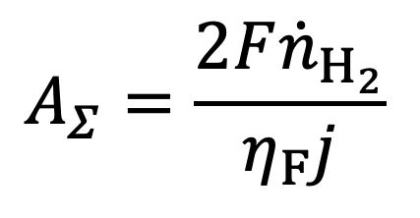
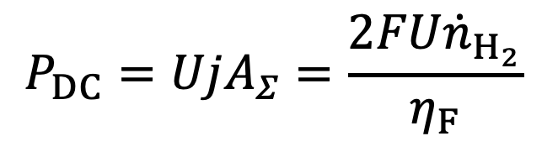
04 • CASE 2 — GREEN METHANOL
At fixed production, area and power respond differently
REQUIRED ACTIVE AREA
TOTAL DIRECT-CURRENT POWER
$$A_{Σ}=\frac{2F{\dot{n}}_{H_{2}}}{η_{F}j}$$
$$P_{DC}=UjA_{Σ}=\frac{2FU{\dot{n}}_{H_{2}}}{η_{F}}$$
Higher current density
reduces required area
if efficiency is fixed.
Higher voltage increases
power at fixed production
if efficiency is fixed.
SYMBOLIC REGRESSION / CHEMICAL ENGINEERING
40
Notes:
TEACHING NOTES
Rearrange Faraday's law to calculate total required active area for a fixed hydrogen production rate. With fixed efficiency, area is inversely proportional to current density. Total direct-current power is the sum over identical cells, U j A_Sigma. Substituting the area expression shows that, at fixed hydrogen production, power depends on the cell-voltage-to-efficiency ratio. Current density still matters indirectly through its effect on voltage and efficiency. Therefore, operating at a larger current density can reduce electrode area while increasing specific electrical demand. When efficiency varies, the simple halving-of-area conclusion must be revisited using eta_F(j). This is an engineering consequence obtained by combining a performance relation with a conservation law.

Slide 41
04 • CASE 2 — GREEN METHANOL
Worked comparison at the same hydrogen production rate
Quantity | j = 0.30 A cm⁻² | j = 0.60 A cm⁻²
Cell voltage / V | 1.826 | 2.071
Total active area / m² | 67.00 | 33.50
DC power / kW | 367.10 | 416.26
DC electricity / kWh kg⁻¹ H₂ | 50.58 | 57.36
50% less active area
13.4% more DC electricity
Calculated from the teaching relation; ηF = 0.96 and hydrogen production = 1 mol s⁻¹.
SYMBOLIC REGRESSION / CHEMICAL ENGINEERING
41
Notes:
TEACHING NOTES
Assume a molar hydrogen production of 1 mol s^-1 and eta_F = 0.96 at both operating points. Convert current density from A cm^-2 to A m^-2 before calculating area. At 0.30 A cm^-2, area is 67.0037 m² and DC power is 367.0958 kW. At 0.60 A cm^-2, area is 33.5019 m² and DC power is 416.2633 kW. Using a teaching hydrogen molar mass of 0.002016 kg mol^-1, the production rate is 7.2576 kg h^-1. Dividing kW by kg h^-1 gives 50.5809 and 57.3555 kWh kg^-1. The electricity increase is about 13.39%. These values omit rectification losses, compression and balance-of-plant electricity. Area is a scale indicator, not total plant capital cost.
TEACHING CUE
Ask students to reproduce the first area calculation, including the current-density unit conversion.

Slide 42
04 • CASE 2 — GREEN METHANOL
Do not confuse a component metric with a plant metric
DC ELECTRICITY IS NOT THE WHOLE PLANT
AREA IS NOT TOTAL CAPITAL COST
The calculation excludes rectification losses, hydrogen compression, pumps and other auxiliaries.
Half the active area does not imply half the plant investment. Equipment and infrastructure scale differently.
State the system boundary before comparing energy demand or cost.
SYMBOLIC REGRESSION / CHEMICAL ENGINEERING
42
Notes:
TEACHING NOTES
The electrical calculation is a direct-current stack-level quantity under identical-cell assumptions. A system-level efficiency or specific energy consumption must include all components within its stated boundary. Compare like with like: DC electrolysis electricity, AC input electricity and total process energy are not interchangeable. Similarly, an area proxy may capture one part of electrochemical equipment scale, but costs also depend on pressure, materials, balance of plant, installation, controls and other equipment. A rigorous economic model requires an explicit costing basis, not a blanket proportionality between electrode area and plant CAPEX. These distinctions keep the illustrative result useful without overstating its industrial meaning.

Slide 43
04 • CASE 2 — GREEN METHANOL
A recycle loop changes overall conversion
Reactor
Ideal product
separation
Fresh CO₂
Recycle the unreacted CO₂
Purge fraction φ
Assume: fixed single-pass conversion X, no side reactions and complete removal of products.
SYMBOLIC REGRESSION / CHEMICAL ENGINEERING
43
Notes:
TEACHING NOTES
Define X as the single-pass CO₂ conversion and phi as the fraction of unreacted gas that is purged. The remaining fraction, 1-phi, is recycled. Product removal is ideal, no side reactions occur and X is held fixed. Let F0 be the fresh CO₂ molar flow and F_in the CO₂ molar flow entering the reactor. These symbols refer to CO₂ flow, not the total gas flow. Under these assumptions, the recycle is (1-phi)(1-X)F_in. A real methanol loop can include other carbon species and composition-dependent conversion, so the simple result is only an idealised material-balance demonstration. The following derivation shows why single-pass conversion cannot be equated to overall plant conversion.

Slide 44
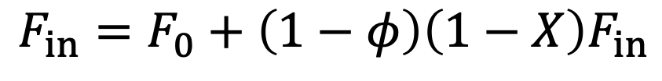
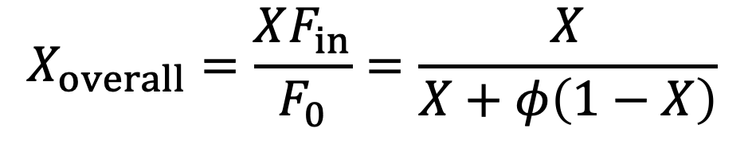
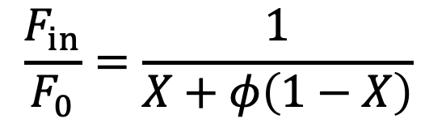
04 • CASE 2 — GREEN METHANOL
Derive the idealised carbon balance step by step
1 FRESH FEED PLUS RECYCLED UNREACTED CO₂
$$F_{in}=F_{0}+\left(1−φ\right)\left(1−X\right)F_{in}$$
2 REARRANGE THE INLET BALANCE
$$\frac{F_{in}}{F_{0}}=\frac{1}{X+φ\left(1−X\right)}$$
3 CONVERTED CARBON RELATIVE TO FRESH CARBON
$$X_{overall}=\frac{XF_{in}}{F_{0}}=\frac{X}{X+φ\left(1−X\right)}$$
SYMBOLIC REGRESSION / CHEMICAL ENGINEERING
44
Notes:
TEACHING NOTES
Begin with the fresh-plus-recycle inlet balance. Move the recycle term to the left and factor F_in: F_in[1-(1-phi)(1-X)] = F0. Expand the bracket to obtain X + phi(1-X). Divide by this positive denominator to obtain the inlet-to-fresh ratio. The converted CO₂ flow is XF_in; divide it by fresh CO₂ flow to obtain overall conversion. As phi approaches one, there is no recycle and overall conversion approaches X. As phi approaches zero with X greater than zero, the idealised overall conversion approaches one, but circulation can be very large when X is small. The combination X = 0 and phi = 0 is singular and cannot sustain a finite steady state with positive fresh feed.
TEACHING CUE
Ask students to test the limiting case φ = 1 before substituting numbers.

Slide 45
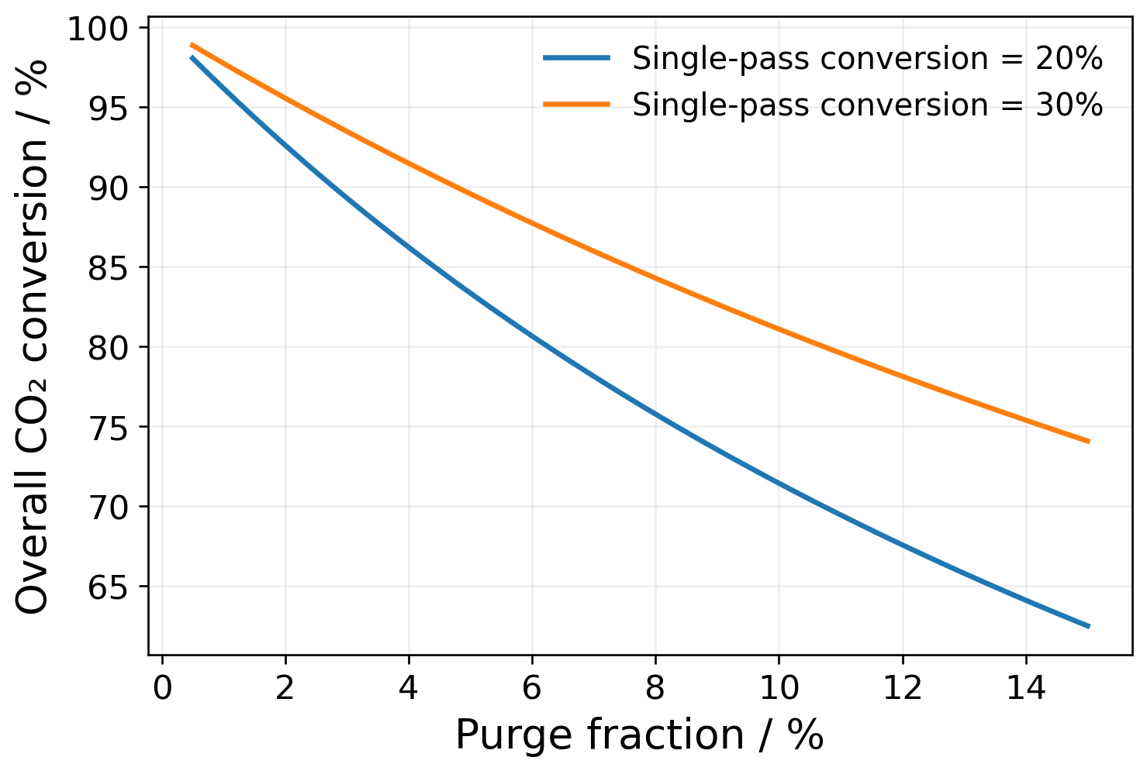
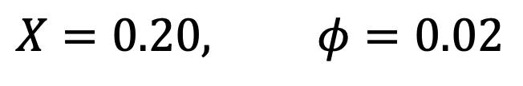
04 • CASE 2 — GREEN METHANOL
Low single-pass conversion can still mean high overall conversion
$$X=0.20, φ=0.02$$
92.6%
overall CO₂ conversion
4.63 ×
reactor-inlet / fresh CO₂ flow
Idealised fixed-conversion recycle calculation; not a complete methanol-plant prediction.
SYMBOLIC REGRESSION / CHEMICAL ENGINEERING
45
Notes:
TEACHING NOTES
For X = 0.20 and phi = 0.02, the denominator is 0.20 + 0.02(0.80) = 0.216. The overall conversion is 0.20/0.216 = 0.925926, or 92.6%, and F_in/F0 is 1/0.216 = 4.62963. This is the ratio for CO₂ flow, not automatically the total reactor-gas-flow ratio. The plot shows how the same idealised balance responds to purge fraction at two fixed single-pass conversions. It is derived from the equation rather than fitted data. Higher circulation may affect reactor sizing and compression demand in a real process, but this simplified calculation does not quantify those costs. Composition, kinetics, equilibrium and separation behaviour would have to be coupled to determine actual system performance.

Slide 46
04 • CASE 2 — GREEN METHANOL
Replacing a unit model does not remove recycle convergence
Inlet state
Surrogate conversion
Balances and separation
Updated recycle state
Iterate until flow and composition are consistent.
SYMBOLIC REGRESSION / CHEMICAL ENGINEERING
46
Notes:
TEACHING NOTES
In the earlier algebraic example, X was fixed, allowing a closed-form solution. In a realistic unit surrogate, conversion depends on inlet composition and flow, which change when the recycle changes. Start with an inlet-state estimate, evaluate the surrogate, solve the balances and separation relationships, update the recycle and repeat until an appropriate residual tolerance is met. Damping or more advanced numerical solvers may be needed. Monitor whether each iterated state remains inside the surrogate's valid domain; an optimiser or a recycle solver may evaluate intermediate states that were not represented in training. A faster unit model reduces evaluation cost but does not guarantee convergence of the full flowsheet.

Slide 47
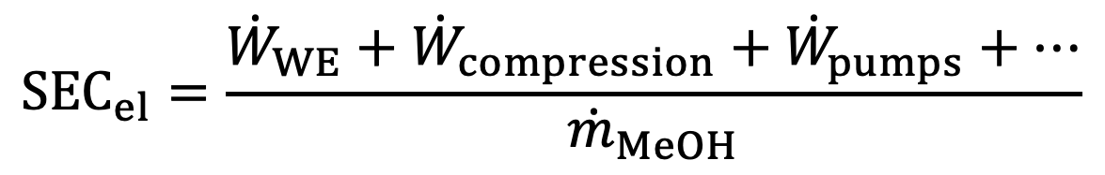
04 • CASE 2 — GREEN METHANOL
Translate unit predictions into system objectives
ELECTRICITY PER UNIT METHANOL PRODUCTION
$${SEC}_{el}=\frac{{\dot{W}}_{WE}+{\dot{W}}_{compression}+{\dot{W}}_{pumps}+⋯}{{\dot{m}}_{MeOH}}$$
ENERGY
CARBON
EQUIPMENT SCALE
Use a consistent boundary and unit basis.
Track fresh input, product carbon and losses.
Distinguish a proxy from a complete cost model.
SYMBOLIC REGRESSION / CHEMICAL ENGINEERING
47
Notes:
TEACHING NOTES
SEC_el is an electricity-specific metric. With power expressed in kW and methanol production in kg h^-1, the ratio is kWh kg^-1. Thermal duties should not be added directly to electrical power without defining an energy accounting convention, such as separate utilities or an explicit equivalent-energy basis. The electrical power terms are denoted W_dot to distinguish them from the operating pressures P introduced earlier. The WE subscript identifies the water-electrolysis unit. Other objectives may include carbon utilisation and a capital-scale indicator. Their definitions and boundaries must be fixed before comparing alternatives.

Slide 48
04 • CASE 2 — GREEN METHANOL
There are two different Pareto problems
MODEL SELECTION
PROCESS DESIGN
Objectives:
Prediction error and expression complexity.
Decision: which surrogate is suitable?
Objectives:
Energy, equipment scale and carbon performance.
Decision: which operating point is suitable?
A simple model and a resource-efficient process are different optimisation outcomes.
SYMBOLIC REGRESSION / CHEMICAL ENGINEERING
48
Notes:
TEACHING NOTES
At the model-development stage, candidates are equations and the trade-off is usually between fit and complexity, subject to validity requirements. At the process-design stage, candidates are operating points or equipment choices and the trade-off concerns engineering performance. The model-selection frontier is not the process-design frontier. A small error reduction may or may not matter for a particular engineering decision. Conversely, a surrogate can have a good average error while distorting the region near the predicted process Pareto set. This motivates local verification of selected process candidates and, where necessary, additional high-fidelity sampling around decision-relevant regions.

Slide 49
04 • CASE 2 — GREEN METHANOL
Close the loop with high-fidelity verification
1
Optimise the surrogate
Screen many operating conditions.
2
Recompute key candidates
Check feasibility and performance using the original model.
3
Compare decisions
Does the recommended trade-off survive verification?
4
Refine when necessary
Add development data near unreliable regions; preserve an independent test.
The optimiser searches favourable predictions—and may exploit surrogate errors.
SYMBOLIC REGRESSION / CHEMICAL ENGINEERING
49
Notes:
TEACHING NOTES
A process optimiser actively seeks apparently favourable parts of the surrogate surface. It can therefore expose errors that are not obvious from average test metrics. After optimisation, rerun important candidates through the original simulator and check both feasibility and objective values. A point that looked optimal under the surrogate may be infeasible or dominated after verification. Additional high-fidelity evaluations can be added to the development dataset, followed by refitting and renewed validation. Preserve an independent evaluation set or clearly declare a new protocol; do not continue calling previously used development data an untouched test. Robust engineering conclusions require verification of the decisions, not just a regression plot.

Slide 50


05 • RELIABILITY AND GOOD PRACTICE
R² alone is not an engineering acceptance criterion
ERROR IN THE ORIGINAL OUTPUT UNITS
$$RMSE=\sqrt{\frac{1}{n}\sum_{i=1}^{n}{{\left(z_{i}−{\hat{z}}_{i}\right)}^{2}}}$$
Check error magnitude, not only explained variance.
Inspect boundaries, high-load conditions and optimiser-selected regions.
SYMBOLIC REGRESSION / CHEMICAL ENGINEERING
50
Notes:
TEACHING NOTES
RMSE retains the output unit and therefore helps connect prediction error with engineering tolerance. R² measures the fraction of output variance explained relative to the mean predictor; its value depends on the test distribution and can be negative. Neither metric guarantees small worst-case error, correct derivatives or accurate rankings between closely competing operating points. Inspect residuals against each input and against predicted output, quantify maximum or high-quantile error when relevant, and examine decision-sensitive regions. The parity plot is calculated from the independent Peaks test design; only a subset of exact-fit markers is shown for readability. A small absolute voltage bias near the selected operating point can change an energy comparison even when a global fit looks strong.

Slide 51


05 • RELIABILITY AND GOOD PRACTICE
A computable extrapolation is not a validated prediction
EXAMPLE TRAINING RANGE
OUTSIDE THE RANGE
$$0.2≤j≤0.8 A cm^{−2}$$
$$j=2.0 A cm^{−2}$$
The formula still returns a number.
The evidence may not support that number.
Define and enforce the valid input domain during simulation and optimisation.
SYMBOLIC REGRESSION / CHEMICAL ENGINEERING
51
Notes:
TEACHING NOTES
These current-density values illustrate a hypothetical training domain and an extrapolation; they do not establish a safe operating range for any real electrolyser. A symbolic equation may remain algebraically evaluable outside its training domain, but its predictive validity has not thereby been demonstrated. Extrapolation can also occur within each marginal range if a new combination lies outside the jointly sampled region. Mathematical domain restrictions and data-support restrictions are separate: the logarithm may remain defined even when the operating condition is unsupported by data. A deployment implementation should record bounds, applicability assumptions and relevant scenario restrictions, and should reject or flag unsupported evaluations.

Slide 52
05 • RELIABILITY AND GOOD PRACTICE
Audit both physics and numerical behaviour
Check | What can go wrong?
Physical bounds | Negative efficiencies, impossible conversion or inconsistent flows.
Conservation | Independently fitted outputs need not close a balance.
Mathematical domain | Near-zero denominators, invalid logarithms or overflow.
Exported operators | A protected division is not ordinary division near zero.
Units and derivatives | Incorrect scaling, implausible slopes or fragile sensitivities.
Protected-operator semantics: gplearn API [2].
SYMBOLIC REGRESSION / CHEMICAL ENGINEERING
52
Notes:
TEACHING NOTES
Physical range checks should be combined with conservation checks and numerical-domain tests. Protected operators deserve particular attention: some genetic-programming implementations return a specified value when a divisor is too close to zero. Replacing that operator by ordinary division when exporting the equation changes its meaning. Preserve exact operator definitions, preprocessing and units in deployment. Evaluate denominator margins and exponent magnitudes throughout the intended region, including intermediate states encountered by numerical solvers. Derivatives may be important when the surrogate is used inside optimisation or sensitivity analysis, so validate them when they support a decision. These checks reduce risk but cannot prove validity for every unseen operating state.
SOURCES
[2] gplearn documentation. Introduction to Genetic Programming; API reference (protected operators).
https://gplearn.readthedocs.io/en/stable/intro.html

Slide 53

05 • RELIABILITY AND GOOD PRACTICE
A static surrogate does not automatically describe dynamics
STATIC INPUT–OUTPUT RELATION
The current inputs must be sufficient to specify the output.
$$y=g\left(x\right)$$
HISTORY MATTERS
MULTIPLE STEADY STATES
A dynamic model needs suitable states, history or evolution equations.
Identify the operating branch; do not average incompatible branches.
SYMBOLIC REGRESSION / CHEMICAL ENGINEERING
53
Notes:
TEACHING NOTES
A static mapping assumes that the supplied inputs are enough to determine the output under the stated conditions. If two experiments have identical current inputs but different internal temperatures, inventories or catalyst states because of their histories, a static model of the current inputs alone is insufficient. Introduce state variables, lagged information or an explicit dynamic formulation as appropriate. Similarly, a process with multiple steady states may have more than one output at the same manipulated inputs. The dataset and model must distinguish operating branches, or a regressor may average them into a response that is not physically realised. A successful steady-state fit is not evidence of dynamic-control suitability.

Slide 54
05 • RELIABILITY AND GOOD PRACTICE
A decision-ready surrogate needs more than a good fit
1
Prediction
Independent errors meet the intended engineering tolerance.
2
Physics
Bounds, balances, units and trends are consistent.
3
Numerics
The exported implementation is stable over its valid domain.
4
Decision
High-fidelity checks support the recommended operating points.
Record limitations explicitly. Validation is evidence for a defined use—not a universal guarantee.
SYMBOLIC REGRESSION / CHEMICAL ENGINEERING
54
Notes:
TEACHING NOTES
These four checks bring the modelling and engineering objectives together. Prediction concerns independent data and an application-specific tolerance. Physics concerns bounds, conservation, units and plausible trends. Numerics concerns the exact deployed expression and its behaviour throughout the intended domain. Decision validation concerns whether recommended designs remain advantageous under high-fidelity or experimental verification. Also document data provenance, sampling, random seeds, model selection, failure handling and software implementation. None of these alone is sufficient. A model may pass a test-data metric but fail a balance, or pass a balance but distort a process ranking. The acceptance standard should be chosen before using the model to justify a preferred design.

Slide 55
05 • TAKE-HOME MESSAGE
The formula is a means; reliable engineering is the goal
Define the task.
Design the data.
Establish a baseline.
Search the expression.
Validate the model.
Verify the decision.
Peaks teaches representation.
Engineering adds conservation, coupling and verified decisions.
SYMBOLIC REGRESSION / CHEMICAL ENGINEERING
55
Notes:
TEACHING NOTES
Return to the central distinction: symbolic regression jointly searches mathematical structure and coefficients, but a useful surrogate is defined by its intended engineering role. The Peaks example demonstrates how a representation containing the correct functional components can be extremely efficient, while its conditioning and favourable construction limit generalisation. The chemical case demonstrates how a compact response relation can be combined with exact balances to expose meaningful design trade-offs. The complete workflow begins with a decision, not an algorithm brand, and ends with verified engineering consequences, not merely a compact equation. Students should now be able to outline a small surrogate project and identify the evidence needed before using it for optimisation.

Slide 56
06 • CLASSROOM EXERCISES
Three exercises to consolidate the method
1
Peaks: diagnose the claim
Why does near-zero test error here not prove that genetic programming will recover arbitrary functions?
2
Electrolysis: relax an assumption
Would doubling current density still halve required area if Faradaic efficiency changed?
3
Recycle: calculate and interpret
At X = 0.30 and φ = 0.02, calculate overall conversion and the inlet-to-fresh CO₂ ratio.
SYMBOLIC REGRESSION / CHEMICAL ENGINEERING
56
Notes:
TEACHING NOTES
Exercise answers. (1) The computation is finite-library selection, not a genetic-programming benchmark. The dictionary contains the exact generating terms and the data are noise-free; the result provides no universal recovery guarantee or noise-stability demonstration. (2) At fixed hydrogen production, A2/A1 = eta_F,1 j1 / (eta_F,2 j2). If j2 = 2 j1, the ratio is eta_F,1/(2 eta_F,2), so exactly one-half only follows when efficiencies are equal. Total DC power at fixed production varies with U/eta_F. (3) The denominator is 0.30 + 0.02 × 0.70 = 0.314. Overall conversion is 0.30/0.314 = 0.955414, or 95.54%; the inlet-to-fresh CO₂ ratio is 1/0.314 = 3.18471. Compare these with 92.59% and 4.62963 at X = 0.20. Keep the idealised assumptions explicit when interpreting the comparison.
TEACHING CUE
Use these questions for a short discussion or an assessed calculation. Answers are in the notes, not on the slide.

Slide 57
06 • REPRODUCIBILITY
Reproduce the numerical examples independently
Script: symbolic_regression_tutorial.py
python symbolic_regression_tutorial.py --plot --out outputs
Requirements
Python, NumPy and SciPy; Matplotlib for the plots.
What it runs
Restricted-library Peaks regression and the specified chemical teaching calculations.
SYMBOLIC REGRESSION / CHEMICAL ENGINEERING
57
Notes:
TEACHING NOTES
The existing script supplied with the tutorial reproduces the polynomial baselines, restricted-library selection and the illustrative chemical calculations. It requires Python 3.10 or newer, NumPy and SciPy; Matplotlib is required only when plotting. Running the command writes a JSON results file and the two original Peaks figures into the selected output directory. The deck contains additional diagnostic illustrations created from the same functions and assumptions. The script does not install or run PySR, and it does not fit Aspen or experimental process data. Record the package versions in a real study. Small changes at machine precision may occur across numerical libraries; the meaningful conclusion is the reported near-zero error under the explicitly favourable assumptions.

Slide 58
07 • SOURCES AND FURTHER READING
References 1 of 2
Primary papers and official documentation; source numbers appear on relevant slides.
[1]
Cranmer, M. (2023). Interpretable Machine Learning for Science with PySR and SymbolicRegression.jl. arXiv:2305.01582.
https://arxiv.org/abs/2305.01582
[2]
gplearn documentation. Introduction to Genetic Programming; API reference (protected operators).
https://gplearn.readthedocs.io/en/stable/intro.html
[3]
Brunton, S. L., Proctor, J. L. & Kutz, J. N. (2016). Discovering governing equations from data by sparse identification of nonlinear dynamical systems. PNAS 113, 3932–3937.
https://doi.org/10.1073/pnas.1517384113
[4]
MathWorks. MATLAB documentation: peaks — Peaks function.
https://www.mathworks.com/help/matlab/ref/peaks.html
[5]
SciPy documentation. scipy.stats.qmc.LatinHypercube.
https://docs.scipy.org/doc/scipy/reference/generated/scipy.stats.qmc.LatinHypercube.html
SYMBOLIC REGRESSION / CHEMICAL ENGINEERING
58
Notes:
TEACHING NOTES
The sources support the algorithmic principles, reference function, sampling method, validation practice and selected physical constraints. The chemical voltage coefficients, runtime example, Pareto schematic and idealised recycle scenario are teaching constructs, not empirical results from these publications. The finite-library Peaks calculation is provided by the tutorial script. Source [3] concerns sparse identification of dynamical systems and is cited for the sparse-library principle; this lecture's numerical fit is static. Source [9] is cited as a 2025 preprint, not as a claim of a later publication status. Official online documentation was consulted when preparing this teaching deck. The main mathematical derivations and worked arithmetic are explained in the corresponding notes.
SOURCES
[1] Cranmer, M. (2023). Interpretable Machine Learning for Science with PySR and SymbolicRegression.jl. arXiv:2305.01582.
https://arxiv.org/abs/2305.01582
[2] gplearn documentation. Introduction to Genetic Programming; API reference (protected operators).
https://gplearn.readthedocs.io/en/stable/intro.html
[3] Brunton, S. L., Proctor, J. L. & Kutz, J. N. (2016). Discovering governing equations from data by sparse identification of nonlinear dynamical systems. PNAS 113, 3932–3937.
https://doi.org/10.1073/pnas.1517384113
[4] MathWorks. MATLAB documentation: peaks — Peaks function.
https://www.mathworks.com/help/matlab/ref/peaks.html
[5] SciPy documentation. scipy.stats.qmc.LatinHypercube.
https://docs.scipy.org/doc/scipy/reference/generated/scipy.stats.qmc.LatinHypercube.html

Slide 59
07 • SOURCES AND FURTHER READING
References 2 of 2
Primary papers and official documentation; source numbers appear on relevant slides.
[6]
scikit-learn documentation. Common pitfalls and recommended practices: preprocessing and data leakage.
https://scikit-learn.org/stable/common_pitfalls.html
[7]
Tenachi, W., Ibata, R. & Diakogiannis, F. I. (2023). Deep symbolic regression for physics guided by units constraints: toward the automated discovery of physical laws. ApJ 959, 99.
https://doi.org/10.3847/1538-4357/ad014c
[8]
IDAES documentation. ALAMOPY: ALAMO Python — algebraic surrogate modelling.
https://idaes-pse.readthedocs.io/en/stable/explanations/modeling_extensions/surrogate/api/alamopy/index.html
[9]
de Carvalho Servia, M. Á. et al. (2025). Constraint-Guided Symbolic Regression for Data-Efficient Kinetic Model Discovery. arXiv:2507.02730 (preprint).
https://arxiv.org/abs/2507.02730
[10]
NIST. CODATA value: Faraday constant.
https://physics.nist.gov/cgi-bin/cuu/Value?eqf=
SYMBOLIC REGRESSION / CHEMICAL ENGINEERING
59
Notes:
TEACHING NOTES
The sources support the algorithmic principles, reference function, sampling method, validation practice and selected physical constraints. The chemical voltage coefficients, runtime example, Pareto schematic and idealised recycle scenario are teaching constructs, not empirical results from these publications. The finite-library Peaks calculation is provided by the tutorial script. Source [3] concerns sparse identification of dynamical systems and is cited for the sparse-library principle; this lecture's numerical fit is static. Source [9] is cited as a 2025 preprint, not as a claim of a later publication status. Official online documentation was consulted when preparing this teaching deck. The main mathematical derivations and worked arithmetic are explained in the corresponding notes.
SOURCES
[6] scikit-learn documentation. Common pitfalls and recommended practices: preprocessing and data leakage.
https://scikit-learn.org/stable/common_pitfalls.html
[7] Tenachi, W., Ibata, R. & Diakogiannis, F. I. (2023). Deep symbolic regression for physics guided by units constraints: toward the automated discovery of physical laws. ApJ 959, 99.
https://doi.org/10.3847/1538-4357/ad014c
[8] IDAES documentation. ALAMOPY: ALAMO Python — algebraic surrogate modelling.
https://idaes-pse.readthedocs.io/en/stable/explanations/modeling_extensions/surrogate/api/alamopy/index.html
[9] de Carvalho Servia, M. Á. et al. (2025). Constraint-Guided Symbolic Regression for Data-Efficient Kinetic Model Discovery. arXiv:2507.02730 (preprint).
https://arxiv.org/abs/2507.02730
[10] NIST. CODATA value: Faraday constant.
https://physics.nist.gov/cgi-bin/cuu/Value?eqf=

