Slide 1


Signal of Topological defects
Can you spot the cosmic string above?

Slide 2






Topological defects in QFT
Consider a class of a quantum field theories with a symmetry generated by the underlying continuous symmetry group (for example a Yang-Mills theory interacting with fermions):
This has an associated local gauge symmetry in the fermion spinors, with the gauge boson appearing in the definitions of the components of the connection and the curvature two form:
The fields within the model have potentials and associated vacuum manifolds from which discontinuities can lead to solutions homotopically distinct from the vacuum solution, known as a topological defect / topological soliton.
Moreover, it often occurs that defects form during symmetry breaking with such patterns as:

Slide 3





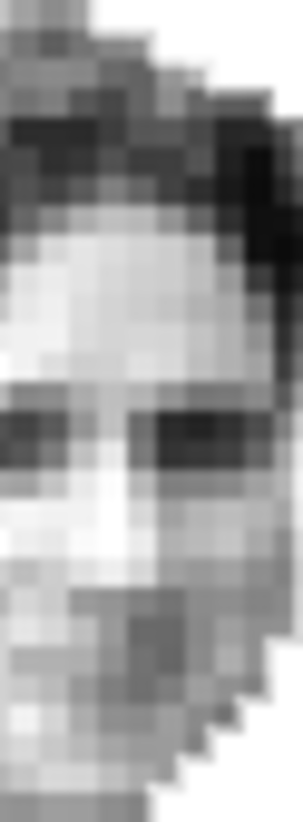

Stability conditions of TDs
During each point in the symmetry breaking pattern (multiple symmetry group breaking leads to composite defects) we can characterize a stability condition which dictates if the theory has the associated topological defect.
This is described via homotopy / fundamental groups and homogeneous spaces, the relations of which can be easily derived from an exact sequence. The sequence is composed of functions mapping from the continuous symmetry group to a subgroup and so on and looks like:
Here dsds represents the n'th homotopy group of the symmetry group (which is also a manifold if it is a Lie group). For some intuition, the first homotopy group of the vacuum manifold is the group of equivalence classes under homotopy of loops in M. From this we can have the following example stability conditions:
Above we see topological stable (TS) monopoles exist in the theory if the universal covering of H is non simply connected and TS cosmic strings exist iff the connected part of the universal covering of H has disconnected pieces. In general, a theory has a TD if the homotopy group is non-trivial:

Slide 4
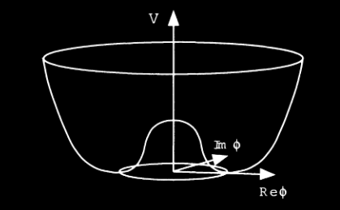



Linear defects: cosmic strings
Now we turn our focus to a specific linear 1D topological defect, U(1) cosmic strings. These are of particular interest as their linear mass density is proportional to the energy scale and thus their observation would allow us to probe particle physics models at very high energy scales relevant to structure formation.
Consider a theory admitting cosmic strings with a U(1) phase symmetry. Below a certain critical temperature, spontaneous symmetry breaking occurs and through bubble nucleation, the state moves from a false vacuum to a metastable state. This is characterized by the scalar potential:
The the vacuum manifold here is the circle in the complex scalar field plane. When vacuum decay occurs, there is an intersection of the nucleated bubbles and to satisfy continuity the field must vanish at some point within the circle, where there is trapped energy at a point. Moreover, in the Abelian Higgs model, we can have string configurations that are translationally invariant, and thus by this symmetry there is a line of points with a vanishing field, and thus traces out our trapped energy, the cosmic string.

Slide 5

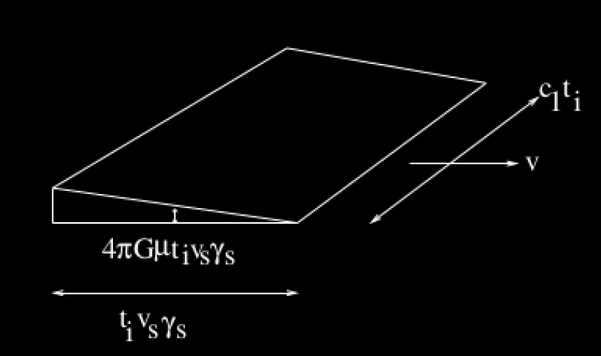


Cosmic string signal
Cosmic strings can either occur as infinitely long (bounded by the horizon) or in loops. It turns out that the rate at which cosmic strings intersect, form loops and lose energy through gravitational radiation after they have been formed via a phase transition in the early universe equilibrates and there is a scale invariant distribution of them, and it suffices to take one cosmic string per Hubble volume.
Moreover, in our model for cosmic strings, they shall have finite length. As cosmic strings move through space relativistically as dictated by the Nambu-Goldstone action, they produce a wake of overdensities and give rise to a wedge shape in physical space:
The signal of the wake is shallow in the redshift direction and is what will allow us to to look for it in cosmological observations.
Our goal is to extract the cosmic string signal from the noisy background onsent by cosmological perturbations (ΛCDM) via appropriate statistics.
Moreover, it is of particular interest to find an upper limit on the string tension being that and this affects the amplitude of the string signal.

Slide 6

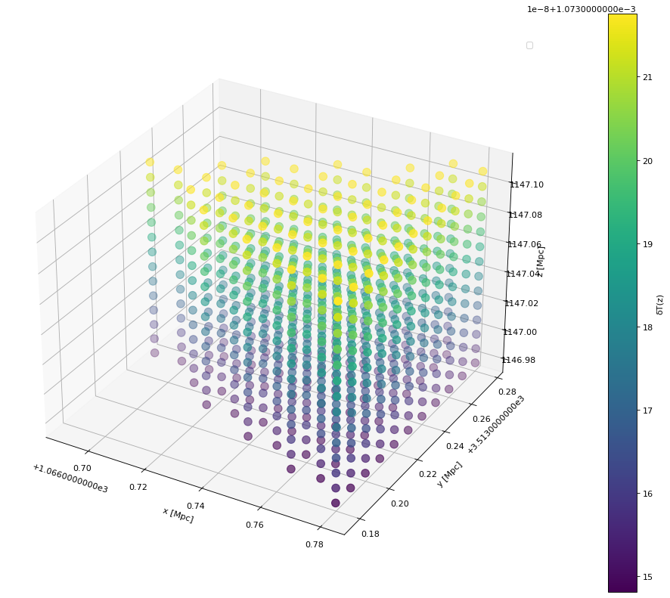
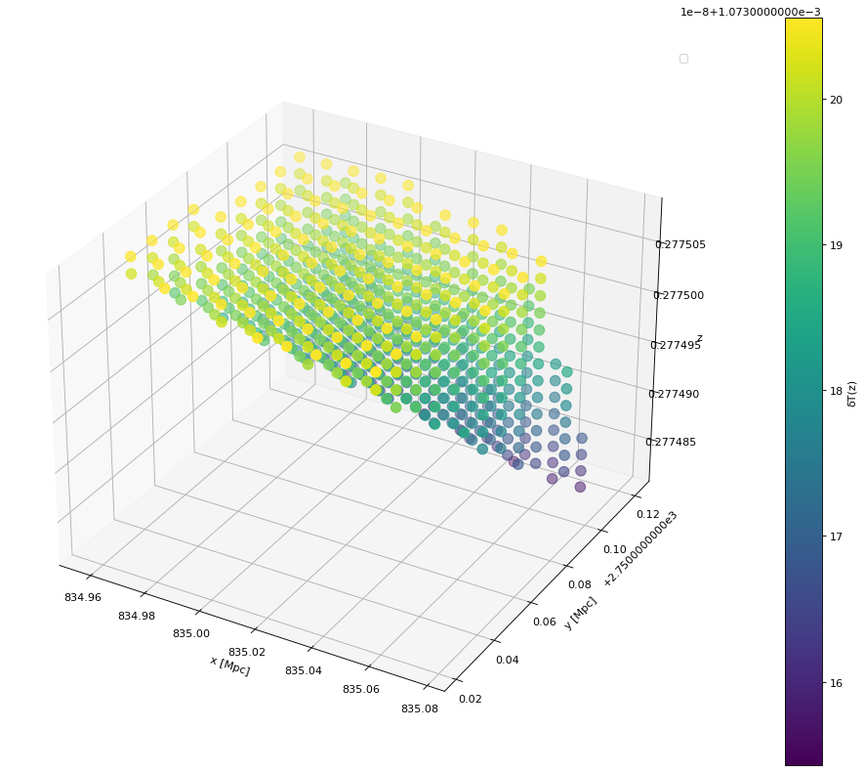
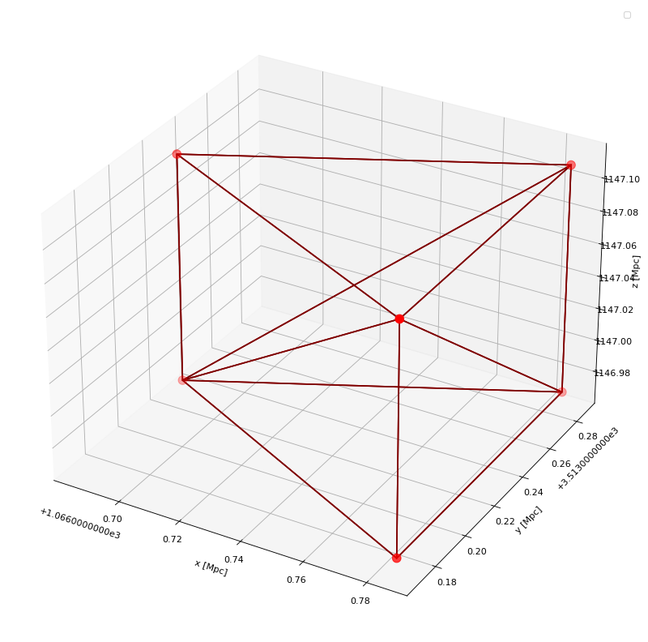
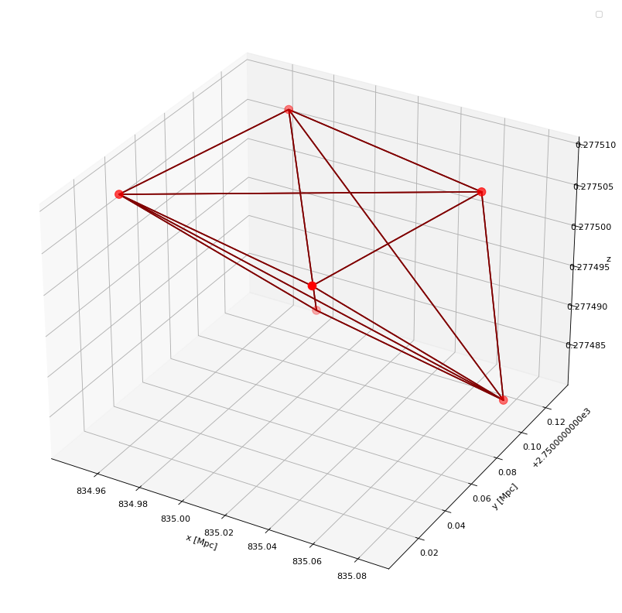
Building wake the wake signal
What exactly are we looking for? When light passes through the string, depending on the orientation there will be a Doppler shift and a change in brightness temperature of the radiation. This is often compared to the ambient CMB temperature, and takes the form:
It is this brightness temperature that we wish to observe over the temperature of the perturbations. We can construct the wedge in physical space and perform arbitrary rotations on it to make it more general. Next, we convert from comoving to physical coordinates via a redshift dependent scale factor and convert the z axis to redshift. Finally, to get our signal we assign a brightness temperature to all the points within the wake which looks like:

Slide 7
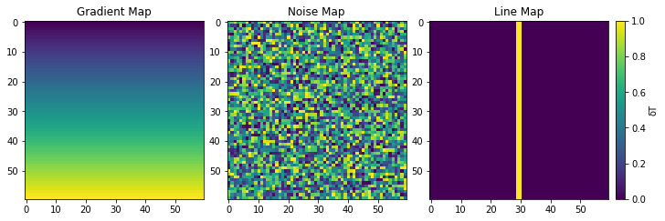
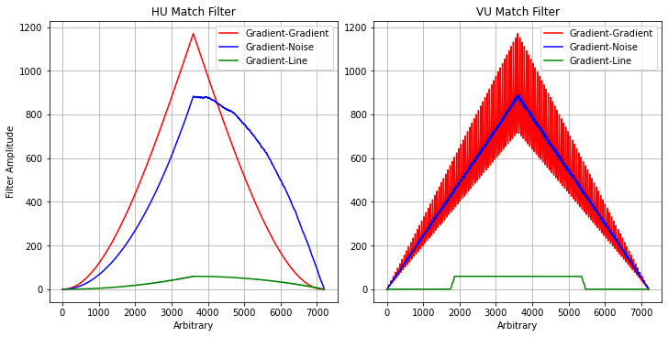
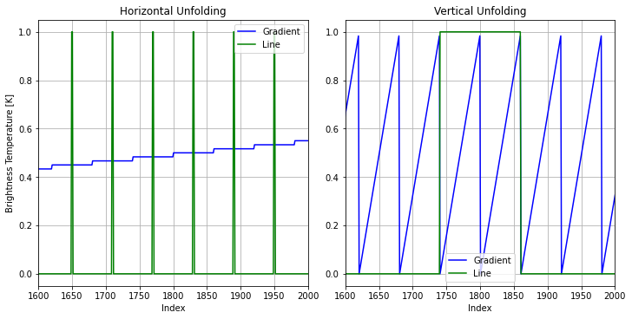
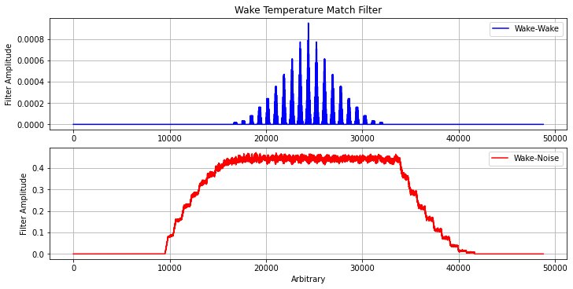
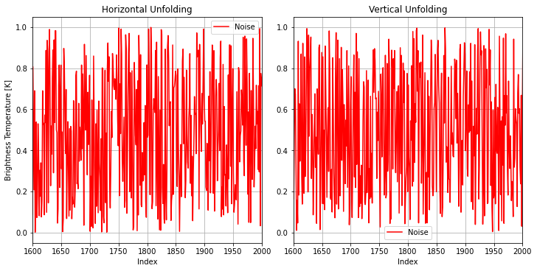
Signal extraction statistics: match filtering
Next, we can take intersections of the 3D ΛCDM noise map and the wake gradient map and perform match filtering to extract the signal. To visualize, consider the following maps:
From this we can perform match filtering in 1D and 2D. For 1D, we unfold the data and then convolve the resulting signal, which looks like:

Slide 8
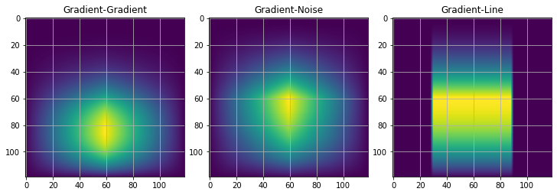
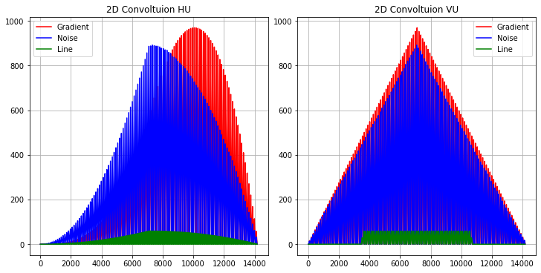

Statistics continued
Moreover, we can do this computation in 2D which results in:
For a 3D match filter, one requires to generalize the convolution for arbitrary indices, but loses its beauty as Einstein summation and physical intuition runs into issues with shifted indices.
Future goals of the project include performing statistics along different lines of sight within the Hubble volume and stitching together that data to give a 3D representation of the signal. Moreover, it might be interesting to look into genus curves relating to the curvature of cosmic strings.

