Slide 1
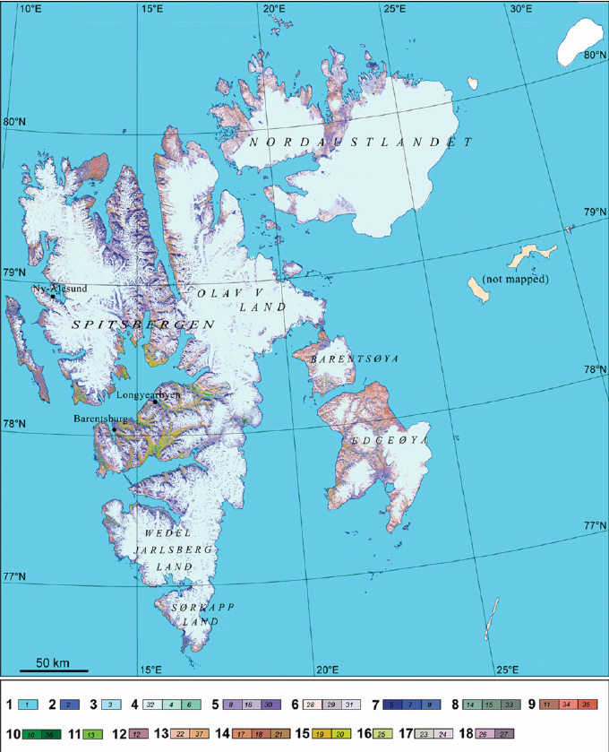

Slide 2
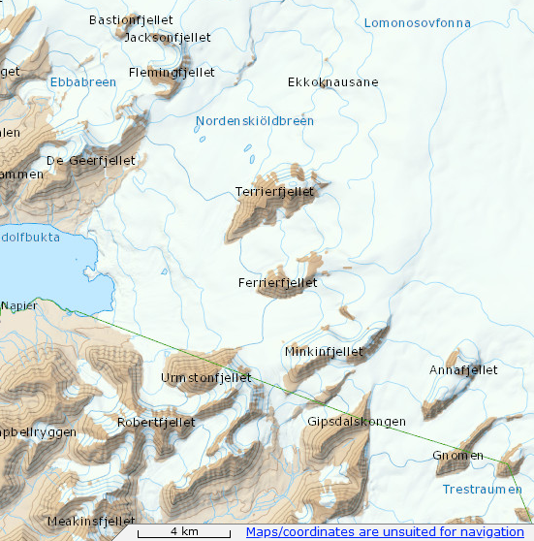

Slide 3
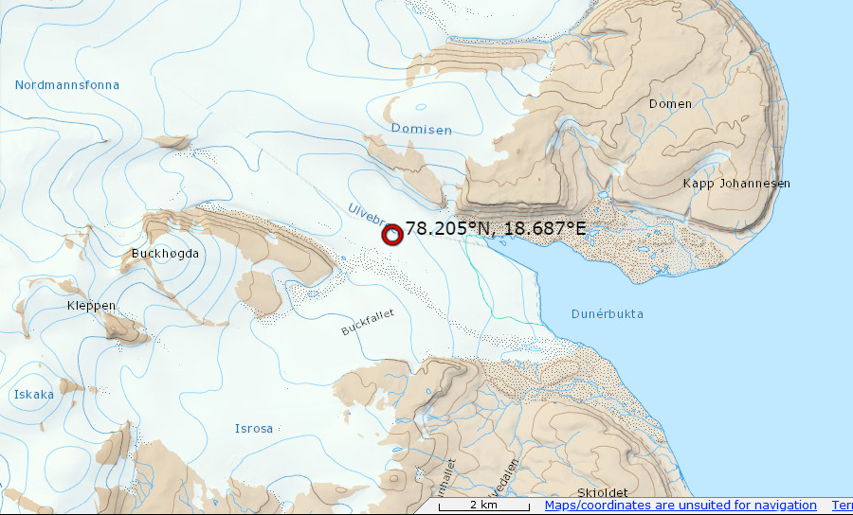

Slide 4
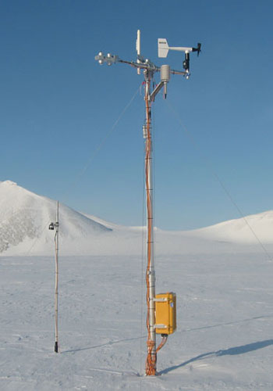
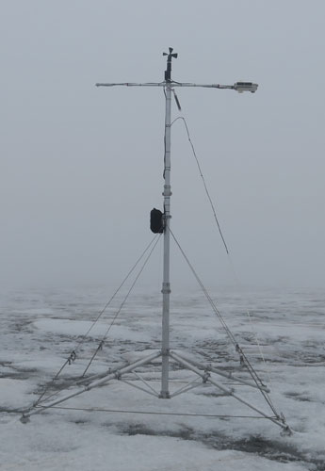
Nordenskiöldbreen
Ulvebreen

Slide 5
PCA Winddir
[[1. 0.11458907 0.37392154]
[0.11458907 1. 0.56317597]
[0.37392154 0.56317597 1. ]]
eigenvalues: [1.73214264+0.j 0.89487026+0.j 0.3729871 +0.j]
Eigenvalue 1 = 1.7321426407196063
Eigenvalue 2 = 0.8948702586896115
Eigenvalue 3 = 0.37298710059078394
Variance of total data:
Eigenvalue 1 = 57.738088023986876
Eigenvalue 2 = 29.829008622987047
Eigenvalue 3 = 12.43290335302613
eigenvectors:
[[-0.43855177 -0.83699375 -0.32728245]
[-0.59006219 0.54284893 -0.5976133 ]
[-0.67786353 0.06896737 0.73194572]]
number 1: -0.4385517669693483 -0.590062185949309 -0.6778635293337335
number 2: -0.836993753714971 0.5428489275313869 0.06896736996685765
number 3: -0.3272824528296397 -0.5976133018857139 0.731945720309279

Slide 6
PCA Windspeed
[[1. 0.62589092 0.63877069]
[0.62589092 1. 0.69326062]
[0.63877069 0.69326062 1. ]]
eigenvalues: [2.30572493+0.j 0.38824158+0.j 0.30603349+0.j]
Eigenvalue 1 = 2.30572492652982
Eigenvalue 2 = 0.3882415812665583
Eigenvalue 3 = 0.3060334922036205
Variance of total data:
Eigenvalue 1 = 76.857497550994
Eigenvalue 2 = 12.941386042218609
Eigenvalue 3 = 10.201116406787351
eigenvectors:
[[ 0.56506437 0.82142899 -0.07717944]
[ 0.58157296 -0.46291829 -0.66893912]
[ 0.58521376 -0.33310818 0.73929953]]
number 1: 0.5650643708906329 0.5815729647028391 0.585213758789661
number 2: 0.8214289931302869 -0.46291829370832854 -0.3331081845213845
number 3: -0.07717944023466546 -0.6689391153736788 0.7392995292357111

Slide 7
PCA T-2m TA
[[1. 0.96744203 0.95924812]
[0.96744203 1. 0.96819833]
[0.95924812 0.96819833 1. ]]
eigenvalues: [2.92993131+0.j 0.04076847+0.j 0.02930022+0.j]
Eigenvalue 1 = 2.929931311987825
Eigenvalue 2 = 0.04076846661638439
Eigenvalue 3 = 0.029300221395791408
Variance of total data:
Eigenvalue 1 = 97.66437706626084
Eigenvalue 2 = 1.358948887212813
Eigenvalue 3 = 0.9766740465263802
eigenvectors:
[[-0.57670524 -0.72222661 0.38183737]
[-0.5784872 0.03098743 -0.81510266]
[-0.57685667 0.69096201 0.43566946]]
number 1: -0.5767052431704728 -0.5784871988297967 -0.5768566748246406
number 2: -0.7222266147466163 0.030987425819239345 0.6909620079228234
number 3: 0.3818373730416173 -0.8151026562532794 0.435669462227415

Slide 8
PCA P luchtdruk
[[1. 0.87833401 0.99169127]
[0.87833401 1. 0.87540947]
[0.99169127 0.87540947 1. ]]
eigenvalues: [2.83138757+0.j 0.00828897+0.j 0.16032346+0.j]
Eigenvalue 1 = 2.8313875658218937
Eigenvalue 2 = 0.16032346392847416
Eigenvalue 3 = 0.008288970249631876
Variance of total data:
Eigenvalue 1 = 94.37958552739646
Eigenvalue 2 = 5.344115464282472
Eigenvalue 3 = 0.2762990083210625
eigenvectors:
[[-0.58579632 -0.71128698 0.38847587]
[-0.56068307 0.00955682 -0.82797534]
[-0.58521549 0.70283675 0.40440492]]
number 1: -0.5857963198528137 -0.5606830721903274 -0.585215485275395
number 2: -0.7112869805196672 0.00955681647707408 0.7028367510325838
number 3: 0.3884758718248986 -0.8279753376870833 0.4044049173685274

Slide 9
Verschillen tussen meetstations en hoe te verklaren
Temperatuur – hoogte
Mooie plaatjes – katabatic wind – richting gletsjer
Sneewhoogte en straling - hoogte

