Slide 1
Verschillen tussen meetstations en hoe te verklaren
Temperatuur – hoogte
Mooie plaatjes – katabatic wind – richting gletsjer
Sneewhoogte en straling - hoogte

Slide 2
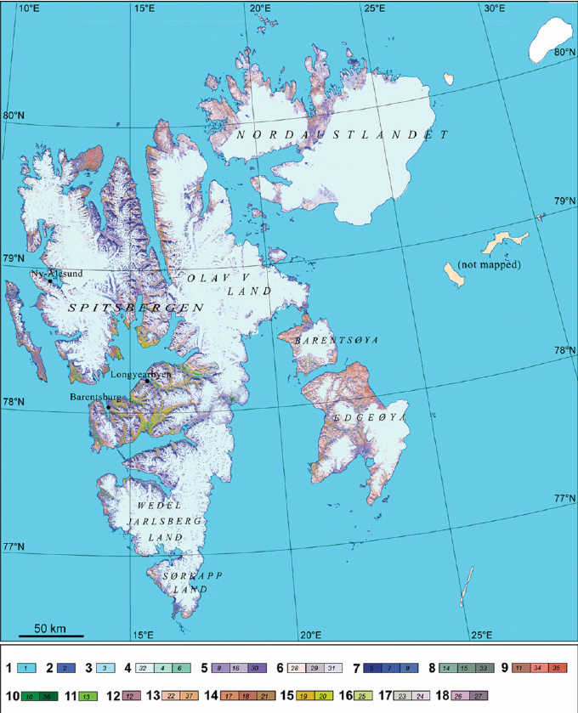

Slide 3
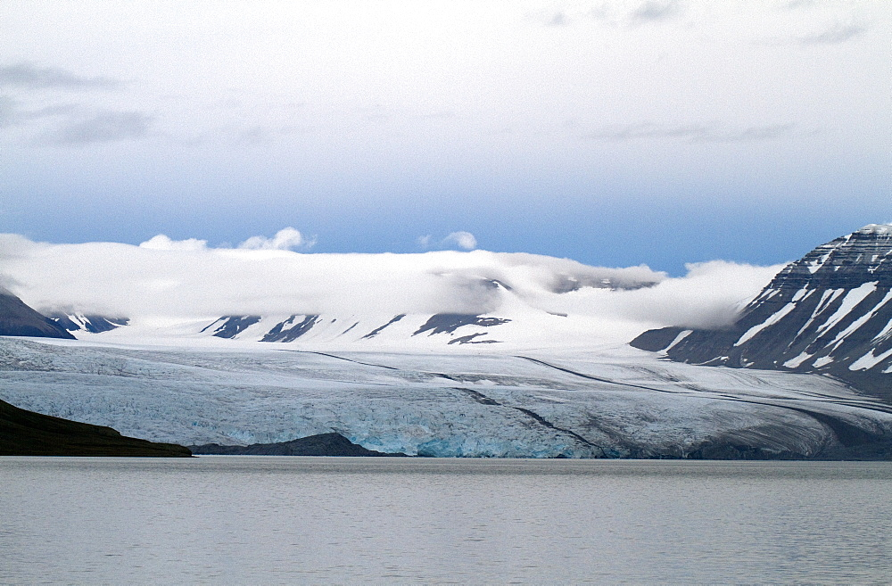
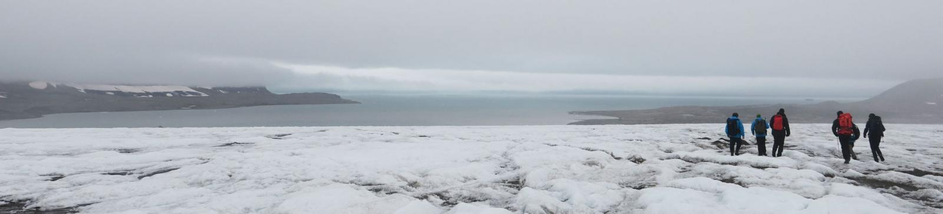

Slide 4
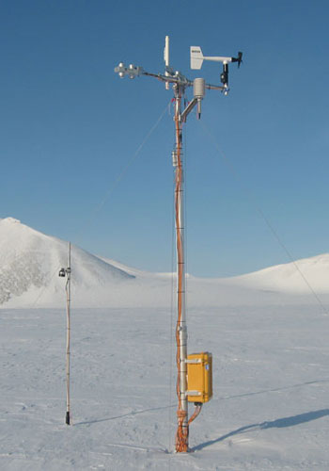
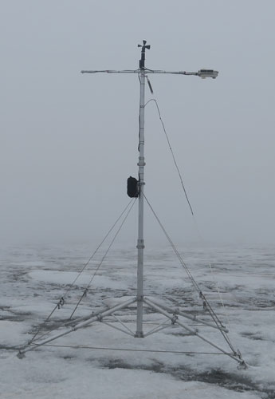
Nordenskiöldbreen
Ulvebreen

Slide 5
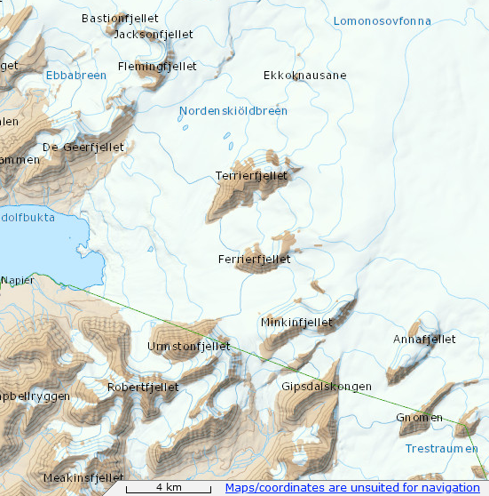

Slide 6
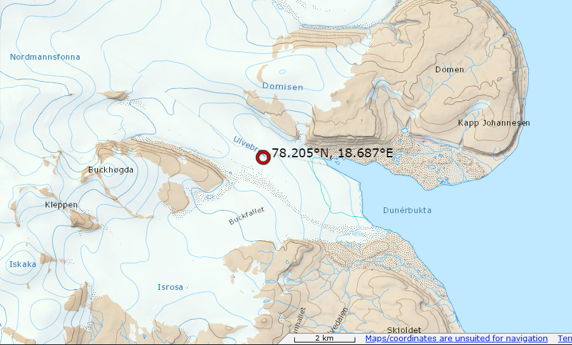

Slide 7
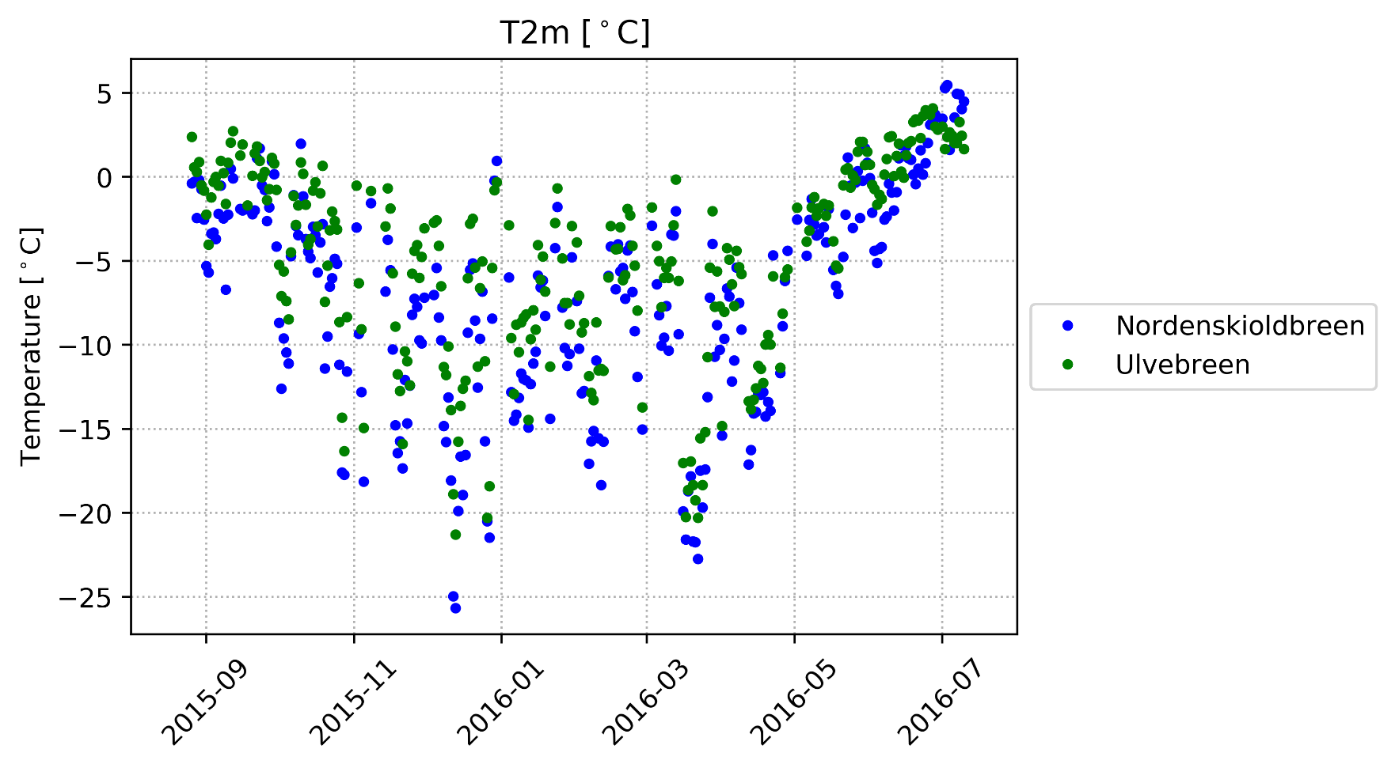
Temperature differences
Notes:
Nordenskioldbreen seems colder than Ulvebreen. This is because the weather station on the nordenskioldbreen is situated at a higher level: 529 m, Ulvebreen: 140m.

Slide 8
Lapse rate
Height difference: 389 m
Lapse rate: 0.6 °C/100m (also used in literature)
Expected T difference: 2.334 °C
Still an unexplained mean difference of -0.22 °C (Ulvebreen colder than expected)
However: no significant difference according to t-test.
(so no effect from east side island)

Slide 9
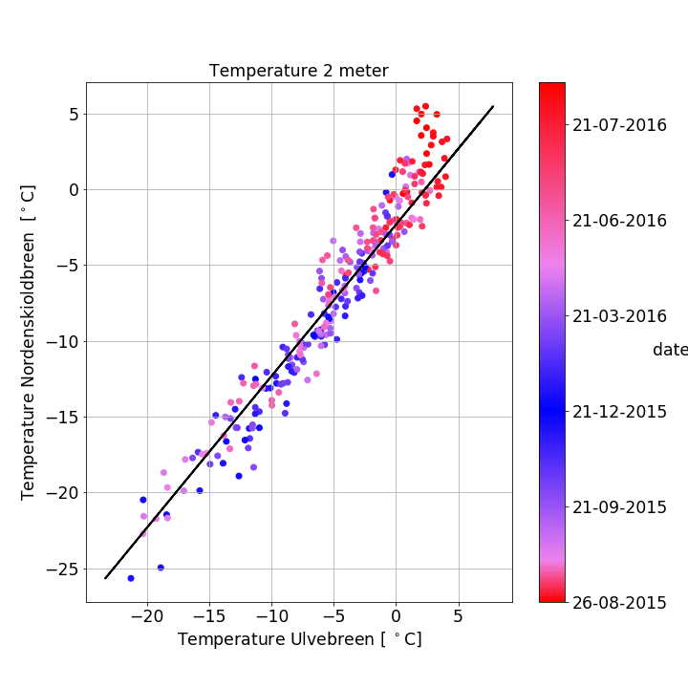
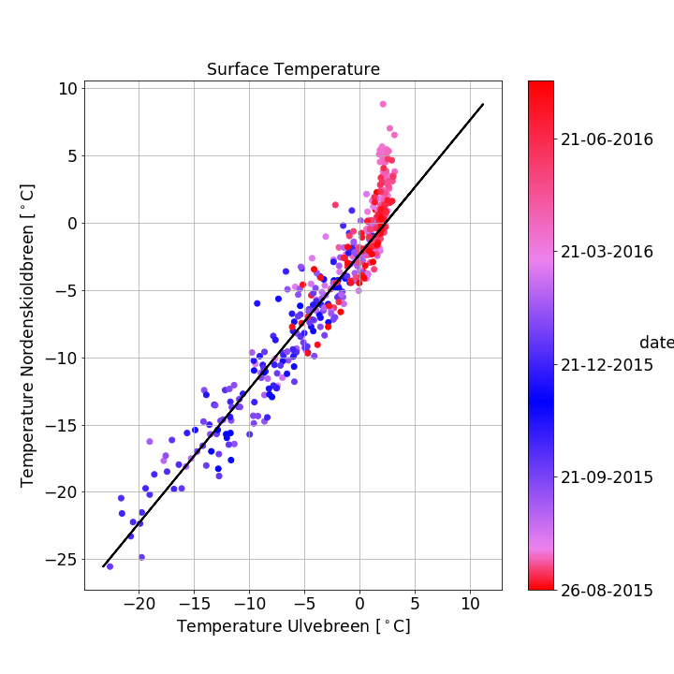
Temperature
Nordenskiöldbreen – 529 m a.s.l.
Ulvebreen – 140 m a.s.l.
529 – 140 = 389 * 0.6 degrees / meter = 2,3 degrees
Notes:
Temperature depended on height of gletsjer. In these plots, temperature at 2 meter height and surface temperature are plotted over time, corresponding to the colorbar. At the x-axis the temperatures at the Ulvebreen are visible and at the y-axis, the temperatures at the Nordeskiolbreen are visible. Looking through the different values at the axis, the Nordenskioldbreen looks colder, because the Nordenskiolbreen is located higher. To correct for this, the lapse rate of 2,334 degrees per meter is added to the data, corresponding to the black line. Taking the correction factor into account, a T-test is done. With a p-value of 0.4, the Nordeskioldbreen is not significant warmer than the Ulvebreen. Afbuigen boven 0 graden? (immers if 0 graden, dan smeltijs)

Slide 10
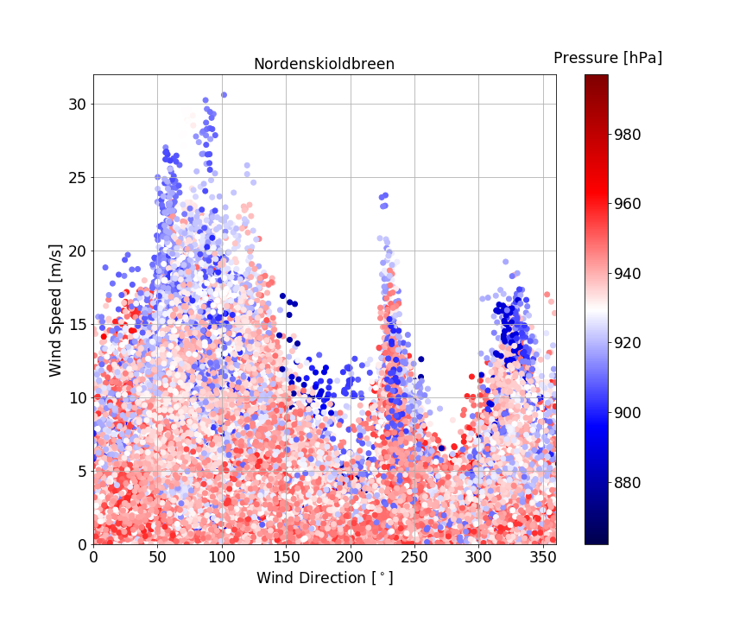
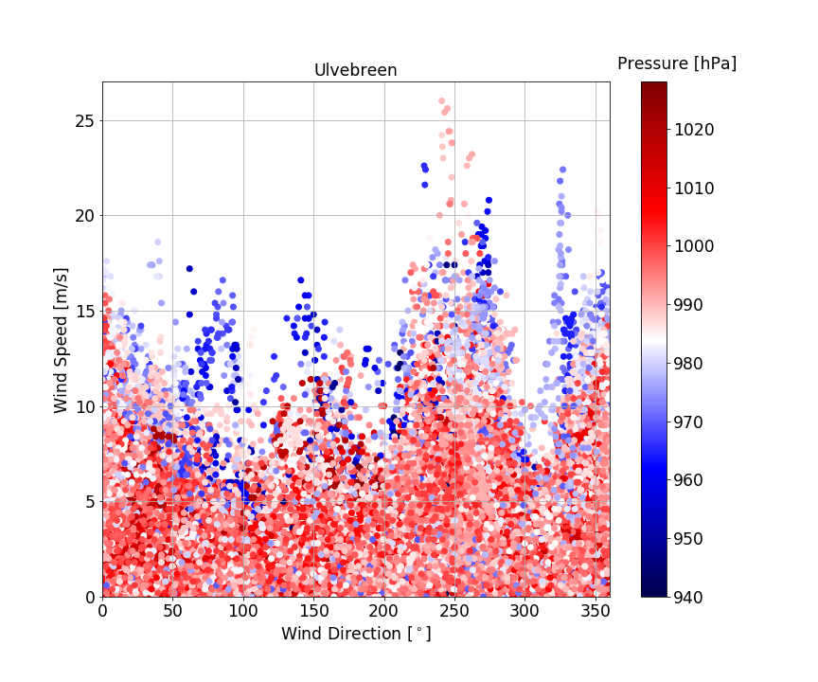
katabatic wind – richting gletsjer
Notes:
The Nordenksioldbreen and Ulvebreen are located in different directions. Plotted are winddirection on x-axis, windspeed at y-axis and colors are corresponding with pressure, as visible at the colorbar. Katabatic winds are clearly visible at the ulvebreen at 250 degrees. Usually the higher the wind speed, the lower the pressure, but an exception is visible for the katabatic wind speed.

Slide 11
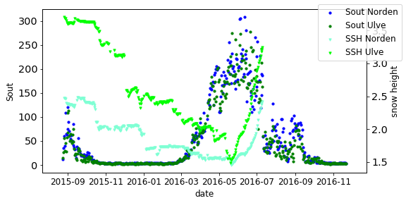
Sout & snow height

Slide 12
PCA Winddir
[[1. 0.11458907 0.37392154]
[0.11458907 1. 0.56317597]
[0.37392154 0.56317597 1. ]]
eigenvalues: [1.73214264+0.j 0.89487026+0.j 0.3729871 +0.j]
Eigenvalue 1 = 1.7321426407196063
Eigenvalue 2 = 0.8948702586896115
Eigenvalue 3 = 0.37298710059078394
Variance of total data:
Eigenvalue 1 = 57.738088023986876
Eigenvalue 2 = 29.829008622987047
Eigenvalue 3 = 12.43290335302613
eigenvectors:
[[-0.43855177 -0.83699375 -0.32728245]
[-0.59006219 0.54284893 -0.5976133 ]
[-0.67786353 0.06896737 0.73194572]]
number 1: -0.4385517669693483 -0.590062185949309 -0.6778635293337335
number 2: -0.836993753714971 0.5428489275313869 0.06896736996685765
number 3: -0.3272824528296397 -0.5976133018857139 0.731945720309279

Slide 13
PCA Windspeed
[[1. 0.62589092 0.63877069]
[0.62589092 1. 0.69326062]
[0.63877069 0.69326062 1. ]]
eigenvalues: [2.30572493+0.j 0.38824158+0.j 0.30603349+0.j]
Eigenvalue 1 = 2.30572492652982
Eigenvalue 2 = 0.3882415812665583
Eigenvalue 3 = 0.3060334922036205
Variance of total data:
Eigenvalue 1 = 76.857497550994
Eigenvalue 2 = 12.941386042218609
Eigenvalue 3 = 10.201116406787351
eigenvectors:
[[ 0.56506437 0.82142899 -0.07717944]
[ 0.58157296 -0.46291829 -0.66893912]
[ 0.58521376 -0.33310818 0.73929953]]
number 1: 0.5650643708906329 0.5815729647028391 0.585213758789661
number 2: 0.8214289931302869 -0.46291829370832854 -0.3331081845213845
number 3: -0.07717944023466546 -0.6689391153736788 0.7392995292357111

Slide 14
PCA T-2m TA
[[1. 0.96744203 0.95924812]
[0.96744203 1. 0.96819833]
[0.95924812 0.96819833 1. ]]
eigenvalues: [2.92993131+0.j 0.04076847+0.j 0.02930022+0.j]
Eigenvalue 1 = 2.929931311987825
Eigenvalue 2 = 0.04076846661638439
Eigenvalue 3 = 0.029300221395791408
Variance of total data:
Eigenvalue 1 = 97.66437706626084
Eigenvalue 2 = 1.358948887212813
Eigenvalue 3 = 0.9766740465263802
eigenvectors:
[[-0.57670524 -0.72222661 0.38183737]
[-0.5784872 0.03098743 -0.81510266]
[-0.57685667 0.69096201 0.43566946]]
number 1: -0.5767052431704728 -0.5784871988297967 -0.5768566748246406
number 2: -0.7222266147466163 0.030987425819239345 0.6909620079228234
number 3: 0.3818373730416173 -0.8151026562532794 0.435669462227415

Slide 15
PCA P luchtdruk
[[1. 0.87833401 0.99169127]
[0.87833401 1. 0.87540947]
[0.99169127 0.87540947 1. ]]
eigenvalues: [2.83138757+0.j 0.00828897+0.j 0.16032346+0.j]
Eigenvalue 1 = 2.8313875658218937
Eigenvalue 2 = 0.16032346392847416
Eigenvalue 3 = 0.008288970249631876
Variance of total data:
Eigenvalue 1 = 94.37958552739646
Eigenvalue 2 = 5.344115464282472
Eigenvalue 3 = 0.2762990083210625
eigenvectors:
[[-0.58579632 -0.71128698 0.38847587]
[-0.56068307 0.00955682 -0.82797534]
[-0.58521549 0.70283675 0.40440492]]
number 1: -0.5857963198528137 -0.5606830721903274 -0.585215485275395
number 2: -0.7112869805196672 0.00955681647707408 0.7028367510325838
number 3: 0.3884758718248986 -0.8279753376870833 0.4044049173685274

