Slide 1


EVOP 2026 Introduction to Linux pt. 1
Dr. Isolde van Riemsdijk
Copenhagen University

Slide 2
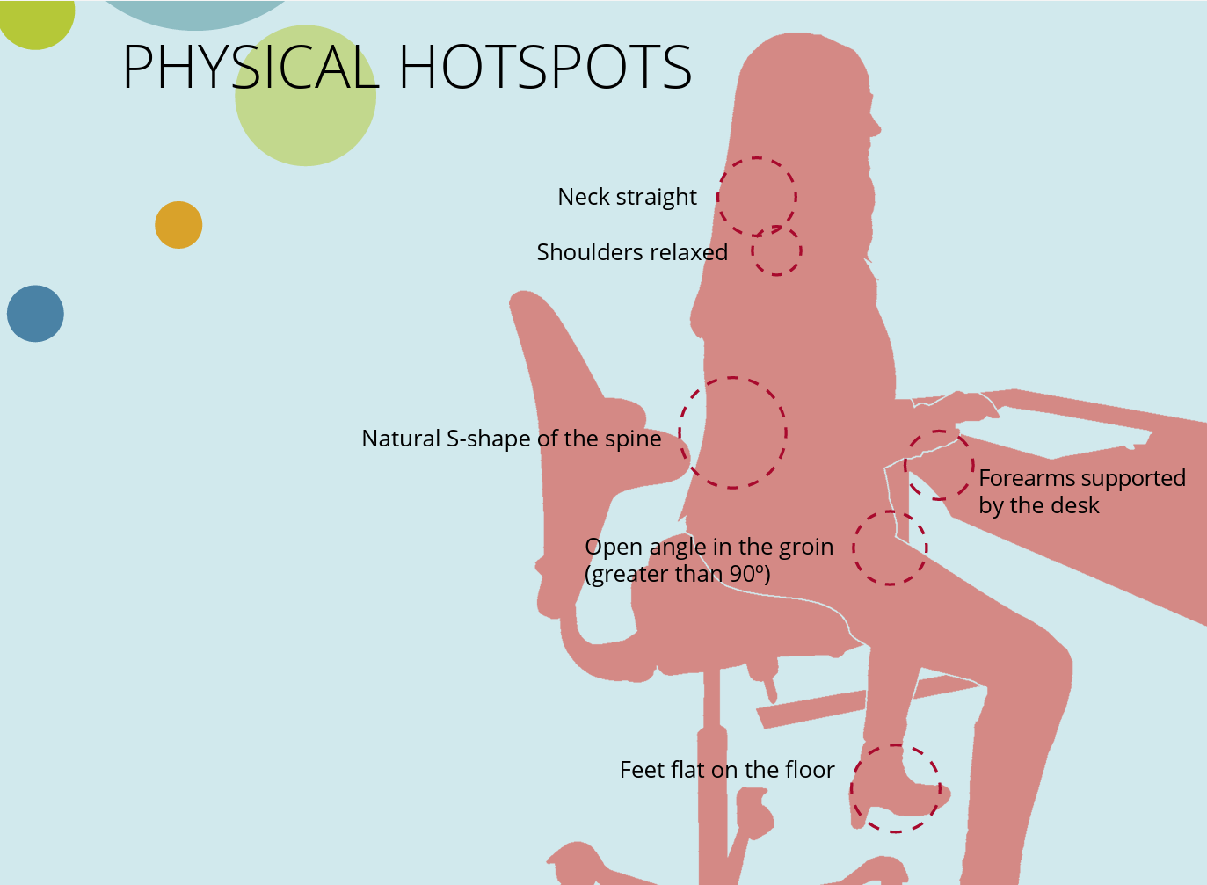
Welcome
Set up your work station
Notes:
Add pictures etc.

Slide 3
Welcome
Set up your work station
Notes:
Add pictures etc.

Slide 4
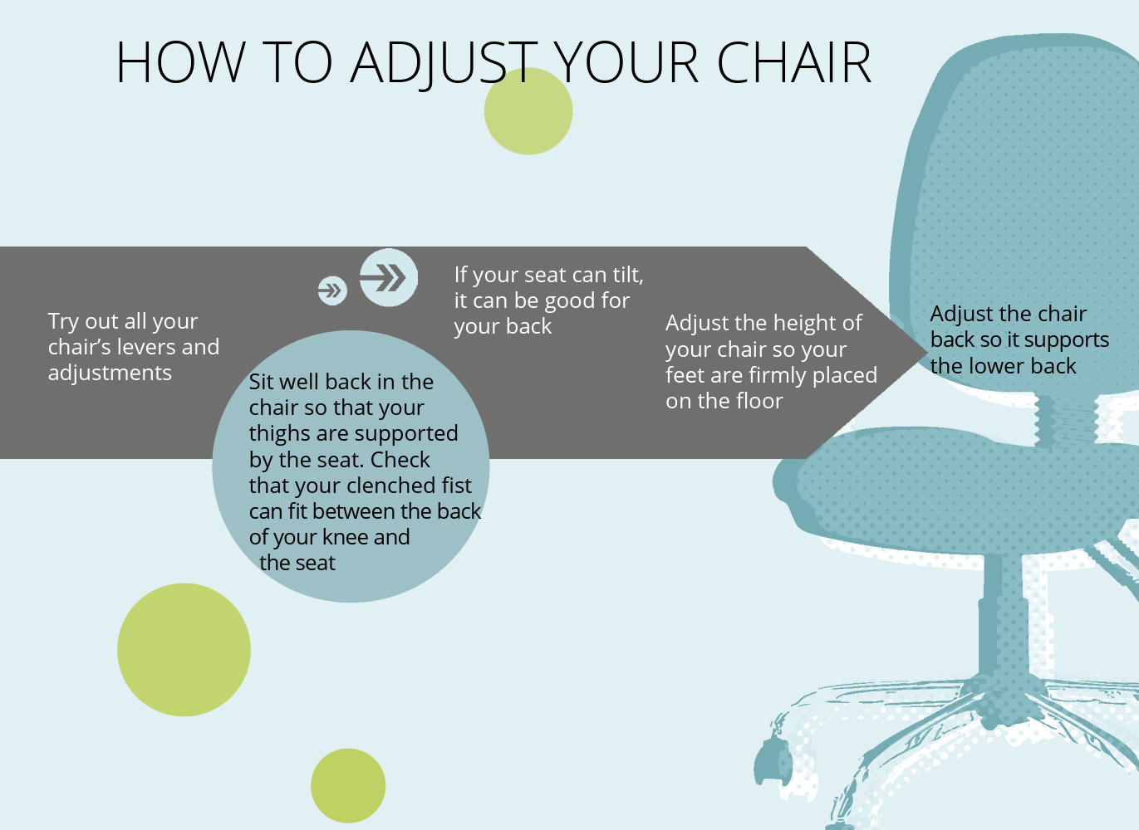
Welcome
Set up your work station
Notes:
Add pictures etc.

Slide 5
Welcome
And keep it tidy!
Notes:
Add pictures etc.

Slide 6

Logistics
Teaching Assistants
Second screen
Sticky notes
Set-up and log into the desktop
Slides are also on: https://github.com/IsoldevR/Linux_Intro_EVOP_2026
Notes:
Add pictures etc.

Slide 7
Introduction of Unix & Terminal
What is Unix?
Operating system
Runs on any computer
Designed for developing software
Sharing of tools
Free UNIX-like variants
Ubuntu, Fedora, Debian
Notes:
Add pictures etc.

Slide 8
Introduction of Unix & Terminal
Philosophy of Unix
String small programms / steps together by pipes
Strung together with pipes: | or >
Pipeline:
Program 1 + file 1 > output 1
Program 1 + file 1 | Program 2 + output 1 | etc.
Notes:
Add pictures etc.

Slide 9
Introduction of Unix & Terminal
Philosophy of Unix
Advantages:
Checks each step
Errors easy to solve
Computationally efficient
Flexible
Updates of programs don‘t break the whole pipeline
Disadvantages:
Requires some coding skills
Good documentation needed for reproducibility
Notes:
Add pictures etc.

Slide 10
Log-in to LOCAL computer & Explore!
We will switch now between this presentation and GitHub
Exercise 0: Log-in to the computer
Exercise 1: Explore the local computer
Notes:
Add pictures etc.

Slide 11
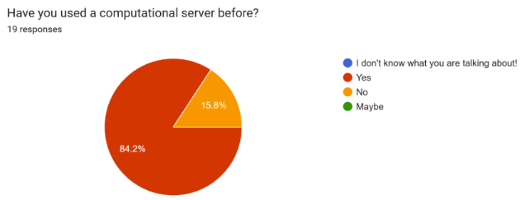
Types of server
Cloud server <> physical server
Server / cluster manager / IT
Notes:
Add pictures etc.

Slide 12
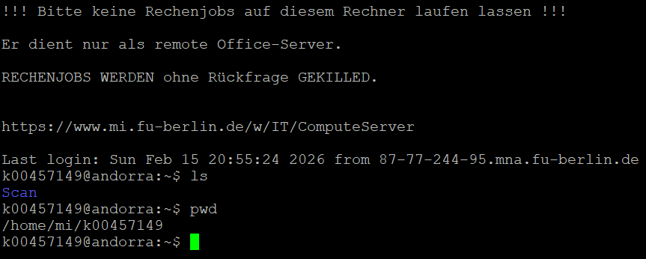
Command line
Notes:
Add pictures etc.

Slide 13
Two words on error reporting
„It doesn‘t work“😭
„I tried program x and it doesn‘t work“😢
„I ran this command with program x and it doesn‘t work“🥲
„I am logged in on the server, loaded the right package, am in the right directory, and this command with program x doesn‘t work, I already checked if I didn‘t make any typo‘s“🥳🥳🥳
Notes:
Add pictures etc.

Slide 14
Nodes, CPU’s and Memory
Node: a single, self-contained within the server. A server can have multiple nodes.
CPU: the „Central Processing Unit“ – does the actual computing (the more CPU‘s, the higher computational speed)
RAM: Random Access Memory (RAM); temporary, high-speed storage where the CPU holds data it is working on. „Active memory“
Notes:
Add pictures etc.

Slide 15
Nodes, CPU’s and Memory
Example!
Laptop:
4+ Core (CPU – but same chip)
RAM 16Gb or 32 GB
Mjolnir server:
24 Nodes
CPU: 56-256
512-2092 GB RAM
Notes:
Add pictures etc.

Slide 16
Nodes, CPU’s and Memory
Log-in nodes … are not computing nodes!
Solutions:
interactive node (example on GitHub)
& job submission
Computing node
Local computer
Internet
Log-in node
Computing node
Etc.
Notes:
Add pictures etc.

Slide 17
Exercise 2: log in to the server
Notes:
Add pictures etc.

Slide 18
Local – internet – Server
Local computer
Internet
Server
Notes:
Add pictures etc.

Slide 19
Local – internet – Screen – Server
Local computer
Internet
SCREEN
Server
Notes:
Add pictures etc.

Slide 20
Exercise 3: Use a screen
Notes:
Add pictures etc.

Slide 21
Files & Folders
We can move files between local and server
What is the folder structure?
Expences of data storage
What can we do?
Zip data
Remove intermediate files
Notes:
Add pictures etc.

Slide 22
Files & Folders
ssh <username>@<remote_host>
scp /path/to/local/file <username>@<remote_host>:/path/to/remote/directory
Notes:
Add pictures etc.

Slide 23
Exercise 4: downloading
Notes:
Add pictures etc.

Slide 24
Wildcards
Using a “*”; it can mean anything e.g.
File_*.fq.gz =
File_1_F.fq.gz
File_1_R.fq.gz
File_2_F.fq.gz
File_2_R.fq.gz
output.txt
File_1_*.fq.gz =
File_1_F.fq.gz
File_1_R.fq.gz
File_2_F.fq.gz
File_2_R.fq.gz
Notes:
Add pictures etc.

Slide 25
Exercise 5.1 More downloading
Notes:
Add pictures etc.

Slide 26
Using keys
Ctrl + C → Cancel a job
Magic “tab” → Fill out the remaining folder or file name
“history” → find back what commands you were running before
“clear” → clear your screen
Notes:
Add pictures etc.

Slide 27
Exercise 5.2 using the “tab”
Notes:
Add pictures etc.

Slide 28
Exercise 5.3 & 5.4
Notes:
Add pictures etc.

Slide 29
Executing commands
User name @ server: ~$ COMMAND
Notes:
Add pictures etc.

Slide 30
Executing commands
Command, parameter (-o), arguments
Notes:
Parameter is defined in a function, program etc, that accepts a value from its’ execution call
Argument is the data in the execution call being sent to the parameter

Slide 31
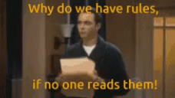
User manual?

Slide 32
User manual?

Slide 33
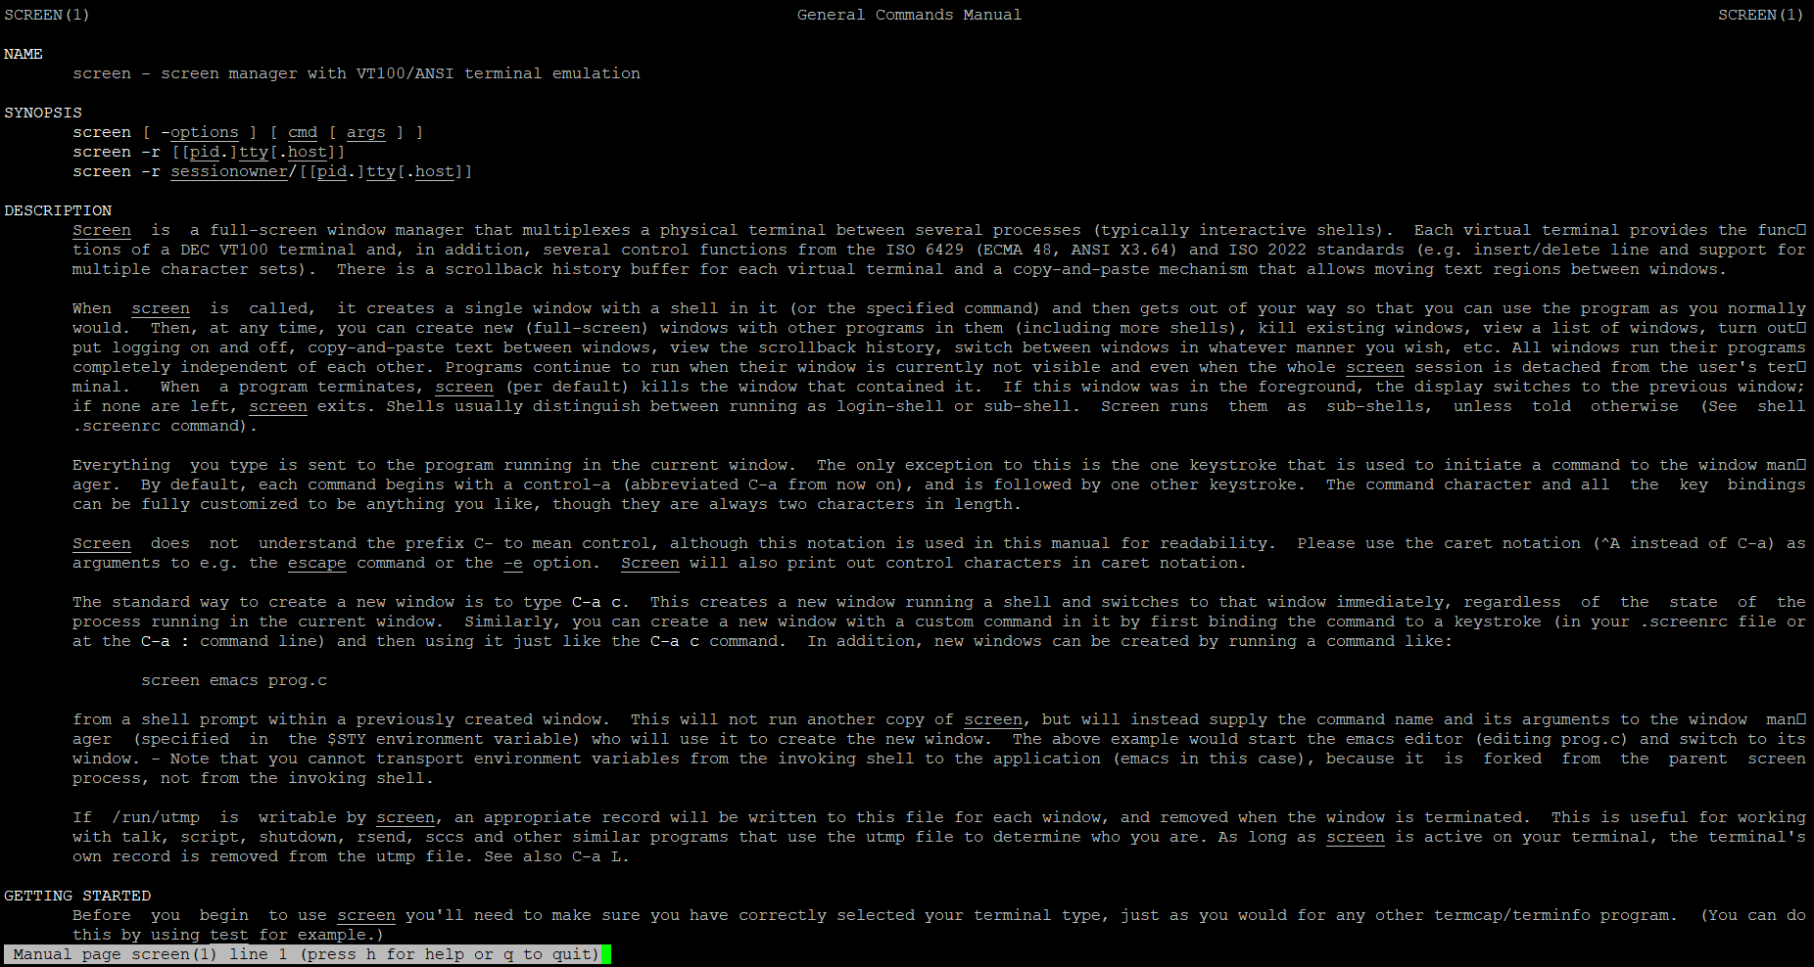
man screen

Slide 34
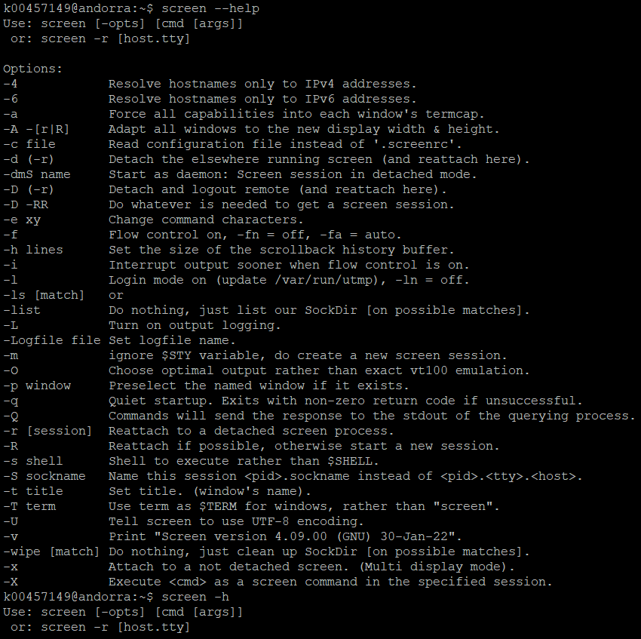
screen -h

Slide 35

Finding which version

Slide 36
Exercise 6

Slide 37
Coffee break

Slide 38



Most used commands
pwd : Print Working Directory
cd : Change Directory
cd ../
cd ~
cd <tab> <tab>
ls : LiSt
mkdir: MaKe DIRectory
mkdir Intro_Unix
Notes:
Explain folders divided by slashes

Slide 39
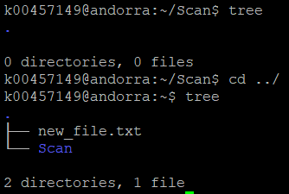
Most used commands
Bonus; “tree”
Notes:
Parameter is defined in a function, program etc, that accepts a value from its’ execution call
Argument is the data in the execution call being sent to the parameter

Slide 40
Exercise 7
Notes:
Parameter is defined in a function, program etc, that accepts a value from its’ execution call
Argument is the data in the execution call being sent to the parameter

Slide 41
More most used commands
mv: MoVe <old file> <same file with new name or location>
cp (scp): CoPy <old file> <copy (new) file>
rm: ReMove <a file> (also possible with directories)
rm * 😭
No bin
get = get <something from the web>
Notes:
Parameter is defined in a function, program etc, that accepts a value from its’ execution call
Argument is the data in the execution call being sent to the parameter

Slide 42
Exercise 8.1
Notes:
Parameter is defined in a function, program etc, that accepts a value from its’ execution call
Argument is the data in the execution call being sent to the parameter

Slide 43
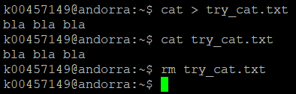
cat
cat: conCATenate
cat file 1
cat file1 file2
cat > file1
<write something>
ctrl + D to close file
Notes:
Parameter is defined in a function, program etc, that accepts a value from its’ execution call
Argument is the data in the execution call being sent to the parameter

Slide 44
Exercise 8.2
Notes:
Parameter is defined in a function, program etc, that accepts a value from its’ execution call
Argument is the data in the execution call being sent to the parameter

Slide 45
Even more “most used” commands
tar ; for tar.gz files! “tarball” archive with multiple files and folders. Tar doesn’t do compression
gzip ; for .gz files! a single file
unzip ; for .zip files! Zip archive can contain multiple files / folders. Zip does compression

Slide 46
Even more “most used” commands
more: view a file and only scroll forwards
less: view a file and scroll back and forth
most: supports multiple files
Notes:
Parameter is defined in a function, program etc, that accepts a value from its’ execution call
Argument is the data in the execution call being sent to the parameter

Slide 47
Exercise 9.1
Notes:
Parameter is defined in a function, program etc, that accepts a value from its’ execution call
Argument is the data in the execution call being sent to the parameter

Slide 48
Even more “most used” commands
head: prints the first 10 lines of a file
tail: prints the last 10 lines of a file
Notes:
Parameter is defined in a function, program etc, that accepts a value from its’ execution call
Argument is the data in the execution call being sent to the parameter

Slide 49
Exercise 9.2 & 9.3
Notes:
Parameter is defined in a function, program etc, that accepts a value from its’ execution call
Argument is the data in the execution call being sent to the parameter

Slide 50

Even more “most used” commands
clear: clears your terminal screen
exit: leave the connection or screen or interactive node
Notes:
Parameter is defined in a function, program etc, that accepts a value from its’ execution call
Argument is the data in the execution call being sent to the parameter

Slide 51
Searching in files
grep <pattern> <file>
pattern can be anything:
“hello”
“GENE_12”
“ACTG”
Good practice to use “”
There are many options; case sensitive, start line, end line … !

Slide 52
Exercise 10 (and extra)
Notes:
Parameter is defined in a function, program etc, that accepts a value from its’ execution call
Argument is the data in the execution call being sent to the parameter

Slide 53
Searching in files like a PRO
awk <filters> <file name>
For tabular files
It recognizes columns (Goodbye Excel!!)
You can indicate which column you want to search in with the “$”
E.g. $3 is the third column.
You can also calculate new numbers, e.g. $3-$2 !
Notes:
Parameter is defined in a function, program etc, that accepts a value from its’ execution call
Argument is the data in the execution call being sent to the parameter

Slide 54
Exercise 11 (and extra)
Notes:
Parameter is defined in a function, program etc, that accepts a value from its’ execution call
Argument is the data in the execution call being sent to the parameter

Slide 55
Working on zipped files
zcat
zgrep
Notes:
Parameter is defined in a function, program etc, that accepts a value from its’ execution call
Argument is the data in the execution call being sent to the parameter

Slide 56
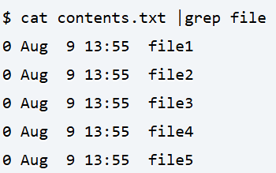
Piping
Command 1 file 1 > output
Directs the output of command 1 into
Command file 1 | command 2 output
…

Slide 57
Exercise 12
Notes:
Parameter is defined in a function, program etc, that accepts a value from its’ execution call
Argument is the data in the execution call being sent to the parameter

Slide 58
LUNCH BREAK!
Notes:
Parameter is defined in a function, program etc, that accepts a value from its’ execution call
Argument is the data in the execution call being sent to the parameter

Slide 59
THIS SLIDE GOES AFTER SCRIPTS
Task: you want to automise downloading your reads (e.g. wget), doing a quality check on them (fastqc) and cleaning them (fastp)
How would you structure the script(s) for this task?
Notes:
Add pictures etc.

