Slide 1


EVOP 2026 Introduction to Linux Pt. 2
Dr. Isolde van Riemsdijk
Copenhagen University

Slide 2

Moving from commands to scripts!
Notes:
Add pictures etc.

Slide 3
Regular expressions & repeating
And: &&
Or: ||
e.g. in grep or awk!
Notes:
Add pictures etc.

Slide 4
Exercise 13
Notes:
Parameter is defined in a function, program etc, that accepts a value from its’ execution call
Argument is the data in the execution call being sent to the parameter

Slide 5
Editing a file
Different file viewer programs (e.g. notepad-like):
nano
vim
vi
emacs
Notes:
Add pictures etc.

Slide 6
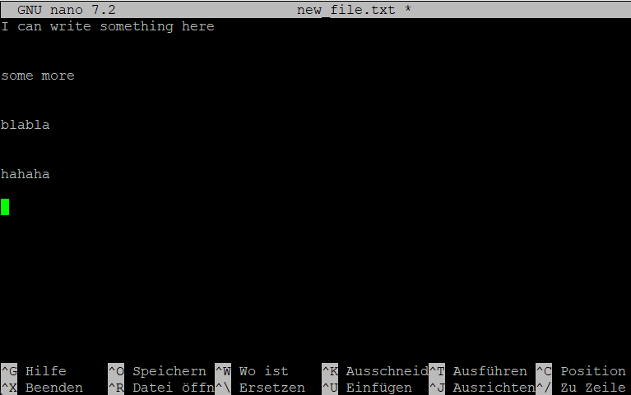
Editing a file
Notes:
The ^ stands for ctrl

Slide 7
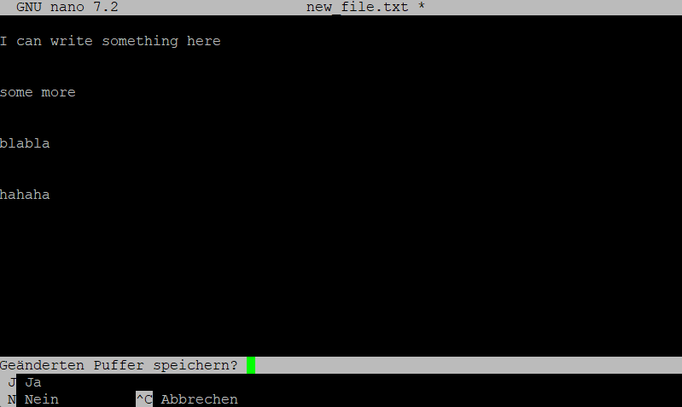
Editing a file
Notes:
The ^ stands for ctrl

Slide 8
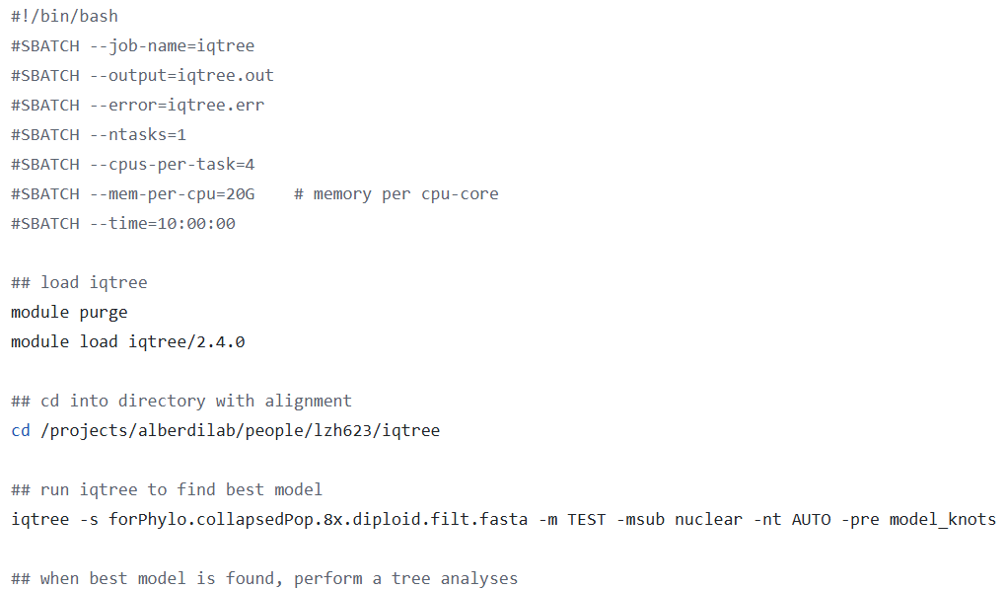
A script (.sh)

Slide 9
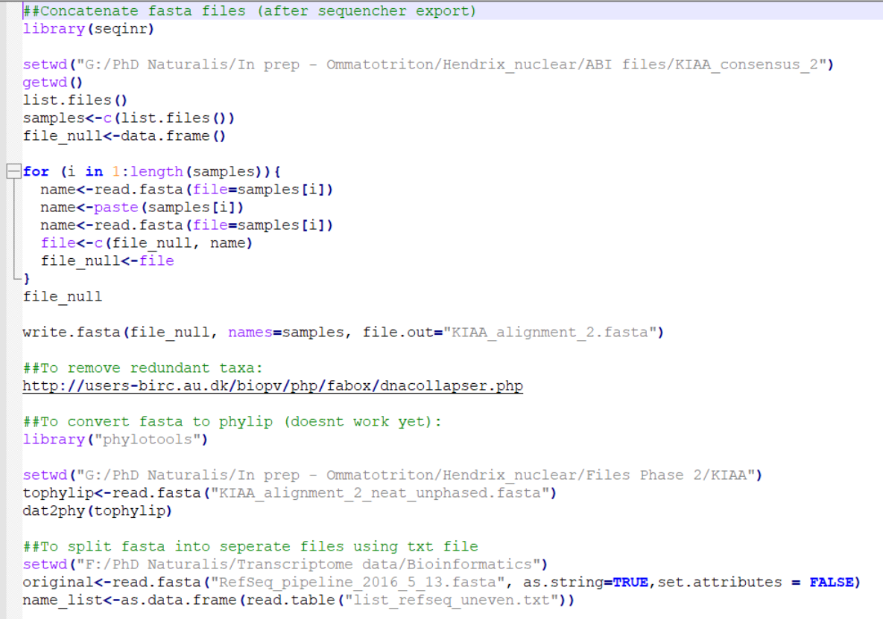
A bad script (.R) – myself 8 years ago :P

Slide 10
Using a Unix philosophy …
Task: you want to automise downloading your reads (e.g. wget), doing a quality check on them (fastqc) and cleaning them (fastp)
How would you structure the script(s) for this task?
Notes:
Add pictures etc.

Slide 11
Exercise 14
Notes:
Parameter is defined in a function, program etc, that accepts a value from its’ execution call
Argument is the data in the execution call being sent to the parameter

Slide 12
Coffee break! (probably)
Notes:
Parameter is defined in a function, program etc, that accepts a value from its’ execution call
Argument is the data in the execution call being sent to the parameter

Slide 13
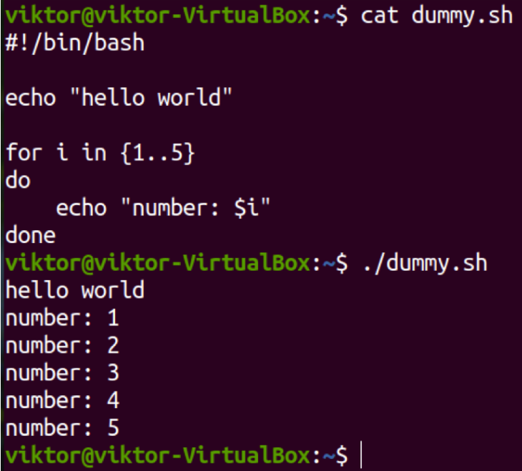
More concepts
A loop: you want to do something for each (set of) variables
From: https://linuxhint.com/bash-for-loop-one-line/
Notes:
Add pictures etc.

Slide 14
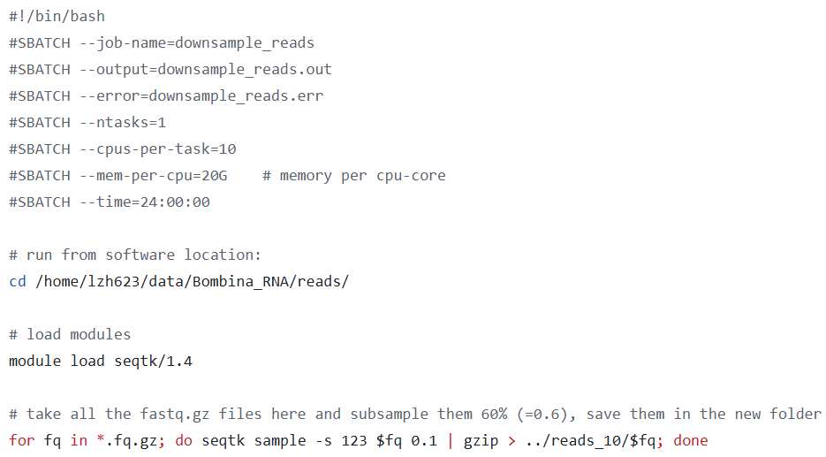
More concepts
A loop: you want to do something for each (set of) files
Notes:
Add pictures etc.

Slide 15
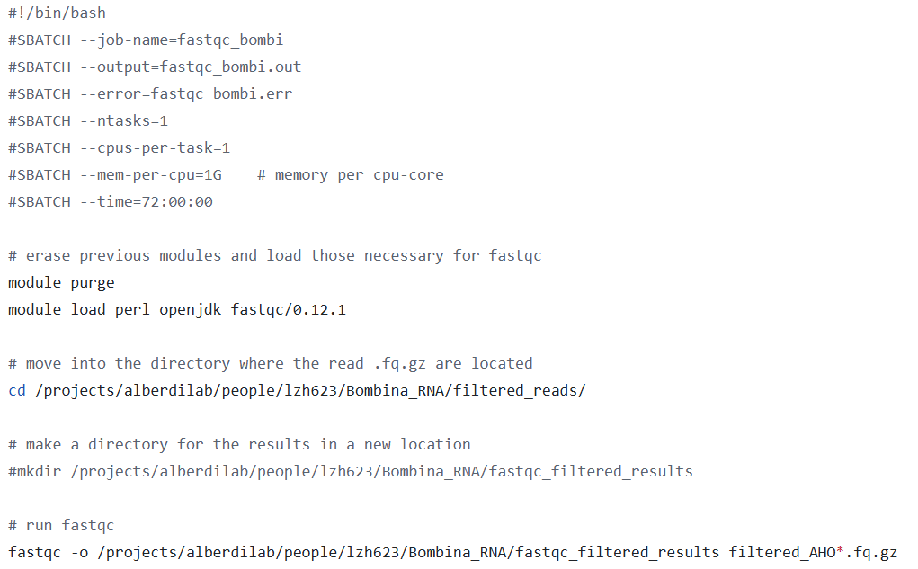
More concepts
A loop: you want to do something for each (set of) files
Notes:
Add pictures etc.

Slide 16
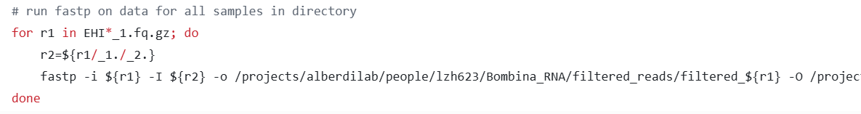
More concepts
A loop: you want to do something for each set of files
Notes:
Add pictures etc.

Slide 17
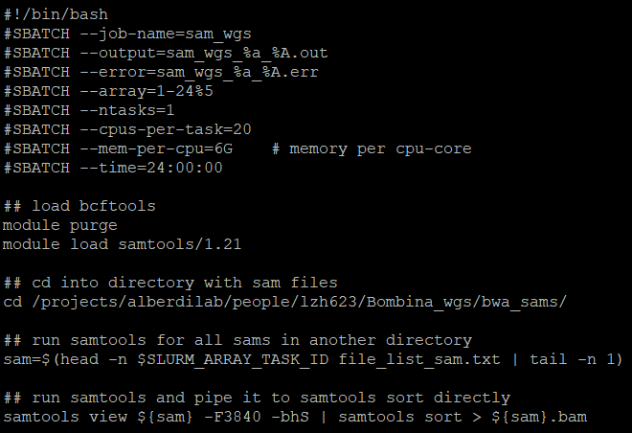
More concepts
An array (just for fun)
Notes:
Add pictures etc.

Slide 18
Exercise 15
Notes:
Parameter is defined in a function, program etc, that accepts a value from its’ execution call
Argument is the data in the execution call being sent to the parameter

Slide 19
The Advanced Stuff
Environments
Conda
Pipelines / snakemake /….
Containers / images / etc.
Notes:
Add pictures etc.

Slide 20
RECAP
Notes:
Parameter is defined in a function, program etc, that accepts a value from its’ execution call
Argument is the data in the execution call being sent to the parameter

Slide 21
Extra exercises!
Notes:
Parameter is defined in a function, program etc, that accepts a value from its’ execution call
Argument is the data in the execution call being sent to the parameter

