Slide 1
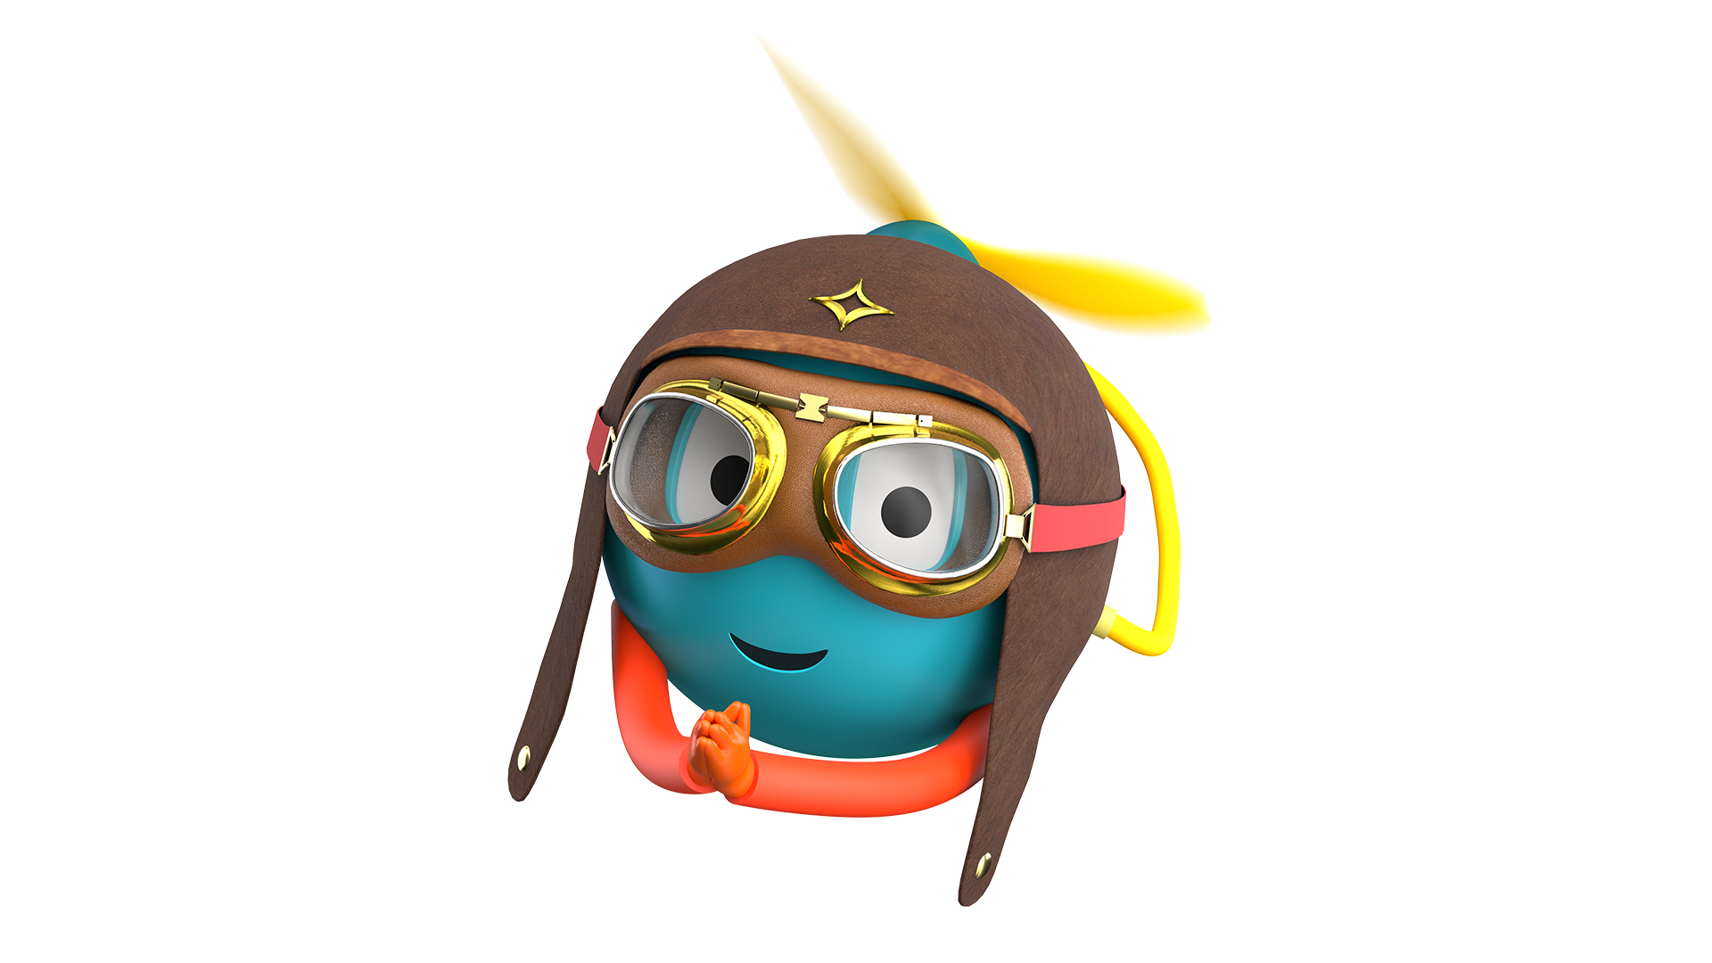
AURA- Adaptive Universal
Reality ASSISTANT
UiPath
CaseProof AI
A UiPath Maestro case gate for high-value refund exceptions. It checks evidence, milestones, policy, and action safety before human review.
A multimodal AI accessibility platform that combines computer vision, conversational AI, document intelligence, and intelligent automation to simplify everyday life for people with disabilities.

Slide 2
Problem statement and proposed solution
Problem statement and proposed solution
UiPath
Problem
Solution
Problem
Solution
AURA is an AI-powered accessibility companion that combines multimodal AI with UiPath intelligent automation to help people with disabilities navigate, understand, and automate everyday tasks . It is more than a typical AI assistant it’s like an intelligent accessibility companion that helps users move around, make sense of information, and finish daily activities with more confidence. and, honestly, more independence too.
People with disabilities often deal with unnecessary barriers when they’re using digital services, government portals, and regular everyday places. While a lot of accessibility tools solve one little thing at a time, very few actually give a unified experience, one that can “read” what the person is seeing around them, explain complicated stuff, and also automate tasks in the real world.
AI can prepare a refund exception case quickly, but a prepared case can still miss evidence, skip a milestone, bypass policy, or route a high-value refund too early.
CaseProof validates a synthetic Maestro case packet and returns HOLD, BLOCK, or ALLOW_HUMAN_REVIEW_ONLY. It never issues refunds or changes customer records.

Slide 3
Benefits and technologies used
Benefits and technologies used
UiPath
Benefits, impact and outcomes
End-user​ | People with disabilities,Senior citizens,Government service applicants
User department​ | Government Citizen Service Centers,Disability Support Organizations,NGOs
Industries​ | Accessibility,Public Services,Government,Healthcare
UiPath products used​ | UiPath Studio - UiPath Agent Builder - UiPath Maestro
Other - integrations / APIs / technologies used​ | React - TypeScript - Vite - Tailwind CSS - Node.js - Express.js
Benefits, impact, and outcomes
UiPath components and agent type
Reduces the complexity of government paperwork through AI-guided assistance.
Enables users to understand official documents using AI-powered document intelligence.
Minimizes repetitive form filling with reusable user profiles and automation.
Improves accessibility by combining voice, vision, and document understanding in a single platform. .
Prevents unsafe case movement before evidence and milestones are complete.
Makes refund exception review auditable and bounded.
Keeps the strongest action at human review, not automatic approval.
UiPath Components:
Automation Cloud, Maestro case model, Studio Web or API Workflow handoff, optional Apps/Action Center style human review, coded Python validator, synthetic Maestro case packets.
Agent Type:
Coded Agent validator plus low-code Maestro/API workflow integration path.

Slide 4
Solution architecture
Solution architecture
UiPath
"See complete architecture and screenshots in our GitHub repository:"
GitHub Repo: https://github.com/nisithaa-03/AURA-.git
Flow: Maestro case packet -> evidence and milestone check -> CaseProof validator -> HOLD / BLOCK / ALLOW_HUMAN_REVIEW_ONLY -> human case review.
GitHub: https://github.com/Isometric-Architect/caseproof-ai-agenthack
Demo: https://youtu.be/N25lvoKJjug
Boundary: the app prepares evidence for review. It does not approve, merge, deploy, issue refunds, or update customer records.

Slide 5
UiPath
CaseProof AI: review only
Claim boundary: CaseProof is a public-safe hackathon prototype. It does not issue refunds, settle claims, update records, or replace human review.
Submitted to UiPath AgentHack 2026

