Slide 1
CaseProof AI
A human-review gate for high-value refund exception cases.
Agents can prepare refund cases, but preparation is not approval.
CaseProof checks evidence, policy, required milestones, and review routing.
The only allowed outcome is a human review task.

Slide 2
Problem
A refund case can look complete while delivery proof or a customer statement is missing.
An agent can skip policy or risk review.
A high-value refund can be routed as if it were low risk.

Slide 3
What It Checks
Required evidence is present and referenced.
The decision belongs to the same case.
Required Maestro case milestones are present.
Policy caps route risky cases to human review.

Slide 4
Demo Outcomes
HOLD: refund evidence is missing.
ALLOW_HUMAN_REVIEW_ONLY: ready for a person.
BLOCK: policy bypass or skipped milestone.
Auto-approval remains disabled.

Slide 5
UiPath Fit
UiPath Maestro is the orchestration layer.
Studio Web or API Workflow can call the validator.
The result opens a review task instead of taking an external action.
Public repo uses synthetic packets only.

Slide 6
Claim Boundary
This is a public-safe hackathon prototype.
It is not production approval or compliance certification.
A real tenant run should bind case URL, process instance, and review task.

Slide 7
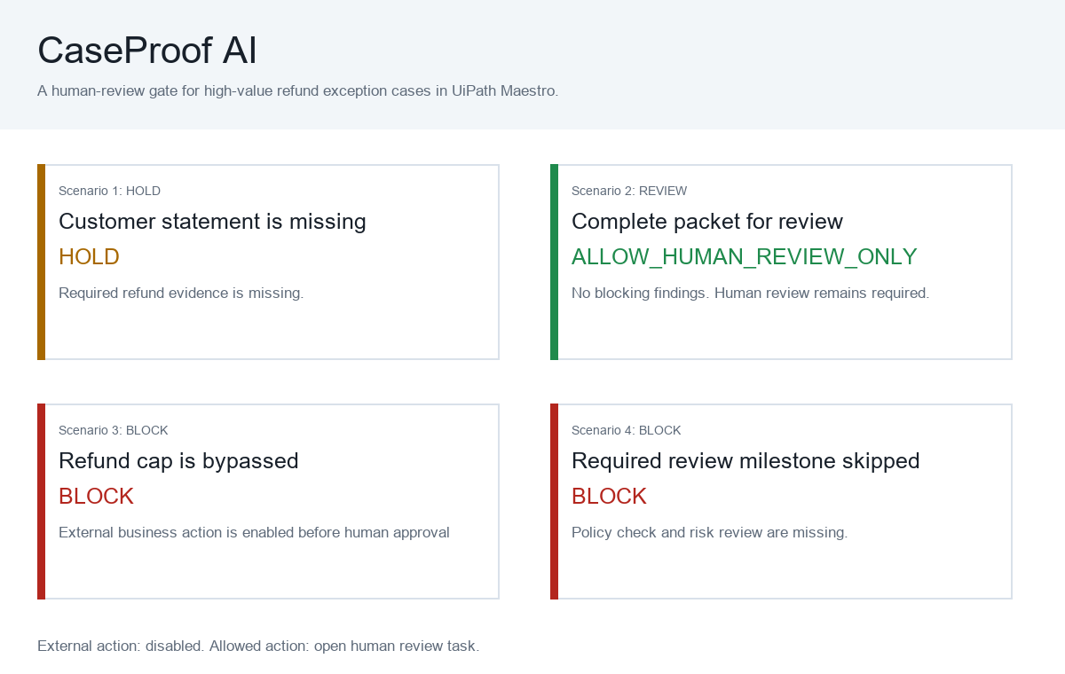
Demo Dashboard

