Slide 1
Course Introduction
Prof. Salvatore Orlando - DAIS, Campus Scientifico – orlando@unive.it

Slide 2
Website
e-learning platform:
http://moodle.unive.it/
The name of the course is: ET4018
You can access the platform by using the credentials of your personal area.
To enroll in the course, a keyword is requested: introcod
The information available on the moodle website are:
Lecture notes
News, Forum
Exam results
…

Slide 3
Office hours
Make an appointment by email (orlando@unive.it)
DAIS, Campus Scientifico, Zeta Building
Via Torino 155
Mestre Venezia
Room Zeta-B09
Wed afternoon (if compatible with the professor’s schedule)

Slide 4
Textbooks and other materials
Think Python. How to Think Like a Computer Scientist (2e). Allen Downey. Green Tea Press.
http://greenteapress.com/thinkpython2/thinkpython2.pdf
The interactive version of the same book: https://runestone.academy/runestone/static/thinkcspy/index.html
(interactive) lecture notes.

Slide 5
Course contents
A very small introduction on computer fundamentals:
How computers store and transmit data
How computer hardware and software operate on data
How humans use computers to solve problems
The main topics of the course include
notion of computation and problem solving
the Python3 language
simple algorithms and data structures
development of funny software
If we have time, some topics regarding history of computer science, and social/ethic issues in computing.

Slide 6
Software for coding in Python3
During the course, we will use several tools
Install Anaconda Navigator and Anaconda Prompt on your computer:
https://www.anaconda.com/download/
Install Python 3.6 version (64 bit)
Instructions:
https://docs.anaconda.com/anaconda/install/windows (Windows)
https://docs.anaconda.com/anaconda/install/mac-os#macos-graphical-install (Mac-OS)
Install also a text editor for coding
The multi-platform Atom (http://atom.io)
Notepad++, only for Windows (http://notepad-plus-plus.org)
Repl.it provides a cloud coding environment (to write code stored and run on remote computer systems)
https://repl.it/languages/python3

Slide 7
Exam
The exam will be written and organized into two parts:
The first brief one is concerned with a set of open questions, aiming at testing the proficiency of the student with respect to the various topics of the course, and the specific technical terminology
The second part of the exam is related to the skill assessment, through the solution of exercises on the course subjects, in particular by solving small problems by coding

Slide 8
A Very Short Introduction to Computer Science
Minor: COMPUTER AND DATA SCIENCE
INTRODUZIONE ALLA PROGRAMMAZIONE [NS001A]
Prof. Salvatore Orlando - DAIS, Campus Scientifico – orlando@unive.it

Slide 9
Study Computer Science to Think Computationally
Computer science is having a revolutionary impact on scientific research and discovery.
Simply put, it is nearly impossible to do scholarly research in any scientific or engineering discipline without an ability to think computationally.
The impact of computing extends far beyond science, however, affecting all aspects of our lives. To flourish in today's world, everyone needs computational thinking

Slide 10
Computing systems A dynamic entity that interacts with its environment
Hardware The physical elements of a computing system (printer, circuit boards, wires, keyboard…)
Software The programs that provide the instructions for a computer to execute
Information/Data that the computing system manages

Slide 11
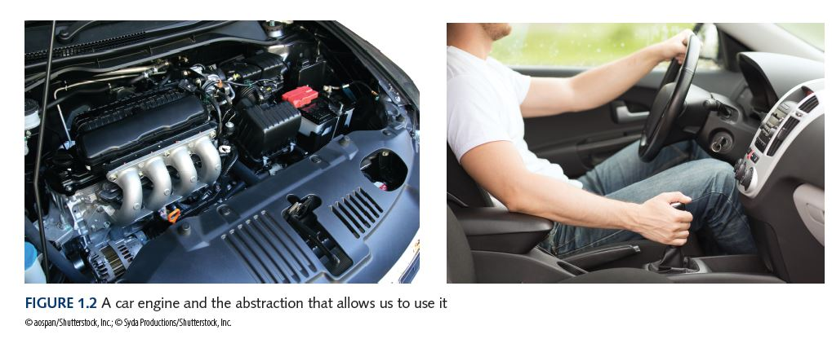
Understanding a computing system by abstraction
Abstraction A mental model that removes complex details
Computing system are complex, and some some kind of abstract models are needed to understand and manage them.
The six layers of computing system is an abstract model

Slide 12
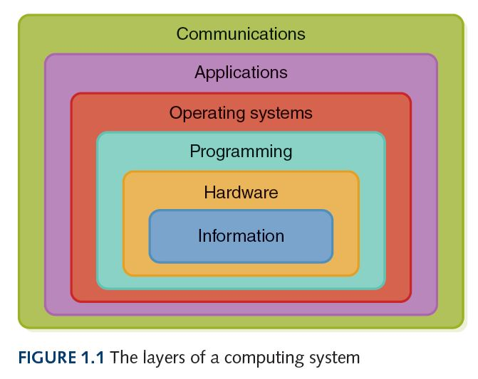
Layers of a computing system
Information have to be represented and stored in a computer to be managed and elaborated
All the information, numbers, texts, photos, audio, video, Web pages, etc. are all represented using binary digits 0 and 1

Slide 13
Layers of a computing system
Computer hardware includes electronic circuits and gates, which control the flow of electricity
The main hardware components are the Central Processing Units (CPU), the memory (volatile and stable), the peripherals for input/output (keyboard, screen, network)

Slide 14
Layers of a computing system
This layer deal with software, the instructions that the system executes to accomplish computations and manage data.
Learning how to program or code is the main goal of this course.
Coding can be done at various levels, from a low level very close to the hardware (assembly), to higher levels, much easier for humans (Python, Java, C, etc.)

Slide 15
Layers of a computing system
Every computer has an operating system (OS) to help manage the computing system’s resources
Microsoft Windows 10, Mac OS, Linus, Android, etc.

Slide 16
Layers of a computing system
Computing systems users run application programs to perform real-world problems, for example - write a text document, draw a picture or play a game.
Every program you run on your computer’s operating system is an application program that help you to reach you goals or solve a certain problem.

Slide 17
Layers of a computing system
Communication layer is a layer where two computer system can operate and exchange date.
Computers are connected into a networks to share information and resources.
We use internet to exchange data, access the Web, or simply chat.

Slide 18
Information layer

Slide 19
Data rapresentation
Computers are multimedia devices, dealing with a vast array of information categories
Computers store, present, and help us modify
Numbers
Text
Audio
Images and graphics
Video
All information is stored as patterns of binary digits (bits): 0 or 1
Why a binary alphabet?
Will be clear in a while

Slide 20
Analog vs. Digital Information
Computers are finite!
How do we represent an infinite world?
We represent enough of the world to satisfy our computational needs and our senses of sight and sound
Two possible way to represents data
Analog: A continuous representation, analogous to the actual information it represents
Digital data: A discrete representation, breaking the information up into separate elements

Slide 21
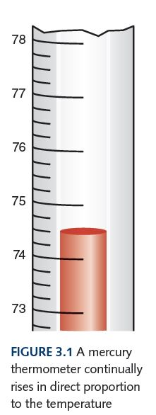
Analog vs. Digital Information
Computers cannot work well with analog continuous data, so we digitize the data
Discretization: Read an analog signal at regular time intervals (frequency), sampling the value of the signal at the point.
Quantization: Sampled values (samples) are rounded to a fixed set of numbers
Computers store (an transmit) units called binary digits or bits
A digital signal thus becomes
a sequence of discrete numbers, in turn represented as binary patterns of fixed length
A mercury thermometer
is an analog device
Actually, we have a continuous
quantity (temperature)
which is measured
continuously along the time (another continuous value)
Low Voltage = 0
High Voltage = 1

Slide 22
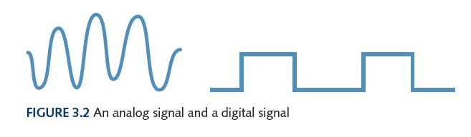
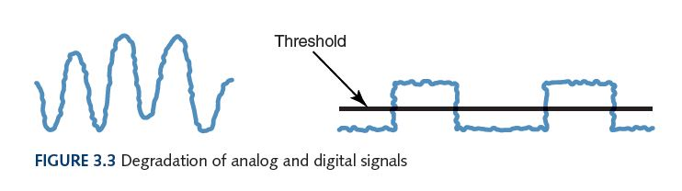
Electronic signals used to store (discrete) values
Important facts about electronic signals
An analog signal continually fluctuates in voltage up and down
A digital signal, if we use binary numbers, has only a high state or a low state, corresponding to the two binary digits 0/1
All the electronic signals (both analog and digital) degrade as they move down a wire. The voltage of the signal fluctuates due to environmental effects.
Digital signals can be easily reshaped, and are less error-prone than analog signals.

Slide 23
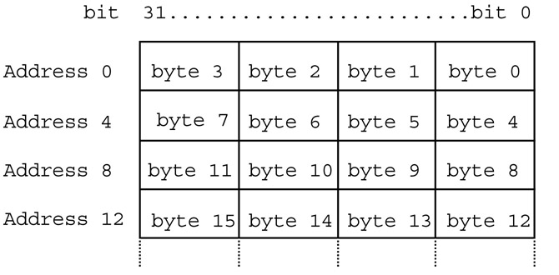
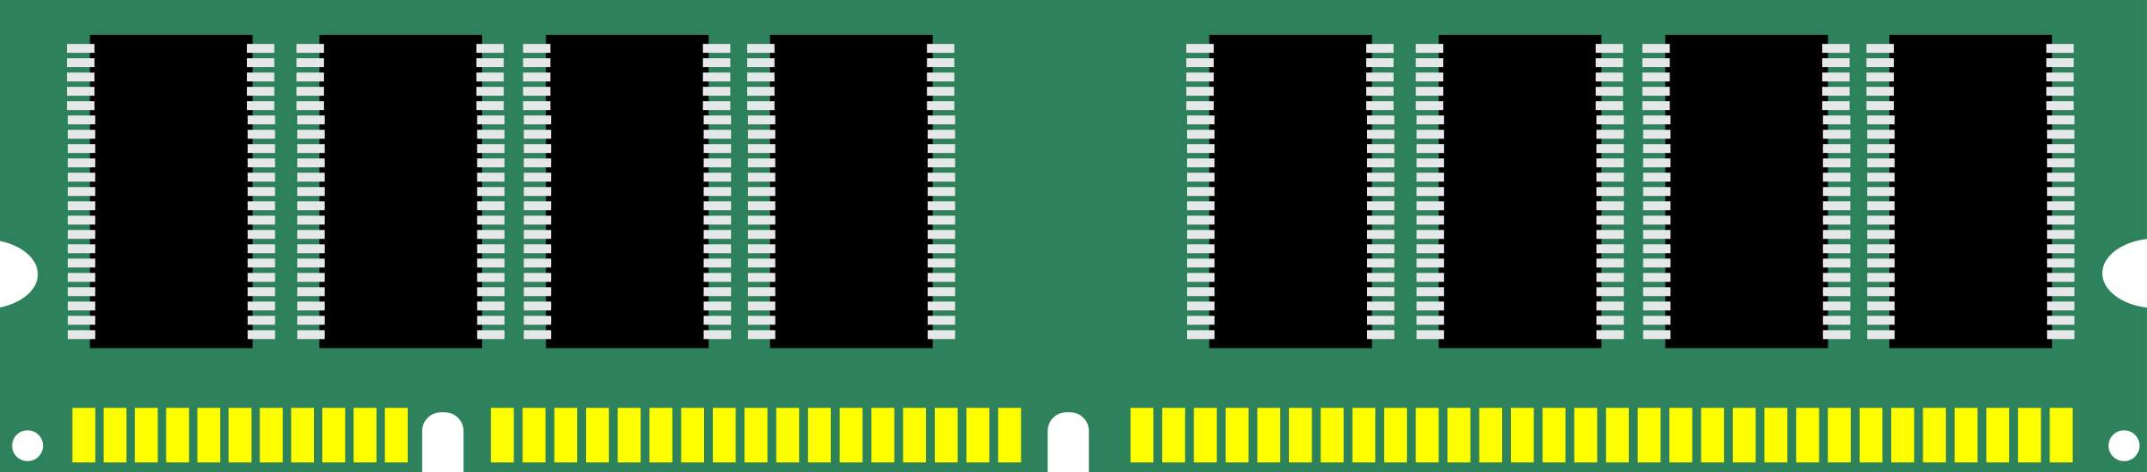
Binary numbers and computers
Low Voltage = 0
High Voltage = 1
Computers have storage units called binary digits or bits
Computer memory stores digital information as multiple of bytes, where a byte is composed of 8 bits = 2³ bits
A volatile memory to store data with byte and word addresses:

Slide 24
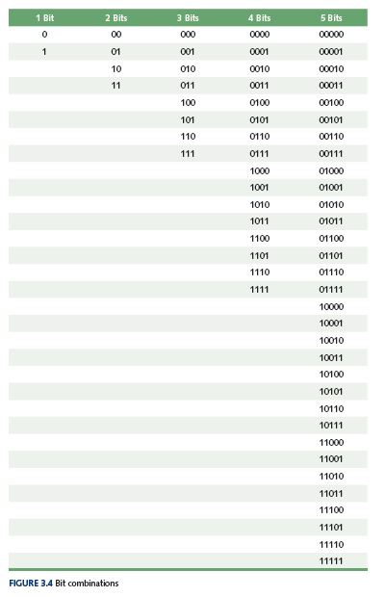
Binary representation
How many things can n bits represent?
With 1 bits: 2¹ things
By doubling the bits, that is 2 bits: 2² things
In general, with n bits we thus represent: 2^{n} things

Slide 25
Example to represent 7 things (days of a week)
To represent 7 distinct items we need at least 3 bits
3 bits, by which we can represent 2³ = 8 distinct objects, is the minimum number of bits we can use
000 Mon
001 Tue
010 Wed
011 Thu
100 Fri
101 Sat
110 Sun
111 Non used
Mon Tue Wed
Thu
Fri Sat Sun
Mon Tue Wed
Thu
Fri Sat Sun
Mon Tue Wed
Thu
Fri Sat Sun
000
0
00
001
01
010
011
10
100
1
101
11
110
111
1-BIT code
Only 2 groups
2-BIT code
Only 4 groups
3-BIT code
8 groups

Slide 26
Representing text
Fortunately the number of characters to represent is finite (whew!), so list them all and assign each a binary string
Character set
A list of characters and the codes used to represent each one.
Computer manufacturers agreed to standardize
ASCII character set
American Standard Code for Information Interchange
7 bits version allows 128 unique characters

Slide 27
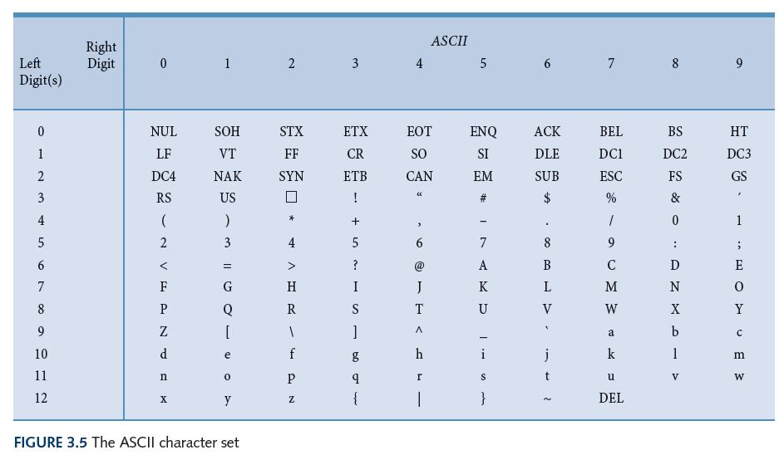
ASCII Character Set Mapping

Slide 28
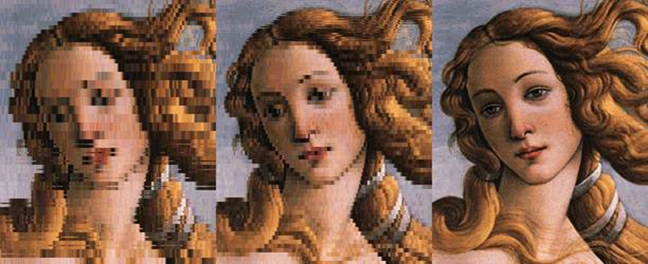
Digital images
The images is sampled:
subdivided in points called pixel (pixel element)
Each pixel is quantized by encoding as a discrete number corresponding to:
a specific color
a particolar grey tone for b/w images
Image represented as a grid/matrix of numbers
Usually numbers associated with pixels have a fixed length (a multiple of a byte)
For color images, a common method is to represent each pixel with 3 numbers, each corresponding to a fundamental color (RGB – Red,Green,Blue)
Along with the pixel values we have to store the size of the image (no. of rows and columns) and the resolution (dpi, “dot per inch”)
Images are finally stored in files as sequences of numbers, one row of pixels after the other.

Slide 29
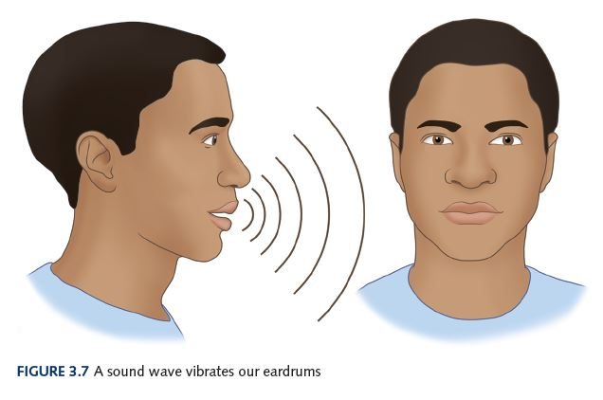
Representing Audio Information
We perceive sound when a series of air pressure waves vibrate a
membrane in our ear, which sends signals to our brain

Slide 30
Representing Audio Information
Digital audio systems includes microphones converting sound to an analog electrical signal
Then an analog-to-digital converter converts the analog signal into a digital signal.
Digitize the analog electric signal by
Sampling: periodically measure the voltage
Quantization: represent the voltage as a number using a finite number of bits
How often should we sample?
A sampling rate of about 40,000 times per second is enough to create a reasonable sound reproduction.

Slide 31
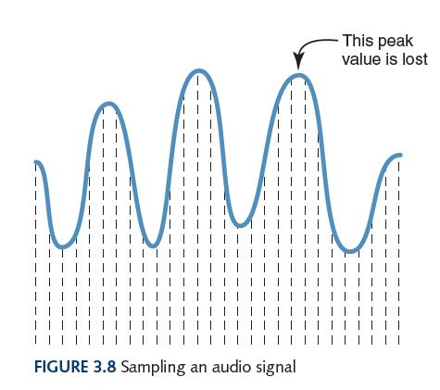
Representing Audio Information
Some data
is lost, but a
reasonable
sound is
reproduced

Slide 32
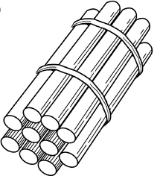
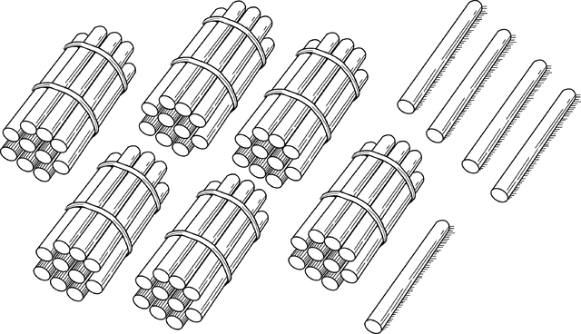
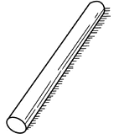
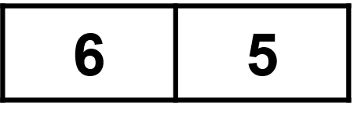
Integer numbers
Review the positional notation to represent numbers
6 x
5 x
10 is the base of this representation
We need 10 simbols, whose value depends on the position

Slide 33
Positional notation
B is the base
of the number
Value of a number represented in a generic base B with symbols used for digits representing quantities: 0,1, …., B-1
d_{n} * B^{n-1} + d_{n-1} * B^{n-2} + ... + d₂ * B¹ + d₁ * B⁰
n is the number of
digits in the number
d_{i} is the digit in the
i^{th} position
in the number
642 (d₃d₂d₁ expressed in base B=10) is equal to: 6 * 10² + 4 * 10¹ ⁺ 2 * 10⁰ = 600 + 40 + 2

Slide 34
Binary integer numbers
Decimal numbers have base 10 and need 10 digit symbols: 0,1,2,3,4,5,6,7,8,9
Exadecimal numbers have base 16 and need 16 digit symbols:
0,1,2,3,4,5,6,7,8,9,A,B,C,D,E,F
Binary numbers have base 2 and only need 2 digit symbols:
0,1
For a number to exist in a given base B, it can only contain the digits in that base, which range from 0 up to B-1

Slide 35
Converting from binary to decimal
What is the decimal equivalent N₁₀ of the binary number N₂ =1101110?
1 x 2⁶ = 1 x 64 = 64
+ 1 x 2⁵ = 1 x 32 = 32
+ 0 x 2⁴ = 0 x 16 = 0
+ 1 x 2³ = 1 x 8 = 8
+ 1 x 2² = 1 x 4 = 4
+ 1 x 2¹ = 1 x 2 = 2
+ 0 x 2⁰ = 0 x 1 = 0
Sum = 110 in base 10

Slide 36
Converting from decimal to binary
Given a natural number N₁₀, where its representation in base 2 is:
N₂ = d_{n-1} … d₁ d₀
we have:
N₁₀ = d_{n-1}*2^{n-1} + … + d₁*2¹ + d₀*2⁰
We determine the various d_{i} ∈ {0,1} with the division-by-2 method :
N is divided by two.
The remainder is the least-significant bit d₀.
The quotient is again divided by 2
The remainder is the next least significant bit d₀.
And so on, until a quotient of zero is reached.
NOTE: each remainder must be either 0 or 1 when dividing by 2

Slide 37
Converting from decimal to binary
Binary equivalent N₂ of the binary number N₁₀ =110 :
N₁₀ Reminder 110 0 = d₀
55 1 = d₁
27 1 = d₂
13 1 = d₃
6 0 = d₄
3 1 = d₅
1 1 = d₆
N₂ =1101110
quotient
quotient

Slide 38
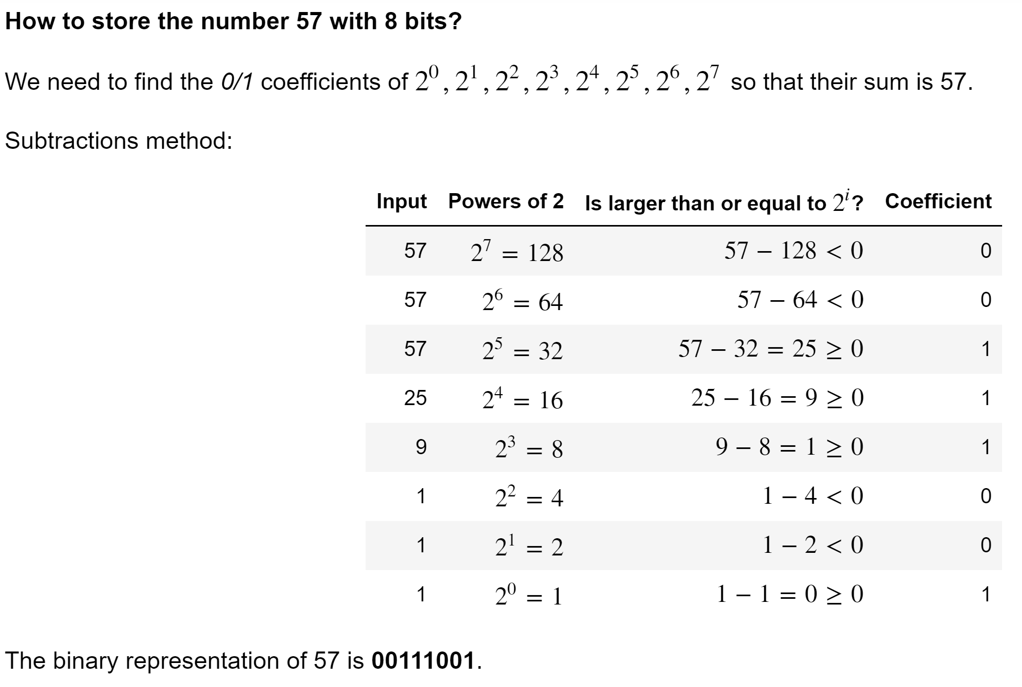
Converting from decimal to binary (alternative way)

Slide 39
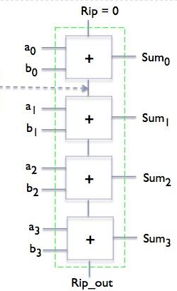
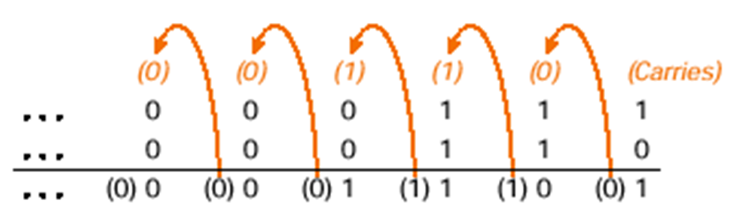
Binary Arithmetic
Remember that there are only 2 digit symbols in binary, 0 and 1. Therefore 1 + 1 = 0 with a carry
This is analogous to decimal arithmetic: 5 + 5 = 0 with a carry
Example of 7 (111) + 6 (110) = 13 (1101):
Carry
propagation
Arithmetic Logic Unit (ALU) made of Single-bit Adders

Slide 40
Real numbers to binary
Using a Byte (8 b), we can use a simple approach (Fixed-point representation):
4 bits for the integer part, and 4 bits to represent the fractional part
Warning !! The smallest number we can represent is 2⁻⁴=1/16=0.0625
Warning !! Even worse!! We can represent only 2⁴ numbers between 0 and 1.
Not only are we limited to a smallest and largest representable number, but since real numbers are infinite while bit configurations are finite, we can only represent a limited set of number in between the smallest and largest values.

Slide 41
Real numbers to binary
Since any binary number can be represented as ±1.????...?? × 2^{N}, computers most commonly use:
Single precision (32 bits) Floating-point representation:
1 bit for the sign (negative vs. positive)
8 bits for the exponent N of 2^{N}
23 bits for the significand ????..??
Double precision uses 64 bits, and it is therefore more accurate (but more expensive)

Slide 42
Different Binary Units
Note that 1024 = 2¹⁰ ≈ 10³ = 1000
UNIT | VALUE | STORAGE
Bit | 1 or 0
Byte (B) | 8 Bits | Character
Kilobyte (KB) | 1024 Bytes = 2¹⁰ Bytes | Half page of text
Megabyte (MB) | 1024 Kilobytes = 2²⁰ Bytes | About 2 mins MP3 file
Gigabyte (GB) | 1024 Megabytes = 2³⁰ Bytes | About one hour Movie
Terabyte (TB) | 1024 Gigabytes = 2⁴⁰ Bytes | 128 DVD Movies
Petabyte (PB) | 1024 Terabyte = 2⁵⁰ Bytes | 7 billion Facebook photos
Exabyte (EB) | 1024 Petabyte = 2⁶⁰ Bytes | 50,000 years of DVD
Zettabyte (ZB) | 1024 Exabyte = 2⁷⁰ Bytes | Global internet traffic per year (2016)

Slide 43
Hardware layer

Slide 44
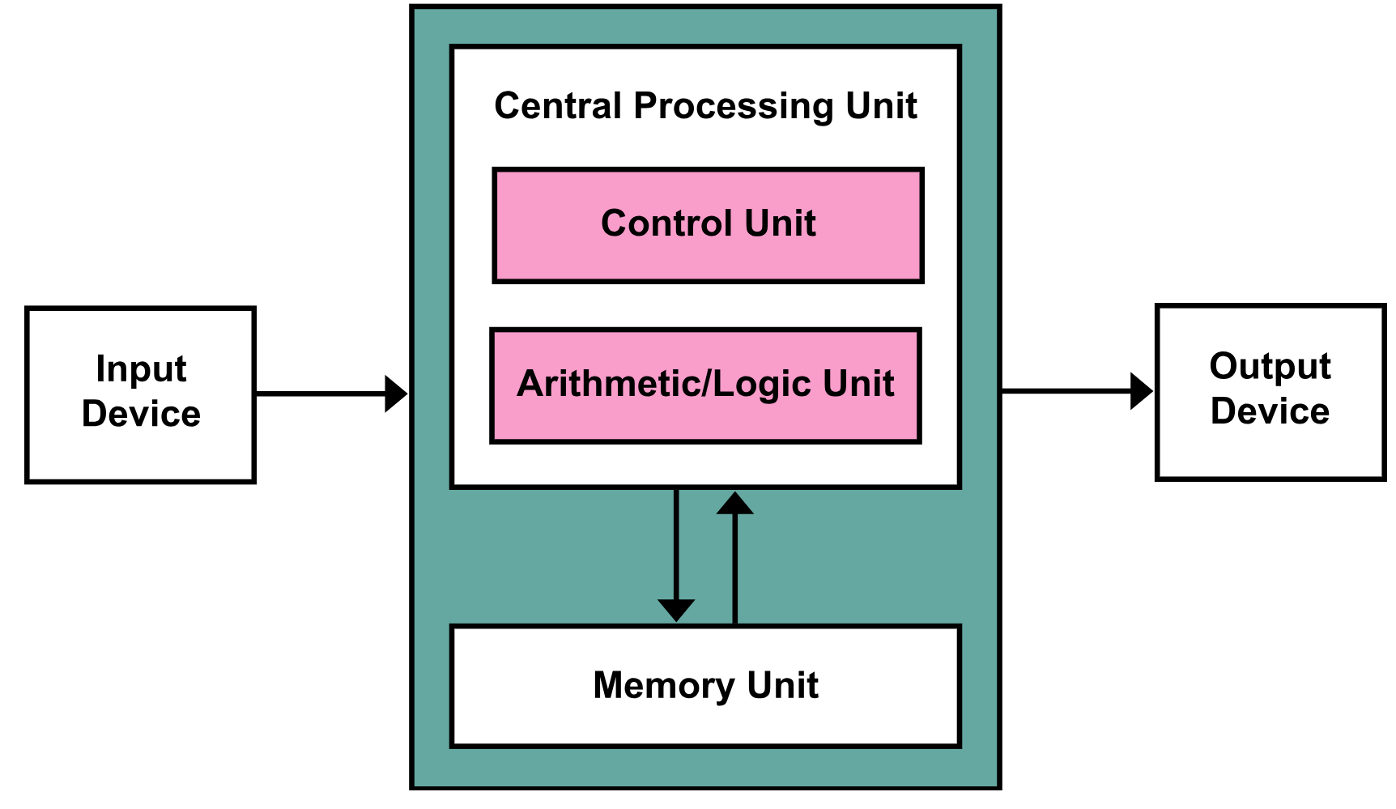
Von Neumann architecture of a computing system
Architecture composed of
CPU: Central processing unit
ALU to perform arithmetic/logic operations
Memory to store
Programs (stored-program)
Data accessed by program
Input/Output (I/O) devices
including disks and SSD

Slide 45
Machine languages
CPU are designed to recognize machine instructions stored in memory as sequences of bits
The (short) list of instructions with their binary encoding is called machine languages
Example of machine language
ADD A,B,C where A,B, and C are operands, and the semantics is: A←B+C
Encoding on 4 Bytes, where A, B and C are fast memory registers in the CPU
OPCODE
Target operand
Source oper. 1
Source oper. 2
Encoding ADD operation
Encoding reg. A
Encoding reg. B
Encoding reg. C
17 bits
5 bits
5 bits
5 bits

Slide 46
Program execution
The order in which instructions are fetched/executed (control flow) corresponds to the sequential order in which instruction are stored in memory
So the flow of control of the CPU is guided by an address in memory
The Program Counter (PC) maintain for a running program the address of the next machine instruction to execute

Slide 47
Program execution
The CPU continuously repeat the following 3 steps:
Fetch from memory the next instructions pointed by the PC
Decode the instruction
Execute the instruction, and update the PC to the next instruction to fetch
The sequential control flow can be modified by the program, executing special instruction of JUMP/BRANCH.

Slide 48
Programming layer

Slide 49
What is a program?
A program is a sequence of instructions that specifies how to perform a computation.
Examples: finding the roots of a polynomial (math), searching and replacing text in a document (symbolic), or processing an image (graphical)
Programming as the process of breaking a large, complex task into smaller and smaller subtasks until the subtasks are simple enough to be performed by combining basic instructions.
The program is run/executed by the computer to realize a given application, following the control flow
Luckily, we can avoid to write programs in machine language !!

Slide 50
What is a program?
We can program in different languages, and generally we have ways to do:
input: Get data from the keyboard, a file, the network, or some other device.
output: Display data on the screen, save it in a file, send it over the network, etc.
math: Perform basic mathematical operations like addition and multiplication.
conditional execution: Check for certain conditions and run the appropriate code.
repetition: Perform some action repeatedly, usually with some variation.

Slide 51
Languages for programming?
Natural languages: languages that people speak, such as English, Italian, or French, and they evolved naturally.
Formal languages: particular languages designed for specific applications. Example: math notation.
Strict syntax rules concerning tokens and structure
No ambiguity
Programming languages are formal languages that have been designed to express computations.

Slide 52
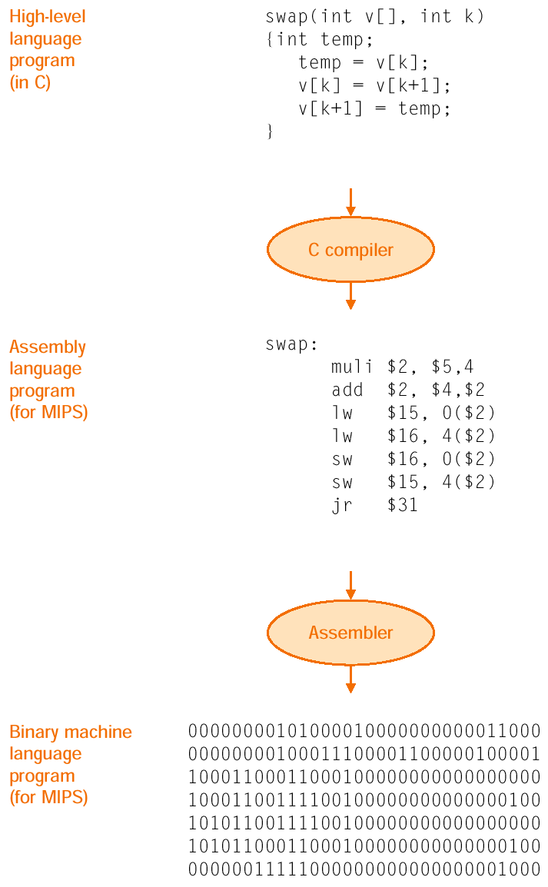
Abstracting the machine to ease the programming job
On the left, an example of language hierarchies
High-level language
Productivity
Code portability because of translators, such as compiler or assembler
Assembly language
Mnemonic representation of machine instructions
Machine language
Binary digits (bits)
Encoding of machine instructions and data

Slide 53
Learning to code with Python
From Wikipedia, the free encyclopedia
Python is a widely used high-level programming language for general-purpose programming, created by Guido van Rossum and first released in 1991. Guido was a fan of the TV series Monty Python's Flying Circus :-)
An interpreted language, Python has a design philosophy that emphasizes code readability (notably using whitespace indentation to delimit code blocks rather than curly brackets or keywords), and a syntax that allows programmers to express concepts in fewer lines of code than might be used in other high-level languages such as C++ or Java.
An interpreter is a computer program that directly executes, i.e. performs, instructions written in a programming or scripting language, without previously compiling them into a machine language program

Slide 54
Computational thinking

Slide 55
What is Computational Thinking
Computational thinking is the thought processes involved in formulating problems and their solutions so that the solutions are represented in a form that can effectively be carried out by an information-processing agent.
Cuny, Snyder, Wing

Slide 56
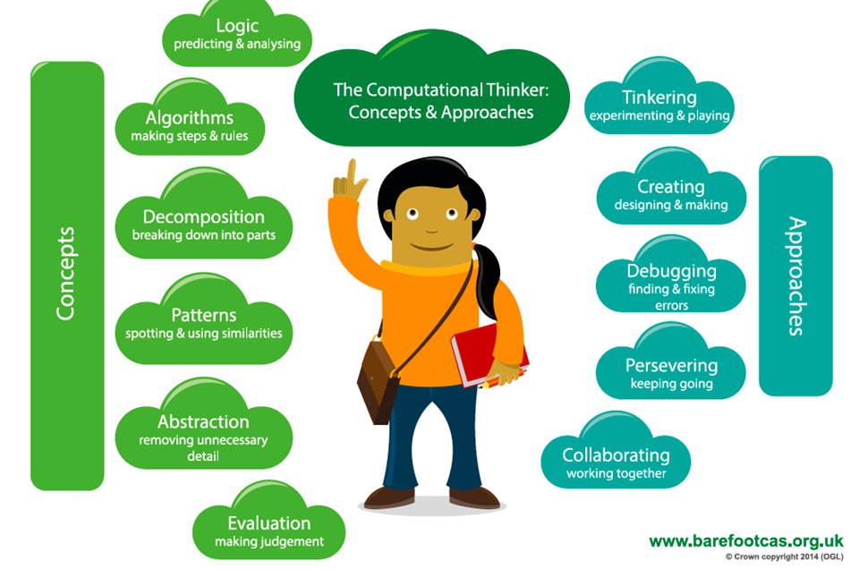
Important elements of computational thinking

Slide 57
Problem solving and programming
The single most important skill for a computer scientist is thus problem solving
the ability to formulate problems,
think creatively about solutions, and
express a solution clearly and accurately.
with solutions that can be carried out by an information- processing agent
Learning how to code/program is an excellent opportunity to practice problem-solving skills
Programming for problem solving is funny and creative

