Slide 1
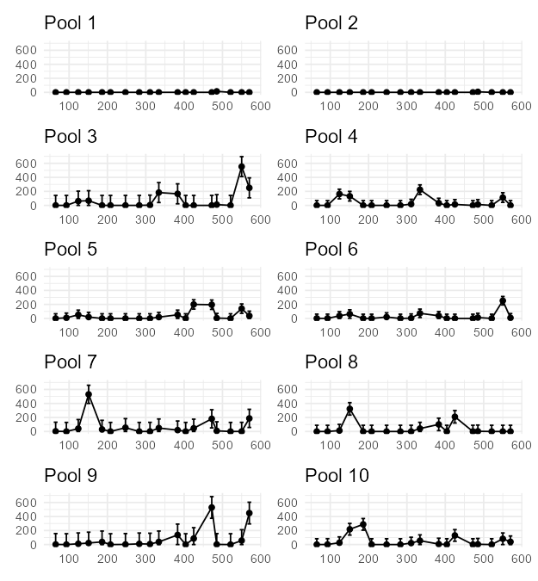
Organismal Abundance
Days Since January 1st, 2022

Slide 2
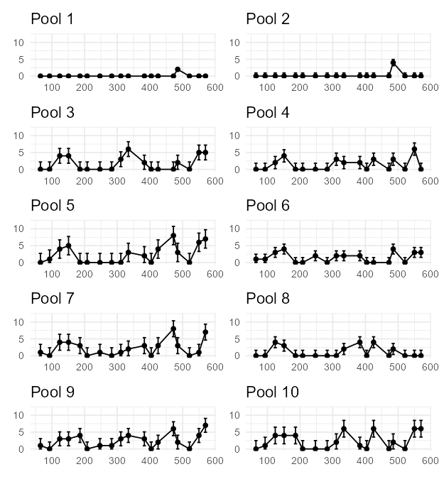
Species Richness
Days Since January 1st, 2022

Slide 3

Species Richness
Days Since January 1st, 2022

Slide 4
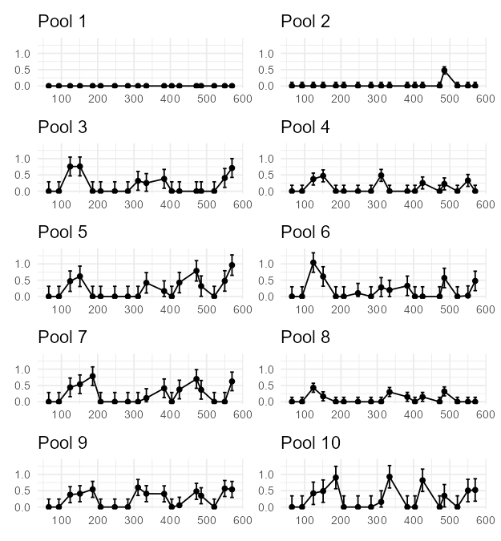
Shannon Diversity
Days Since January 1st, 2022

Slide 5
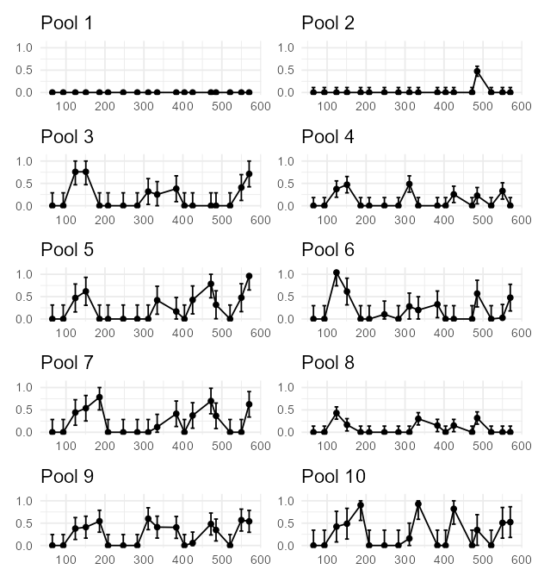
Shannon Diversity
Days Since January 1st, 2022

