Slide 1
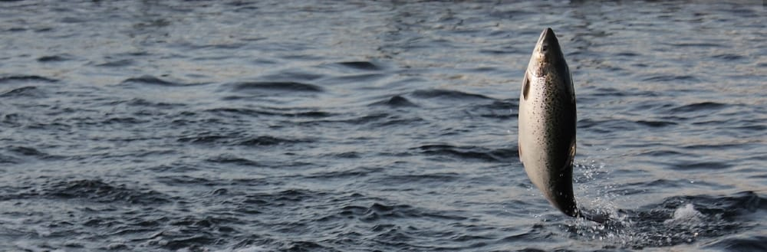
The triploid Atlantic salmon

Slide 2
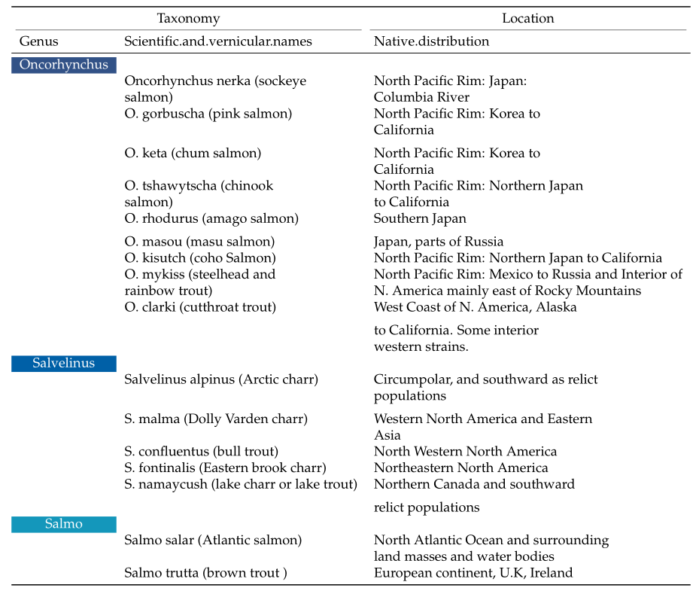
Nomenclature and distribution area of the three genera of salmonids

Slide 3
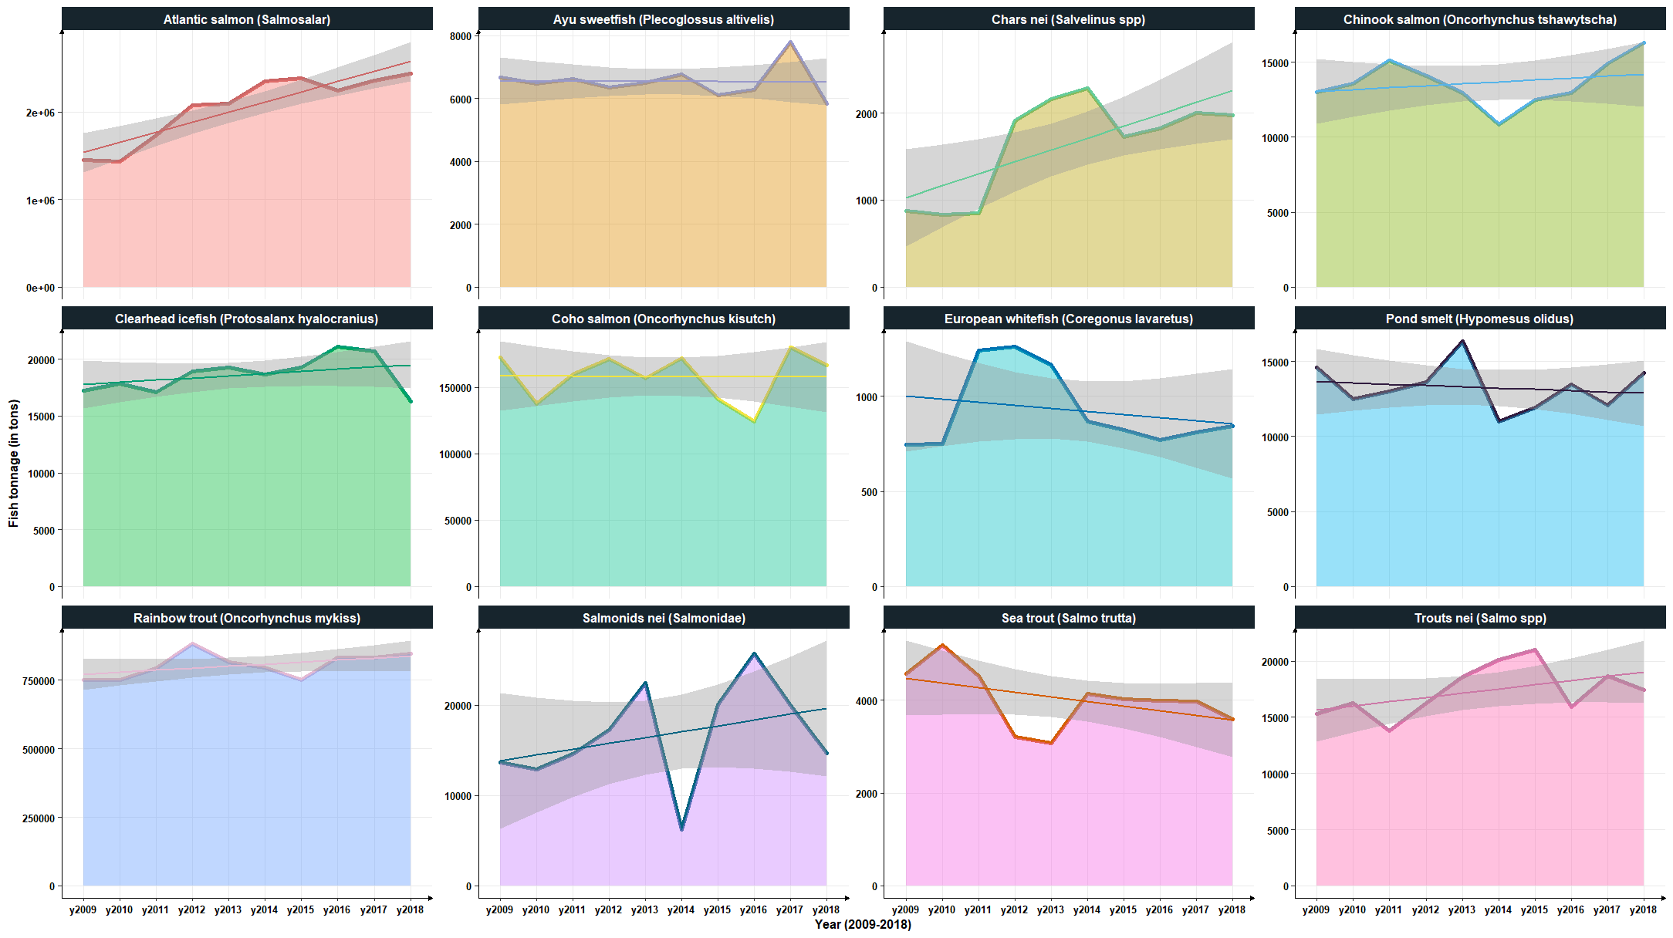

Slide 4
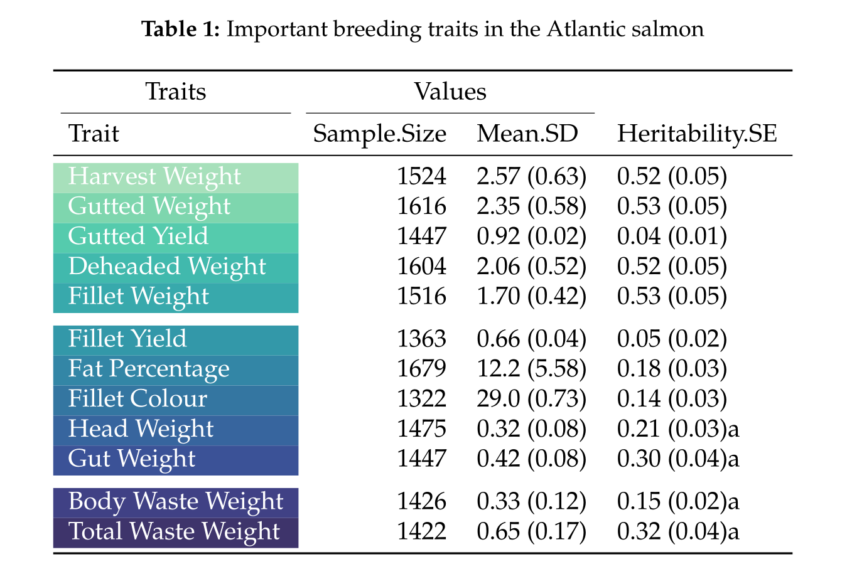
Major traits of the salmons

Slide 5
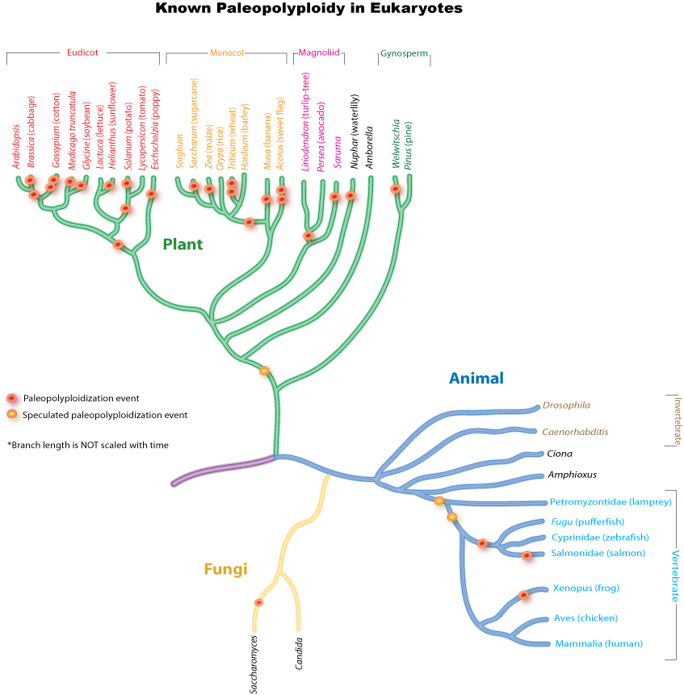
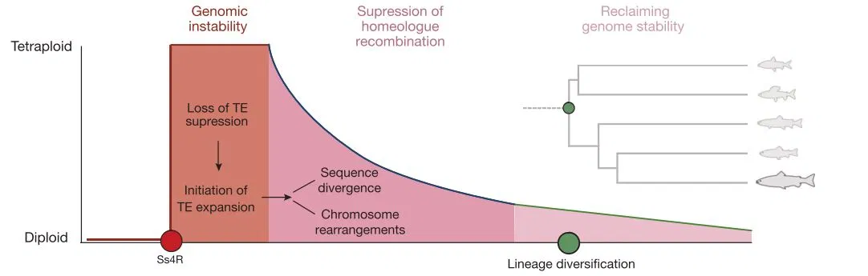
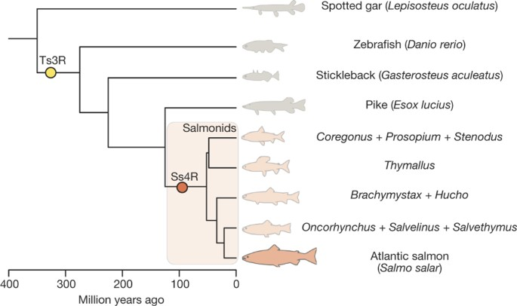

Slide 6
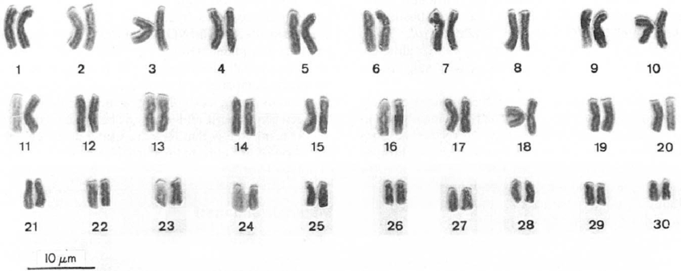
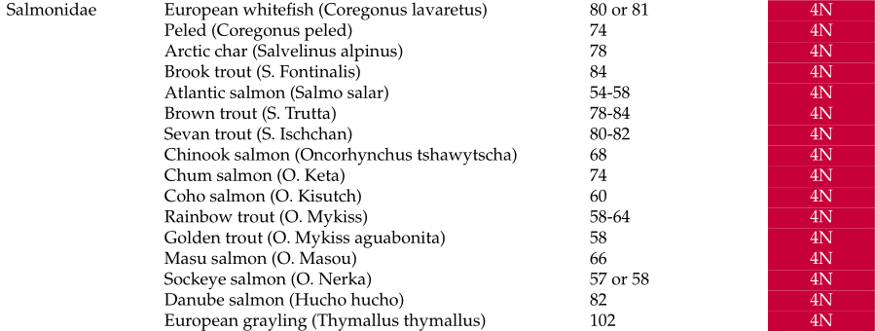
Salmonid's ploidy
Giemsa karyotype of a Coho salmon (2 n = 60) homozygous

Slide 7
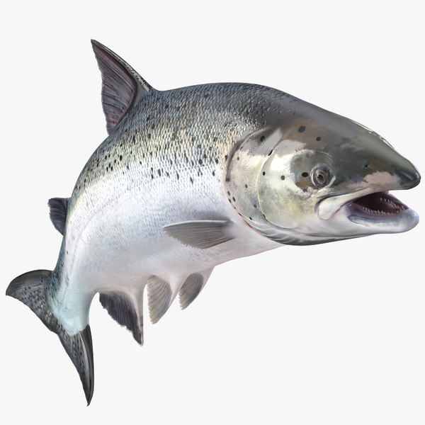
How about me?
Pilot-scale evaluation of triploid Atlantic salmon for aquaculture
Scotland
60 years ago - first reported production of triploid Atlantic salmon (Salmo salar)
Took 30 years before further attempts were to produce triploid Atlantic salmon -unsuccessful
Success followed 10 years later
Atlantic Canada
Tasmania
USA
Ireland
Norway

Slide 8
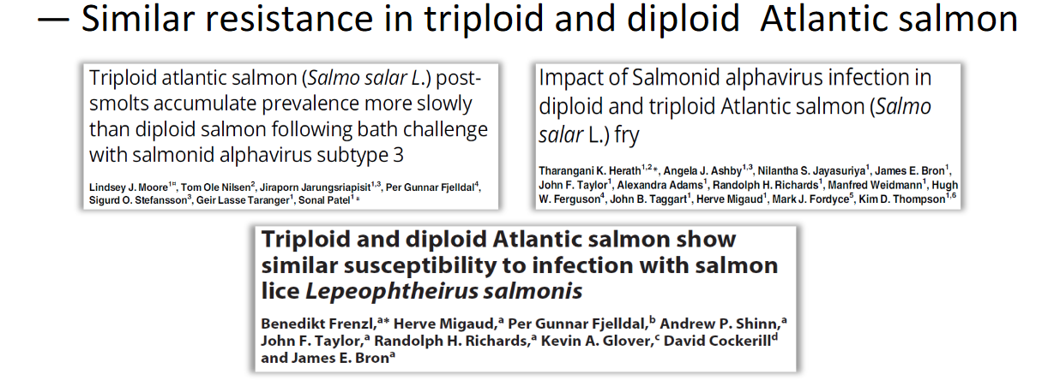
Effect of the triploid on the disease resistance
Pancreas disease & sea lice―Similar resistance in triploid and diploid Atlantic salmon
The response of triploids to...”―Bacterial disease ―Amoebic gill disease―Vaccination

Slide 9
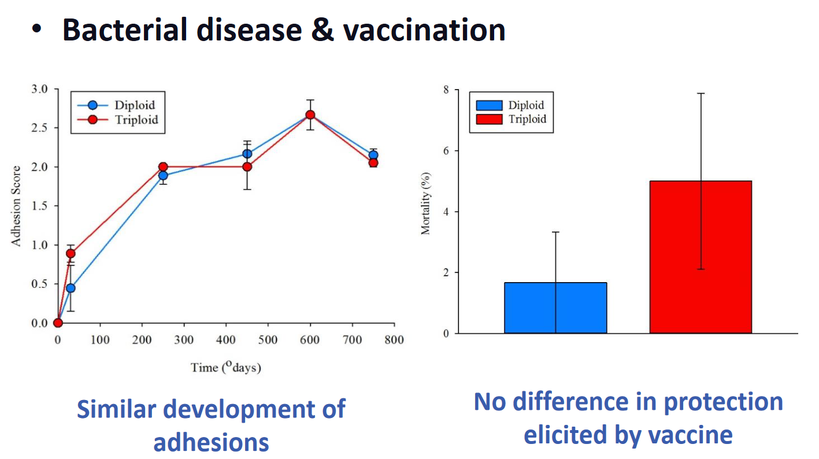
Health in triploid salmon

Slide 10
Effect of the triploid on the disease resistance
Triploids have comparable disease resistance to diploids
Triploids are not more susceptible to disease as believed in the past
Salmon producers can be confident in stocking triploid Atlantic salmon

Slide 11
Table 1: Results of polyploid experiments
Fish species | Pressure shock applied | Time period | Shock Time | Induction rate for |  | Reference
 |  |  |  | Polyploidy
Nile tilapia | 8,000 psi | 2 minutes | 9 minutes | 100% | 91.8±2.1 % | Hussain et al. (1991)
Rainbow trout | 8,000 psi | 10 minutes | 40 minutes | 80-90% | 51% | Lou and Purdom
 |  |  |  |  |  | (1984)
Rainbow trout | 7,000 psi | 4 minutes | 40 minutes | 100% |  | Chourrout (1984)
Rainbow trout | 7,000 psi | 4 minutes | 5 to 50 minutes | 100% |  | Chourrout (1984)
Coho salmon | 6.9 x 10 kPa | 4 minutes | 20 to 40 minutes | 100% |  | Teskeredzic et al.
 |  |  |  |  |  | (1993)
Brook trout | 700 Kg / square meter | 6 minutes | 10 minutes | 75% |  | Arai et al. (1989)
Chum salmon | 680 Kg / square meter | 7 minutes | 13.2 mn | 3 (4n) + |  | Yamazaki and
 |  |  |  | Aneuploïdy |  | Goodier (1993)
Land lock Atlantic | 10,150 psi | 3 to 6 minutes | 17 to 14 minutes | 100% |  | Benfey and Sutterlin
salmon |  |  |  |  |  | (1984)
Yellow Perch | 9,000 psi | 8 to12 minutes | 5 minutes | 30-70% |  | Malison et al. (1993)
 | 11,000 psi
Pacific abalone | 200 Kg / square meter | 7 minutes | 60 minutes | 50% |  | Arai et al. (1986)
Pacific abalone | 200 Kg / square meter | 22 minutes | 60 minutes | 65% |  | Arai et al. (1986)
Note: psi = pressure unit, psi = 6.894 kPa

Slide 12
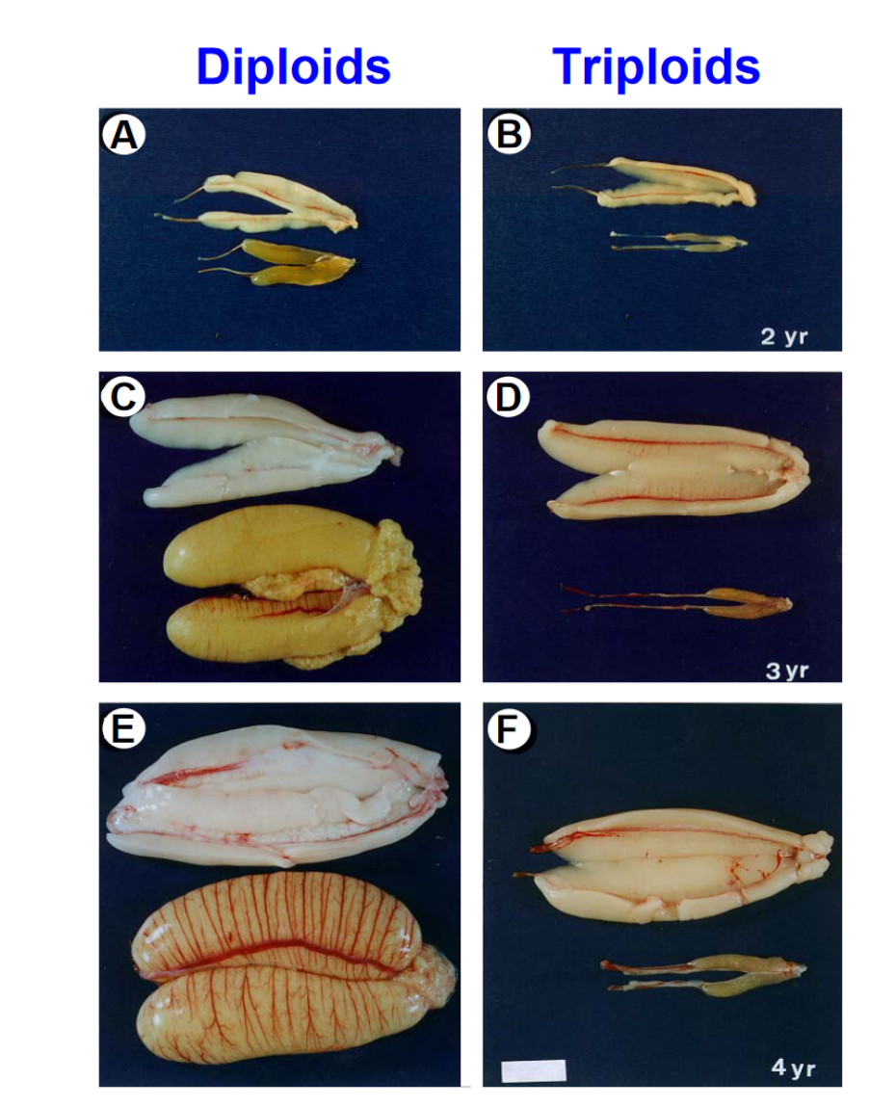
Effect of triploidy on fertility and gametogenesis
Gonadial atrophy
Defective and reduced gametogenesis
Fertility (decreased sperm count and motility)
Fertility of 0 to 10% in salmon (vs. diploid)

Slide 13
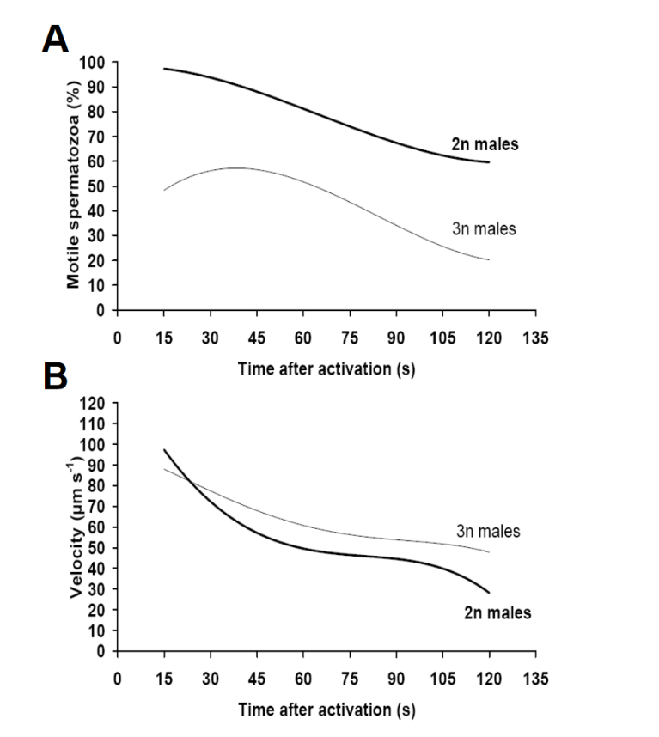
Effect of triploidy on sperm activity
Sperm motility and velocity decreased in Atlantic salmon for triploids (3N) vs. diploids (2N)
Fertility is defined by a lower success rate of reproduction due to less vigorous sperm.
(decreased sperm count and motility)

Slide 14
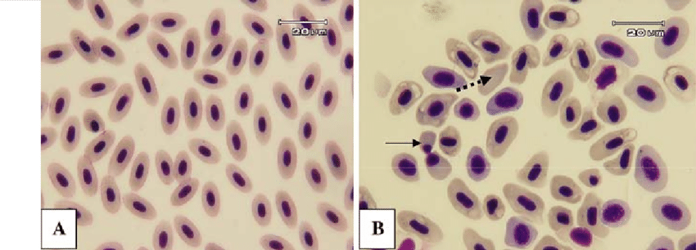
Effect of triploidy on cell morphology
Cell cytoplasm increase up to 150%
More water = Diluted mRNAs
Bigger nucleus 150% bigger.
Dilution of transcription factors such as EF-1a
Gene expression expected to be reduced by 1/3rd
BUT . . .
Diploid (a) and triploid (b) Caspian salmon erythrocytes

Slide 15
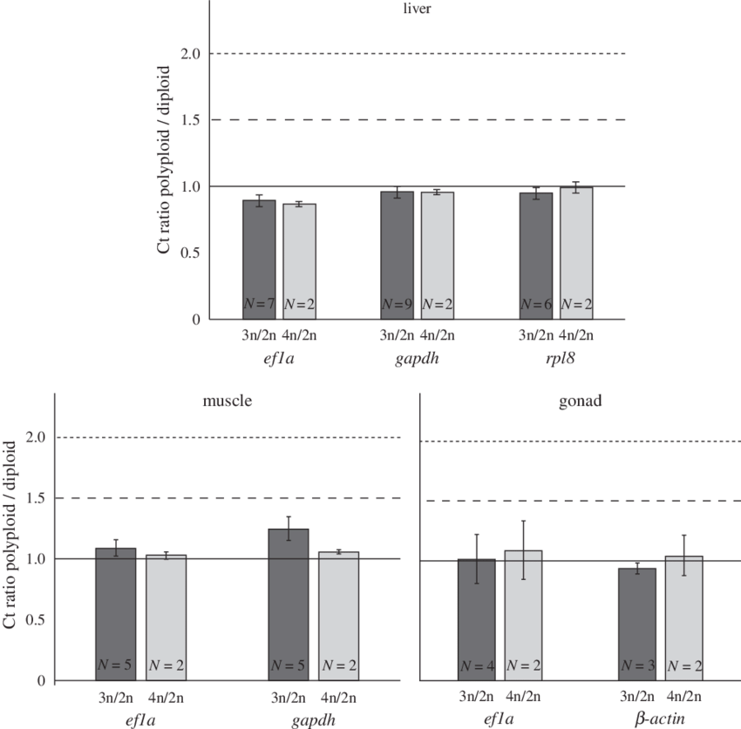
Effect of triploidy on transcription factors
Because of the increase in ploidy 2N -> 3N
Transcript abundance must increase by 1/3rd
The +150% mRNA abundance effect is cancelled due to +150% cell size.
Gene expression in triploid is not too different from diploids

Slide 16
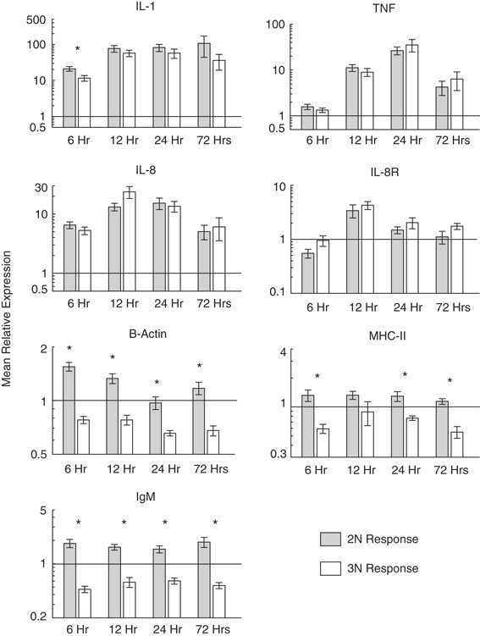
Effect of triploidy on gene expression
However, triploids have a different gene response for some genes.
It does not always produce a different observable phenotype
As shown previously, the response to diseases and vaccination in salmon is similar in 2N, 3N.

Slide 17
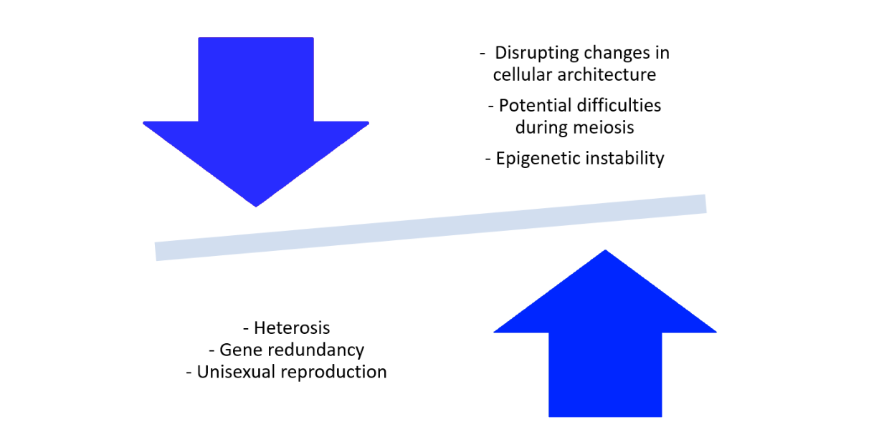
Advantages & Disadvantages

Slide 18
THANK YOU

