Slide 1
PYSPARK
DATA ANALYSIS
Distributed Data Processing using Apache Spark
Pakistan Energy Access
Household Panel Survey
ETL Pipeline · Spark SQL Validation · Performance Benchmarking · Visual Analytics
Student Name
Course / Instructor
Date
Insa Saleem (043)
Isra Asif (045)
Maria Yasmeen (059)
Ma’am Madiha Wahid
19th May 2026
Tools : PySpark · Spark SQL · Python · Matplotlib · Jupyter / VS Code
Dataset: pakistanenergyaccesshouseholdpanelsurveydata.csv

Slide 2
Introduction & Motivation
💡 Energy as a Development Indicator
📊 Messy, Large-Scale Survey Data
Energy access directly impacts quality of life, productivity, education, and public health — making it a critical policy metric.
Household survey datasets contain missing values, inconsistent categories, and mixed data types — requiring a scalable cleaning and processing framework.
⚙️ Need for Scalable Processing
✅ Correctness & Reproducibility
Apache Spark provides distributed, in-memory computation that scales to millions of records, far beyond what single-threaded Python can handle.
Results from Spark SQL and pure python must be validated against each other to guarantee analytical correctness.
We will see, do traditional Python struggles as data grows ? or Spark does the processing smoothly and efficiently?

Slide 3
Project Overview
🎯 Four Core Objectives
Build a clean, robust ETL pipeline using PySpark
1
ETL pipeline (extract, transform, load)
2
Map / filter / reduce / groupBy examples
3
Spark SQL + performance comparison vs pure Python. Performance graphs (rendered as ASCII so it works without extra plotting libraries)
4

Slide 4
Tools & Technologies
PySpark
Spark DataFrame API for scalable, distributed data processing at scale
Spark SQL
SQL queries executed against registered Spark temporary views — used for validation
Python
Orchestration, baseline benchmarking, and utility scripting (csv.DictReader)
Matplotlib
Chart generation — all plots exported in JPG format only (no PNG output)
Jupyter / VS Code
Interactive notebook development environment — primary execution environment

Slide 5
ETL Pipeline Methodology
EXTRACT
TRANSFORM
1
2
Load raw CSV into Spark DataFrame via spark.read.option("header","true").csv(...)
Standardize categories, safe-cast numerics, derive connection_status, filter nulls/UNKNOWN
LOAD
VALIDATE
3
4
Export connected_counts_by_region to CSV and JSONL in etl_output/
Compare Spark SQL and DataFrame aggregations expect zero row mismatches
ANALYZE
BENCHMARK
5
6
Produce multiple unique analytical plots across demographics, geography, and numerics
Measure execution time: Spark DataFrame vs Spark SQL vs pure Python CSV scan

Slide 6
Data Cleaning & Quality Rules
Category Columns
Connection Status
Numeric Columns
✓ Remove null values
✓ Map code 1 → 'Connected'
✓ Apply safe numeric casting (safe_int / safe_float)
✓ Remove empty strings
✓ Map code 2 → 'Not Connected'
✓ Drop null or non-numeric values before plotting
✓ Remove literal 'UNKNOWN' entries
✓ Unknown / NA → excluded from grouped analyses
✓ Used for: Household size, Monthly spend, Distance to connected HH
✓ Applied to: Region, District, Cultural Belt, Gender, SEC, Housing Type, Area Type
✓ Clean labels used in all charts

Slide 7
Functional Programming Transformations
map()
withColumn + when/otherwise maps raw connectivity codes (1 or 2) to readable labels — applied to every row in the DataFrame
df.withColumn('connection_status', when(col==1,'Connected').otherwise('Not Connected'))
filter()
.filter() removes rows where labels are empty, null, or 'UNKNOWN' — ensuring only high-quality data enters analytics
df.filter(col('connection_status') != 'Unknown/NA')
groupBy()
.groupBy('region') or .groupBy('connection_status') groups related rows for aggregation — equivalent to SQL GROUP BY
df.groupBy('region').agg(F.sum('is_connected').alias('count'))
reduce()
.count() or .agg(F.sum(...)) collapses each group into a single numeric result — e.g. total connected HHs per region
df.agg(F.sum('count').alias('total_connected')).collect()[0]

Slide 8
What is Benchmarking?
“Comparing the performance of different systems or methods using measurable tests.”
We test following between Spark SQL vs Pure Python:
which method is faster,
more efficient,
scalable,
and performs better under workload.
We are comparing:
execution time
scalability
processing efficiency
using the same dataset and same operations.

Slide 9
Performance Benchmark
🐍 Small Datasets
⚡ Large Datasets
🏆 Key Finding
Pure Python sometimes appeared competitive.
Spark initialization overhead exists (~0.5–0.7s startup).
Below ~6,000 rows:
Python can be faster.
Spark became significantly faster.
Performance gap increased continuously with data size.
At 100,000 rows:
Spark was many times faster.
Spark scales efficiently as data volume grows.
Crossover point:
~6,000–7,000 rows
Beyond this: Spark SQL is the superior choice.
Benchmark: performance_speedup_vs_python.jpg — shows speedup ratio across all three row-count tests.

Slide 10
Efficiency Crossover Point
⚡ Important Discovery
🔬 Why This Happens
There is an efficiency crossover point at ~6,000–7,000 rows.
Small datasets → Python is acceptable.
Large datasets → Spark dominates.
Spark's distributed architecture becomes more beneficial as computational workload increases.
Parallelism, Catalyst, and Tungsten all compound — the bigger the data, the bigger the gain.
🏢 Real-World Importance
This proves Spark is ideal for:
Enterprise systems processing millions of records
Large-scale analytics on national or regional datasets
Real-time processing pipelines with continuous data ingestion
Any workload where single-threaded Python would bottleneck
The crossover point is the key metric for deciding between Python and Spark in production.

Slide 11
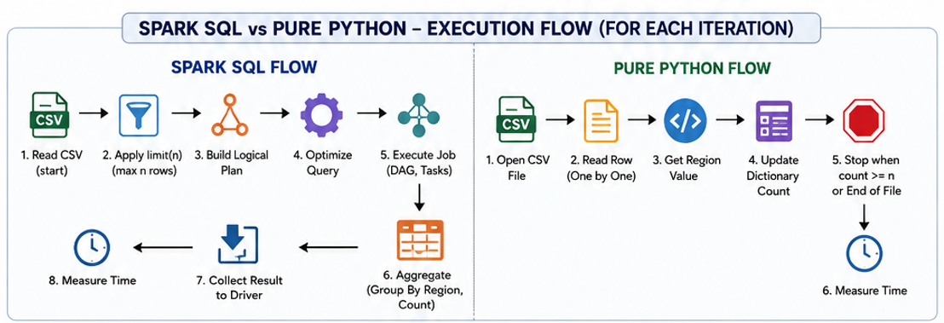

Slide 12
SPARK SQL vs PYTHON FLOW
Spark | Pure Python
Distributed engine | Single-thread sequential
Uses optimizer | No optimizer
Builds execution plan | Direct execution
Uses DAG tasks | Simple loop
Has overhead | Minimal overhead
Better for huge data | Better for small data

Slide 13
Performance Analysis: Py Spark vs Pure Python
⚠️ The Problem
🎯 Our Goal
Traditional Python processing becomes slow when:
Dataset size increases significantly
Multiple aggregations are required
Complex filtering is applied
Memory usage grows unbounded
Single-threaded processing hits a wall.
We wanted to determine:
Can Spark process data faster?
Is Spark scalable to millions of rows?
Are the results reliable and correct?
Which approach suits real-world big data?
Answer: Spark dominates at scale.
Performance analysis ensures the right tool is chosen for production-scale data pipelines.

Slide 14
Final System Testing
🔍 System Test Purpose
Verifies that all pipeline components produced correct, consistent, and complete outputs.
Verified Components
🧪 Why Testing Matters
✅ ETL outputs were created correctly
✅ Spark SQL results are correct
✅ DataFrame results are correct
✅ Functional programming results match
✅ Benchmarking results exist properly
✅ No mismatches exist between any outputs
Without systematic testing, analytical outputs cannot be trusted.
Catches silent data errors
Confirms end-to-end correctness
Validates both APIs agree
Ensures benchmarks are reproducible
All tests passed — system is production-ready.
Final system testing closes the loop: every output was verified before conclusions were drawn.

Slide 15
Conclusion
⚡ Spark for Scale
This project demonstrated that Apache Spark is an effective and scalable framework for large-scale survey analytics.
Key takeaways include:
• Spark enables efficient ETL at scale with multiple parallel analysis pipelines.
• SQL and DataFrame interfaces yield equivalent results, providing flexibility without sacrificing correctness.
• Strict data cleaning rules materially improve the quality and interpretability of visual outputs.
• Visual analytics provide evidence-based insights into energy access distribution across regions and districts, inequality factors (SEC category, rural/urban classification, education), and potential infrastructure barriers (distance, reasons for non-connection).
As dataset sizes grow, Spark's distributed architecture delivers exponentially greater speedups over single-threaded Python, confirming its suitability as the foundation for large-scale data engineering workflows.

