Slide 1
Plasma elements and the proteome in ART-treated macaques
Within-animal analysis of 8 elements, 6 ratios and 11,011 plasma proteins
27 samples | 8 animals | viral load, ART stage and 7 naive animals as reference

Slide 2
Small cohort, so every animal is its own baseline
27
8
11,011
14
samples with proteomics
animals (5 with repeated samples)
plasma proteins (SomaScan)
variables: 8 elements + 6 ratios
1
Each animal's own mean is removed, so animal, cohort and slide offsets cannot create associations
2
Permutation p-values (element shuffled within animals) and FDR across proteins
3
Model: protein ~ element + log10 viral load; viral load stands in for ART time

Slide 3
Four findings, from strongest to most speculative
Viral load outweighs the elements
Mg and Cu are predictable
2-75 proteins pass FDR<0.05 for viral load; at most 3 do for any element (Mg, P). P is the one exception
Predicted from the proteome in unseen animals: rho 0.56 (Mg) and 0.49 (Cu), time-adjusted
Mg and P track platelet proteins
Cu tracks acute-phase proteins
Platelet set test p=0.002 (Mg) and 0.004 (P): a cell-content signal
CRP, SAA1, HP rise with Cu (set test p=0.008): a lead for new samples

Slide 4
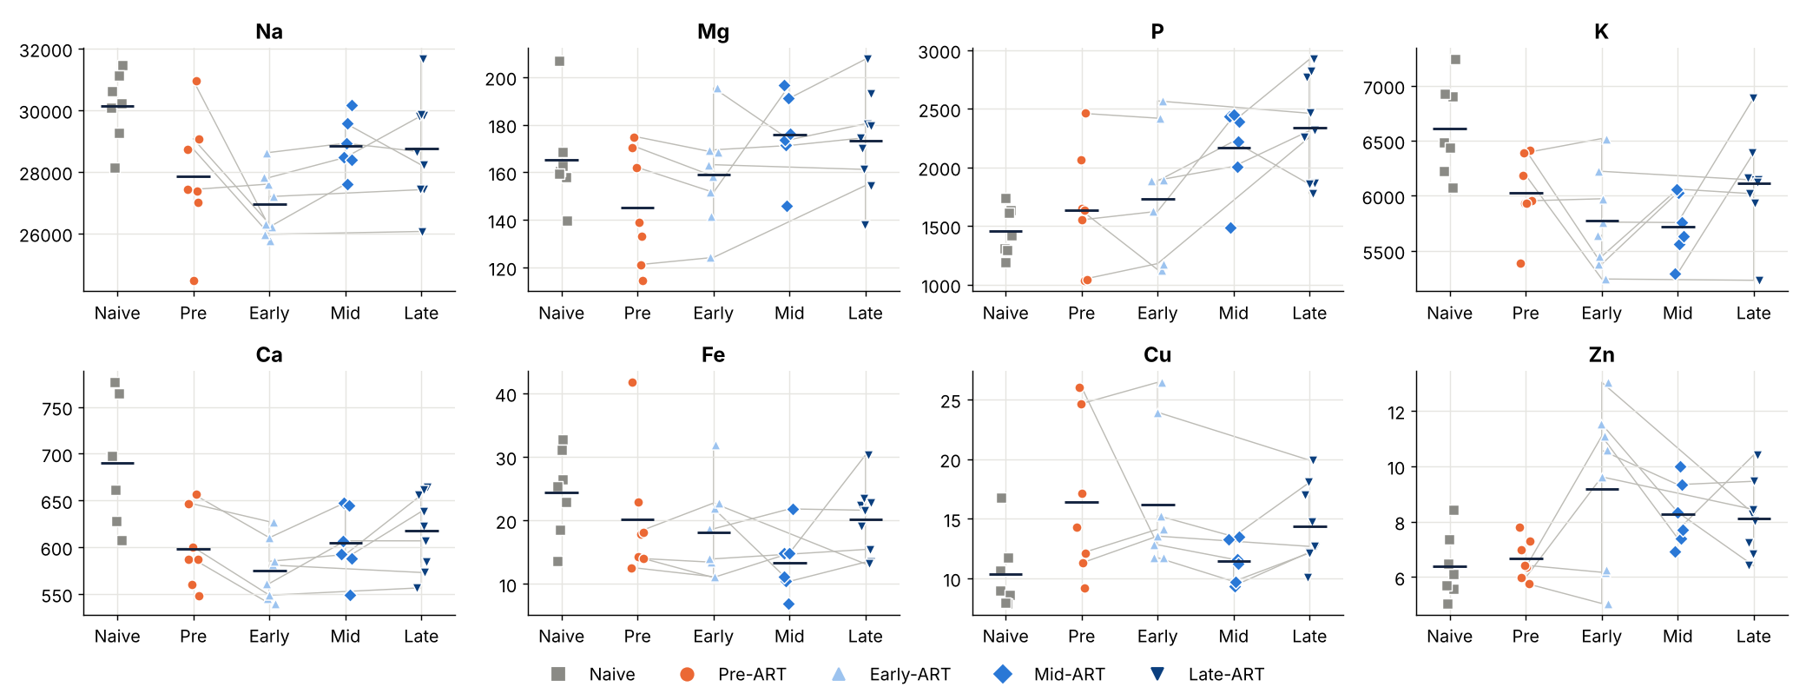
Elements shift with ART stage, but naive animals are a different cohort
P and Mg rise over treatment weeks
Na, K and Ca are lower in infected than naive animals
Cu is higher before ART than in naive animals
Naive animals are unmatched: differences may be batch or cohort

Slide 5
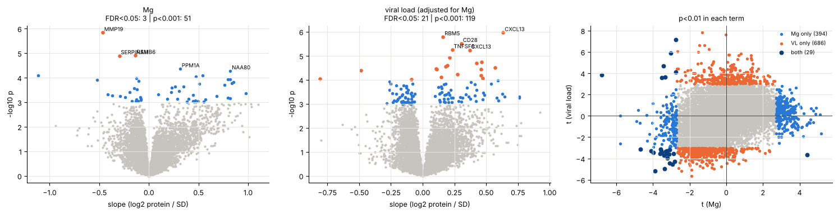
Mg: 3 proteins pass FDR<0.05, far more than chance reach p<0.001
3
51
21
proteins at FDR<0.05 (element)
proteins at p<0.001 (chance: 11)
proteins at FDR<0.05 (viral load)

Slide 6
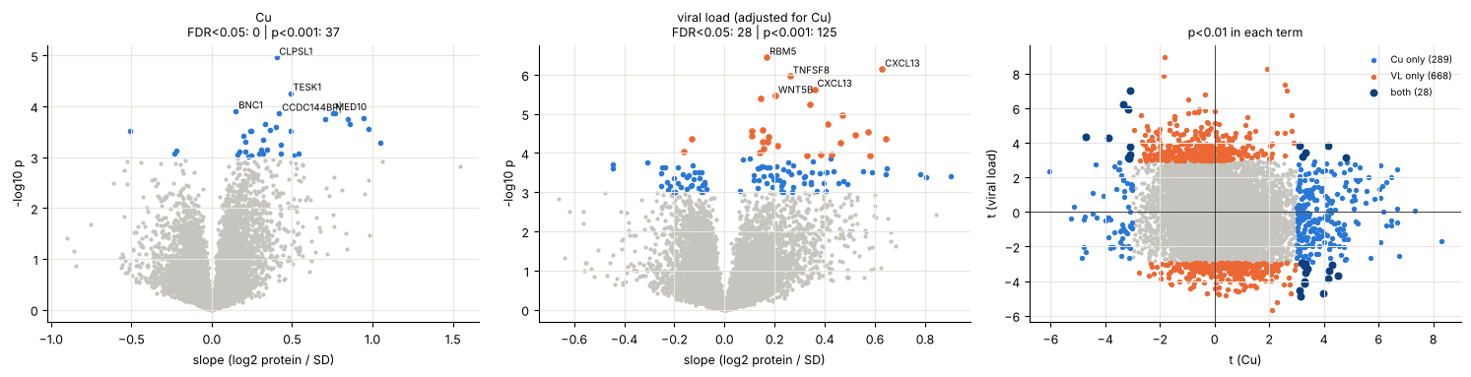
Cu: 37 proteins at p<0.001, none at FDR<0.05
0
37
28
proteins at FDR<0.05 (element)
proteins at p<0.001 (chance: 11)
proteins at FDR<0.05 (viral load)

Slide 7
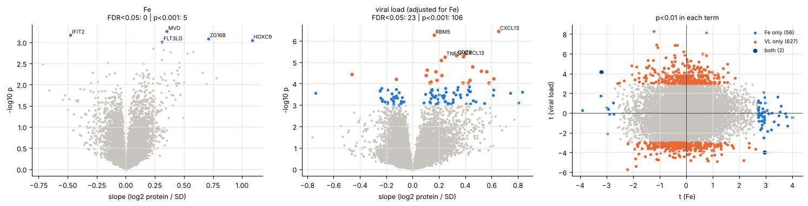
Fe: indistinguishable from chance
0
5
23
proteins at FDR<0.05 (element)
proteins at p<0.001 (chance: 11)
proteins at FDR<0.05 (viral load)

Slide 8
Viral load outweighs the elements in the proteome
No protein passes FDR<0.05 for both an element and viral load
P is the exception: 3 element hits vs 2 for viral load
At p<0.01 the overlap is near what the two hit lists predict for Mg, P and Fe
Na and Ca overlap more than expected (27 vs 10, 49 vs 14)

Slide 9
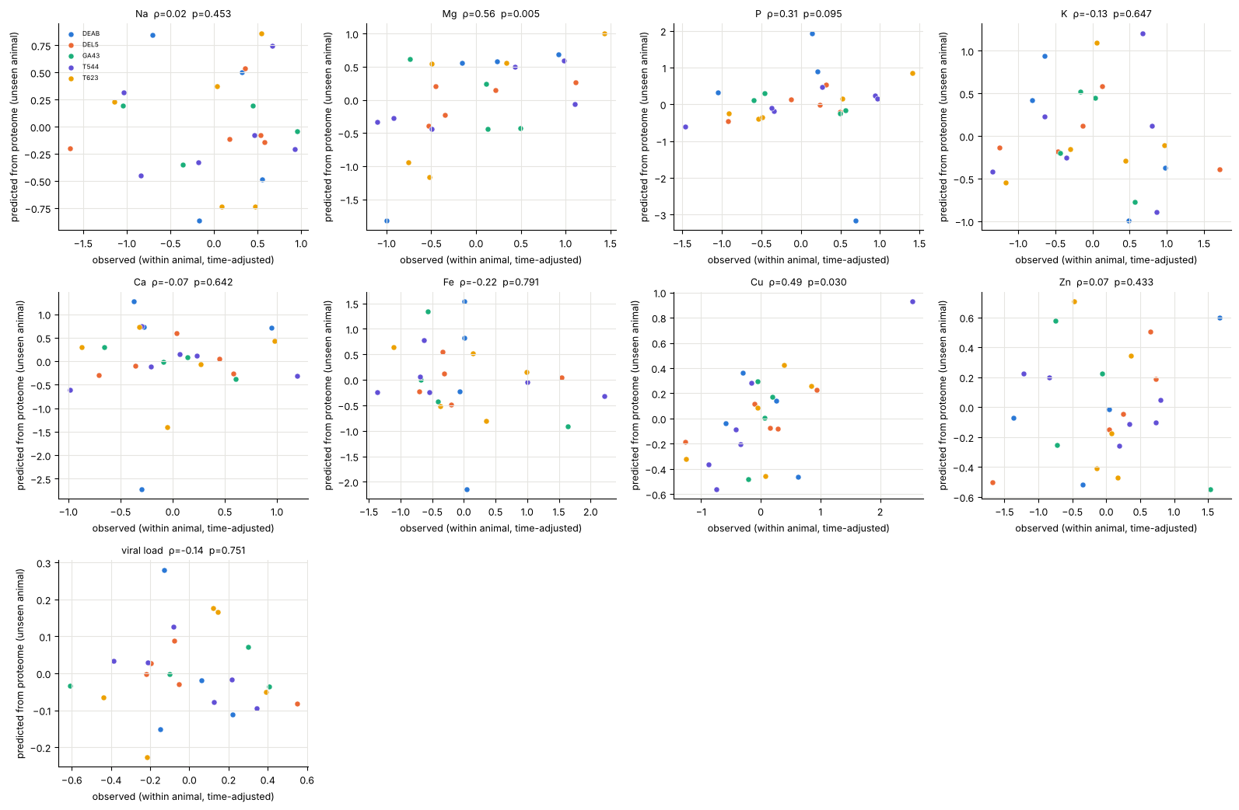
Mg and Cu are predicted from the proteome in animals the model never saw
0.56
Mg (p=0.005)
0.49
Cu (p=0.03)
0.31
P (p=0.10)
Spearman, predicted vs observed, time trend removed. Na, K, Ca, Fe, Zn: not predicted

Slide 10
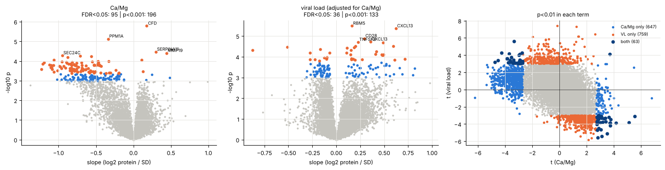
Ca/Mg is the only ratio with FDR-significant proteins, all driven by Mg
95
196
0
proteins at FDR<0.05 for Ca/Mg (Mg alone: 3)
proteins at p<0.001 (chance: 11)
proteins at FDR<0.05 for Fe/Cu (60 at p<0.001)

Slide 11
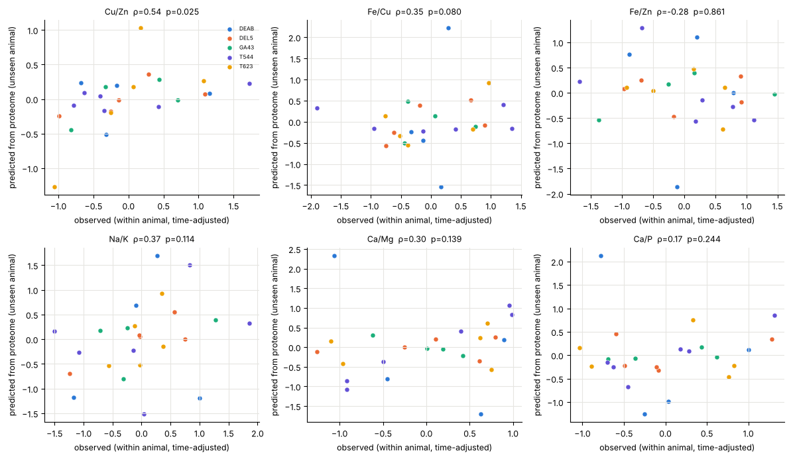
Cu/Zn is predicted in unseen animals; Fe/Cu is borderline
0.54
Cu/Zn (p=0.025)
0.35
Fe/Cu (p=0.08)
Fe/Zn, Na/K, Ca/Mg, Ca/P: not predicted

Slide 12
Known protein groups: platelet, calcium/bone and iron sets stand out
Protein group | Na | Mg | P | K | Ca | Fe | Cu | Zn | Cu/Zn | Fe/Cu | VL
Iron | 0.142 | 0.074 | 0.044 | 0.409 | 0.387 | 0.275 | 0.066 | 0.715 | 0.066 | 0.012 | 0.048
Copper | 0.493 | 0.096 | 0.166 | 0.629 | 0.465 | 0.491 | 0.134 | 0.838 | 0.573 | 0.140 | 0.026
Zinc | 0.146 | 0.038 | 0.108 | 0.499 | 0.010 | 0.411 | 0.170 | 0.992 | 0.912 | 0.281 | 0.200
Calcium/bone | 0.126 | 0.042 | 0.040 | 0.525 | 0.128 | 0.327 | 0.004 | 0.431 | 0.104 | 0.020 | 0.010
Na/K transport | 0.473 | 0.018 | 0.020 | 0.451 | 0.240 | 0.577 | 0.212 | 0.904 | 0.190 | 0.138 | 0.016
Acute phase | 0.549 | 0.683 | 0.501 | 0.585 | 0.230 | 0.629 | 0.008 | 0.683 | 0.160 | 0.034 | 0.212
Interferon | 0.038 | 0.062 | 0.064 | 0.956 | 0.439 | 0.190 | 0.068 | 0.519 | 0.168 | 0.054 | 0.002
Platelet | 0.870 | 0.002 | 0.004 | 0.673 | 0.501 | 0.800 | 0.265 | 0.711 | 0.457 | 0.251 | 0.002
Red cell | 0.533 | 0.150 | 0.329 | 0.814 | 0.697 | 0.124 | 0.295 | 0.641 | 0.335 | 0.076 | 0.164
Set-test p-values (mean squared within-animal t of the group vs shuffled element). Shaded: p<0.05, darker: p<0.01. Not corrected across groups.

Slide 13
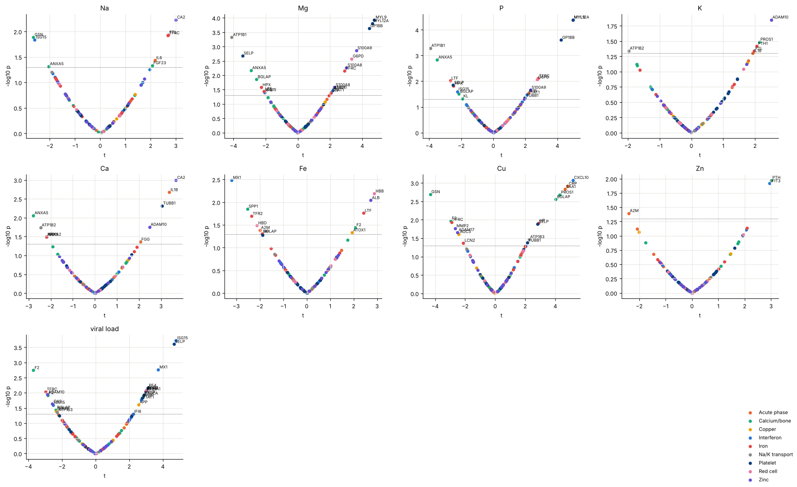
Individual known proteins: Cu rises with inflammation markers
Cu: CXCL10, CRP, SAA1, HP up; GSN down
Mg and P: MYL9, MYL12A, GP1BB (platelet) up
Viral load: ISG15, MX1 up (expected interferon response)

Slide 14
Limits and next steps
Limits
Next steps
8 animals, 24 usable samples: only large effects are detectable
Slide is almost the same as animal, so slide effects cannot be fully separated
Viral load is 94% explained by time, so it stands in for ART
Group-test p-values are not corrected across groups
Validate the Cu acute-phase link in new samples
Spread each animal's time points across slides in the next run
Check free hemoglobin and platelet counts for the Mg/P signal
Add the UniProt metal-binding sets (needs internet in Colab)

